Slide 1

CONSULTING ANALYSIS REPORT
Columbia Asia Hospital
Revenue, Staffing & Patient Discount Strategy
Aishik Dalui
Consultant Data Analyst | Professional Certificate Course in Data Science – January 2026
Columbia Asia Hospital — Consulting Analysis
1

Slide 2




THE ENGAGEMENT
Problem Statement & Data Overview
Columbia Asia Hospital has engaged an external data analyst to turn its operational records into a set of clear, decision-ready insights across three business questions:
Revenue Generation
The Dataset
Where does the hospital make its money, and which departments drive it?
One operational table of patient visit records, covering demographics, wait times, satisfaction, referrals, doctors, and billing.
Hiring Priorities
9,216
patient visit records
Which departments are most in need of additional doctors?
14
fields per record
Patient Discounts
8
hospital departments
Where and how should discounts be offered without hurting margins?
Columbia Asia Hospital — Consulting Analysis
2

Slide 3

THE ENGAGEMENT
Data Schema — hospital_er
Date
Visit date & time (DD-MM-YYYY HH:MM, no AM/PM marker)
Patient Race
White, African American, Asian, Native American/Alaska Native, Two or More Races, etc.
Patient ID
Unique identifier, e.g. 124-62-3289
Patient Admin Flag
Boolean (TRUE/FALSE) administrative indicator
Patient Gender
M / F
Patient Wait Time
Minutes waited before being seen
Patient Age
Age in years
Department Referral
Department assigned, or “None”
Patient Sat Score
Single-digit satisfaction score; scale not fully documented
Doctor Name
Attending doctor
Patient First Initial
First initial of the patient's first name
Appointment Fees
Consultation cost
Patient Last Name
Patient's surname
Total Bill
Full amount billed, including all charges
Columbia Asia Hospital — Consulting Analysis
3

Slide 4



BASELINE
Where the Hospital Stands Today
9,216
35.26 min
5.47 / 10
509M
total patient visits
average wait time
average satisfaction
total revenue
Every insight that follows is measured against this baseline.
Columbia Asia Hospital — Consulting Analysis
4

Slide 5
OBJECTIVE 1
Revenue Generation
Where does Columbia Asia make its money, and which departments drive it?
Columbia Asia Hospital — Consulting Analysis
5

Slide 6
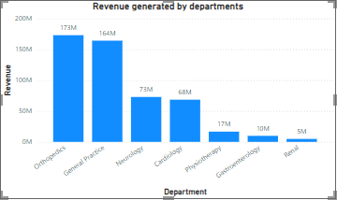
OBJECTIVE 1 · REVENUE
Revenue by Department
FINDING 1 OF 4
Two departments drive two-thirds of revenue
Orthopaedics (173M) and General Practice (156M) together generate roughly 65% of total revenue. Renal contributes the least, at just 5M — a nine-times gap between the top and bottom department.
Columbia Asia Hospital — Consulting Analysis
6

Slide 7
OBJECTIVE 1 · REVENUE
Revenue by Age Group
FINDING 2 OF 4
Younger patients generate the most revenue
The 0-18 (122M) and 19-35 (114M) age groups bring in the most revenue, tapering off with age down to 82M for 66+. Values shown in millions.
Columbia Asia Hospital — Consulting Analysis
7

Slide 8
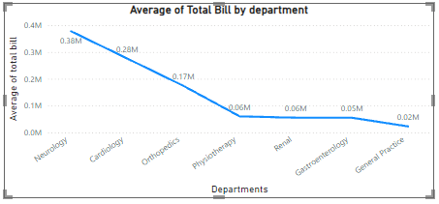
OBJECTIVE 1 · REVENUE
Average Bill by Department
FINDING 3 OF 4
Neurology bills the most per visit, by far
Neurology's average bill (0.38M) is more than double Cardiology's (0.28M) and over twenty times General Practice's (0.02M) — revenue here is driven by bill size, not footfall.
Columbia Asia Hospital — Consulting Analysis
8

Slide 9

OBJECTIVE 1 · REVENUE
Highest Appointment Fee
FINDING 4 OF 4
Neurology commands the top consultation fee
At ₹1,500 per appointment, Neurology charges the highest fee of any department — reinforcing it as the hospital's premium, high-margin specialty despite lower patient volume.
Columbia Asia Hospital — Consulting Analysis
9

Slide 10
OBJECTIVE 2
Hiring Priorities
Which departments are carrying the heaviest load, and where should new doctors go?
Columbia Asia Hospital — Consulting Analysis
10

Slide 11
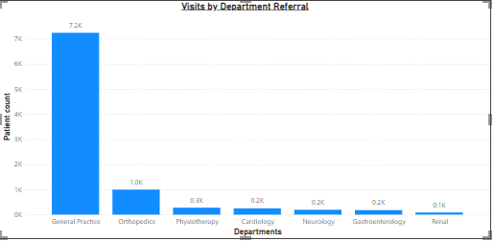
OBJECTIVE 2 · STAFFING
Visits by Department Referral
FINDING 1 OF 4
General Practice absorbs over 3 in 4 visits
General Practice handles 7.2K of the hospital's ~9.2K total visits — more than 75% of all patient traffic funnels through a single department.
Columbia Asia Hospital — Consulting Analysis
11

Slide 12
OBJECTIVE 2 · STAFFING
Doctors per Department
FINDING 2 OF 4
Staffing doesn't scale with patient load
General Practice runs on just 3 doctors — the same as low-traffic Renal — despite carrying 7.2K patients versus Renal's 0.1K. This is the clearest staffing mismatch in the data.
Columbia Asia Hospital — Consulting Analysis
12

Slide 13
OBJECTIVE 2 · STAFFING
Average Waiting Time by Department
FINDING 3 OF 4
Wait times are fairly uniform, with two outliers
Neurology and Physiotherapy run slightly longer waits (37 min) than the rest of the hospital (35-36 min) — both worth watching as secondary hiring candidates.
Columbia Asia Hospital — Consulting Analysis
13

Slide 14
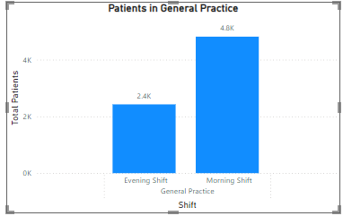
OBJECTIVE 2 · STAFFING
General Practice: Patients by Shift
FINDING 4 OF 4
Morning shift carries double the evening load
Within General Practice, the morning shift sees 4.8K patients versus 2.4K in the evening. A two-shift staffing model — not just more doctors — would ease the pressure.
Columbia Asia Hospital — Consulting Analysis
14

Slide 15
OBJECTIVE 3
Patient Discount Strategy
Where and how can the hospital offer discounts without hurting its margins?
Columbia Asia Hospital — Consulting Analysis
15

Slide 16
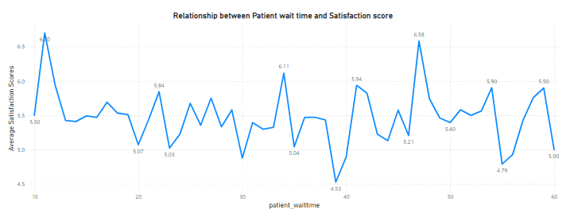
OBJECTIVE 3 · DISCOUNTS
Wait Time vs. Satisfaction
FINDING 1 OF 3
Satisfaction dips sharply after ~35-40 minutes
Ratings hold in the 5-6 range for most of the wait-time range, but fall as low as 4.53 past the 35-40 minute mark — a natural trigger point for a goodwill discount or voucher.
Columbia Asia Hospital — Consulting Analysis
16

Slide 17
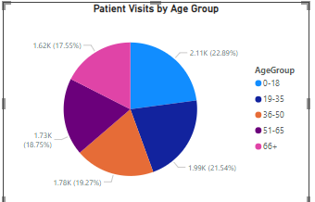
OBJECTIVE 3 · DISCOUNTS
Patient Volume by Age Group
FINDING 2 OF 3
0-18 and 19-35 are the largest patient segments
These two groups together make up over 44% of all visits (2,110 and 1,990 patients respectively) — discount campaigns aimed here would reach the broadest share of the patient base.
Columbia Asia Hospital — Consulting Analysis
17

Slide 18
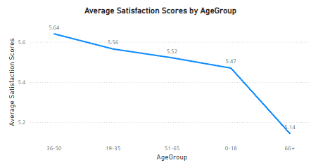
OBJECTIVE 3 · DISCOUNTS
Satisfaction by Age Group
FINDING 3 OF 3
Senior patients (66+) are the least satisfied
The 66+ age group reports the lowest average satisfaction (5.14), while 36-50 reports the highest (5.64). A loyalty or senior-citizen discount could directly target the weakest spot.
Columbia Asia Hospital — Consulting Analysis
18

Slide 19
BRINGING IT TOGETHER
Summary of Key Findings
Revenue
Staffing
Discounts
Orthopaedics & General Practice drive ~65% of revenue
General Practice: 75%+ of visits, only 3 doctors
Satisfaction drops sharply past 35-40 min of waiting
Neurology bills highest per visit (0.38M avg) and charges the top fee (₹1,500)
Neurology & Physiotherapy show the longest waits (37 min)
0-18 & 19-35 are the largest, most reachable segments
Younger age groups (0-18, 19-35) generate the most revenue
General Practice mornings see 2x the evening patient load
66+ patients report the lowest satisfaction (5.14)
Columbia Asia Hospital — Consulting Analysis
19

Slide 20

BRINGING IT TOGETHER
Recommendations
Protect & grow Neurology / Cardiology
Hire into General Practice first
These are the highest-fee, highest-bill departments. Focus retention efforts and premium service quality here before discounting.
It's the clearest mismatch in the data — heaviest patient load, fewest doctors relative to volume. A second-shift hire would relieve the morning crunch directly.
Target discounts by moment, not blanket cuts
Lead discount campaigns with 0-18 & 19-35
Offer a wait-time goodwill voucher past ~35 minutes, and a loyalty discount for 66+ patients — both backed directly by the satisfaction data.
These segments already represent the largest share of visits — a modest discount here reaches the most patients per rupee spent on the campaign.
Columbia Asia Hospital — Consulting Analysis
20

Slide 21
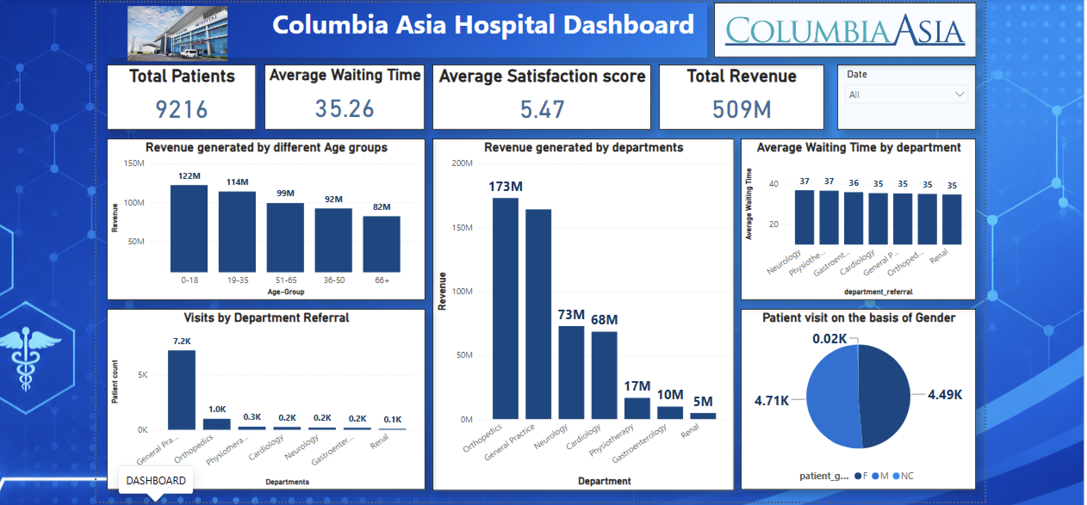
APPENDIX
The Live Power BI Dashboard
All figures in this report trace back to this interactive dashboard — filterable by date, department, doctor, and demographic.
Columbia Asia Hospital — Consulting Analysis
21

Slide 22

Thank You
Questions on any finding or recommendation are welcome.
Aishik Dalui
Consultant Data Analyst | Power BI • SQL • DAX
Columbia Asia Hospital — Consulting Analysis
22

