Slide 1
SEC EDGAR CIK 0000320193 · SQL FORENSIC AUDIT
October 27, 2026
MANAGEMENT FINANCIAL HEALTH REVIEW
Apple Inc. Performance & Cash Conversion (FY2007–FY2025)
Record profitability meets a cash conversion divergence worth investigating in FY2025.
Prepared by Aishik Dalui, Data Analyst
19-Year Cross-Statement Analysis · Income Statement, Balance Sheet & Cash Flow

Slide 2
EXECUTIVE SNAPSHOT · FY2025
Record Earnings vs. Lagging Cash Conversion
$416.2B
$112.0B
1.00x
−71.1d
FY2025 Revenue (+6.4%)
Record Net Profit (+19.5%)
Cash Conversion Warning
Cash Conversion Cycle
17% annual growth since FY2007
26.9% net margin (19-year peak)
OCF ($111.5B) trailed profit (−$0.53B)
Year-end basis (−71.8d Power BI avg)
Core Takeaway: Profitability reached a record high, while FY2025 operating cash flow trailed net income (−$528M) — a divergence to investigate.

Slide 3
SECTION 01 · INCOME STATEMENT TRAJECTORY
Multi-Stage Profitability Expansion (FY2020–FY2025)
Fiscal Year | Revenue ($B) | YoY Growth | Gross Margin | Operating Margin | Net Income ($B) | Net Margin
FY2020 | 274.5 | +3.6% | 38.2% | 24.1% | 57.4 | 20.9%
FY2021 | 365.8 | +33.3% | 41.8% | 29.8% | 94.7 | 25.9%
FY2022 | 394.3 | +7.8% | 43.3% | 30.3% | 99.8 | 25.3%
FY2023 | 383.3 | −2.8% | 44.1% | 29.8% | 97.0 | 25.3%
FY2024 | 391.0 | +2.0% | 46.2% | 31.5% | 93.7 | 24.0%
FY2025 | 416.2 | +6.4% | 46.9% | 32.0% | 112.0 | 26.9%
Step-Change Insight: FY2021 marked a step-up in margins that was sustained through FY2025; FY2024 net income dipped due to a one-time $10.2B State Aid tax charge.

Slide 4
SECTION 01 · MARGIN LEVERAGE (EXP2.SQL)
Margin Expansion Drives Bottom-Line Growth
Sustained Step-Up: FY2021 marked a step-up in margins sustained through FY2025.
5-YEAR GROSS MARGIN GAIN
+870bps
Operating Leverage: Operating margin reached 32.0% in FY2025 (+790 bps vs. FY2020).
Profit Multiplier: 6.4% revenue growth generated 19.5% net profit growth in FY2025.
Expanded from 38.2% in FY2020 to 46.9% in FY2025.
Maturity Profile: 5-year revenue CAGR moderated to 8.7% vs. 17% 18-year average.

Slide 5
SECTION 02 · CASH CONVERSION WARNING TO INVESTIGATE
The FY2025 Cash Conversion Divergence
OPERATING CASH FLOW ÷ NET INCOME RATIO (0.9953X UNROUNDED)
1.00x
Down from 1.26x in FY2024 (Displayed FY2021–FY2024 Range: 1.10x–1.26x)
Operating cash flow fell 5.7% to $111.48B ($528M below $112.01B net income) — a cash conversion divergence to investigate rather than poor earnings quality alone.

Slide 6
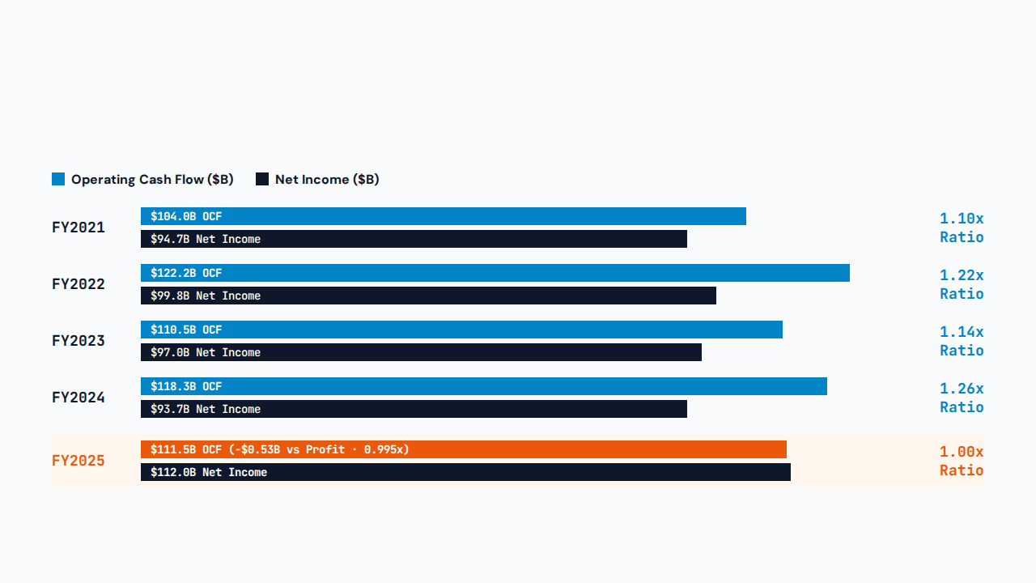
SECTION 02 · CASH CONVERSION COMPARISON (FY2021–FY2025 SHOWN)
Operating Cash Flow vs. Net Income (FY2021–FY2025)

Slide 7
SECTION 02 · SQL EXPERIMENT PART 14 & CASH DEPLOYMENT
Why Cash Flow Lagged & Where FY2025 Cash Went
10-K Cash Tax Reconciliation
FY2025 Cash Deployment ($111.5B OCF)
FY2025 Cash Taxes Paid
$43.37B
Share Repurchases
$90.7B
FY2025 GAAP Tax Provision
$20.72B
Dividends Paid
$15.4B
Excess Cash Tax Outflow
+$22.65B
Capital Spending (+34% YoY)
$12.7B
FY2025 cash taxes paid exceeded the income tax provision by $22.65B. Prior-year State Aid Decision settlement ($10.2B FY24 charge; $15.8B escrow release) and tax-payment timing are key factors to investigate.
Buybacks and dividends consume ~95% of operating cash flow; CapEx rose from $9.4B.

Slide 8
SECTION 03 · SOLVENCY & CAPITAL STRUCTURE (EXP2.SQL)
Balance Sheet De-Risking & Liquidity Context
$73.7B
$132.4B
3.9x
0.89x
Stockholders' Equity
Total Liquid Resources
Liabilities-to-Equity
Current Ratio
29.5% equity expansion in FY2025.
$35.9B cash plus marketable securities.
Down sharply from 5.4x in FY2024.
−$17.7B net working capital balance.
Liquidity Context: Negative working capital reflects Apple's current-liability structure; assess supplier terms alongside cash, marketable securities ($132.4B combined), and operating cash flow.

Slide 9
SECTION 04 · WORKING CAPITAL VELOCITY (YEAR-END VS. POWER BI BASIS)
Cash Conversion Cycle Mechanics (FY2025)
01 · INVENTORY (DIO)
02 · RECEIVABLES (DSO)
03 · PAYABLES (DPO)
NET CYCLE (CCC)
9.4d
34.9d
115.4d
−71.1d
Year-end (10.74d Power BI avg)
Year-end (32.09d Power BI avg)
Year-end (114.6d Power BI avg)
Year-end (−71.82d Power BI avg)
Interpretation: Negative cash conversion cycle of approximately 71 days suggests supplier credit helps finance Apple's operating cycle.

Slide 10
SECTION 04 · YEAR-END BALANCE SERIES VS. POWER BI RECONCILIATION
Customer Collection Is Slowing (FY2022–FY2025)
Fiscal Year | Days to Collect (DSO) | Days to Sell Stock (DIO) | Days to Pay Suppliers (DPO) | Cash Conversion Cycle
FY2021 | 26.2 days | 11.3 days | 93.9 days | −56.4 days
FY2022 | 26.1 days | 8.1 days | 104.7 days | −70.5 days
FY2023 | 28.1 days | 10.8 days | 106.7 days | −67.8 days
FY2024 | 31.2 days | 12.6 days | 119.7 days | −75.8 days
FY2025 | 34.9 days (+8.8d vs FY22) | 9.4 days | 115.4 days (−4.3d YoY) | −71.1 days
Methodology Reconciliation: Table uses year-end balances (34.9 + 9.4 − 115.4 = −71.1d). Power BI & SQL 2-year average balances yield FY2025 DSO = 32.09d, DIO = 10.74d, DPO = 114.6d, CCC = −71.82d.

Slide 11
SECTION 05 · DATA ENGINEERING & SCOPE
Architecture, Cleaning & Analytical Boundaries
SEC EDGAR & MySQL Pipeline
$132.4B Combined Liquidity
Filtered 350–380 day annual 10-K filings (FY2007–FY2025) with least-privilege Power BI read access.
Table cash ($35.9B) excludes marketable securities; total liquid resources reached $132.4B.
Year-End vs. Power BI Averages
Filing & Calendar Anomalies
Slides 9–10 show year-end CCC (−71.1d) alongside 2-year average Power BI results (−71.82d).
FY2015 D&A tag missing in XBRL source; FY2012 and FY2017 reflect 53-week fiscal calendars.

Slide 12
ACTION PLAN & NEXT STEPS
4 Priorities for Executive Management
01 · CASH CONVERSION AUDIT
02 · RECEIVABLES MONITORING
Audit FY2025 10-K tax & working capital notes ($43.4B cash taxes paid).
Investigate DSO creep from 26.1 to 34.9 days across carrier/channel partners.
03 · DASHBOARD CADENCE
04 · PEER BENCHMARKING
Add quarterly OCF-to-Net Income tracking to the Power BI executive review.
Contextualize 0.89x current ratio and benchmark CCC against mega-cap tech peers.
Questions & Discussion · Corporate Financial Health Review

