Slide 1
Weatherify
Aishika Das

Slide 2
INDEX
Problem Statement and Methodology
Languages used
Snapshots and Video of this project
​Summary​

Slide 3
Introduction
Problem statement: The weather app fetches the temperature and Humidity, Pressure, Wind Speed, Sunrise, and Sunset correctly.
Objective:-The objective of this project is to make the weather app using the OpenWeatherAPI.
Methodology:-The web app I have made shows the weather by
fetching the latitudes and longitudes of our current location
using OpenWeatherapi.

Slide 4
Languages used
HTML
CSS
JAVASCRIPT
(OpenWeatherAPI is used)

Slide 5
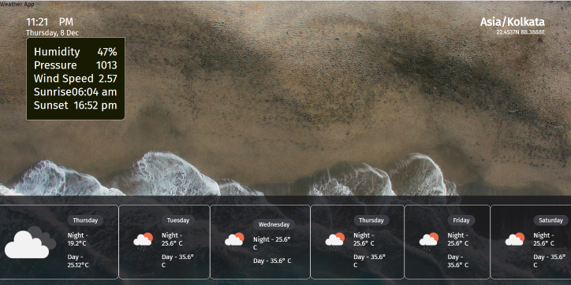
snapshots of your hack to make it even more impressive:-
Demo Video link:-https://youtu.be/H73fyTxKaXw
Website link-https://marvelous-sorbet-7426f6.netlify.app/
Github repository-https://github.com/Aishika3/Weatherify

Slide 6
SUMMARY
The web app which I have made shows the weather by
fetching the latitudes and longitudes of our current location by
using OpenWeatherapi.It shows details of weather like:-temperature and Humidity, Pressure, Wind Speed, Sunrise, and Sunset correctly.

Slide 7
THANK YOU
Aishika Das
aishikadas3@gmail.com
https://dynamic-pothos-7d403b.netlify.app/

