Slide 1
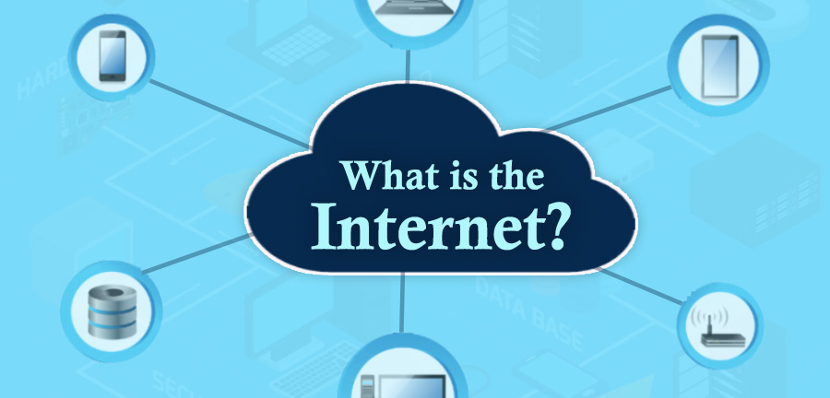

Slide 2

The Internet is the global system of interconnected computer networks that uses the Internet protocol suite (TCP/IP) to communicate between networks and devices. It is a network of networks that consists of private, public, academic, business, and government networks of local to global scope, linked by a broad array of electronic, wireless, and optical networking technologies. The Internet carries a vast range of information resources and services, such as the inter-linked hypertext documents and applications of the World Wide Web (WWW), electronic mail, telephony, and file sharing.
This Photo by Unknown Author is licensed under CC BY-NC-ND

Slide 3
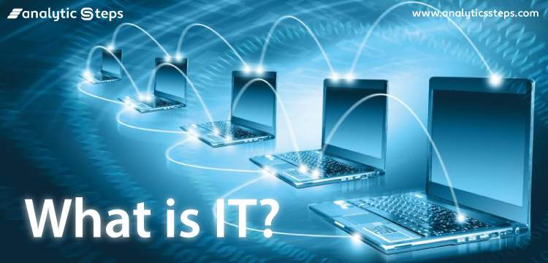

Slide 4
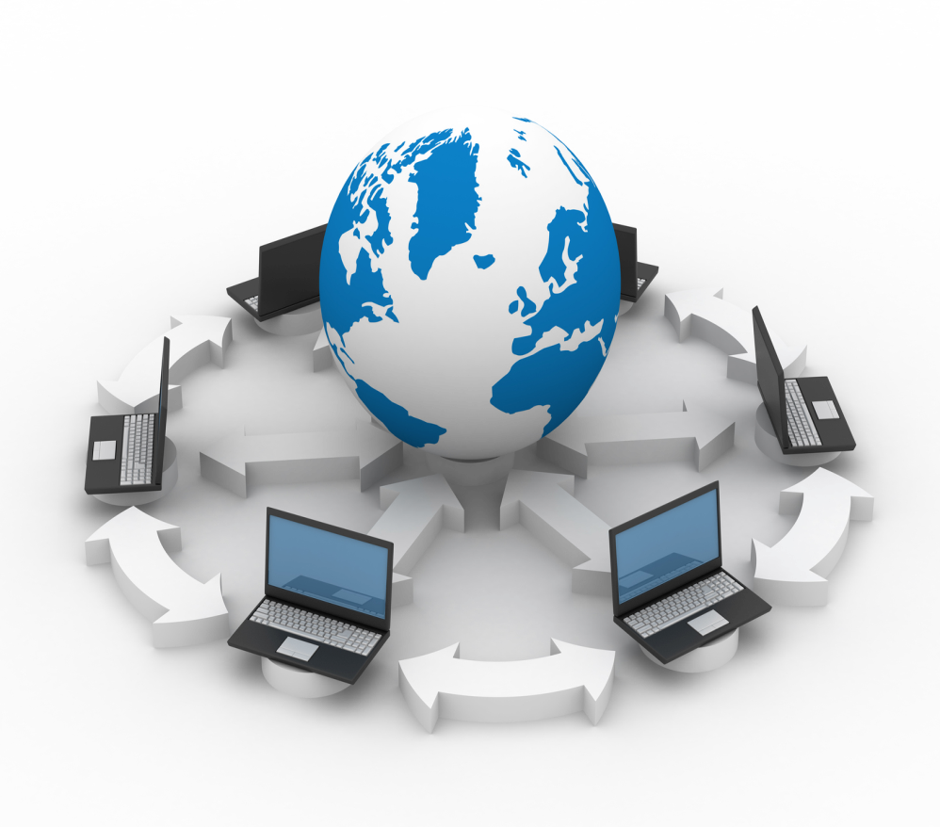
Information technology (IT) is the use of computers to create, process, store, retrieve, and exchange all kinds of data and information. IT is typically used within the context of business operations as opposed to personal or entertainment technologies. IT forms part of information and communications technology(ICT). An information technology system (IT system) is generally an information system, a communications system, or, more specifically speaking, a computer system — including all hardware, software, and peripheral equipment — operated by a limited group of IT users.

Slide 5
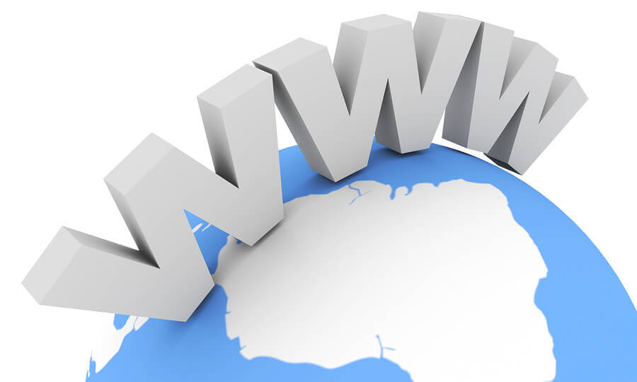
What is Web and its history

Slide 6

The World Wide Web ("WWW", "W3" or, simply, "the Web") is a global information medium which users can access via computers connected to the Internet. The term is often mistakenly used as a synonym for the Internet, but the Web is a service that operates over the Internet, just as email and Usenet do. The history of the Internet and the history of hypertext date back significantly farther than that of the World Wide Web.
Tim Berners-Lee invented the World Wide Web while working at CERN in 1989, applying the concept of hyperlinking that had by then existed for some decades. He developed the first web server, the first web browser, and a document formatting protocol, called Hypertext Markup Language(HTML).

Slide 7

What is Website

Slide 8
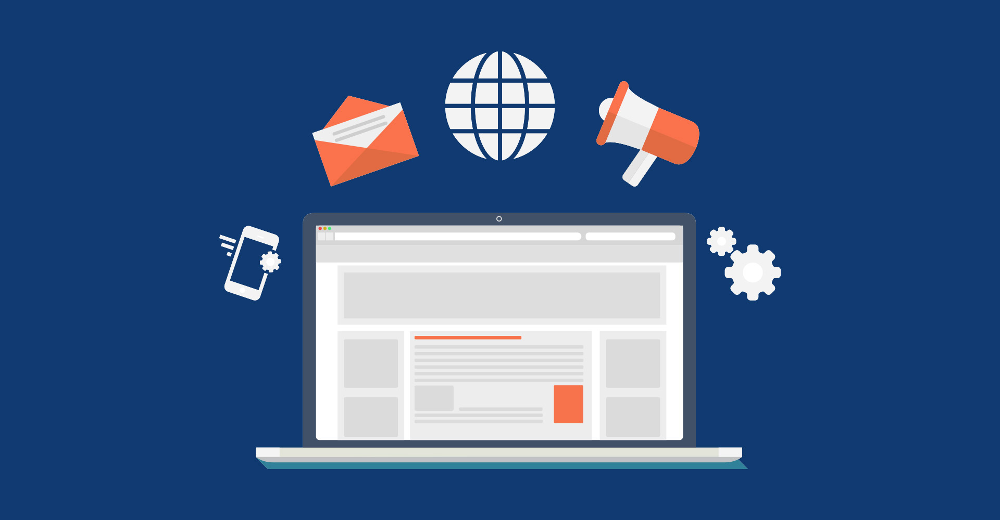
A website is a collection of web pages and related content that is identified by a common domain name and published on at least one web server. Examples of notable websites are Google, Facebook, Amazon, and Wikipedia.
All publicly accessible websites collectively constitute the World Wide Web. There are also private websites that can only be accessed on a private network, such as a company's internal website for its employees.
Websites are typically dedicated to a particular topic or purpose, such as news, education, commerce, entertainment, or social networking. Hyperlinking between web pages guides the navigation of the site, which often starts with a home page.
This Photo by Unknown Author is licensed under CC BY-SA-NC

Slide 9
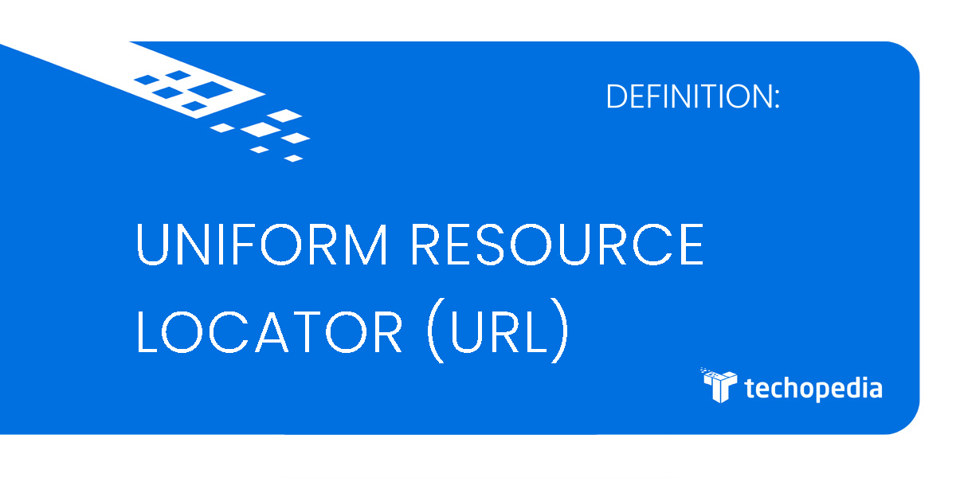
What is URL (Uniform Resource Locator)

Slide 10
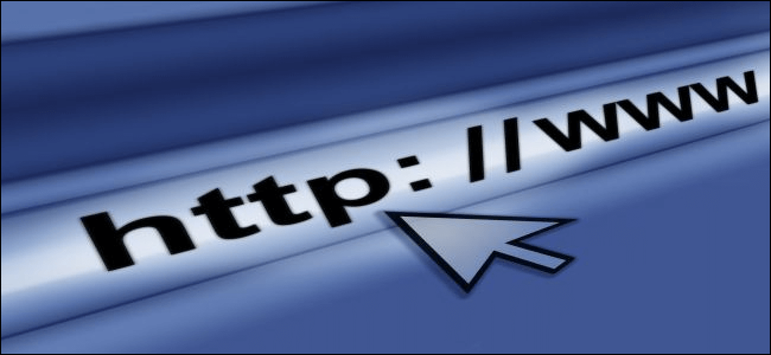
A Uniform Resource Locator, colloquially termed a web address, is a reference to a web resource that specifies its location on a computer network and a mechanism for retrieving it. A URL is a specific type of Uniform Resource Identifier, although many people use the two terms interchangeably.

Slide 11
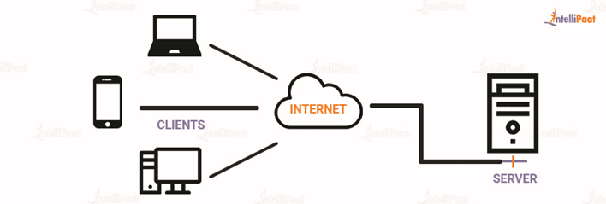
What is Server and its Types

Slide 12
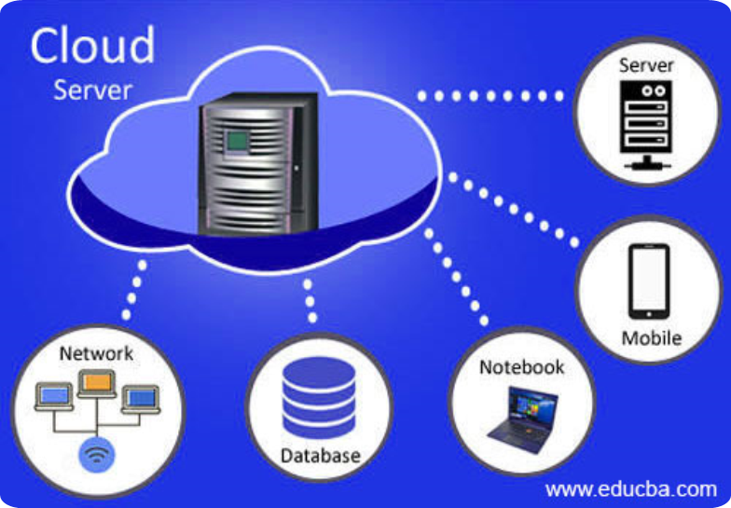
A server is a computer or system that provides resources, data, services, or programs to other computers, known as clients, over a network.
Types:
File servers:
File servers store and distribute files.
Print servers:
Print servers allow for the management and distribution of printing functionality
Application servers:
Application servers run applications in lieu of client computers running applications locally.
Domain Name System (DNS):
DNS servers are application servers that provide name resolution to client computers by converting names easily understood by humans into machine-readable IP addresses.
Mail servers:
Mail servers are a very common type of application server.
Web servers:
One of the most abundant types of servers in today’s market is a web server. A web server is a special kind of application server that hosts programs and data requested by users across the Internet or an intranet

Slide 13
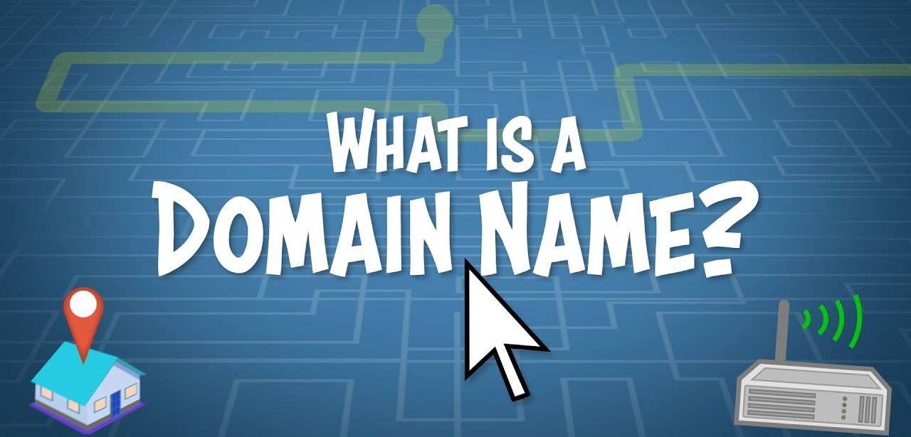

Slide 14
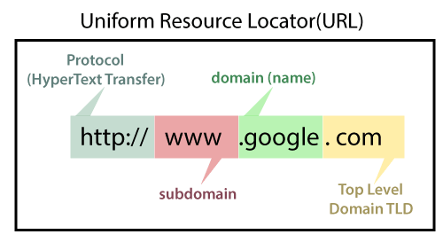
A domain name is a string that identifies a realm of administrative autonomy, authority or control within the Internet. Domain names are used in various networking contexts and for application-specific naming and addressing purposes. In general, a domain name identifies a network domain or an Internet Protocol (IP) resource, such as a personal computer used to access the Internet, or a server computer. Domain names are often used to identify services provided through the Internet, such as websites and email services.

Slide 15
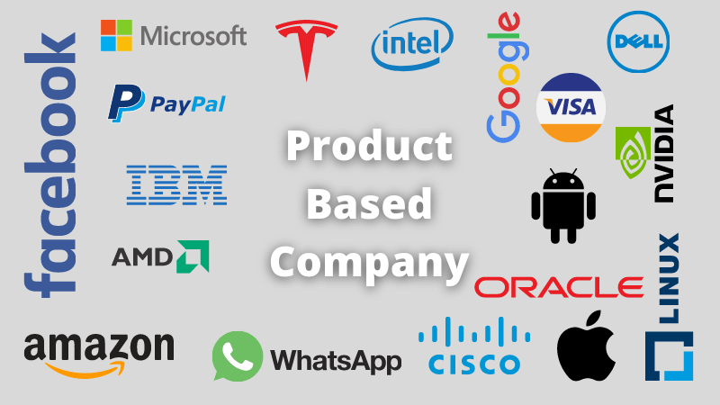
Product Based Company:
Adobe
Amazon
Cisco
Amdocs
Facebook
Google
Microsoft
Hewlett- Packard(HP)
Informatica
Intel
McAfee
Paypal
Salesforce
VMware
Intuit
Flipkart
Uber
Orcale
SAP( System, Application & Products in Data Processing)
BMC

Slide 16

Service Based Company
Accenture
Infosis
IBM
Tata Consultancy Services(TCS)
Deloitee
Wipro
Nippon Telegraph & Telephone Corporation Data(NTT Data)
Larsen &Toubro(L&T)
Redington
Bharti Airtel
Capgemini
HCL
Tech Mahindra
W S Atkins
Mphasis
Birlasoft
Cognizant
KPIT Technology
Mindtree
Hexaware Technologies
Cyient

Slide 17
Thank U

