Slide 1
Chapter 15
The Federal Reserve
System and Open Market Operations

Slide 2
Chapter Outline
What is the Federal Reserve System?
The U.S. Money Supplies
Fractional Reserve Banking, the Reserve Ratio, and the Money Multiplier
How the Fed Controls the Money Supply
The Federal Reserve and Systemic Risk
Revisiting Aggregate Demand and Monetary Policy
Who Controls the Fed?
Appendix: The Money Multiplier Process in Detail

Slide 3

Introduction
2008—The worldwide financial system was in a crisis and banks and other financial institutions wanted to borrow more than $2 trillion.
The only person in the world capable of lending that kind of money: Ben Bernanke, Chairman of the Federal Reserve System
Why was the Fed able to do this?

Slide 4
Introduction
Studying this chapter helps you understand:
  The Federal Reserve and its powers.
  What is meant by the money supply.
  How the Fed is able to influence the money supply.
  How the Fed has more influence over AD than anyone else.

Slide 5
What Is the Federal Reserve System?
The Central Bank of the United States
Acquires its unique powers through its ability to issue and create money.
  Take a bill out of your wallet or purse and see what it says at the top.
  The Fed doesn’t have to literally print money; it can create money “by computer”.

Slide 6
What Is the Federal Reserve System?
A Bank with two Customers:
  The government’s bank.
    It maintains the bank account of the U.S. Treasury.
    It manages government borrowing.
      Issuing, transferring, and redeeming of U.S. Treasury bonds, bill, and notes.
  It is the banker’s bank:
    Large private banks keep their own accounts at the Fed.
    Banks can borrow from the Fed.

Slide 7
What Is the Federal Reserve System?
The Fed Also:
  Regulates other banks.
  Manages the nation’s payment system.
  Protects financial consumers with disclosure regulations.
Most important Function: Regulating the U.S. money supply.

Slide 8
The U.S. Money Supplies
Money – a widely accepted means of payment.
Most important assets that serve as means of payment in the U.S. today:
  Currency—Paper bills and coins.
  Total reserves held by banks at the Fed.
  Checkable deposits—your checking or debit account.
  Savings deposits, money market mutual funds, and small-time deposits.

Slide 9
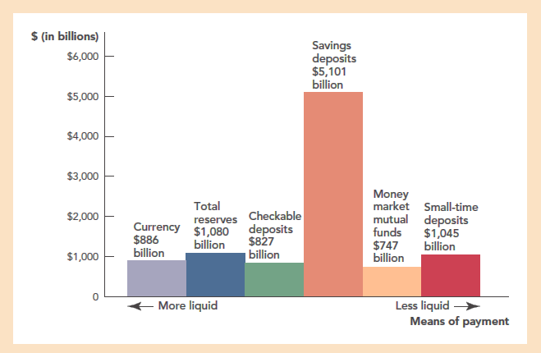
The U.S. Money Supplies
Let’s look a little closer at each of these means of payment.

Slide 10
The U.S. Money Supplies
Currency – Coins and paper bills
  Some of it is cash on hand as well as in cash registers and ATMs.
  Drug dealers hold a lot of cash.
  A lot is held by people in other countries.
    Panama, Ecuador, and El Salvador use the U.S. dollar as their official currency.
    Dollars are held by others in unstable countries to protect their wealth.

Slide 11
The U.S. Money Supplies
Total Reserves – Value of accounts banks have at the Federal Reserve System.
  Used to trade with other banks
  Used for dealings with the Federal Reserve itself.
  Not currency but electronic claims
  Part of the money supply because these claims can be easily converted into currency.

Slide 12
The U.S. Money Supplies
Checkable Deposits – deposits you can write checks on or access with a debit card.
Savings deposits, money market mutual funds, small-time deposits.
  Not as liquid as the other means of payment.
  Each can be used to pay for goods and services, but this requires a little extra effort.

Slide 13
The U.S. Money Supplies
Liquid asset – an asset that can be used for payments or, quickly and without loss of value, be converted into an asset that can be used for payments.
  The money supply can be defined in different ways depending on exactly what kinds of liquid assets are included.

Slide 14
The U.S. Money Supplies
The three most important definitions of the money supply are:
  The monetary base (MB) – currency outstanding and total reserves at the Fed.
  M1 – currency outstanding and checkable deposits.
  M2 – M1 plus saving deposits, money market mutual funds, and small-time deposits.
These definitions correspond to an inverted pyramid shown in the next figure.
Notes:
Instructor Note: Students often confuse currency held by the public and currency that may be held at the Fed banks. Only currency outside the Fed is included in the definition of the money supply.

Slide 15
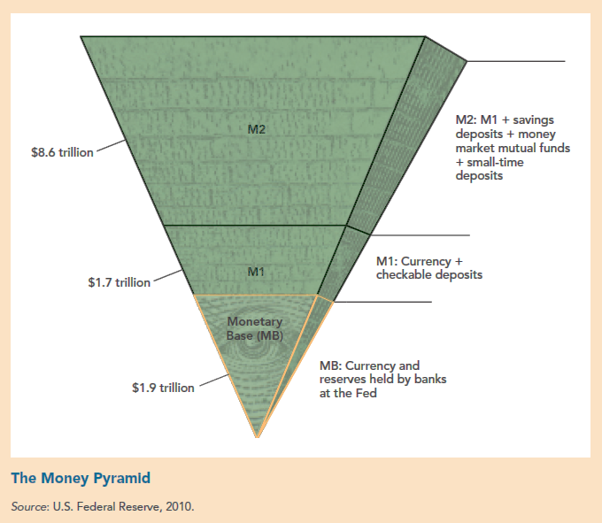
The U.S. Money Supplies

Slide 16
Check Yourself
Define the monetary base.
What is the amount of currency in circulation compared to the amount of checkable deposits?

Slide 17
The U.S. Money Supplies
Difficulty of Central Banking
  The Fed has direct control only over the monetary base.
    But it is M1 and M2 that have the greatest impact on AD.
    It tries to use its control over MB to influence M1 and M2.
  M1 and M2 can change independent of what the Fed does.
  Aggregate demand can change for other reasons than changes in M1 and M2.
Let’s see how the Fed influences M1 and M2

Slide 18
Fractional Reserve Banking, Reserve Ratio, Money Multiplier
Fractional reserve banking – banks hold only a fraction of deposits on reserve.
The amount of money created depends on:
  The reserve ratio (RR) – the fraction of deposits held on reserve
    RR is determined by how liquid banks wish to be.
    The Fed sets a minimum RR.
  Money multiplier (MM) – the amount the money supply expands with each dollar increase in reserves.

Slide 19
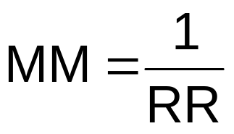
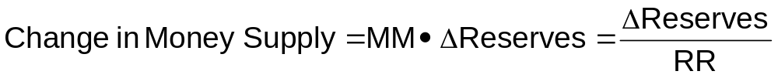
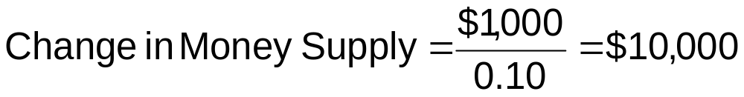
Money Multiplier and the Change in the Money Supply
Suppose RR = 10%
∆Reserves = $1,000
Let’s take a closer look the process.

Slide 20
Fractional Reserve Banking, Reserve Ratio, Money Multiplier
Fed credits your banking account with an additional $1,000. Assume RR = 10% for all banks.
  Your bank loans out $900 (90%) of your increased deposit.
  Sam borrows the $900 and deposits it in his bank: Total ↑M = $1,900 ($1,000 + $900)
  Sam’s bank loans out $810 (90%) of his increased deposit: Total ↑M = $2,710
  The rippling process continues until the total change in the money supply = $10,000

Slide 21
Check Yourself
If the reserve ratio is 1/20, what percent of deposits are kept as reserves?
If the reserve ratio is 1/20, what is the money multiplier?
If the Fed increases bank reserves by $10,000 and the banking system has a reserve ratio of 1/20, what is the change in the money supply?

Slide 22
How the Fed Controls the
Money Supply
Three Major Tools:
  Open market operations – the buying and selling of U.S. government bonds.
  Discount rate lending and the term auction facility – Federal Reserve lending to banks and other financial institutions.
  Required reserves and payment of interest on reserves – Changing the minimum RR for banks and other depository institutions; paying interest on any reserves held by banks at the Fed.
Let’s look at each of these in turn.

Slide 23
Open Market Operations
When the Fed buys anything, even apples, reserves increase.
The Fed can buy and sell billions of dollars of government bonds in a matter of minutes.
The Fed usually buys and sells short-term bonds called Treasury bills or T-bills (sometimes called treasury securities or Treasuries).

Slide 24
Open Market Operations
If the Fed wants to increase the money supply, they will buy T-bills:
  If the Fed wants to decrease the money supply, they will sell T-bills.
M↑ as the
money creation
process ripples
through the
economy
Fed
electronically
↑reserves of the
seller
With more
reserves, bank
↑ loans
To pay for
the T-bills
M↓ as the
money creation
process ripples
in reverse through
the economy
With fewer
reserves, bank
↓ loans
Fed sells
T-bills
↓reserves of the buyer

Slide 25
Open Market Operations
Remember:
A complicating factor – the size of the money multiplier is not fixed.
  Determined by banks as they choose the RR.
    When the banks are confident and eager to lend, MM will be higher.
    When the banks are fearful and reluctant to lend, MM will be lower.

Slide 26
Open Market Operations
Summary
  The Fed can increase or decrease the money supply by buying and selling government bonds.
  The increase in reserves boosts the money supply through a multiplier process.
  The size of the multiplier is not fixed but depends on how much of their assets banks want to hold as reserves.

Slide 27
Open Market Operations and
Interest Rates
When you hear that the Fed has lowered (or raised) interest rates, don’t be confused.
  The Fed does not determine interest rates just by saying they will be a certain value.
  Interest rates are determined in a broad market through the supply and demand for loans.
    The Fed works through supply and demand

Slide 28
Open Market Operations and
Interest Rates
Buying and selling government bonds changes interest rates:
Fed buys
bonds
↑Demand
for bonds
↑Price of
bonds
↓Interest
rates
Fed sells
bonds
↓Demand
for bonds
↓Price of
bonds
↑Interest
rates

Slide 29
The Fed Controls the Real Rate of Interest Only in the Short-Run
The Fed has greatest influence over the a short-term interest rate called the Federal Funds rate.
Federal Funds rate – the overnight lending rate that banks charge each other.
Monetary policy is usually conducted in terms of the Federal Funds rate.

Slide 30
The Fed Controls the Real Rate of Interest Only in the Short-Run
Why focus on the Federal Funds rate?
  It is a convenient signal of monetary policy.
  It responds very quickly to actions by the Fed
  It can be monitored on a day-to-day basis.
  M1 and M2 are more difficult to measure and monitor.
The Fed controls the Federal Funds rate through its control of the monetary base.

Slide 31
Discount Rate Lending and the
Term Auction Facility
Discount rate – the interest rate banks pay when they borrow directly from the Fed.
Lender of last resort – Fed loans money to banks when no one else will.
  These loans increase the monetary base directly
  Indirectly they may encourage banks to lend more money

Slide 32
Discount Rate Lending and the
Term Auction Facility
The discount rate is a signal of the Fed’s willingness to allow the money supply to increase.
The discount window is intended to help banks that are in financial stress.
  If a bank suddenly starts borrowing from the discount window, it usually receives an inquiry from the Fed.

Slide 33
Discount Rate Lending and the
Term Auction Facility
Two financial problems banks can get into:
  Insolvency – liabilities are greater than assets.
    To avoid insolvency, banks hold “capital” which means assets in relatively safe forms (e.g. government bonds).
    2008 – the U.S. treasury acted to “recapitalize” parts of the U.S. banking system by setting up a ...
    Term Auction Facility – Fed funds were auctioned until the rate was low enough that banks would borrow the money.

Slide 34
Discount Rate Lending and the
Term Auction Facility
Two financial problems banks can get into:
  Liquidity crisis – when enough depositors want their money back at the same time.
    Banks may be solvent with lots of good loans, but the money will be paid back over time.
    Because people don’t always know if a bank’s assets are good, fear and panic can turn solvent banks into illiquid banks.
    To avoid these crises, the FDIC was set up during the Great Depression.
Notes:
Note: Currently, deposits are insured up to $250,000

Slide 35
Discount Rate Lending and the
Term Auction Facility
The amount of extra lending by the Fed during the financial crisis was staggering.
  December 2007 - May 2008 ≈ $475 billion.
  December 2007 – December 2008 over $2 trillion (over $6,000 for every person in the U.S..
  Final note: if the loans are not paid back, U.S. taxpayers will have to bear the losses.

Slide 36
Payment of Interest on Reserves
A third tool of monetary policy:
  Fed can vary the rate of interest that it pays banks on reserves held at the Fed.
    In the past, reserves earned no interest resulting in banks being reluctant to hold reserves.
    Now the Fed varies the interest rate to help achieve goals of monetary policy.
    How it works:
Banks
↓reserves
↑loans
Fed ↓ interest
rate on reserves
↑M^{s}

Slide 37
Check Yourself
Underline the correct answers. The Fed wants to lower interest rates: It does it by (buying/selling) bonds in an open market operation. By doing this, the Fed (adds/subtracts) reserves and through the multiplier process (increases/decreases) the money supply.

Slide 38
The Federal Reserve and
Systemic Risk
Systemic Risk – the risk that the failure of one financial institution can bring down other institutions as well.
March 2008 – the Fed made loan guarantees to JP Morgan to prevent Bear Sterns from failing
  Fed’s rationale: Bear Sterns owed a lot money to banks, and its failure would cause those banks to fail as well.

Slide 39
The Federal Reserve and Systemic Risk
Whenever the Fed acts to limit systemic risk, it creates moral hazard.
  Moral hazard – The tendency for banks and other financial institutions to take on too much risk, hoping that the Fed and regulators will bail them out.
  Conclusion: Limiting systemic risk while checking moral hazard is the fundamental problem the Fed faces as a regulator of bank safety.

Slide 40
Check Yourself
If a large bank makes some bad lending mistakes, will the Fed always let the bank bear the brunt of its mistakes and go under? If not, what justification will the Fed use?

Slide 41
Check Yourself
Consider the moral hazard that could arise if he Fed bailed out large banks. If you work at a large bank and lose a lot of money betting that oil prices would rise when they in fact fell, what incentive would you have to double your bet the next time?

Slide 42
Revisiting Aggregate Demand and Monetary Policy
The Fed uses the tools of monetary policy to influence aggregate demand (AD).
  Let’s see how this works. Suppose…
    The Fed wishes to increase aggregate demand buying government bonds.
Fed
Buys
bonds
↑Money supply
↓interest rates
↑ Spending (AD)
Let’s illustrate this with our AD/AS diagram

Slide 43
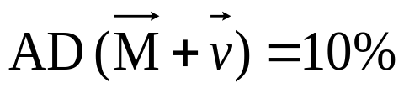
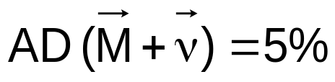
Revisiting Aggregate Demand and Monetary Policy
Inflation
Rate (π)
Solow
Growth
curve
New SRAS
(E(π) = 7%)
Fed ↑ M → ↑ AD:
Short-run: a → b
↑growth rate, ↑π
Long-run: b → c
↑ E(π) → SRAS shifts up → ↑π, ↓growth rate
Old SRAS
(E(π) = 2%)
7%
c
4%
b
2%
a
Real GDP
growth rate
3%
6%
Notes:
Instructor Note: This an animated figure so you can explain as you “draw”.

Slide 44
Monetary Policy Is Difficult
Fed actions do not increase aggregate demand by any guaranteed amount.
  We don’t know exactly how much M1 and M2 will change.
  We don’t know how much low interest rates will stimulate investment spending.
    Fed has most influence over short-term rates and investment is most affected by long-term rates.
  Monetary policy takes time to work and the lags in response are variable.

Slide 45
Monetary Policy Is Difficult
Some of the things that the Fed must try to predict and monitor are:
  Will banks lend out all of their new reserves?
  How quickly will increases in the monetary base translate into new bank loans?
  Will businesses borrow?
  How low do short-term interest rates have to go to stimulate more investment borrowing?
  If businesses do borrow, will they promptly hire labor and capital?

Slide 46
Who Controls the Fed?
The Board of Governors
  Seven members for 14 year terms.
  The chairperson of the Fed is appointed by the president from among the members of the board for 4 year terms.
The U.S. is divided into 12 regions with a Federal Reserve bank in each.
Federal Open Market Committee (FOMC) – most important policy making body of the Fed
  Board of governors
  5 presidents of the regional banks

Slide 47
Who Controls the Fed?
Independence of the Fed
  The structure makes it one of the most independent agencies in the U.S. government
Two different viewpoints:
  The Fed has too much power not to be controlled by democratically elected politicians.
  Without this independence, politicians including the President could order the Fed to boost the money supply just before an election.

Slide 48
Who Controls the Fed?
Even with the current structure some Fed chairpersons have exercised less independent than others.
  Before the 1972 election: President Nixon asked Arthur Burns, chair of the Fed to stimulate the economy.
    Burns did stimulate the economy and Nixon won in a landslide.
    As expected the economic gains were temporary and inflation was too high for the rest of the decade.

Slide 49
Takeaway
The Fed is the government bank, the banker’s bank, and has the power to…
  Create money.
  Influence aggregate demand.
It is important to know what M1 and M2 are.
The Fed controls the money supply buying and selling government bonds using open market operations.

Slide 50
Takeaway
Buying and selling bonds changes bank reserves which changes the money supply through a multiplier process of rippling loans and deposits.
The final result is given by:
ΔMS = Δreserves x MM
where MM is the money multiplier

Slide 51
Takeaway
When the Fed buys bonds, the interest rate falls and investment and consumption are stimulated.
Fed’s influence over aggregate demand is subject to uncertainty in both impact and timing.
When the Fed sells bonds, the interest rate rises and investment and consumption contract.

Slide 52
Takeaway
The Fed focuses its attention on the Federal Funds rate.
The Fed has the most influence over real rates of interest in the short-run.
The Fed has no influence over long-run real rates of interest.
The Fed serves as a “lender of last resort” Preventing “systemic risk” is one of the Fed’s most important jobs.

Slide 53
Appendix
The Money Multiplier Process in Detail

Slide 54

The Money Multiplier Process In Detail
Suppose the Fed buys a government bond for $1,000 from a securities dealer with an account in the First National Bank. First National’s T-account looks like this:

Slide 55

The Money Multiplier Process In Detail
First National decides to keep $100 and loans out the rest, $900. Their T-account now looks like this.

Slide 56

The Money Multiplier Process In Detail
Suppose the borrower wrote a check to Luxury Vacations Inc. which has an account in the Second National Bank. Their T-account now looks like this:

Slide 57

The Money Multiplier Process In Detail
Suppose Second National Bank also want a reserve ratio of 0.1. They will keep $90 and loan out $810. Their T-account now looks like this:

Slide 58

The Money Multiplier Process In Detail
Suppose the person who borrowed from Second National buys a computer and writes a check to Apple who deposits the check into their account at Third National Bank Their T-account now looks like this:

Slide 59

The Money Multiplier Process In Detail
Third National Bank which wants the same reserve ration loans keeps $81 and loans out $729. Their T-account now looks like this:

Slide 60
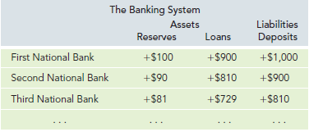
The Money Multiplier Process In Detail
Let’s summarize what we have so far:

Slide 61
The Money Multiplier Process In Detail
Looking at the last table we see:
  First National Bank = $1,000
  Second National Bank = $900 = $1,000 x 0.9.
  Third National Bank = $810 = $1,000 x 0.92
If you guessed that the increase in deposits of a Fourth National Bank would be $729 = $1,000 x 0.93 you would be correct!

Slide 62
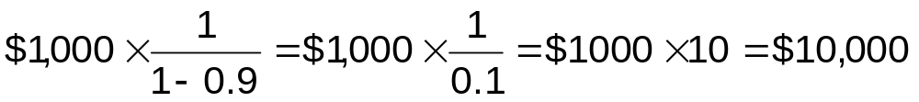
The Money Multiplier Process In Detail
The total process looks like this:
This is a geometric series that converges to:

Slide 63
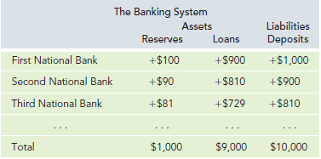
The Money Multiplier Process In Detail
The final account looks like this:

Slide 64
End of Chapter 15

