Slide 1
Chapter 17
The Federal Budget:
Taxes and Spending

Slide 2
Chapter Outline
Tax Revenues
Spending
Will the U.S. Government Go Bankrupt?
Revenues and Spending Undercount the Role of Government in the Economy

Slide 3

Introduction
Ida May Fuller loved social security
First person to receive a SS check.
Paid $24.75 in; first check was $22.54.
Lived to be a 100; received a total of $22,888.92 in benefits

Slide 4
Introduction
From 2008 to 2010 the government spent about 25% of GDP.
Taxes collected are about 18%.
In this chapter we will answer the following questions:
Where does all that money come from?
Where does it go?
How long can the government keep spending more than it raises in taxes?

Slide 5
Tax Revenues
2010 – Federal Government Revenue was about $2.2 trillion.
Major Sources of Revenue
Individual income tax
Social Security and Medicare taxes
Corporate income tax
The following figure helps us see the magnitudes and relative values of these sources.

Slide 6
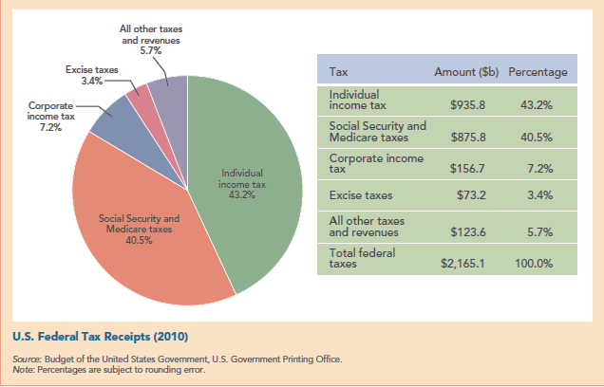
Tax Revenues

Slide 7
The Individual Income Tax
Marginal tax rate (MTR) – the percent paid in taxes on an extra dollar of income.
Example: If the marginal tax rate is 10%,
tax owed on an additional $100 will be (.10) x $100 = $10.
MTR is important because it affects incentives.
Changes in the marginal tax rate cause two effects:
Revenue effect
Incentive effect
Notes:
Instructor Note: Governments at all levels sometimes increase marginal tax rates. Their purpose is to raise more government revenue, but very often the increase in revenue is disappointing because of the incentive effect. That is, raising marginal tax rates reduces the incentive to earn additional income. Because people keep a smaller fraction of the resulting increase in income, they are less willing to work and invest. The result is a smaller tax base to tax.

Slide 8
The Individual Income Tax
Average tax rate (ATR) – total tax payment divided by total income.
Example: If income is $50,000 and tax owed is $6,662, the average tax rate is…
Marginal tax rates are set by government, while the average tax rate is calculated after tax owed is known.

Slide 9
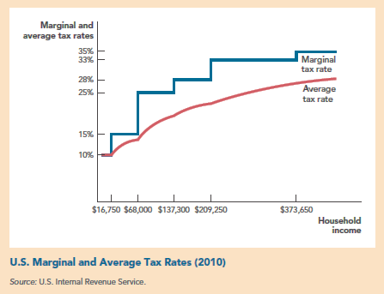
The Individual Income Tax
Notes:
Instructor Note: The average tax rate increases as household income rises. The mathematics of averages and margins implies as the average tax rate rises, the marginal will be greater than the average.

Slide 10
The Individual Income Tax
Exemptions and Deductions – not all income is taxed.
Exemptions: reduce taxable income.
Spouse, Dependents
Each exemption reduces taxable income by $3,650.
Deductions: also reduce taxable income.
Apply only to specific expenses e.g. mortgage interest

Slide 11
Taxes on Capital Gains, Interest, and Dividends
All of these are taxes on investment income.
Dividends – stockholders’ share of the profits.
MTR = 15% for most people.
MTR = 5% for low income people.
Capital Gains – the difference between the purchase price of an asset and its selling price.
MTR = 15% for most people
MTR = 5 % for low income people
Notes:
*only applies for assets held for at least one year.

Slide 12
Taxes on Capital Gains, Interest, and Dividends
Capital gains allow for loss offsets – resulting in a lower effective tax rate.
Political debate about how investment income should be taxed.
Democrats – favor higher tax rates.
Why? Rich should bear a higher share of the burden.
Republicans – favor lower tax rates.
Why? Lower rates provide incentive to invest and create economic growth.

Slide 13
The Alternative Minimum Tax (AMT)
Alternative minimum tax – separate income tax code began in 1969 to prevent the rich from not paying income taxes.
Not indexed to inflation
Requires taxpayers to do two calculations:
Compute taxed owed under standard code.
Compute what they owe based on a flat rate of 26% or 28% with no deductions.
Pay the higher of the two.

Slide 14
Social Security and Medicare Taxes
Social Security Taxes (FICA payroll tax)
Employees pay 6.2% on earnings up to $106,800.
Employers pay 6.2% on same earnings.
employers are able to shift some of the tax back on workers by paying lower wages.
Medicare taxes
1.45% deducted from workers’ paychecks.
1.45% paid by employers.
Again, employers are able to shift the tax.

Slide 15
The Corporate Income Tax
35% in the U.S. – one of the highest in the world.
Tax code lets a good accountant reduce the legal measure of income.
Example: Boeing, over a recent period of 5 years paid an ATR of 0.7%.
Who pays the corporate income tax?
Shareholders and bondholders.
Workers in the form of lower wages.
Consumers in the form of higher prices.
Notes:
Instructor Note: Corporate tax rate are a subject of political debate. While it is true that the U.S. corporate tax rate is one of the highest in the world, some argue that the actual rate paid is lower because some corporations are able to hide their profits in off-shore tax havens or take advantage of the tax code to reduce their legal measure of income as Boeing did. Both of these are ways to avoid the tax. If corporations were unable to do this, what would they do? How many firms would leave the U.S. and move to countries where the corporate tax is lower?

Slide 16
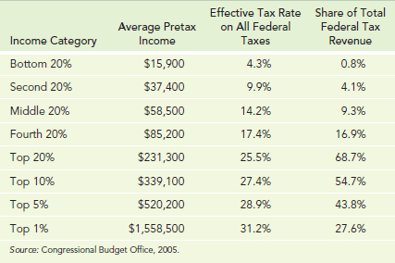
Bottom Line on the Distribution of Federal Taxes
Note: Includes all deductions, exemptions, corporate taxes, payroll taxes,
excise taxes, AMT, and assumptions about incidence.

Slide 17
Bottom Line on the Distribution of Federal Taxes
Progressive tax – has higher tax rates on people with higher incomes.
The U.S. tax code is progressive
Effective tax rate ranges from 4.3% - 31.2%
85.6% of all federal taxes are paid by the top 40% of earners.
What are the implications of such a narrow tax base?
What is a regressive tax?

Slide 18
Bottom Line on the Distribution of Federal Taxes
Flat Tax – has a constant tax rate
Proposed to replace current tax code
MTR is the same for all income levels.
If almost all deductions were eliminated, a flat rate of 19% would raise the same revenue as the current code.
Advantages:
Less complexity.
Lower compliance cost.
Greater incentive to save and invest.

Slide 19
Bottom Line on the Distribution of Federal Taxes
Disadvantage:
MTR for the bottom 80% of taxpayers would rise.
Proponents (Steve Forbes-Republican, Jerry Brown-Democrat) counter argue that…
Efficiency advantages mean that even people whose MTR rose would, with increased economic growth, pay less in total tax.

Slide 20
Tax Revenues
State and Local Taxes
Overall: half the level of federal taxes
States raise more of their revenues, about 20% from sales taxes.
Less progressive than the federal income tax.

Slide 21
Check Yourself
Individual income taxes plus Social Security and Medicare taxes represent what percent of federal revenues?
Calculate the tax owed for an individual making $80,000 pretax and $160,000 pretax. Compare total taxes paid by each and the ATR for each. Is there evidence of a progressive tax?

Slide 22
Spending
Two thirds of the U.S federal budget is spent on…
Social Security
Defense
Medicare
Medicaid
The following figure gives a better picture of where our tax money is spent.

Slide 23
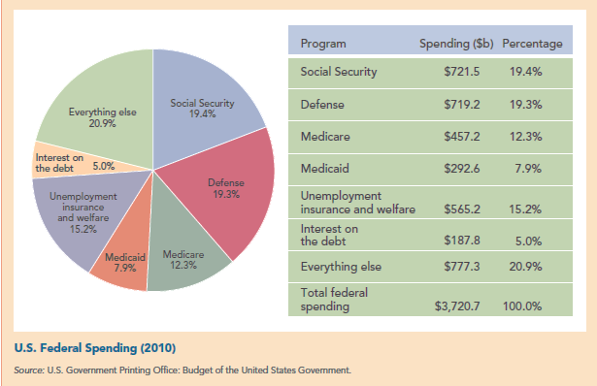
Spending

Slide 24
Social Security
At $586 billion in 2007 – the single largest government program in the world.
Runs on a “pay as you go” basis.
Current contributions pay for benefits of current retirees.
No one has a Social Security account in their name.
Don’t count on living solely on Social Security when you retire.

Slide 25
Social Security
Some people advocate raising the full retirement age – you might want to keep an eye on that.
Benefits are indexed.
Net benefits are declining over time.
Higher taxes on today’s workers funds larger benefits for yesterday’s workers.
The next table shows this.

Slide 26
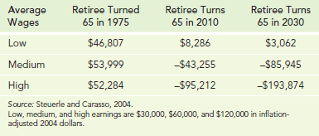
Social Security
Net benefits of Social Security (Single male assuming various retirement years and average wages.)
Notes:
Instructor Note: A Heritage Foundation study found that Social Security's inflation-adjusted rate of return is only 1.23 percent for an average household of two 30-year-old earners with children in which each parent made just under $26,000 in 1996 (assuming both adults were born in 1967). The full report can be found at http://www.heritage.org/research/socialsecurity/cda98-01.cfm#1. Supporters of Social Security argue that the rate of return is irrelevant for an “insurance program” . Whatever position one takes, it is true that the rate of return on contributions to Social Security are much higher for earlier generations and explain why the program is the “most popular government program” for the current elderly, but support is declining among younger workers.

Slide 27
Social Security
Redistributes wealth across income classes.
Net benefits for wage earners retiring in 2030…
Low wage earner = $3,062
High wage earner = - $193,874
Social Security is also a welfare system.

Slide 28
Social Security
Complications
More beneficial for married couples than singles.
You don’t own your account.
Your cannot borrow from the account.
You can’t make an early withdrawal even an emergency such as a terminal illness.
Your survivors do not inherit the money you have put in your account.
It’s better for females than for males because females live longer.

Slide 29
Defense
2007: Spending on defense was $549 billion.
Excludes most spending on the wars in Iraq and Afghanistan.
The U.S. spends more on its military than any other country.
The next table shows the top ten countries listed by military expenditure.

Slide 30
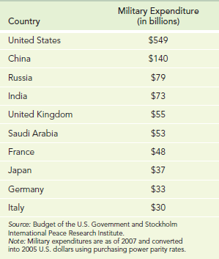
Defense
Top ten countries by military expenditure (billions of U.S. dollars)
Notes:
Instructor Note: The expenditures of the United States alone are almost exactly equal to the sum of the expenditures of the other nine countries combined.

Slide 31
Medicare and Medicaid
Medicare: helps the elderly with medical bills.
Covers individuals over 65 who have paid into the system for at least 10 years.
In 2010 amounted to $457.2 billion.
Medicaid: Covers the poor and the disabled.
Paid for jointly by federal and state governments.
In 2010 amounted to about $300 billion.

Slide 32
Unemployment Insurance and Welfare
Important categories of welfare:
Personal payments to poor households with children.
Largest is TANF – Benefits are limited to 5 years in a lifetime.
Housing vouchers are given to subsidize a portion of rent.
Earned Income Tax Credit (EITC) – is a direct cash payment based on income.
Unemployment insurance (not income tested)

Slide 33
Everything Else
Add up to a large amount of money
Individually are small compared to Social Security, defense, or Medicare.
What about foreign aid? – amounts to about 1% of the total budget.
What about “earmarks” – when a congressman puts an expenditure for his/her district into a broader bill.
Often wasteful, but cutting them out will not save a lot of money.

Slide 34
National Debt, Interest on the National Debt, and Deficits
National Debt held by the public – all federal debt held outside the United States government.
At the end of 2011 it equaled just under $10.5 trillion.
Debt-to-GDP Ratio about 70%
Not necessarily high for the U.S. government.
Has been much higher in the past.
Let’s take a look at some history.
Notes:
Instructor Note: People who are worried about U.S. government may concede the point that if the debt-to-GDP ratio stayed at 50% , there wouldn’t necessarily be a problem. However, it is the increasing debt-to-GDP ratio and the future obligations implied by entitlement programs that cause concern. What do your students think about this?

Slide 35
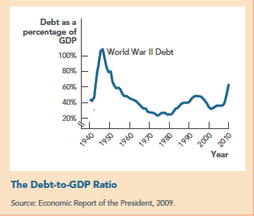
National Debt, Interest on the National Debt, and Deficits

Slide 36
National Debt, Interest on the National Debt, and Deficits
Interest on the national debt
Payment of interest to bond holders in 2010 was $180 billion.
Because interests rates were unusually low, the interest paid was unusually low.
Does it matter if a large amount of the debt is owed to foreigners?
From a purely economic point of view, no.
What matters is how the borrowed dollars are spent.
Notes:
Instructor Note: Media report concerns that China holds such a large share of our debt. The numbers on foreign held debt can be found on the U.S. Treasury website: http://www.treas.gov/tic/mfh.txt. According to the site, as of March 2009, foreign holding of U.S. Government debt was $3,265.2 billion. China holds $767.9 billion, or, 23.5%.

Slide 37
National Debt, Interest on the National Debt, and Deficits
Deficit – the annual difference between federal spending and revenues.
Equals the annual change in the national debt.
The following figure allows us to see the level of deficit-to-GDP ratio and how it has changed over time.

Slide 38
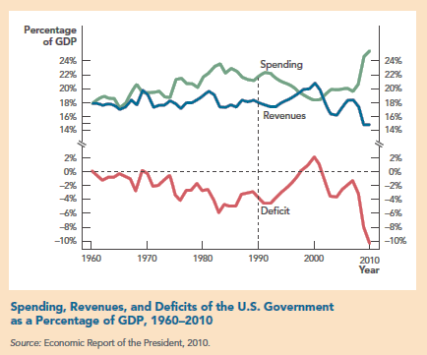
National Debt, Interest on the National Debt, and Deficits

Slide 39
Check Yourself
When you retire, you will receive Social Security benefits as will most Americans. Right now, what percentage of federal spending is represented by Social Security and Medicare payments?
Why is it important to consider the debt-to-GDP ratio rather than just the absolute amount of the national debt? What does the ratio tell us?

Slide 40
Will the U.S. Govt. Go Bankrupt?
The Congressional Budget Office (CBO): “under any plausible scenario, the federal budget is on an unsustainable path…”
Main forces driving the projections:
The population is aging resulting in higher Social Security and Medicare payments.
Health costs per person are rising more than twice as fast as GDP per capita.
The next figure shows the result.

Slide 41
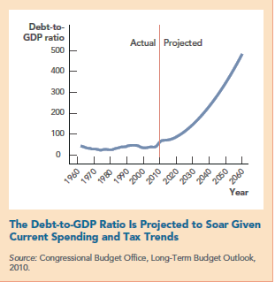
Will the U.S. Govt. Go Bankrupt?
Notes:
Instructor Note: These projections were made in 2007 before the debt jumped by $2 trillion.

Slide 42
Will the U.S. Govt. Go Bankrupt?
We need to distinguish between the national debt and the deficit.
Over the past 40 years spending and revenue have fluctuated around 18% of GDP.
Spending is projected to take off after 2010 while revenue remains close the historical level.
The main reason is Medicare and Medicaid
The next diagram illustrates this.

Slide 43
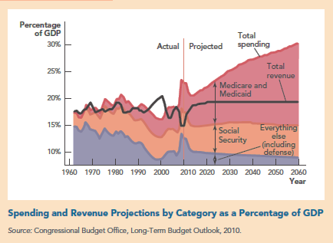
Will the U.S. Govt. Go Bankrupt?

Slide 44
The Future is Hard to Predict
History of relatively low taxes.
The American Revolution was in part about taxes in spite of one of the lowest tax burdens in the world.
The income tax is fairly new—started in 1913.
Taxes and federal spending increased dramatically during WWI and WWII.
Since then, they have remained fairly stable around 18% of GDP until recent years.
Let’s see how the U.S. compares to other countries.

Slide 45
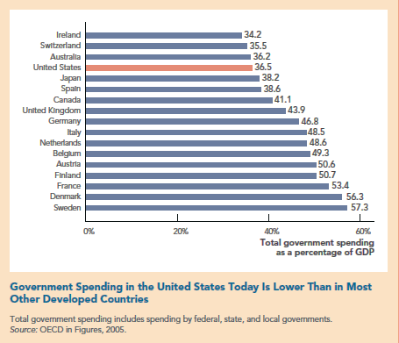
U.S. Government*Spending Compared with Other Countries
*Includes all levels of government

Slide 46
Check Yourself
Projecting forward for the next 40 years, what categories of spending are likely to increase or decrease? What does this mean to overall government spending? Will it grow, fall, or remain the same?
If the pace of idea generation quickens, the Solow growth curve might shift permanently. If this happens, how would this affect the debt-to-GDP ratio? Explain what this means for our nation’s ability to pay for increased benefits to retirees.

Slide 47
Revenues/Spending Undercount the Role of Govt. in the Economy
The federal government imposes other costs that aren’t part of the budget: examples
Environment and other regulations
Military draft
Opportunity cost of taking labor and skills out of the economy.
The voluntary army reduced the total cost to the economy of providing national defense.
Why? More productive labor was freed up to produce other goods and services.

Slide 48
Takeaway
The federal government takes in and spends a great deal of money.
Huge majority of tax revenues come from individuals.
Income tax.
Social Security and Medicare taxes.
General transfers to the elderly are far greater than expenditures for welfare.

Slide 49
Takeaway
Spending is going to go up.
The biggest problem is Medicare and Medicaid.
One question is whether federal revenues rise to keep the budget sufficiently close to balance.

Slide 50
End of Chapter 17

