Slide 1
Introduction to Web development
2
Lecturers: Umarov Fahriddin Alisherovich (Sarsenova Zh.N.)
Labs: Aitim A.K., (Myrzakanurov A.S.)
Email:umarovf19@gmail.com

Slide 2
Agenda
Simple Table
HTML5 Table Extra Tags
The <form> element
<input> tags and types
Grouping FORM data with<fieldset>
FORM attributes tags

Slide 3
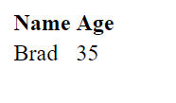

Simple table
WITHOUT BORDER:
<table border=“1”>
<tr>
<th>Name</th>
<th>Age</th>
</tr>
<tr>
<td>Brad</td>
<td>35</td>
</tr>
</table>
WITH BORDER:

Slide 4

Time to make a quiz
Notes:
https://forms.gle/iWpSt6Ao4DzLXqkV9

Slide 5
HTML5 Table Extra tags
The HTML <caption> element specifies the caption (or title) of a table.
The HTML <colgroup> element defines a group of columns within a table.
The HTML <col> element defines a column within a table and is used for defining common semantics on all common cells. It is generally found within a <colgroup> element.
The HTML <thead> element defines a set of rows defining the head of the columns of the table.
The HTML Table Body element (<tbody>) encapsulates a set of table rows (<tr> elements), indicating that they comprise the body of the table (<table>).
The HTML <tfoot> element defines a set of rows summarizing the columns of the table.
Notes:
Making a markup as semantic as possible
https://developer.mozilla.org/en-US/docs/Web/HTML/Element/table

Slide 6
The <form> Element
Getting user input
The HTML <form> element defines a form that is used to collect user input
Form elements are different types of input elements, like text fields, checkboxes, radio buttons, submit buttons, and more.

Slide 7
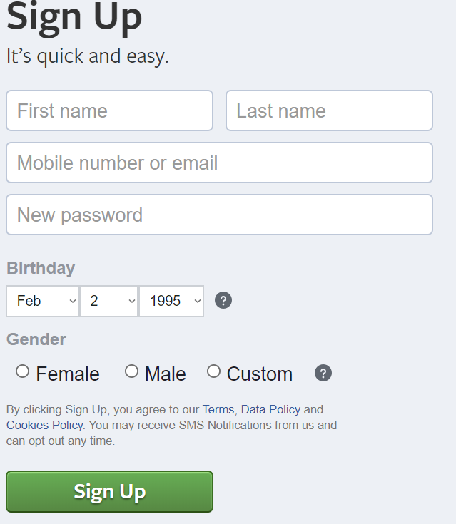
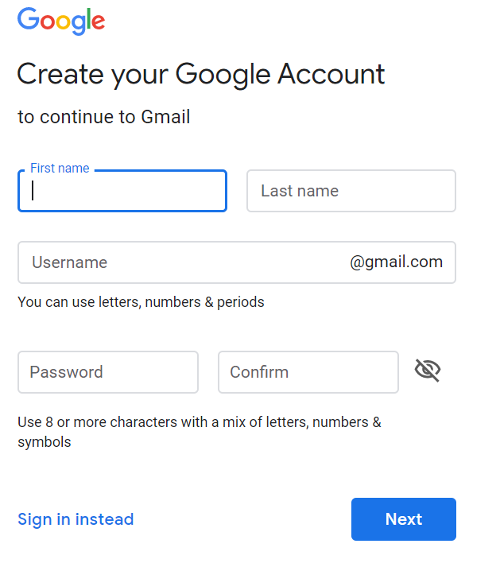
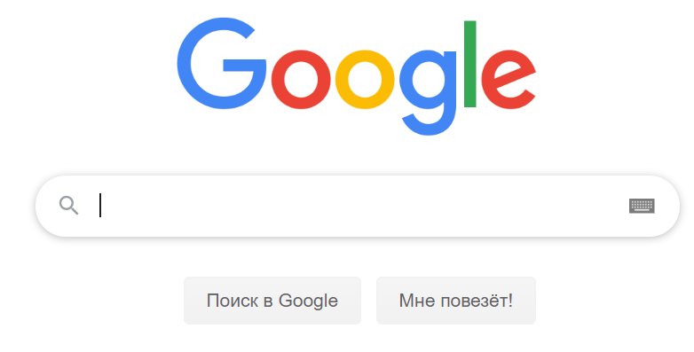
Examples of Forms

Slide 8
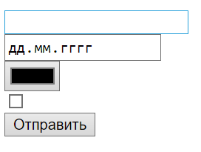
The <input> tag
<input type="text">
<input type="date">
<input type="color">
<input type="checkbox">
<input type=“submit">
Notes:
The <input> tag creates interactive controls. The “type” attribute determines the type of input

Slide 9
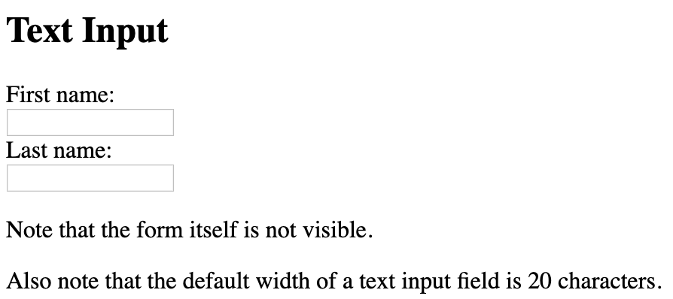
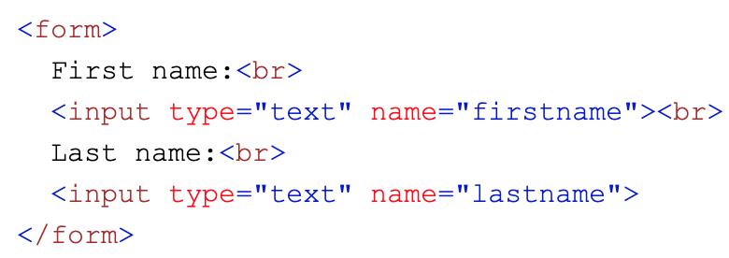
<input type=“text”>

Slide 10
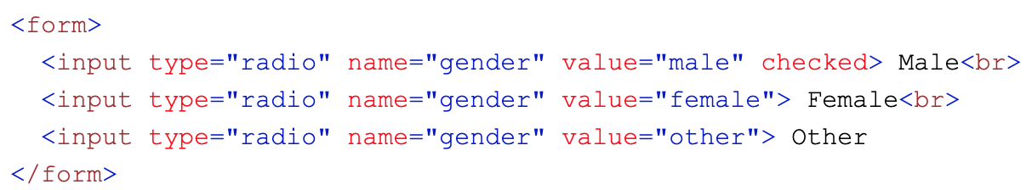
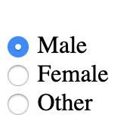
Radio Button <input>

Slide 11
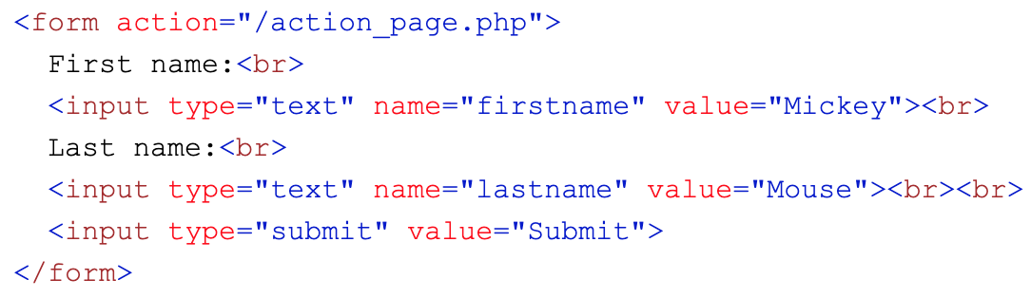
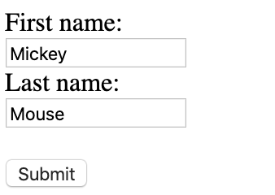
The Submit Button
<input type="submit"> defines a button for submitting the form data to a form-handler.
The form-handler is typically a server page with a script for processing input data.
The form-handler is specified in the form's action attribute:

Slide 12
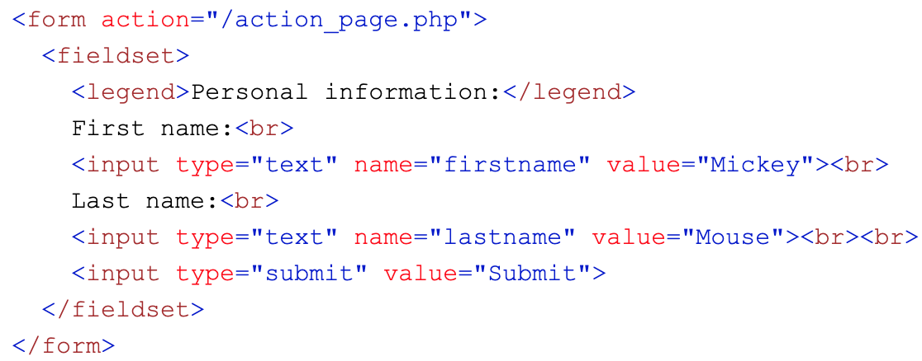
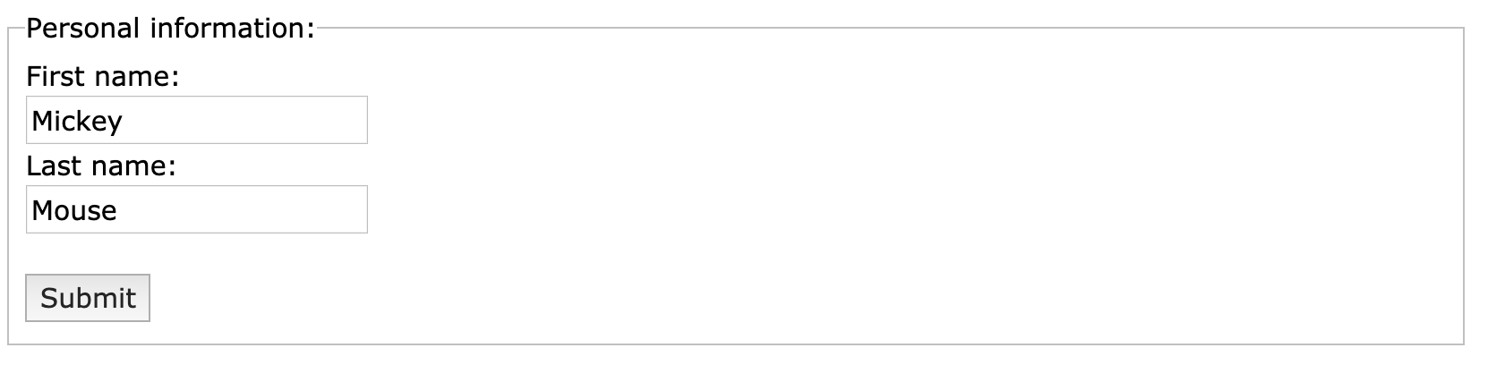
Grouping Form Data with <fieldset>
The <fieldset> element is used to group related data in a form.
The <legend> element defines a caption for the <fieldset> element.

Slide 13
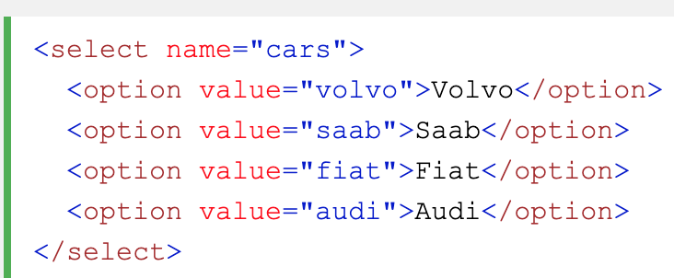
The <select> Element
The <select> element defines a drop-down list:
The <option> elements defines an option that can be selected.
By default, the first item in the drop-down list is selected.
To define a pre-selected option, add the selected attribute to the option:

Slide 14
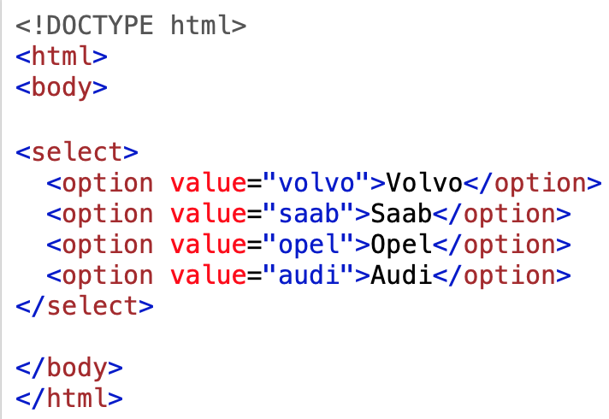
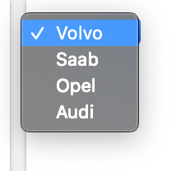
<option>
The <option> tag defines an option in a select list.
<option> elements go inside a <select> or <datalist> element.

Slide 15
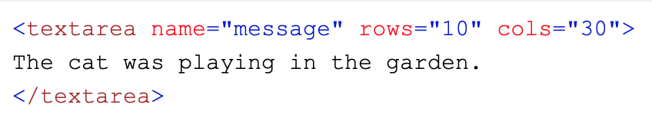
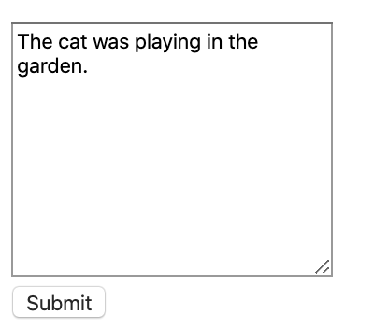
The <textarea> Element
The <textarea> element defines a multi-line input field (a text area):
The rows attribute specifies the visible number of lines in a text area.
The cols attribute specifies the visible width of a text area.

Slide 16
Labels
The <label> element does not render as anything special for the user. However, it provides a usability improvement for mouse users, because if the user clicks on the text within the <label> element, it toggles the control.
Notes:
Labels are really important for making our website accessible

Slide 17
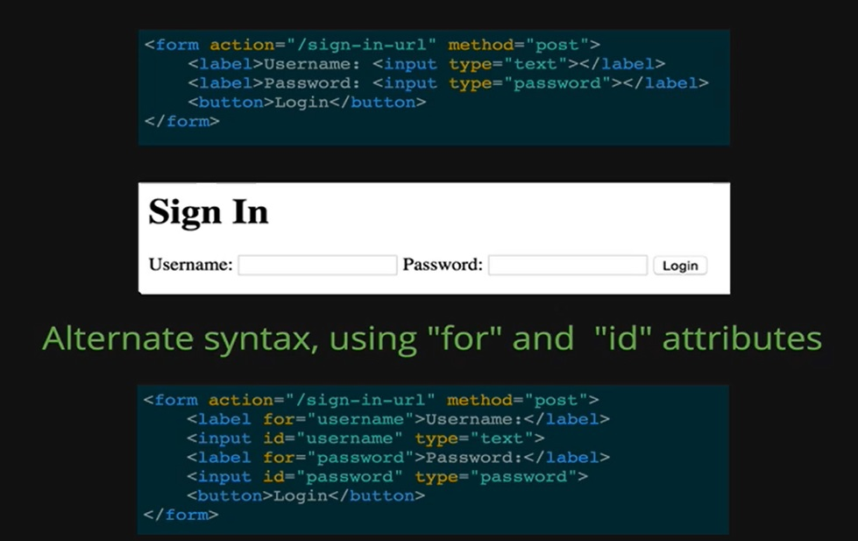
Labels(example)

Slide 18
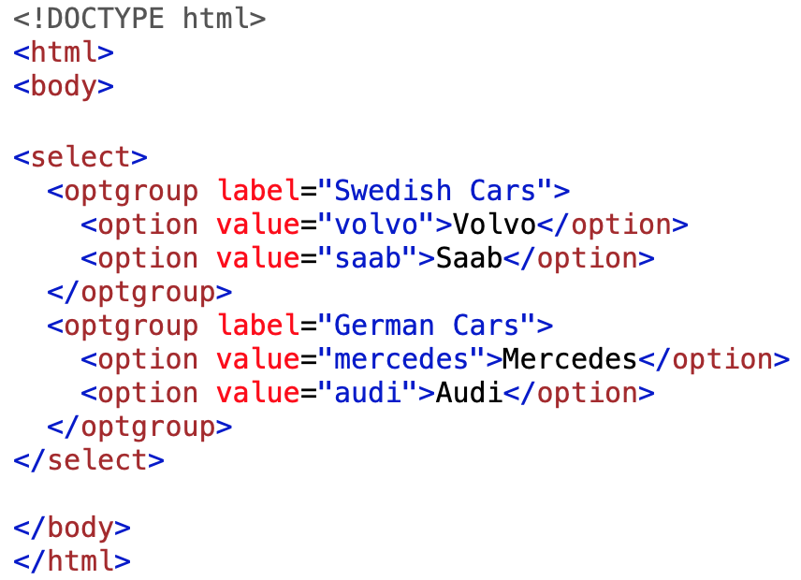
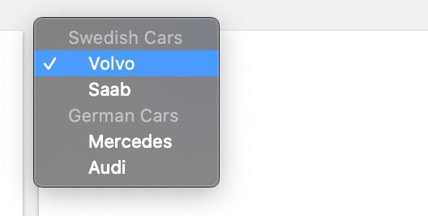
<optgroup>
The <optgroup> is used to group related options in a drop-down list.
If you have a long list of options, groups of related options are easier to handle for a user.

Slide 19
Useful links:
https://developer.mozilla.org/en-US/docs/Web/HTML/Element/table
https://developer.mozilla.org/en-US/docs/Web/HTML/Element/input
https://developer.mozilla.org/en-US/docs/Web/HTML/Element/form
https://developer.mozilla.org/en-US/docs/Learn/Forms/Form_validation
https://stackoverflow.com/questions/10281962/is-there-a-minlength-validation-attribute-in-html5

