Slide 1
Lecture 14: Instruction Set & HW3/HW4 Computer Organization and Architecture Fall 2021
唐继军
jj.tang@siat.ac.cn

Slide 2
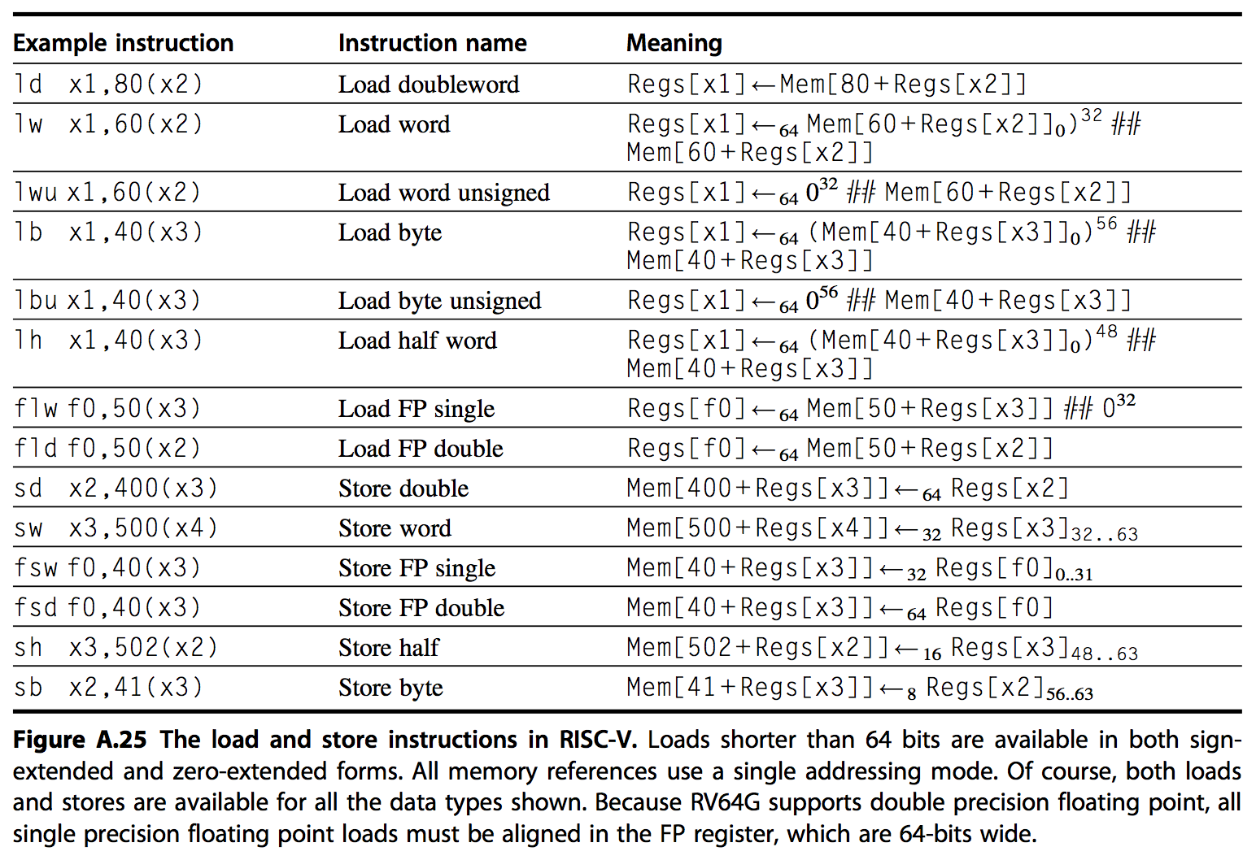
Load/Store Instructions

Slide 3
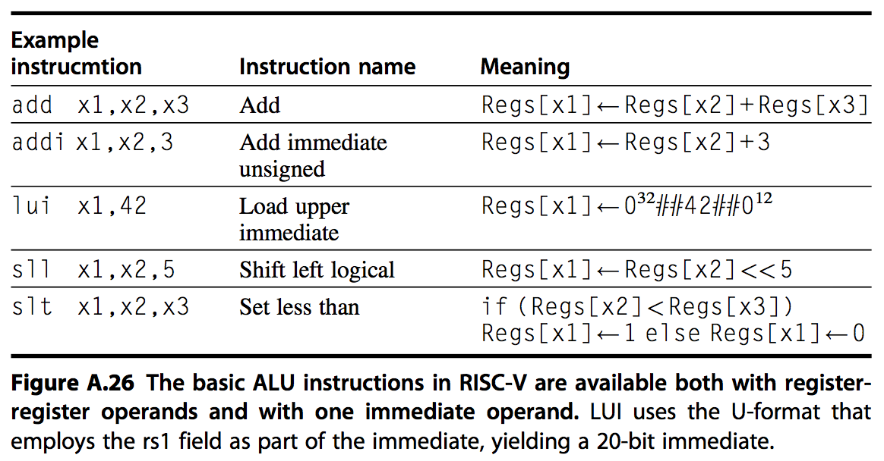
ALU Instructions

Slide 4
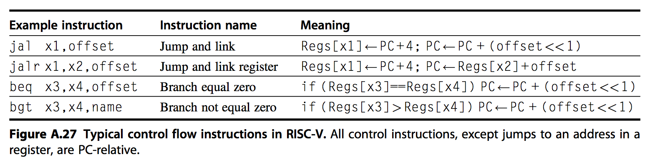
Control Flow Instructions

Slide 5
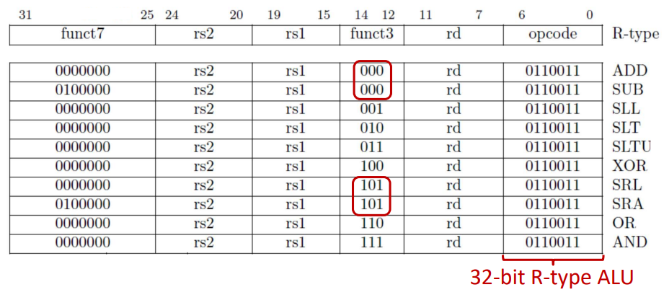
Example Coding

Slide 6
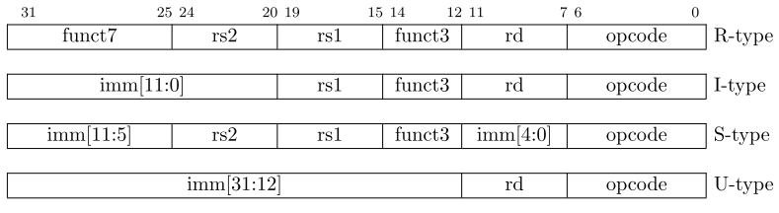
Four Core RISC-V Instruction Formats
https://github.com/riscv/riscv-opcodes/blob/master/opcodes
Additional opcode bits/immediate
Additional opcode bits
7-bit opcode field (but low 2 bits =11₂)
Reg. Source 2
Reg. Source 1
Destination Reg.
Aligned on a four-byte boundary in memory. There are variants!
Sign bit of immediates always on bit 31 of instruction. Register fields never move.

Slide 7
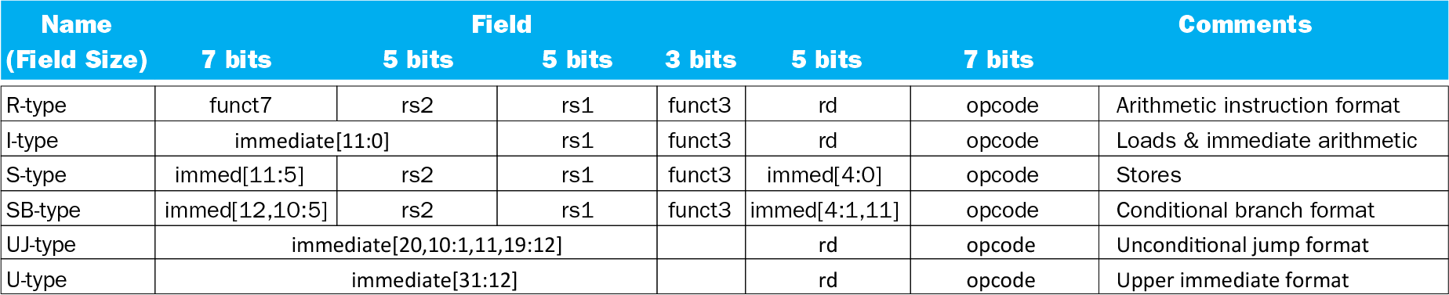
RISC-V Encoding Summary

Slide 8
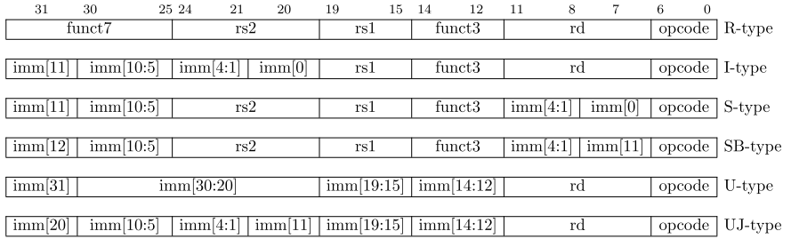
With Variants
Additional opcode bits/immediate
Additional opcode bits
7-bit opcode field (but low 2 bits =11₂)
Reg. Source 2
Reg. Source 1
Destination Reg.
Based on the handling of the immediates

Slide 9
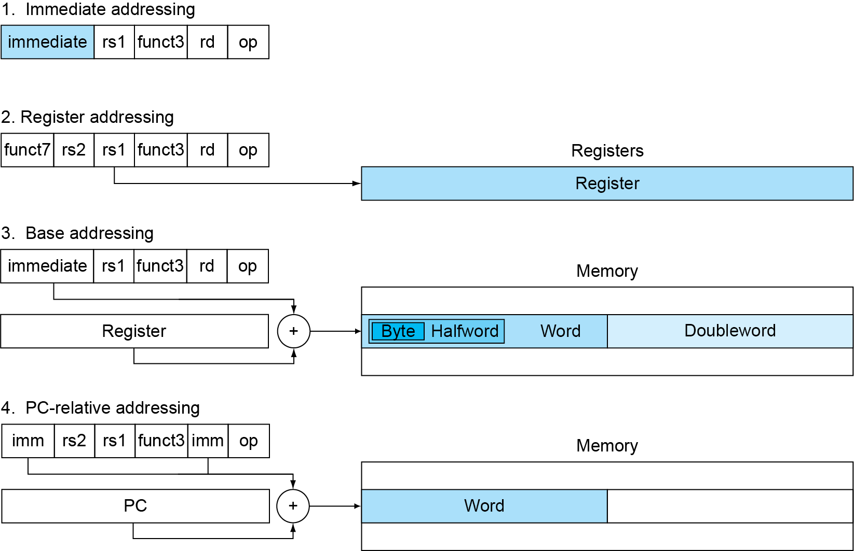
RISC-V Addressing Summary
, i.e., displacement addressing

Slide 10
R-Format Encoding Example
funct7
rs2
rs1
funct3
rd
opcode
7 bits
5 bits
5 bits
3 bits
5 bits
7 bits
add x6, x10, x6
0
6
10
0
6
51
0000000
00110
01010
000
00110
0110011
0000 0000 0110 0101 0000 0011 0011 0011_{two} =
00650333₁₆

Slide 11
RISC-V I-Format Instructions
immediate
rs1
funct3
rd
opcode
12 bits
5 bits
3 bits
5 bits
7 bits
Immediate arithmetic and load instructions
rs1: source or base address register number
immediate: constant operand, or offset added to base address
2s-complement, sign extended
Design Principle: Good design demands good compromises
Different formats complicate decoding, but allow 32-bit instructions uniformly
Keep formats as similar as possible

Slide 12
RISC-V S-Format Instructions
imm[11:5]
rs2
rs1
funct3
imm[4:0]
opcode
7 bits
5 bits
5 bits
3 bits
5 bits
7 bits
Different immediate format for store instructions
rs1: base address register number
rs2: source operand register number
immediate: offset added to base address
Split so that rs1 and rs2 fields always in the same place

Slide 13
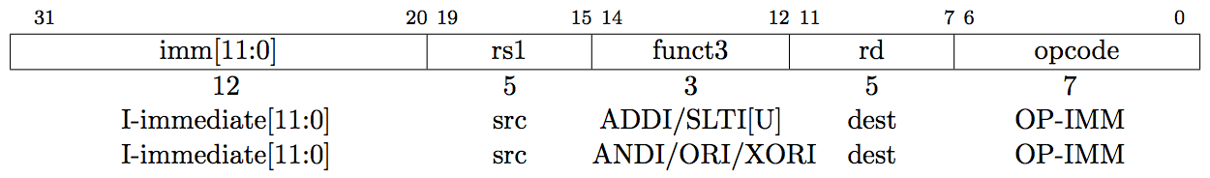
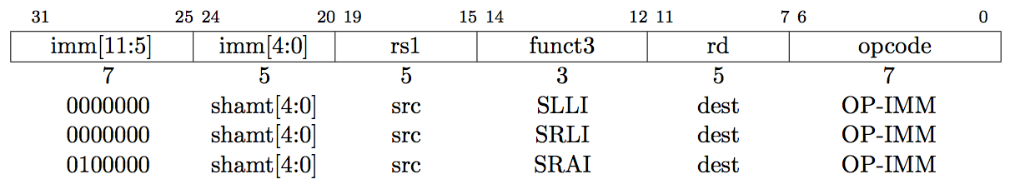
Integer Computational Instructions (ALU)
I-type (Immediate), all immediates in all instructions are sign extended
ADDI: adds sign extended 12-bit immediate to rs1
SLTI(U): set less than immediate
ANDI/ORI/XORI: Logical operations
SLLI/SRLI/SRAI: Shifts by constants
I-type instructions end with I
Notes:
SLTIU: Same as SLTI but compares immediate as unsigned.
I-type instruction ends with I

Slide 14
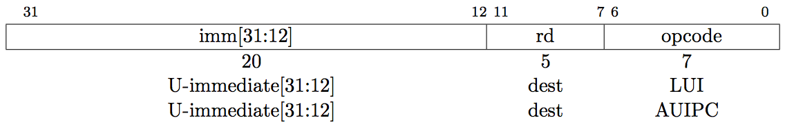
Integer Computational Instructions (ALU)
I-type (Immediate), all immediates in all instructions are sign extended
LUI/AUIPC: load upper immediate/add upper immediate to pc
I-type instructions end with I
Writes 20-bit immediate to top of destination register.
Used to build large immediates.
12-bit immediates are signed, so have to account for sign when building 32-bit immediates in 2-instruction sequence (LUI high-20b, ADDI low-12b)
Notes:
SLTIU: Same as SLTI but compares immediate as unsigned.
I-type instruction ends with I

Slide 15
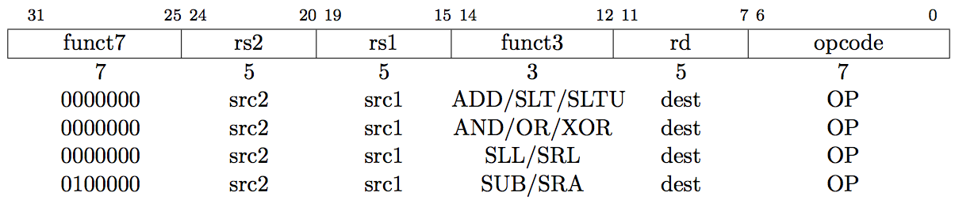
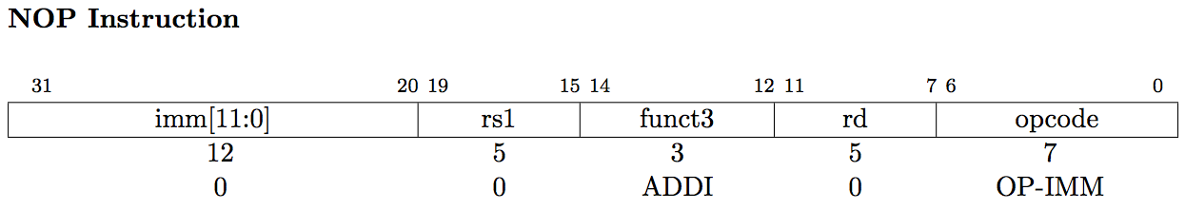
Integer Computational Instructions
R-type (Register)
rs1 and rs2 are the source registers. rd the destination
ADD/SUB:
SLT, SLTU: set less than
SRL, SLL, SRA: shift logical or arithmetic left or right
^{ADDI x0, x0, 0}
Notes:
SLTIU: Same as SLTI but compares immediate as unsigned.

Slide 16
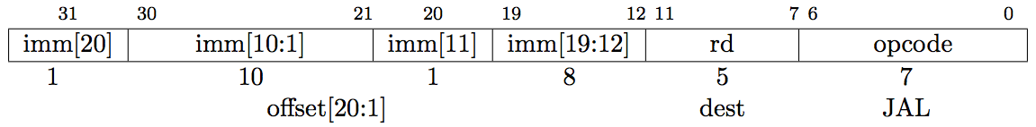
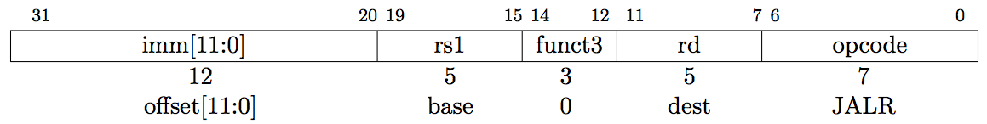
Control Transfer Instructions
NO architecturally visible delay slots
Unconditional Jumps: PC+offset target
JAL: Jump and link, also writes PC+4 to x1, UJ-type
Offset scaled by 1-bit left shift – can jump to 16-bit instruction boundary (Same for branches)
JALR: Jump and link register where Imm (12 bits) + rd1 = target

Slide 17
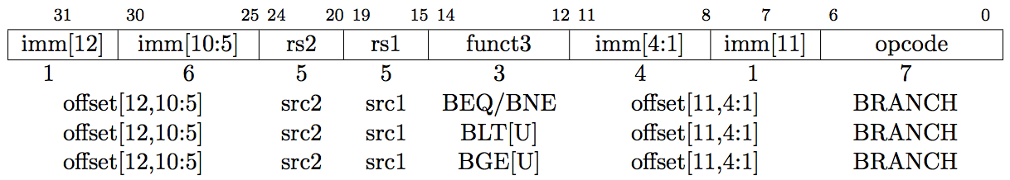
Control Transfer Instructions
NO architecturally visible delay slots
Conditional Branches: SB-type and PC+offset target
12-bit signed immediate split across two fields
Branches, compare two registers, PC+(immediate<<1) target
(Signed offset in multiples of two).Branches do not have delay slot

Slide 18
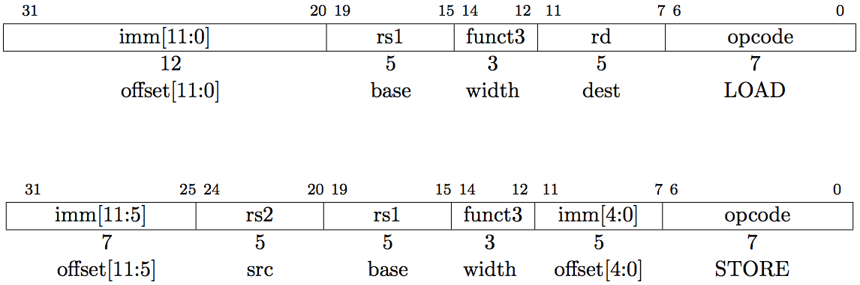
Loads and Stores
Store instructions (S-type)
MEM(rs1+imm) = rs2
Loads (I-type)
Rd = MEM(rs1 + imm)

Slide 19
Specifications and Software From riscv.org and github.com/riscv
Specification from RISC-V website
https://riscv.org/specifications/
RISC-V software includes
GNU Compiler Collection (GCC) toolchain (with GDB, the debugger)
https://github.com/riscv/riscv-tools
LLVM toolchain
A simulator ("Spike")
https://github.com/riscv/riscv-isa-sim
Standard simulator QEMU
https://github.com/riscv/riscv-qemu
Operating systems support exists for Linux
https://github.com/riscv/riscv-linux
A JavaScript ISA simulator to run a RISC-V Linux system on a web browser
https://github.com/riscv/riscv-angel

Slide 20
HW3-Q1
已知某64 位机主存采用半导体存储器，其地址码为26 位，若使用4M X8 位的DRAM 芯片组成该机所允许的最大主存空间，并选用内存条结构形式，问：
(1) 若每个内存条为16M X 64 位，共需几个内存条？
(2) 每个内存条内共有多少DRAM 芯片？
(3) 主存共需多少DRAM 芯片? CPU 如何选择各内存条？
解：
2E26 / 2E24 = 4块
(2) (2E26 / 2E24) * (64 / 8) = 32片
(3) 主存共需要DRAM芯片 128片。
每个内存条有32片DRAM芯片，容量为16M*64位，需24跟地址线完成内存条内存储单元寻址。一共4块内存条，采用2跟高位地址线，通过2：4译码器译码产生片选信号对各模块版进行选择。

Slide 21
HW3-Q2
设存储器容量为64M, 字长为64 位，模块数m =8 , 分别用顺序和交叉方式进行组织。存储周期T = 120 ns, 数据总线宽度为64 位，总线传送周期r= 40 ns 。求：顺序存储器和交叉存储器的带宽各是多少？
解：
（1）顺序存储器耗时：8*120ns = 9.6E-7
带宽为 512/（9.6E-7） = 5.33E8（bit/s）
（2）交叉存储器耗时：120ns + 7 * 40 = 4E-7
带宽为 512/（4E-7） = 1.28E9（bit/s）

Slide 22

HW3-Q3
假设主存容量32M X 32 位， cache 容量64K X 32 位，主存与cache 之间以每块4 X 32 位大小传送数据，请确定直接映射方式的有关参数，并画出主存地址格式。
解：
Cache共有行数：(64K*32)/(4*32)=2^14行，即行号为14；主存共有块数：(32M*32)/(4*32)=2^23块，即地址位为23位；设32位为一个字，按字进行编址，则25位的内存地址为：

Slide 23

HW3-Q4
一个组相联cache 由64 个行组成，每组4 行。主存储器包含32K 个块，每块128 字。请表示内存地址的格式。
解：
块大小=行大小=2^w个字=128=2^7,w=7；每组的行数为：k=4，cache的行数=k*u=64,u=16，组数用d位表示：2^d=16，即d=4；主存块数为：2^s=32K=2^15，即s=15；标记大小为:(s-d)位=15-4=11位，主存地址长度为：15+7=22位，主存寻址单元数为2^(s+w)=2^22，则其内存地址格式为：

Slide 24
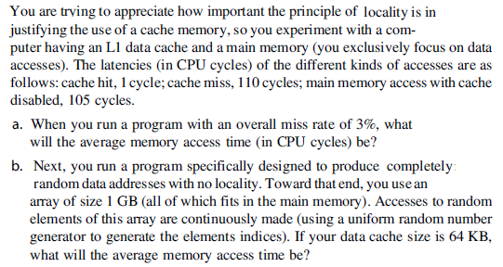
HW3-Q5

Slide 25
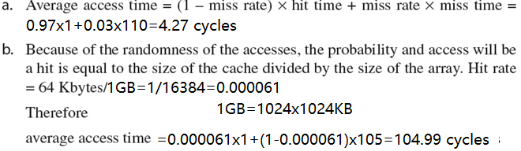
HW3-Q5

Slide 26
HW3-Q6
Whereas larger caches have lower miss rates, they also tend to have
longer hit times. Assume a direct-mapped 8 KB cache has 0.22 ns hit time and miss rate m1; also assume a 4-way associative 64 KB cache has 0.52 ns hit time and a miss rate m2.
a. If the miss penalty is 100 ns, when would it be advantageous to use the smaller cache to reduce the overall memory access time?
b. Repeat part (a) for miss penalties of 10 and 1000 ns. Conclude
when it might be advantageous to use a smaller cache.

Slide 27
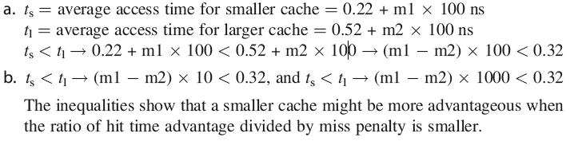
HW3-Q6
Whereas larger caches have lower miss rates, they also tend to have
longer hit times. Assume a direct-mapped 8 KB cache has 0.22 ns hit time and miss rate m1; also assume a 4-way associative 64 KB cache has 0.52 ns hit time and a miss rate m2.
a. If the miss penalty is 100 ns, when would it be advantageous to use the smaller cache to reduce the overall memory access time?
b. Repeat part (a) for miss penalties of 10 and 1000 ns. Conclude
when it might be advantageous to use a smaller cache.

Slide 28
HW4-Q1
一个组相联cache 由64 个行组成，每组4 行。主存储器包含4K 个块，每块128 字。请表示内存地址的格式。
主存：4K 块，每块128字，共2^{（12+7）}字，需要19位
Cache: 每组4行，需要16组，2⁴组，每组128字，需要7位
内存地址19位：
s –d | d | w
8 | 4 | 7

Slide 29
HW4-Q2
有一个处理机，主存容量1MB, 字长1B, 块大小16B, cache 容量32KB, 若cache 采用直接映射式，请给出2 个不同标记的内存地址，它们映射到同一个cache 行。
每块16B，块内地址需要4位，w=4
Cache容量32K，每块16，需要2K块，r=11
内存地址1MB=2²⁰，s+w=20->s=16, s-r=5
s –r | r |w
5 | 11 | 4

Slide 30
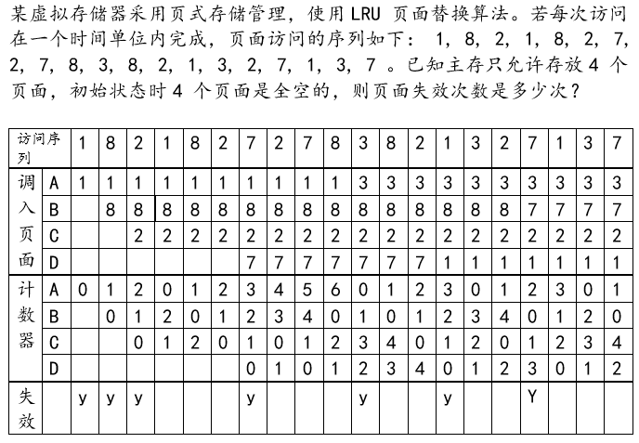
HW4-Q3

Slide 31
HW4-Q4
某计算机的存储系统由cache 、主存和磁盘构成。cache 的访问时间为15ns; 如果被访问的单元在主存中但不在cache 中，需要用60ns 的时间将其装入cache, 然后再进行访问；如果被访问的单元不在主存中，则需要lOms 的时间将其从磁盘中读入主存，然后再装入cache 中并开始访问。若cache 的命中率为95%, 主存的命中率为80%, 求该系统中访问一个字的平均时间。
AMAT=0.95*15+0.05*AMAT_Cache
=14.25+0.05*(0.8*(60+15)+0.2*(10000000+60+15))=100018ns

Slide 32
HW4-Q5
For a direct-mapped cache design with a 64-bit address, the following bits of
the address are used to access the cache.
Tag Index Offset
63–10 9–5 4–0
1） What is the cache block size (in words)?
2） How many blocks does the cache have?
3）Beginning from power on, the following byte-addressed cache references are recorded.
Address
Hex 00 04 10 84 E8 A0 400 1E 8C C1C B4 884
Dec 0 4 16 132 232 160 1024 30 140 3100 180 2180

Slide 33
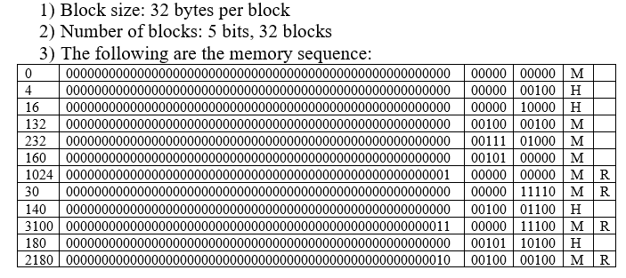
HW4-Q5

