Slide 1

FINANCIAL ACCOUNT MANAGEMENT SYSTEM
DONE BY:
AISHWARYA AND SAHITHYA

Slide 2

INTRODUCTION
This is an application for maintaining the financial accounts of customers
The system provides access to the bank user to create, deposit/withdraw cash, add/remove loan, modify, close and display account details
The following presentation provides the specifications of the system

Slide 3

SYSTEM REQUIREMENTS
SOFTWARE REQUIREMENTS:
Front end: C++
Operating system: Windows 7

Slide 4
HEADER FILES USED
#include<iostream.h> #include<conio.h> #include<string.h> #include<fstream.h> #include<ctype.h> #include<iomanip.h>

Slide 5

FUNCTIONS USED
void welcome ()
void create_new_account()
void deposit_amount()
void withdraw_amount()
void repay_loan()
void add_loan_amount()
void modify_account()
void display_account_details()
void display_txn_account(int)
void display_loan_account (int)
void display_all_accounts()
void close_account()
void write_txn_account(txn_account)
void write_loan_account(loan_account)

Slide 6

MODULES
The modules used are:
Creating an account
Depositing/withdrawing amount
Removing/adding loan
Modify account details
Show account details
All account holder list
Closing an account

Slide 7
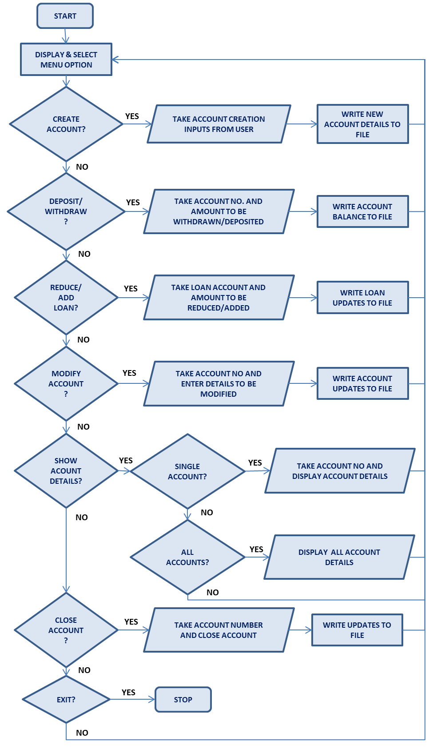
FLOW CHART

Slide 8

CREATING AN ACCOUNT
Used for creating a new account by accepting account holder name, nominee/gurantor name, phone number and initial balance amount from the user

Slide 9

DEPOSIT AND WITHDRAW AMOUNT
Used for depositing or withdrawing amount from the account number entered by the user.

Slide 10
REPAY OR ADD LOAN FROM ACCOUNT
Used to add or reduce loan from the account number entered by the user.

Slide 11

MODIFY ACCOUNT DETAILS
Used to modify account holder name, nominee/guarantor and phone number of the account number entered by the user.

Slide 12

SHOW ACCOUNT DETAILS
Used to display account details of the account number entered by the user.

Slide 13
ALL ACCOUNT HOLDER LIST
Used to display all accounts(transaction, loan or both).

Slide 14

CLOSING AN ACCOUNT
Used to close the account number entered by the user.

Slide 15
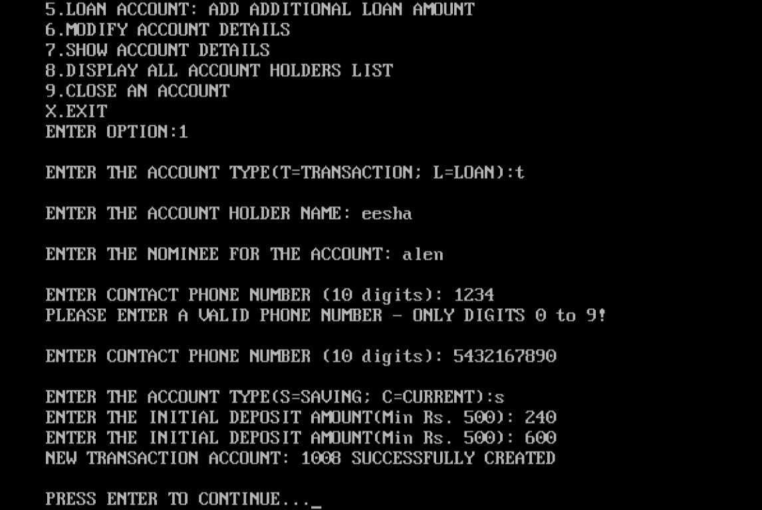
CREATE ACCOUNT

Slide 16
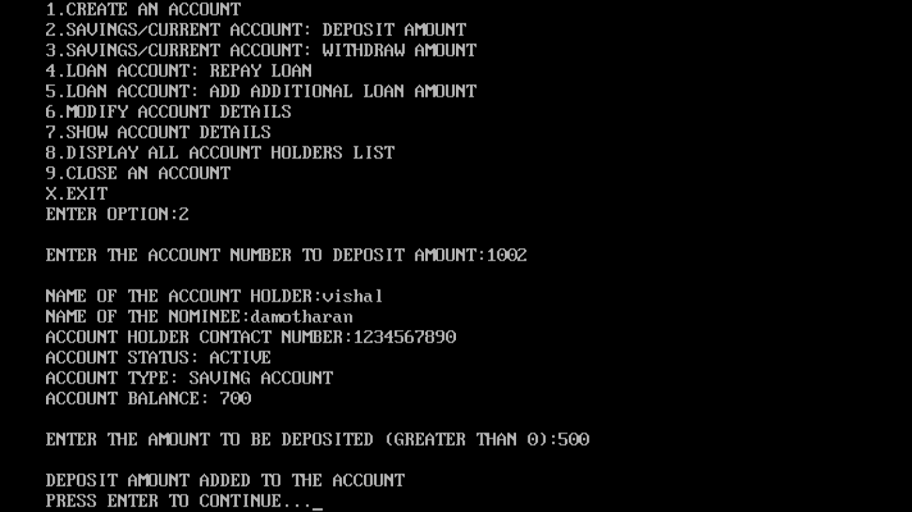
DEPOSIT

Slide 17
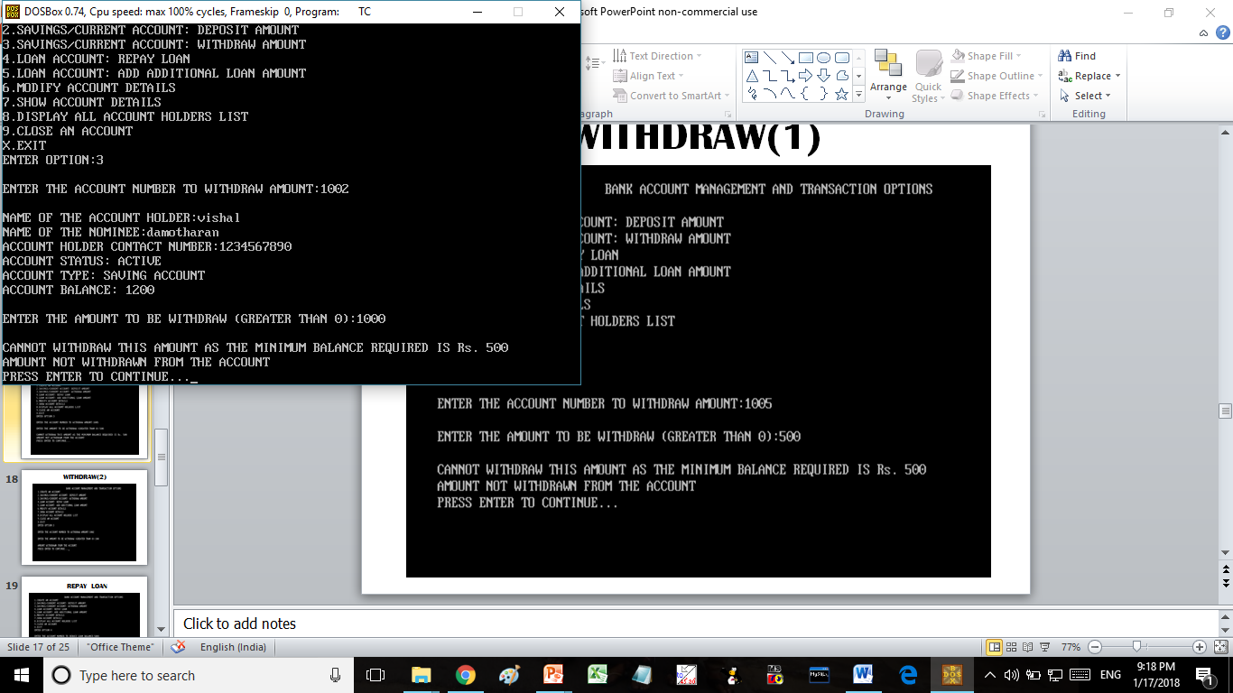
WITHDRAW(1)

Slide 18
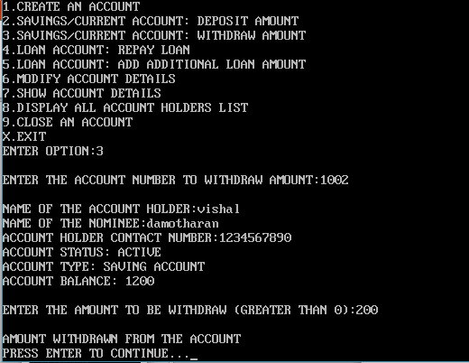
WITHDRAW(2)

Slide 19
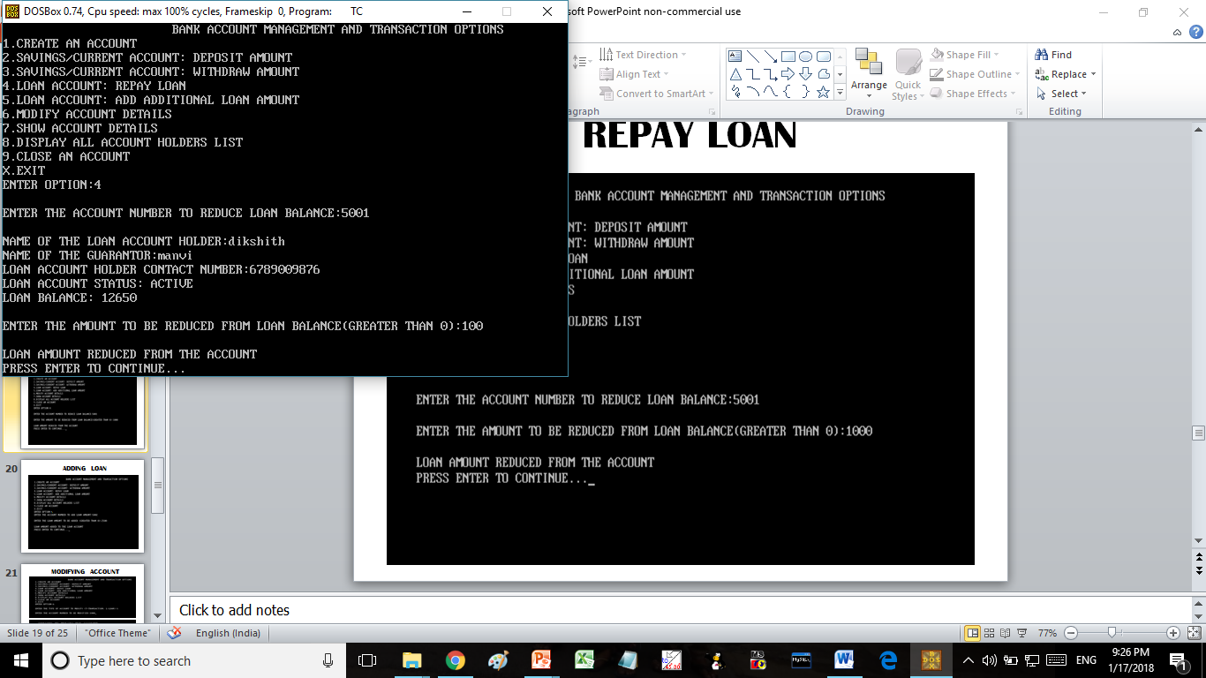
REPAY LOAN

Slide 20
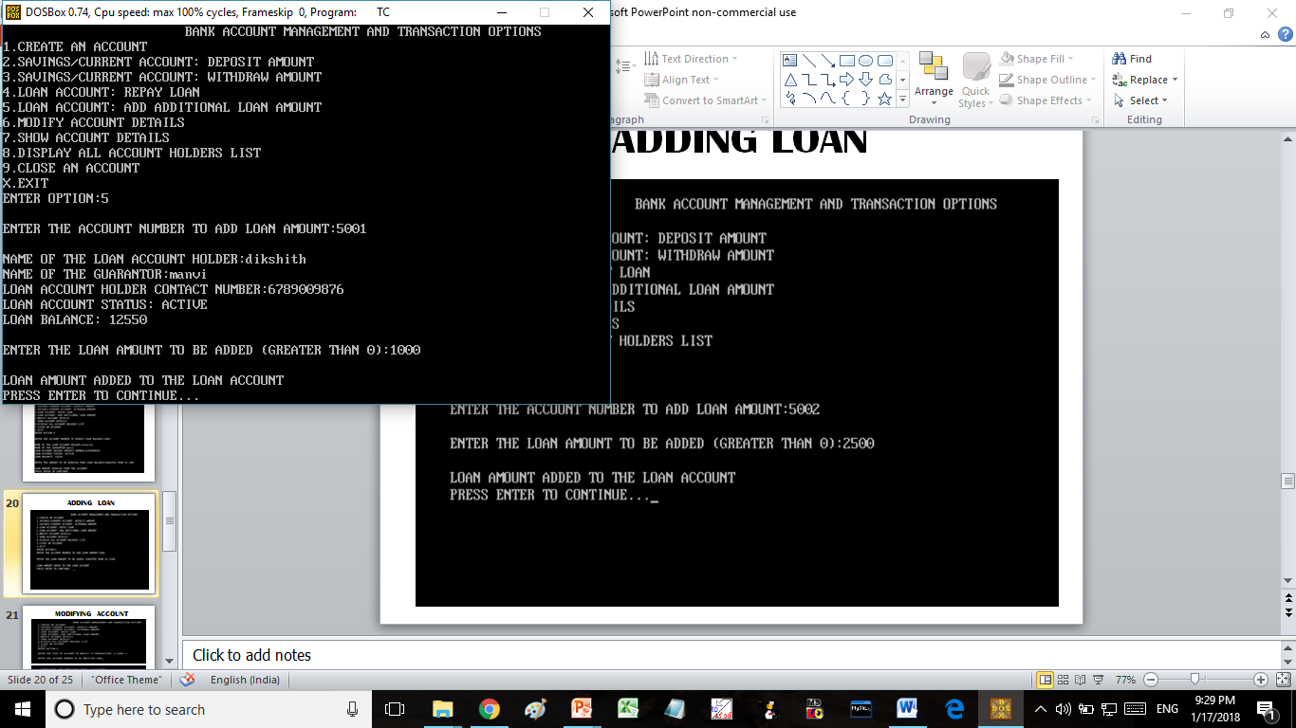
ADDING LOAN
5

Slide 21
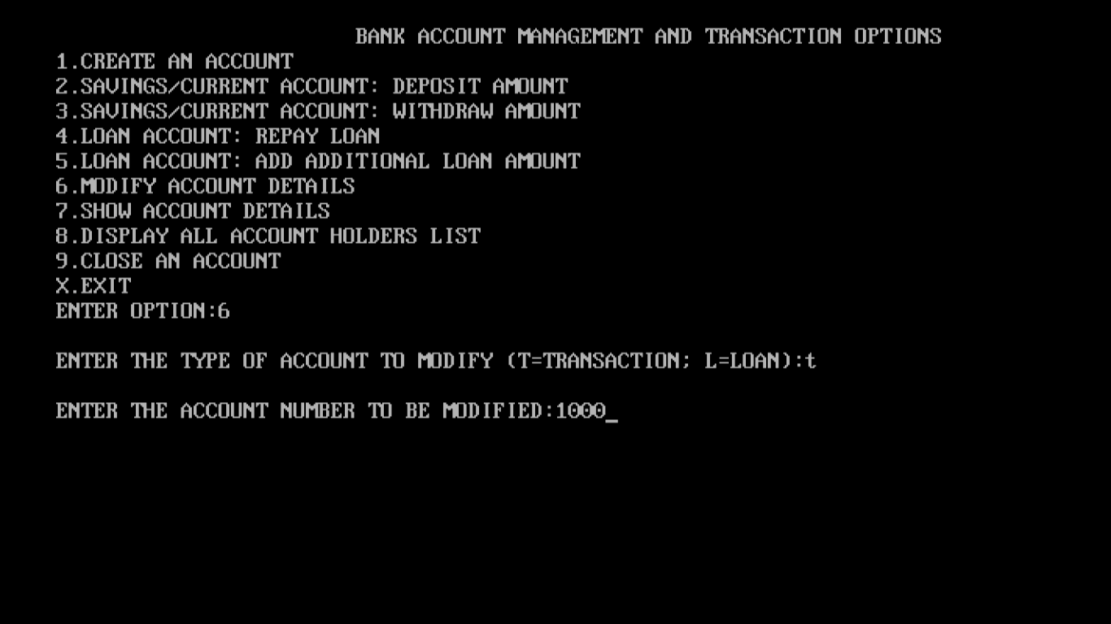
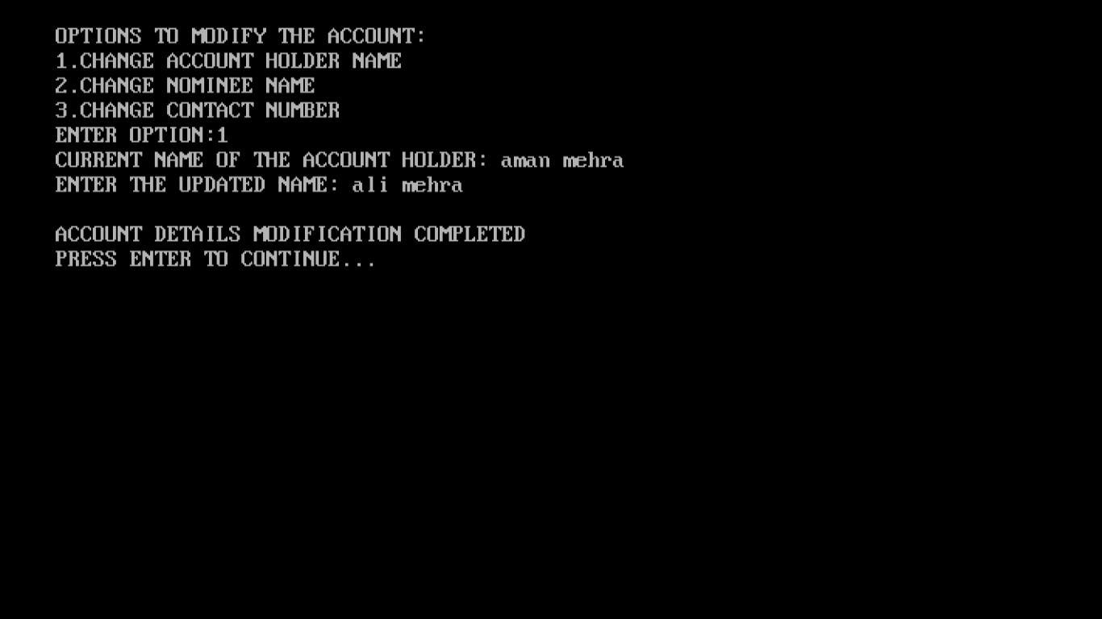
MODIFYING ACCOUNT

Slide 22
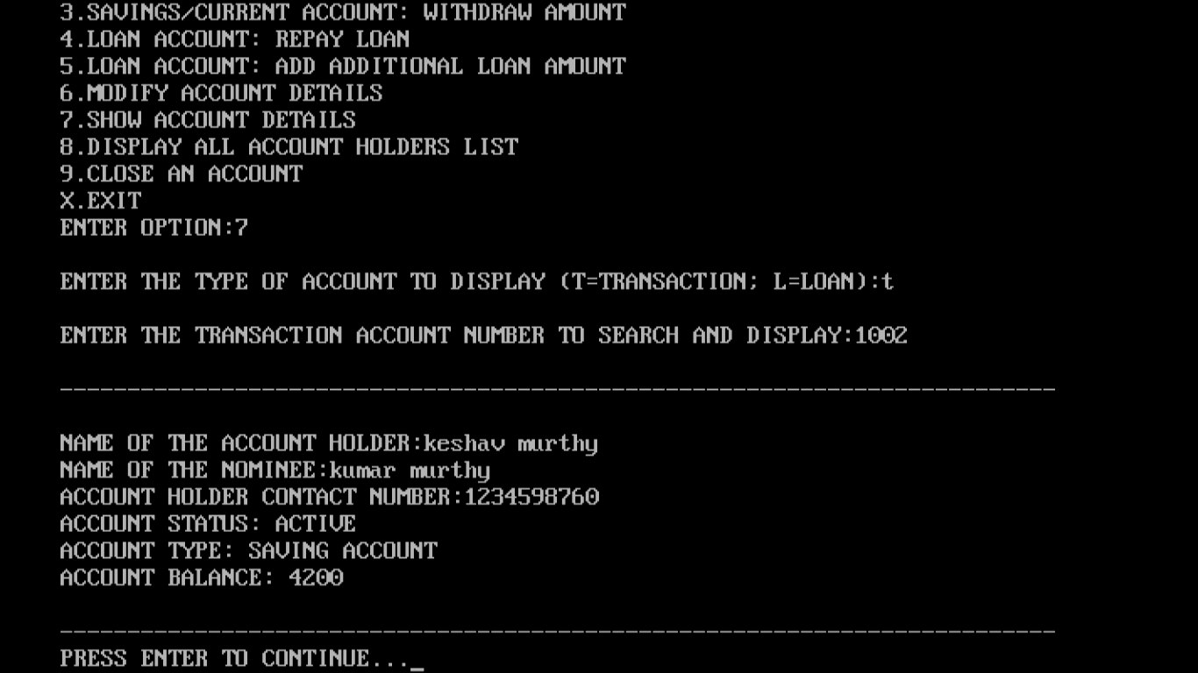
SHOW ACCOUNT DETAILS

Slide 23
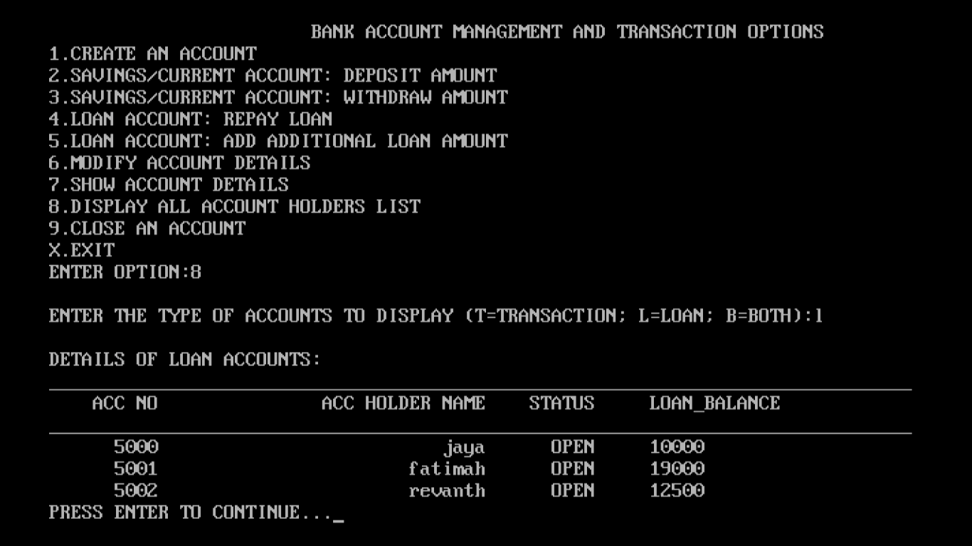
ALL ACCOUNT DETAILS

Slide 24
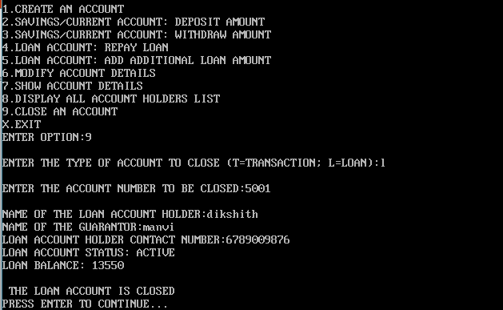
CLOSING AN ACCOUNT

Slide 25


