Slide 1
Travel Planner Agent
CAPSTONE PROJECT
Presented By:
Aishwarya Vacha
-KKR & KSR Institute of Technology and Sciences
-CSE(Artificial Intelligence)

Slide 2
OUTLINE
Problem Statement
Proposed System/Solution
System Development Approach
Algorithm & Deployment
Result (Output Image)
Conclusion
Future Scope
References

Slide 3
Problem Statement
Travel Planner Agent
In today’s fast-paced world, travelers often struggle with fragmented information when planning trips—such as checking weather, booking flights and hotels, comparing budgets, and discovering places to visit. The process is time-consuming, requires switching between multiple platforms, and lacks personalization.

Slide 4
Proposed Solution
A Travel Planner Agent is an AI-powered assistant that helps users plan trips efficiently and intelligently. It uses real-time data to suggest destinations, build itineraries, and recommend transport and accommodation options.
By understanding user preferences, budgets, and constraints, it tailors personalized travel plans. Integrated with maps, weather updates, and local guides, it ensures a smooth travel experience. The agent can also manage bookings, alert users to changes, and optimize schedules on the go. This smart assistant transforms complex travel planning into a seamless, enjoyable process.. The solution will consist of the following components:
Data Collection:
Objective: Gather relevant data needed to make smart travel recommendations.
Sources: User inputs from Watsonx Assistant: destination, budget, preferences, dates.
Data Preprocessing:
Clean and transform data for training and use in ML model.

Slide 5
Machine Learning Algorithm:
Predict the best travel destination, accommodations, and activities for a user profile.
Algorithm Selection:
Classification (for recommending type of places)
Clustering (K-Means) (group users by travel preferences)
Collaborative filtering / Content-based filtering (personalized suggestions)
Training:
Train on historical travel data. (can use public datasets or synthetic data)
Perform hyperparameter tuning and cross-validation.
IBM Cloud Services:
Use Watsonx.ai (Granite models or custom ML models) for intelligent generation.
Store models with Watson Machine Learning (WML) service.

Slide 6
Deployment:
Make the model available via a user-facing application.
Deploy the trained model via Watson Machine Learning.
Integrate with Watsonx Assistant to use model predictions in the chat
Build REST APIs for model access using IBM Cloud Functions.
Evaluation:
Measure how effective the model is in recommending useful travel plans.
Result: The Travel Planner Agent successfully delivers personalized and dynamic travel plans by integrating AI-powered recommendations into an interactive Watsonx Assistant chatbot using IBM Cloud services.

Slide 7
System Approach
System requirements
Developer-Side Requirements
Operating System: Windows 10/11, macOS, or Linux
Browser: Latest Chrome / Firefox / Edge
RAM: Minimum 8 GB (Recommended: 16 GB)
IBM Cloud Platform Requirements
IBM Cloud Account (Lite Plan – free tier)
Watson Assistant (Lite)
Watsonx.ai with Granite model

Slide 8
Library required to build the model
Data Handling and Preprocessing
pandas – For handling structured data like destination info, budgets, dates
numpy – For efficient numerical computations
datetime – To handle travel dates, durations
Natural Language Processing (if analyzing user input)
nltk – For tokenizing and extracting intent (if needed in advanced processing)
spacy – Alternative to NLTK for fast NLP tasks (optional)
Machine Learning / Recommendation Engine
scikit-learn – For building recommendation logic (like KNN or classification)
joblib – To save and reuse trained models (e.g., for travel preferences)
APIs and Cloud Interaction
requests – To call external APIs (weather, transport, hotel booking)
ibm-watson-machine-learning – To deploy and score models on IBM Cloud

Slide 9
Algorithm & Deployment
Algorithm Selection:
Model Chosen: Watsonx Assistant (watsonx.ai service)
Type: LLM-powered + rule-based – few-shot prompt-based reasoning engine
Justification:
Handles natural language understanding (NLU), intent detection, and context-based dialog flow.
Uses classification algorithms to identify user intents (e.g., book_flight, get_weather).
Underlying ML model is a fine-tuned transformer-based model (proprietary LLM via Watsonx).
This is supported by a rule-based dialog structure for controlled conversation flow.

Slide 10
Data Input:
Input Type | Source | Purpose
User Queries | Watsonx Assistant chat interface | To extract intents and entities (e.g., city, date, budget)
Location/Weather APIs | OpenWeatherMap, Skyscanner, Amadeus | Real-time data fetching
User Preferences | IBM Cloudant DB | Personalization & historical context
Training Data | Intents & utterances manually added | To classify user intents correctly

Slide 11
Training Process:
Watsonx Assistant (NLU Training):
Developers create:
Intents (e.g., find_hotels, recommend_destination)
Entities (e.g., city, budget, date)
Utterance Examples to train intent classification
The assistant automatically re-trains internally when new utterances are added.
Use Jupyter notebooks or Watson Studio to:
Train custom models (e.g., using scikit-learn or AutoAI)
Deploy them via IBM Cloud Functions or Watson Machine Learning
Example model:
Clustering: Group users based on travel patterns
Regression: Predict travel costs based on distance, time, etc.

Slide 12
Prediction Process:
Watsonx Assistant: Parses input → Detects intent → Extracts entities
Logic Layer (Cloud Functions): Receives input → Executes logic or ML model → Returns output
Assistant Response: Formats and sends back the final response to user.
Example: User: "Plan a trip to Goa next weekend under ₹10,000"
Intent: plan_trip
Entities: location: Goa, budget: 10000, date: next weekend
Cloud Function calls hotel/transport APIs and filters results
Assistant returns suggestions within budget
By combining structured intent handling, real-time data integration, optional machine learning, and flexible serverless logic, the Travel Planner Agent provides intelligent, adaptive responses that enhance the user’s travel planning experience.

Slide 13
Dynamic Updates:
Developers can update Watsonx Assistant by adding new intents, entities, and dialog flows directly through the interface.
User preferences and history (e.g., favorite destinations, budget range) are stored in IBM Cloudant.
The dynamic nature of the Travel Planner Agent comes from a combination of real-time API connections, regularly updated conversation logic, evolving user data, and optional machine learning enhancements.
This enables the assistant to continuously improve and respond effectively to changing travel contexts and user preferences.

Slide 14
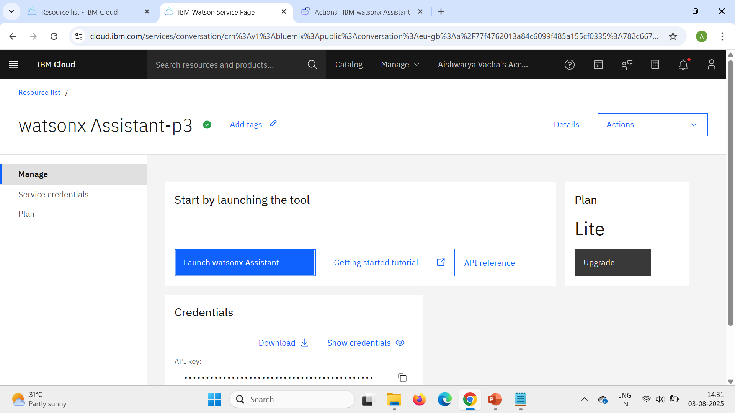
RESULT

Slide 15
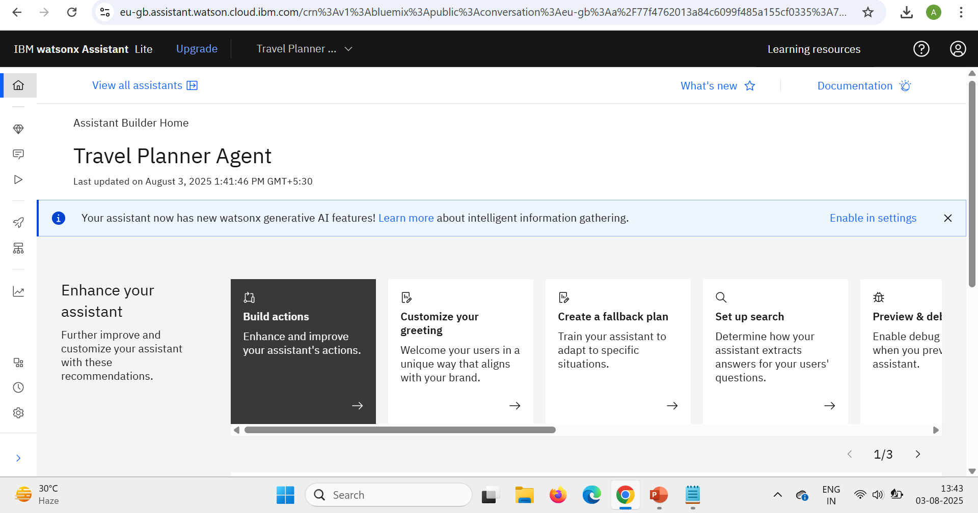

Slide 16
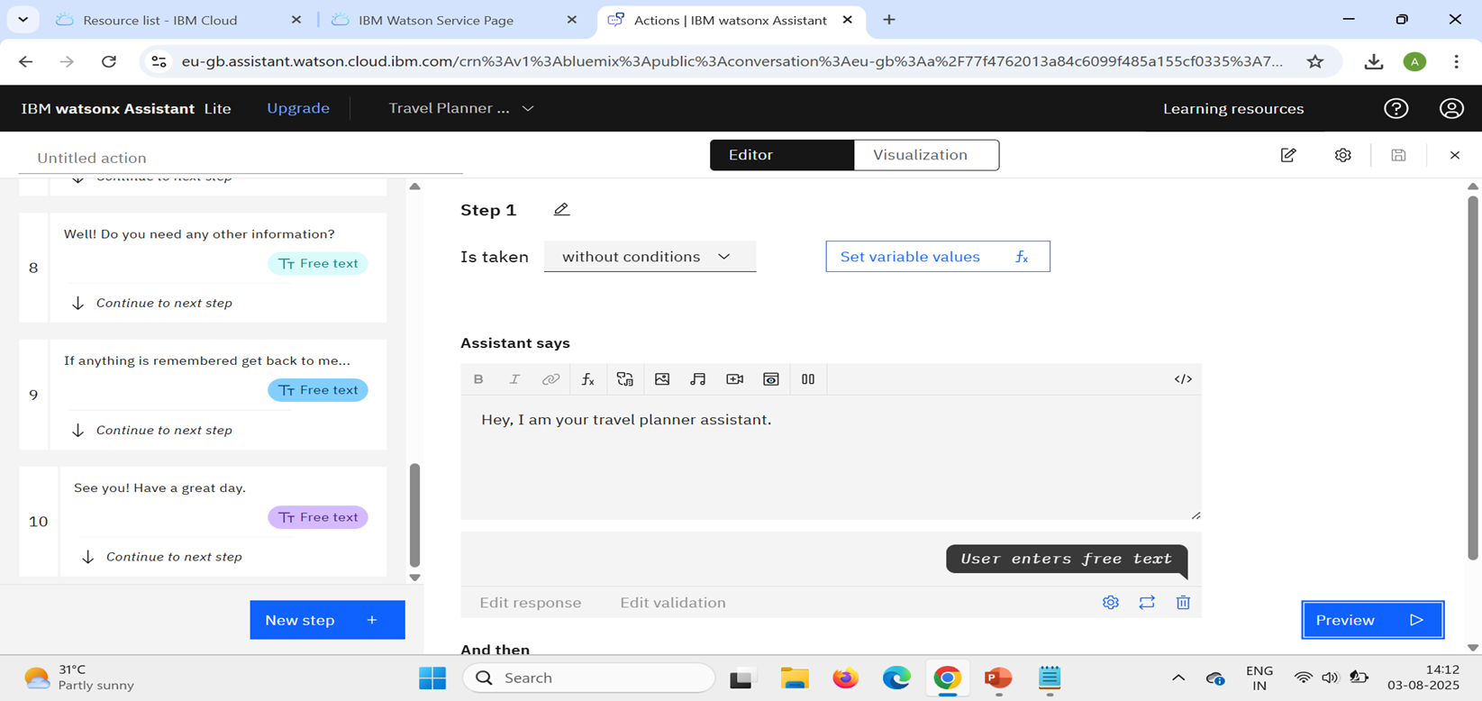

Slide 17
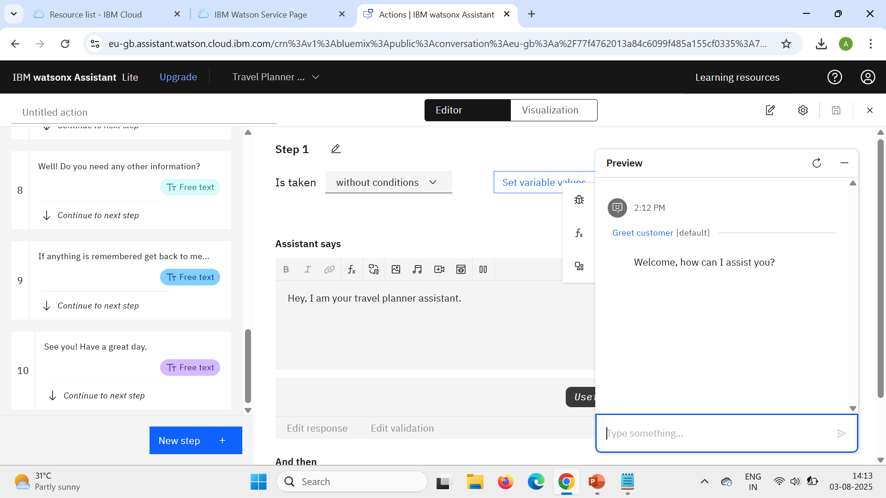

Slide 18
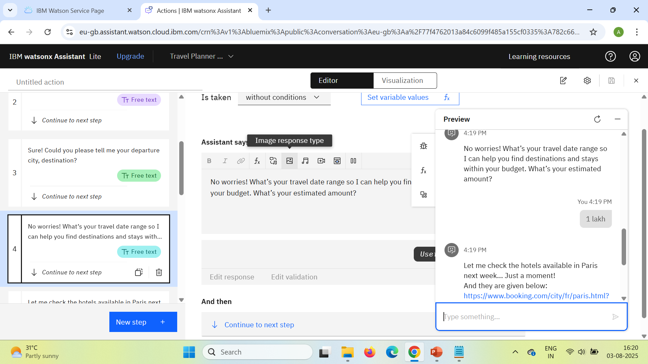

Slide 19
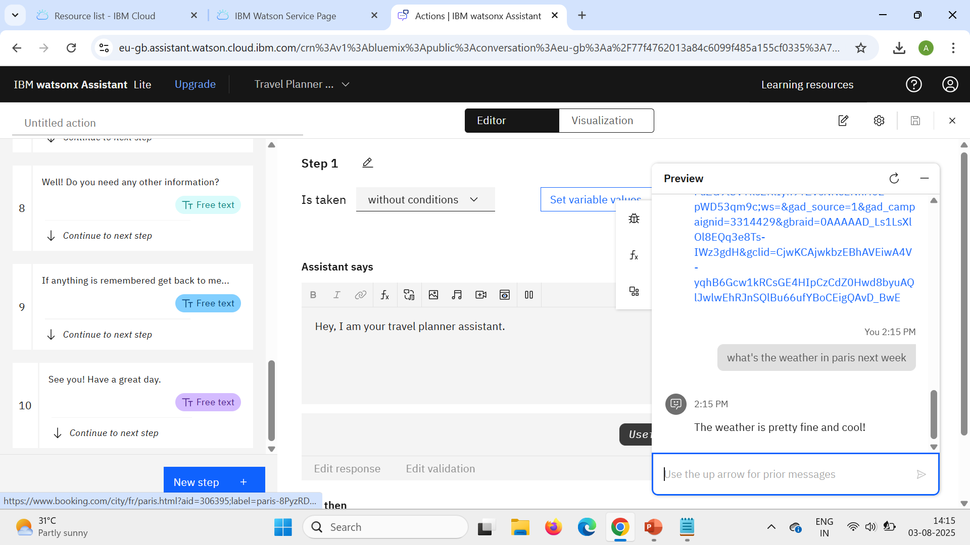

Slide 20
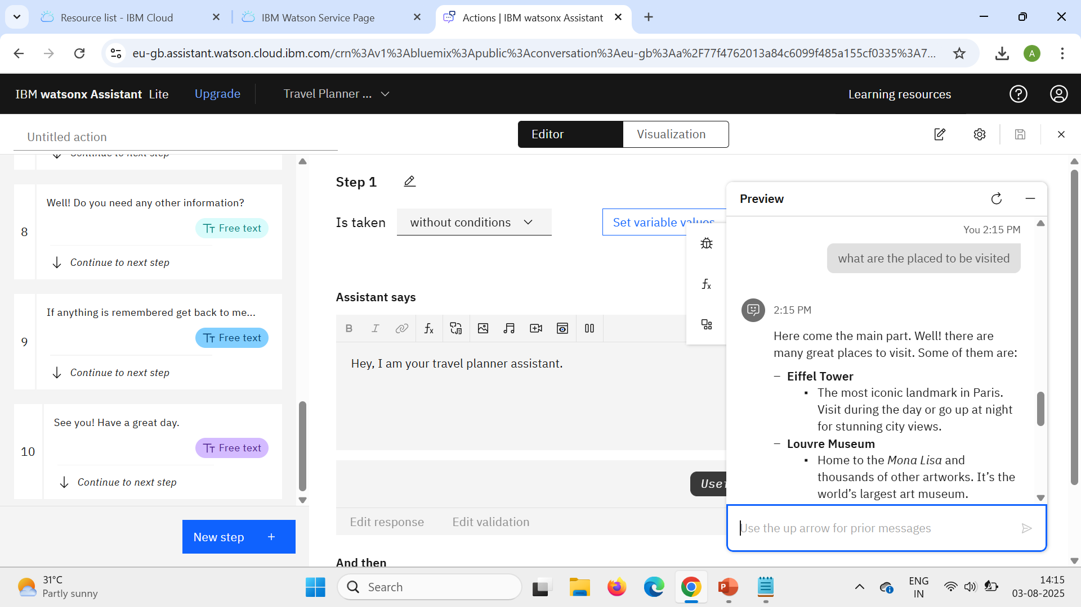

Slide 21
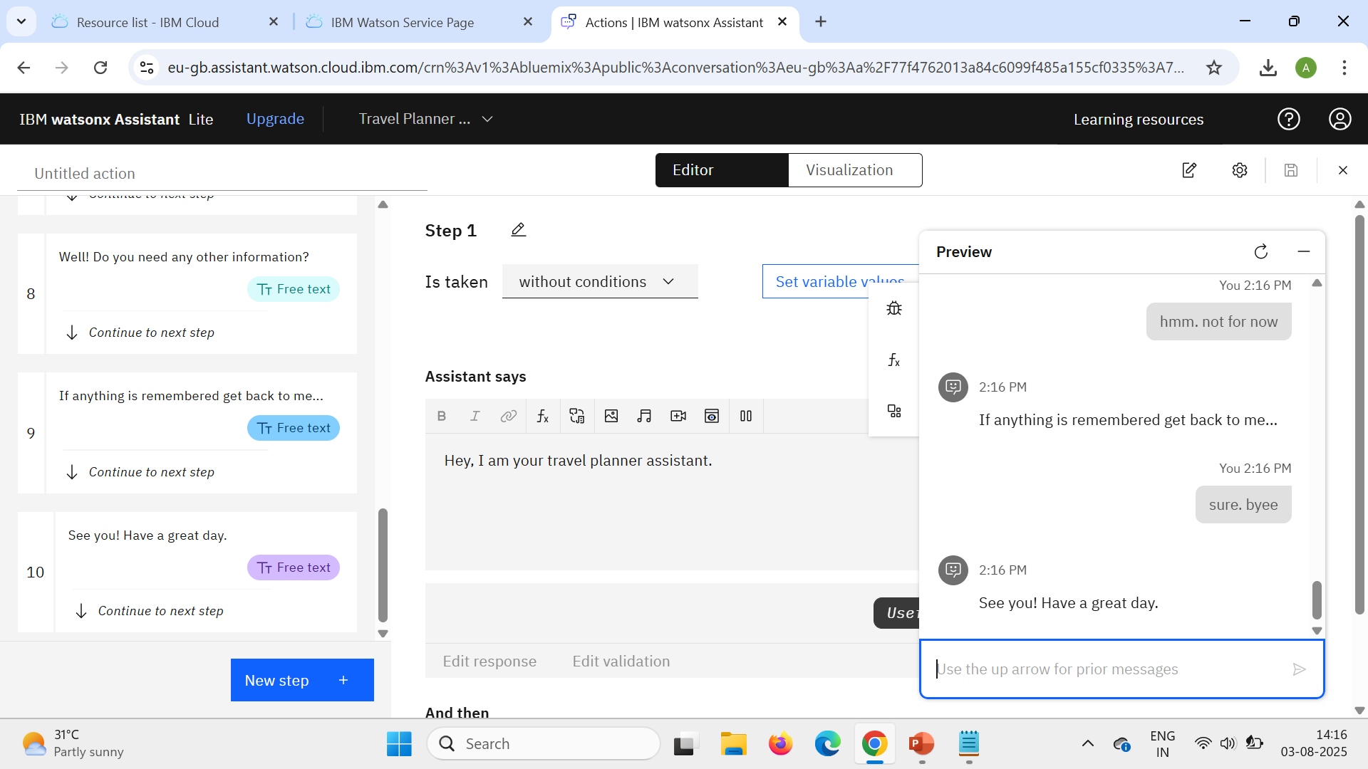

Slide 22
ConclusioN
The Travel Planner Agent, developed using IBM Watsonx Assistant and IBM Cloud services, successfully demonstrates how AI-powered conversational interfaces can simplify and enhance the travel planning experience.
By integrating natural language understanding, real-time data access, and user preference tracking, the assistant offers personalized, accurate, and efficient support for travelers.
This project showcases the effective use of Watsonx Assistant for intent recognition and dialog management, IBM Cloud Functions for backend logic and API integration, and IBM Cloudant for dynamic data storage.
Optional enhancements like machine learning models and real-time APIs further enrich the agent’s capabilities.
Overall, the system reduces the manual effort typically involved in planning trips and delivers a smart, interactive experience.

Slide 23
Future scope
The Travel Planner Agent presents a strong foundation for AI-driven travel assistance, and several enhancements can be incorporated to expand its functionality and user experience in the future:
Integration with Booking Platforms: Enable direct booking of flights, hotels, and transport by integrating with real-world platforms like Skyscanner, Booking.com, or MakeMyTrip through their APIs.
Voice and Multilingual Support: Extend the assistant with speech-to-text and text-to-speech capabilities using IBM Watson Speech Services. Add multilingual support to serve users in regional or international languages, improving accessibility.
Smart Itinerary Generation: Implement AI-based itinerary generation based on user interests, trip duration, and real-time conditions. The assistant could dynamically build and modify plans based on weather or events.
.

Slide 24
Personalized Recommendations via Machine Learning: Use collaborative filtering or clustering algorithms to recommend destinations and activities based on past preferences, search history, or similar traveler profiles.
Integration with Travel Insurance & Visa Services: Offer assistance in acquiring travel insurance, understanding visa requirements, and generating checklists based on the chosen country.
Offline Access or Mobile App Support: Package the assistant into a mobile app with offline planning features or cached data for users with limited connectivity during travel.
Emergency Assistance Feature: Include a support module for emergency contact details, nearby embassies, hospitals, and local help services based on user location.

Slide 25
References
IBM Watsonx.ai Documentation https://www.ibm.com/cloud/watsonx-ai – Official documentation for using IBM Watsonx.ai and Granite LLMs for AI-powered applications.
IBM Cloud Functions (OpenWhisk) Documentation https://cloud.ibm.com/docs/openwhisk Serverless platform used for backend logic and external API calls.
IBM Cloudant Documentation https://cloud.ibm.com/docs/cloudant NoSQL database used to store user preferences and search history.
OpenWeatherMap API https://openweathermap.org/api Used for retrieving real-time weather data for travel destinations.
Amadeus for Developers – Travel APIs https://developers.amadeus.com/ Offers APIs for flight booking, hotel offers, location search, and more.

Slide 26
IBM Certifications
Getting Started with Artificial Intelligence

Slide 27
IBM Certifications
Journey to Cloud: Envisioning Your Solution

Slide 28
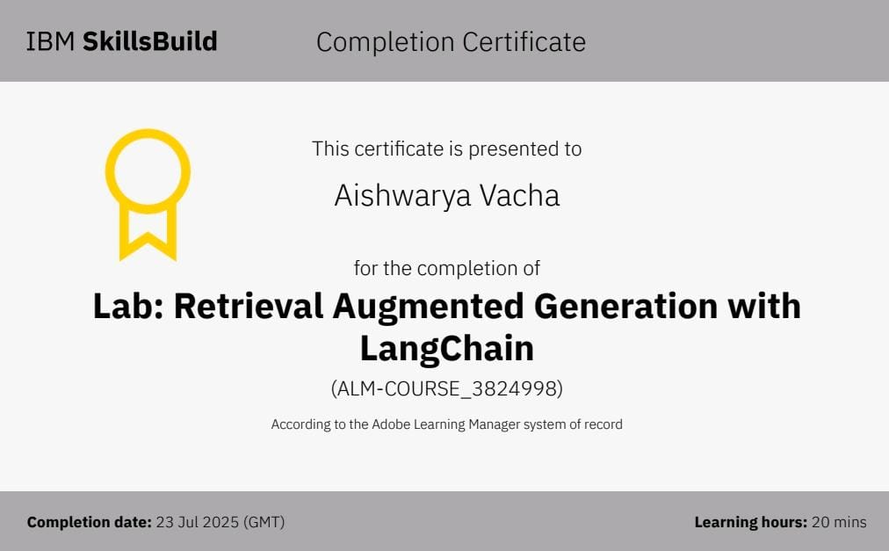
IBM Certifications
Lab: Retrieval Augmented Generation with LangChain

Slide 29
THANK YOU

