Slide 1
REVENUE PREDICTION

Slide 2
Agenda
1
Problem Statement
2
Hypothesis
3
EDA
4
Feature Engineering
5
Model Selection and Model Training
6
Hyper parameter Tuning and Model Evaluation

Slide 3
Problem Statement
The client is facing difficulties in accurately predicting future revenue, which is crucial for effective strategic planning, budgeting, and resource management. Current revenue forecasting methods are limited to basic historical trends and do not incorporate dynamic variables such as customer behaviour, market conditions, and economic changes. This leads to unreliable revenue predictions, impacting decision-making processes and overall business performance. The client needs a more advanced predictive model that can accurately forecast revenue by analysing a wide range of data inputs, enabling better financial planning and strategy formulation.

Slide 4
Agenda
1
Problem Statement
2
Hypothesis
3
EDA
4
Feature Engineering
5
Model Selection and Model Training
6
Hyper parameter Tuning and Model Evaluation

Slide 5
Hypothesis
There's a positive correlation between the customer's total seat count and the Revenue generated.
Longer tenure Customers will have significant impact on the Revenue generated.
High Severity Outages negatively impacts the Customer Satisfaction score, which in turn negatively impacts the Customer Revenue.
Higher Customer satisfaction scores are associated with higher Customer Revenue.
Higher Product Tiers will generate significantly higher Revenue than that of the Lower Product Tiers.
Revenue Across different geographic areas vary differently, reflecting varying market maturity.

Slide 6
Hypothesis
Different Customer segment will have varying Revenue generation, with larger scale business generating more revenue than small and midsize business.
Revenue vary across various industry verticals, revealing which sector drives for the most value.
Customers using more products will generate more revenue.
Customers with less Billing issues will generate more revenue than Customers with more billing issues.
A higher number of provisions in the past is associated with an increase in future revenue.

Slide 7
Agenda
1
Problem Statement
2
Hypothesis
3
EDA
4
Feature Engineering
5
Model Selection and Model Training
6
Hyper parameter Tuning and Model Evaluation

Slide 8
EDA
Datasets given:
Customer Dataset - Tracks customer demographics and operational metrics to analyze base characteristics and engagement patterns.
Customer Feedback Dataset - Measures customer satisfaction outage impact, and support interactions to quantify experience health and its correlation with revenue outcomes.
Expansion Outcome Dataset - Captures current and projected revenue (ARR) with breakdowns of growth drivers to model expansion potential and risks.
Product Dataset - Details product-tier adoption discounting strategies, and usage rates to assess pricing effectiveness and feature demand.
Utilization Dataset - Monitors seat/agent utilization trends and provisioning history to identify capacity inefficiencies or expansion opportunities.
Data Preparation
Handling Null Values.
Formatting Data to a standard format.
Merging the various datasets into single dataset for effective Training.

Slide 9
Agenda
1
Problem Statement
2
Hypothesis
3
EDA
4
Feature Engineering
5
Model Selection and Model Training
6
Hyper parameter Tuning and Model Evaluation

Slide 10
FEATURE ENGINEERING
FEATURE CREATION AND BUCKETING
Long-Term Customer: A binary feature indicating whether a customer has been active for longer than the median customer age in quarters.
High CSAT Score: A binary feature that identifies customers with a CSAT score above the median, indicating high satisfaction levels.
High Product Usage: A binary feature that flags customers using more products than the median, representing higher engagement.
Ticket Volume Bucketing: The max_tickets_per_agent column is categorized into five ranges (0-5k, 5k-10k, 10k-15k, 15k-20k, 20k+), allowing analysis of ticket workload impact.
Seat Utilization Bucketing: The max_seats column is binned into five groups (0-100, 100-200, 200-300, 300-400, 400-500) to assess how seat allocation relates to future ARR.
FEATURE SELECTION
We are selecting key features to predict Future ARR (Annual Recurring Revenue).
The dataset includes attributes such as maximum seats, CSAT score, customer segment, and region.
The dataset was split into 80% training data and 20% testing data to ensure a balanced evaluation.

Slide 11
Agenda
1
Problem Statement
2
Hypothesis
3
EDA
4
Feature Engineering
5
Model Selection and Model Training
6
Hyper parameter Tuning and Model Evaluation

Slide 12
MODEL SELECTION AND TRAINING
Models Selection
Linear Regression – Simple and interpretable.
Decision Tree Regressor – Captures nonlinear relationships.
Random Forest Regressor – Handles high-dimensional data well.
Model Training
Linear Regression Model
We are using Linear Regression to predict Future ARR. The model is trained using the fit() method on the training dataset.
Decision Tree Model
We use a Decision Tree Regressor with a maximum depth of 5 to prevent overfitting.
Random Forest Model
on_estimators=100 → Uses 100 decision trees for robust predictions.
max_depth=10 → Limits tree depth to prevent overfitting.

Slide 13
Agenda
1
Problem Statement
2
Hypothesis
3
EDA
4
Feature Engineering
5
Model Selection and Model Training
6
Hyper parameter Tuning and Model Evaluation

Slide 14
HYPERPARAMETER TUNING AND MODEL EVALUATION
Model Evaluation
Error Metrics
To measure the accuracy of our predictions, we compute the following metrics:
Mean Squared Error (MSE): Measures the average squared difference between actual and predicted values. Lower values indicate better performance.
Root Mean Squared Error (RMSE): A more interpretable version of MSE, as it is in the same unit as the target variable.
Mean Absolute Error (MAE): Measures the average absolute difference between actual and predicted values, making it easy to interpret.
Model Performance Interpretation
R² Score: Indicates the proportion of variance in future_arr explained by the model.
Adjusted R² Score: Adjusts R² for the number of predictors to avoid overfitting.
Key Insights
Low RMSE & MAE: Indicates the model makes accurate predictions.
High R² & Adjusted R²: Shows the model explains most revenue variations.

Slide 15
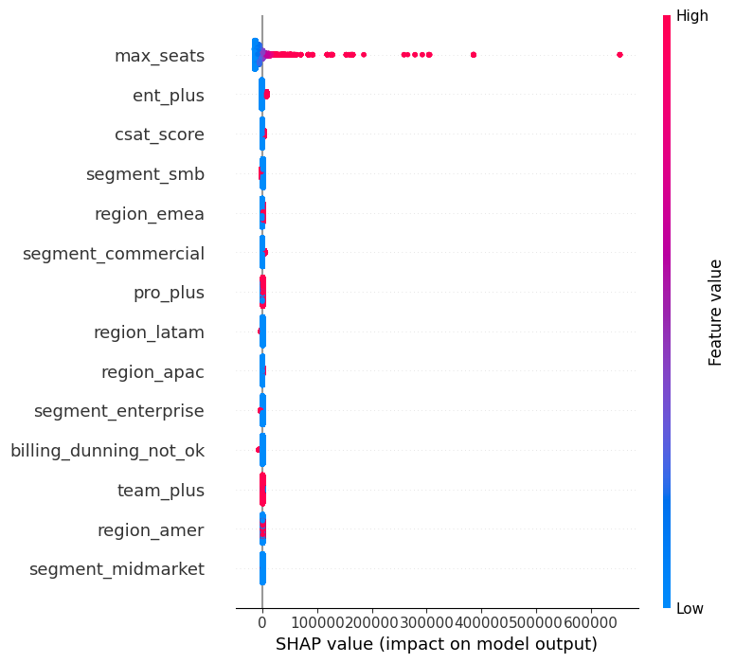
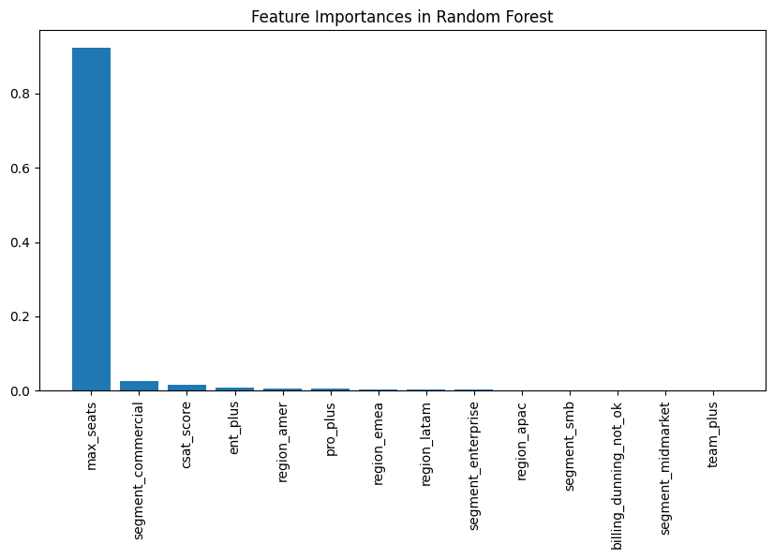
HYPERPARAMETER TUNING AND MODEL EVALUATION

