Slide 1


MAHARAJA INSTITUTE OF TECHNOLOGY MYSORE BELAWADI, NAGUVANAHALLY POST, S.R. PATNA TALUK, MANDYA
DISTRICT-571477
“Decentralized File Storage System using
Blockchain Technology”
Presented by:
Aishwarya D 4MH22CD003
Aishwarya H.D 4MH22CD004
Meghana A.S 4MH22CD026
Sahana S R 4MH22CD051
Under the Guidance of
Prof SHALINI M.C

Slide 2
ABSTRACT
Large amounts of data are stored on cloud platforms like Google Drive and OneDrive.
These platforms use centralized storage.
Server failure or attacks can affect data access and privacy.
This project proposes a Decentralized File Storage System using Blockchain.
The system ensures secure, transparent, and reliable data storage.

Slide 3
INTRODUCTION
Cloud storage systems are commonly used for storing and sharing digital information.
Centralized storage models depend on a single server, making them vulnerable to failures and security threats.
Blockchain technology provides a decentralized and tamper-proof environment for data storage.
By distributing data across multiple nodes, blockchain improves security and reliability.
This project applies blockchain technology to create a decentralized file storage solution.

Slide 4
PROBLEM STATEMENT
Current cloud storage solutions such as Google Drive and OneDrive rely on centralized servers.
Centralized architecture creates a single point of failure, making systems vulnerable to cyberattacks.
These systems face increased risks of data hacking and unauthorized access.
Users may also experience loss of data control and privacy.
Recovery from data loss or cyberattacks in centralized systems can be time-consuming and costly.

Slide 5
OBJECTIVES
To analyze the limitations of centralized file storage systems.
To design a decentralized file storage system using blockchain technology.
To enhance data security and privacy.
To eliminate single point of failure.
To ensure data availability even when a node fails.

Slide 6
LITERATURE SURVEY
1. Juan Benet (2014) – Inter Planetary File System (IPFS)
Title: IPFS – Content Addressed, Versioned, Peer-to-Peer File System
Contribution
Introduced IPFS, a decentralized peer-to-peer file storage system.
Files are identified using a Content Identifier (CID) generated by hashing file content.
Files are split and distributed across multiple nodes.
Improves availability, fault tolerance, and storage efficiency.
Limitation
Availability depends on the number of active nodes.
Requires incentive mechanisms for long-term file persistence.

Slide 7
2. Gavin Wood (2015) – Ethereum and Smart Contracts
Title: Ethereum: A Secure Decentralized Generalized Transaction Ledger
Contribution
Introduced Ethereum, a programmable blockchain platform.
Enabled execution of smart contracts, which are self-executing programs.
Allowed development of decentralized applications (DApps).
Provided fine-grained control over transactions and permissions.
Limitation
Transaction fees (gas costs) can be high.
Scalability issues during network congestion.

Slide 8
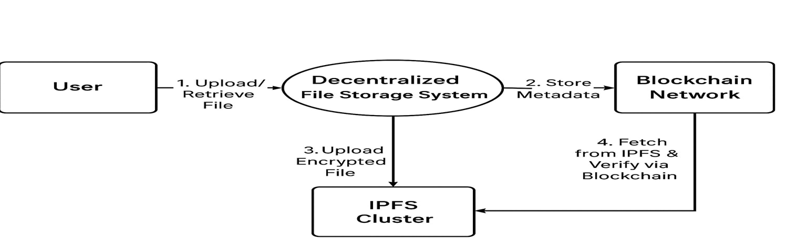
PROPOSED SYSTEM
We propose a decentralized file storage system combining IPFS and blockchain for secure, immutable data handling.
Users interact via a React.js frontend, with MetaMask for authentication.
Files are encrypted, stored in IPFS, and their hashes, along with metadata, are saved on the blockchain using Solidity smart contracts.

Slide 9
TECHNOLOGIES USED
Blockchain
Provides decentralized, tamper-proof data storage.
Ensures transparency and data integrity.
Ethereum
Blockchain platform used to deploy smart contracts.
Manages file ownership and access control.
Smart Contracts
Self-executing programs on Ethereum.
Control file access and permissions automatically.
Database: MongoDB
Stores user details and file metadata.

Slide 10
IPFS (InterPlanetary File System)
Decentralized peer-to-peer file storage.
Stores encrypted files and generates CID.
AES-256 Encryption
Encrypts files before storage.
Ensures data confidentiality.
Backend: Python (Flask)
Handles encryption, IPFS and blockchain interaction.
Acts as a bridge between frontend and backend services.
Frontend HTML, CSS, JavaScript.
User interface for file upload and download.

Slide 11
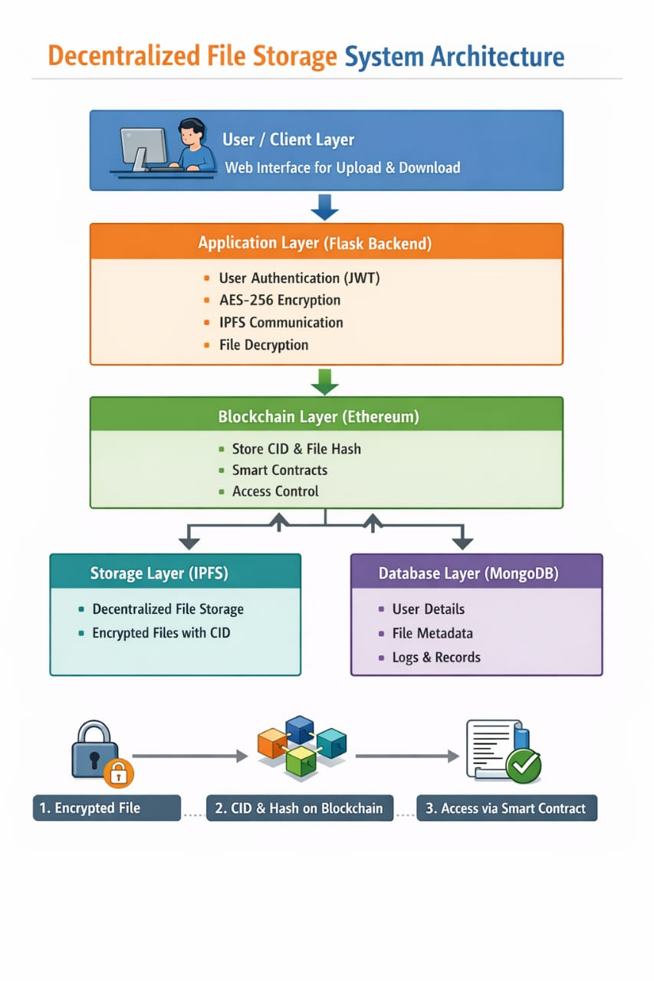
SYSTEM ARCHITECTURE
User / Client Layer
Web interface for user interaction.
Uploads and downloads files.
Application Layer
Handles authentication
Encrypts and decrypts files
Communicates with IPFS and blockchain
Blockchain Layer (Ethereum)
Stores CID, file hash, owner details
Uses smart contracts for verify user access

Slide 12
Storage Layer (IPFS)
Stores encrypted files in decentralized nodes.
This provides decentralized storage with no single point of failure.
Database Layer (MongoDB)
Stores user information and metadata.
Maintains logs and file records.
Architecture Flow
User uploads file→File is encrypted→ Stored in IPFS.
CID and file details→ Stored on Blockchain.
Access verification→ Done via Smart Contracts.

Slide 13
SYSTEM WORK FLOW
First the user logs into our web application.
When the user upload a file, our system first encrypts the file using AES-256 encryption.
AES-256 is a highly secure encryption standard that uses a 256-bit key to scramble data. AES makes the data unreadable to anyone else.
The encrypted file is then uploaded to IPFS.
IPFS stores the fragmented pieces in different nodes and returns the CID, which we record in the blockchain.
Later, when the user wants to retrieve the file, they simply enter the CID. The system collects the file from IPFS, decrypts it and returns it safely.

Slide 14
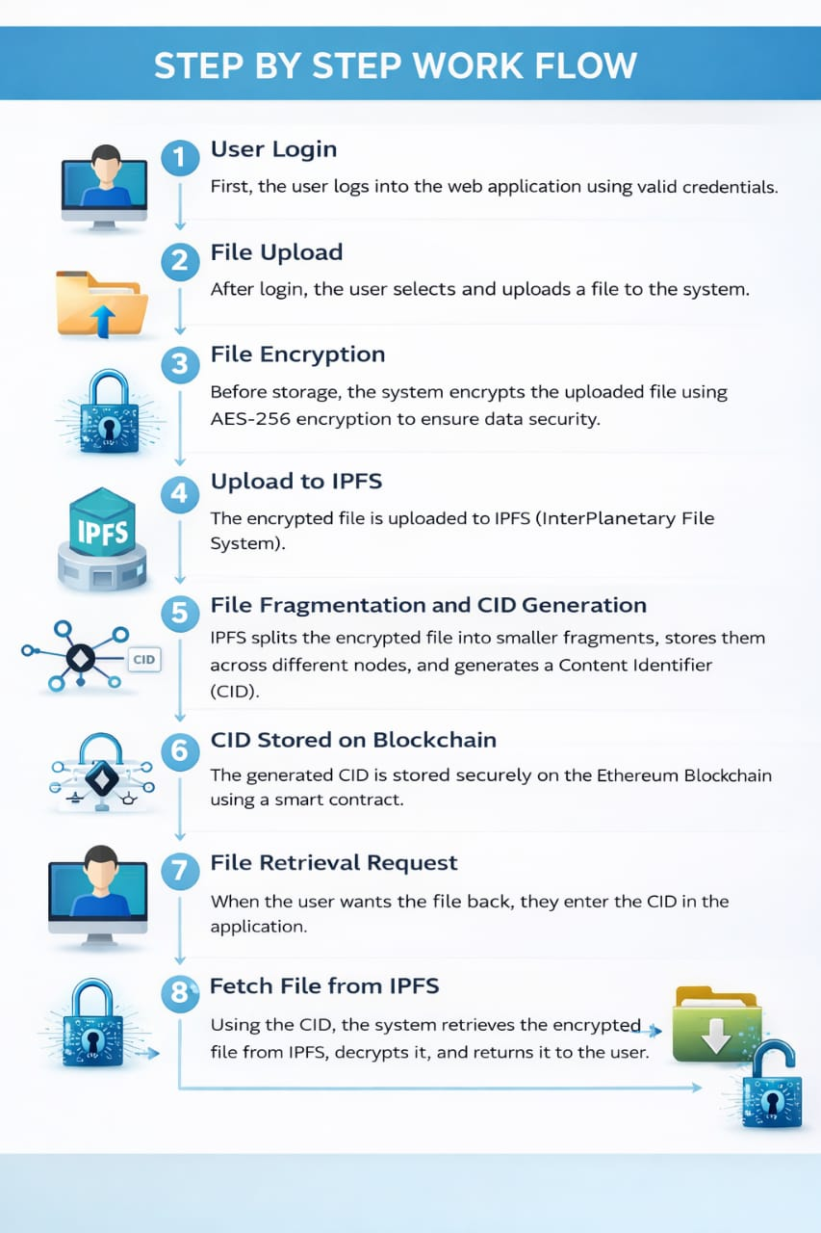

Slide 15
Advantages
It provides strong security using encryption and blockchain.
There is no single point of failure.
User has full control over data and high security.
It is transparent and ensure full data privacy and ownership for the user.
It is also more cost-effective and scalable compared to centralized cloud storage.
Application
Government record storage.
Medical data.
Legal documents.
Banking and confidential files where security is extremely important.

Slide 16
CONCLUSION AND FUTURE ENHANCEMENT
Secure, decentralized, and tamper-proof storage achieved.
Blockchain ensures transparency and trust.
IPFS improves availability and reliability.
System outperforms centralized storage in security aspects.
Integration with Layer-2 blockchain networks to reduce transaction cost.
Implementation of Zero-Knowledge Proofs (ZKPs) for privacy.
Mobile app for file management.
Integration with AI-based monitoring for detecting abnormal access behavior.

Slide 17
TEAM CONTRIBUTION
Aishwarya D (4MH22CD003) – Abstract, Introduction, Problem Statement, Objectives
Meghana A.S (4MH22CD026) – Proposed System, Technologies Used
Aishwarya H.D (4MH22CD004) – System Architecture, System Work Flow, Advantages
Sahana S R (4MH22CD051) – Application, Conclusion & Future Enhancement, References

Slide 18
REFERENCES
[1] R. Parameswaran and M. Kavitha, “A blockchain-based decentralized storage model using Filecoin,” Proceedings of the IEEE Conference on Blockchain Technology, 2021.
[2] K. Ramesh and S. Priya, “Secure decentralized cloud storage using Sia,” Elsevier Journal of Cloud Computing, 2022.
[3] A. Sharma and L. Thomas, “Peer-to-peer encrypted storage using Storj,” Springer Journal of Distributed Systems, 2023.
[4] P. Vivek and G. Meenakshi, “Swarm: A decentralized storage system integrated with Ethereum,” Proceedings of the IEEE Conference on Distributed Computing, 2024.
[5] R. Nagaraj and L. Devi, “Comparative analysis of decentralized storage platforms,” Elsevier Journal of Network and Computer Applications, 2024.
[6] R. Karthik and S. Banerjee, “A hybrid blockchain and IPFS-based decentralized storage system,” IEEE Access, 2022.
[7] D. Ananya and R. Gupta, “Enhanced data verification in decentralized storage using Merkle tree optimization,” Springer Nature Journal of Distributed Computing, 2023.

Slide 19
[8] S. Rohit and K. Bhatia, “Privacy-preserving decentralized cloud storage using homomorphic encryption,” Elsevier Journal of Information Security, 2023.
[9] M. Deepa and T. Arjun, “AI-based predictive caching for decentralized storage systems,” IEEE Transactions on Cloud Computing, 2024.
[10] P. Krishna and K. Sandeep, “Lightweight decentralized storage architecture for small organizations,” Elsevier Journal of Information Systems, 2024.
[11] S. Ritika and N. Prakash, “Blockchain-enabled IPFS framework for secure document sharing,” IEEE Xplore, 2023.
[12] B. Mahesh and T. Rekha, “Decentralized file storage optimized for IoT environments,” Elsevier ICT Express, 2022.
[13] J. Aarav and L. Sneha, “Machine learning-based incentive allocation in decentralized storage networks,” Springer AI & Cloud Journal, 2024.
[14] D. Sowmya and P. Rajesh, “Zero-knowledge proof-based secure metadata management in decentralized storage,” IEEE Transactions on Information Forensics and Security, 2023.
[15] G. Harini and V. Kiran, “Cross-chain data migration for decentralized storage platforms,” Elsevier Journal of Computer Networks, 2024.

Slide 20
Thank You!

