Slide 1


Citi bike Analysis
Aishwarya Das| Cognitive Engineer
New York | 04/30

Slide 2
Contents
IBM Engagement 03
Initial Results 04
Stations with Most Stops 04
Trip Duration by User Type 05
Most Popular Trips 06
Rider Performance 07
Busiest Bike 08
Modelling 09
Approach 09
Results 10
Appendix 12

Slide 3
IBM Engagement
New York City Office of the Mayor needed help in understanding the ridership of Citi bike. The office wanted to understand the various trends within the ridership data of 2017 such as
Stations with Most starts
Trip Duration by User type
Most popular trips based on start and stop station
Rider performance by Gender and Age based on Average Trip Distance, Mean speed
Busiest Bike
To further help the Mayor’s office with an initiative, IBM was asked to create a model to predict the travel time when the rider would enter the start and end stations in the kiosk

Slide 4
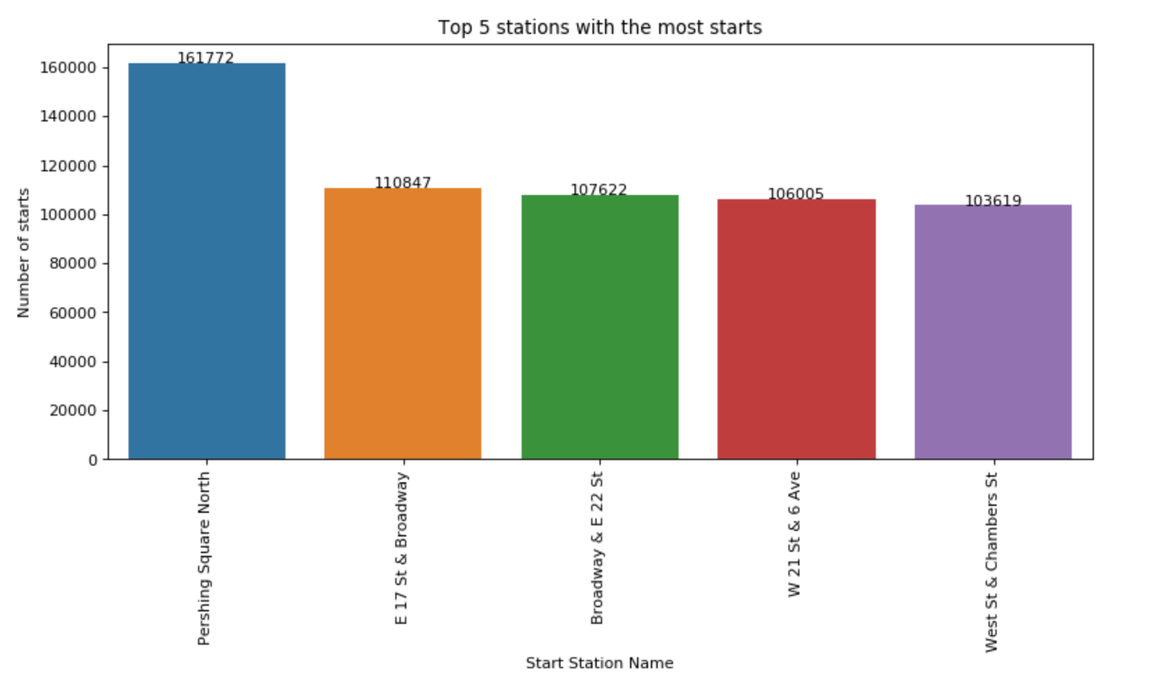
Stations with Most Starts
The majority of trips had started in front of Grand Central at Pershing Square North in 2017
161,772 (1%) trips started at this station
Source : Citi bike Trip History Data ( Jan 2017 – Dec 2017 )

Slide 5
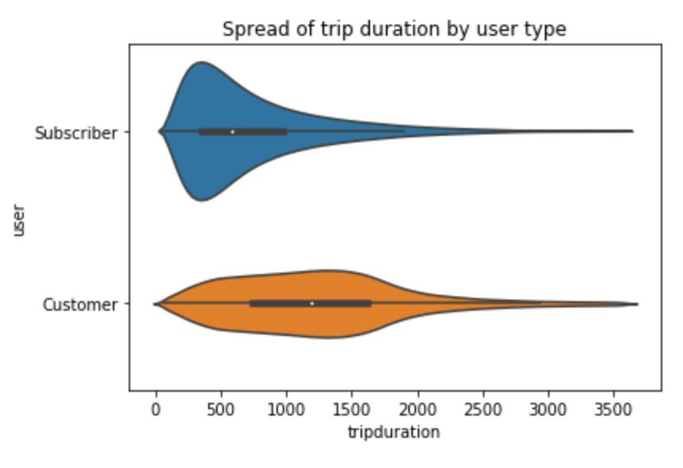
Spread of Trip Duration by User type
Subscribers tend to rides of shorter duration which makes sense as subscribers have monthly or yearly contracts so they tend to use it for specific purpose
Customers tend to have longer duration and use all their preliminary free limit (1800 seconds) and very few go beyond that limit
Source : Citi bike Trip History Data ( Jan 2017 – Dec 2017 )

Slide 6
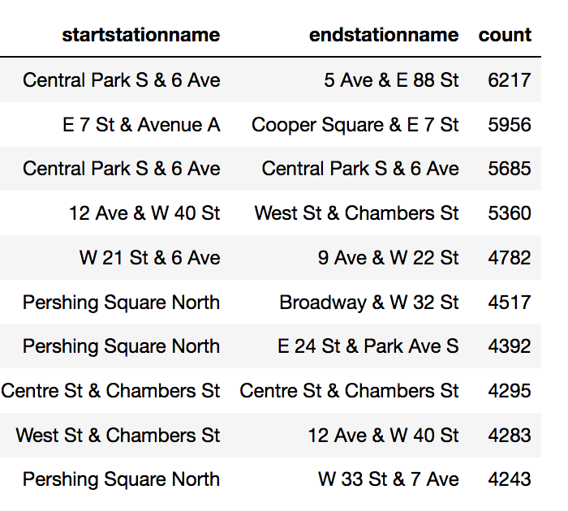
Most Popular Trips
The most popular trip is the one starting at Central Park South and ending at West exit of Central Park
The second most popular trip is around East Village
The third most popular trip is one that starts and ends at Central South
Source : Citi bike Trip History Data ( Jan 2017 – Dec 2017 )

Slide 7
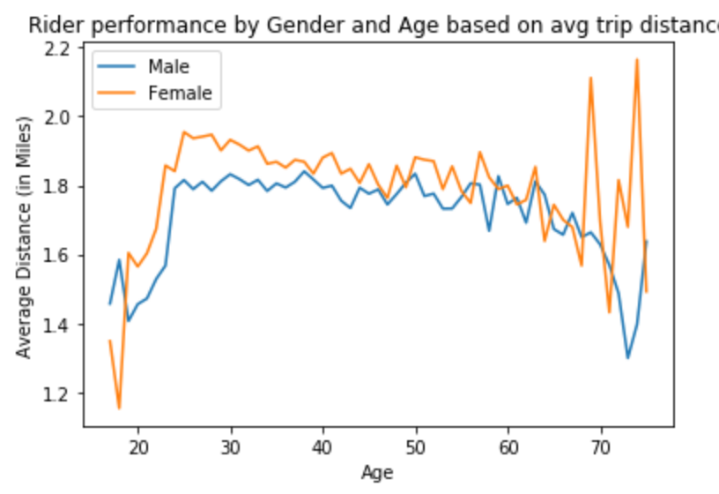
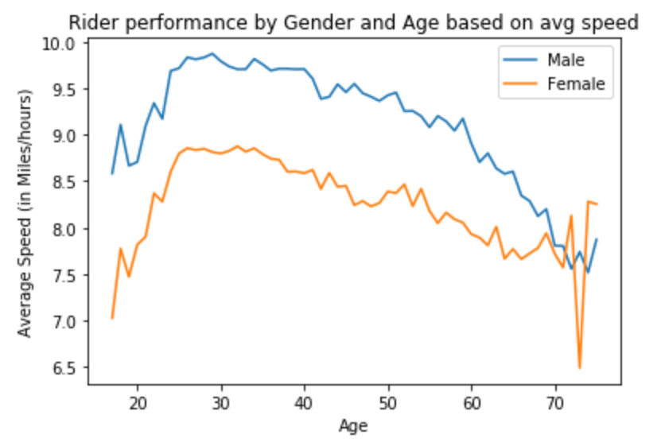
Rider Performance
Females tend to drive for a larger distance as compared to Men.
Men drive faster than Females.
Also younger people (25- 40) tend to drive faster than senior people (40 -70).
Source : Citi bike Trip History Data ( Jan 2017 – Dec 2017 )

Slide 8
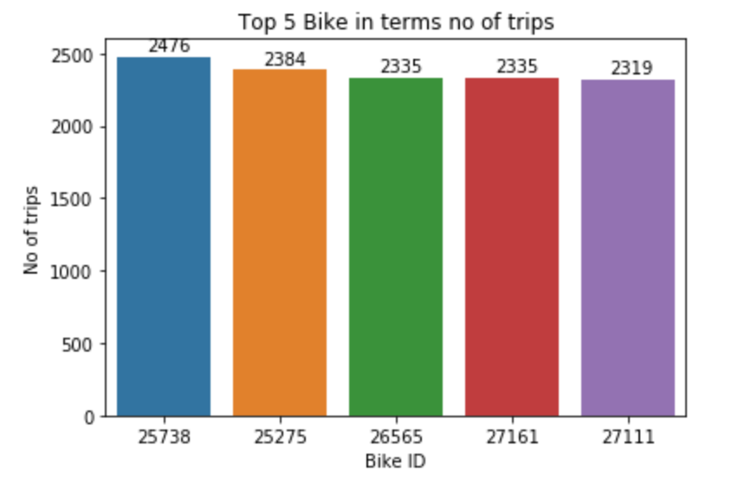
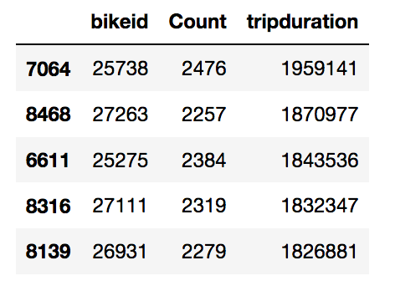
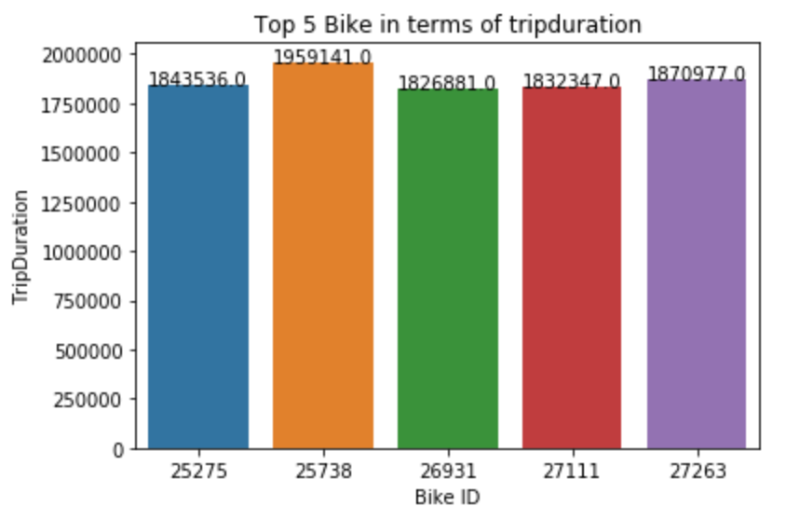
Busiest Bike
The most Busiest bike is with id 25738. It has been used for 2,476 times and it was in motion for 1,959,141 seconds.
Also, it is interesting to find out the if the bike is used for a larger number of times it doesn’t mean that it was in motion for a larger duration.
Source : Citi bike Trip History Data ( Jan 2017 – Dec 2017 )

Slide 9
Modelling - Approach
Data Cleaning is performed to get rid of outliers
Weather data is merged to get weather factors that could potentially influence the trip duration
Some extra features (peak hours, season) were created
Lasso Regression model was used to predict the trip duration (dependent variable) based on other factors like age, gender, temperature, distance, etc (independent variables)
The coefficient of determination (r²) metric is used to evaluate the performance of the model
Two different models were created for subscribers and customers respectively to account for the different ways in which they use Citi bike and also the way the data is captured
Source : Citi bike Trip History Data ( Jan 2017 – Dec 2017 ) and Weather Underground ( Jan 2017 – Dec 2017)

Slide 10
Modelling Result
Subscriber
The model gave a r2 score of 0.903 on the historic data for 2017
The final equation is :
Trip_Duration = 7.9*gender + 3517.6*distance + 16.6*Temp + 7.8*peak + 0.9*Snow - 14.1*Age – 2.5*Rain - 14.6*weekly - 1962.4*avg_speed
Customer
The model gave a r2 score of 0.787 on the historic data for 2017
The final equation is:
Trip_Duration = 433*distance + 20.1*Temp + 45.8*peak + 5.8*Seasonal – 0.2*Humid – 2.5*Rain + 26.2*weekly - 1706*avg_speed
Source : Citi bike Trip History Data ( Jan 2017 – Dec 2017 ) and Weather Underground ( Jan 2017 – Dec 2017)

Slide 12
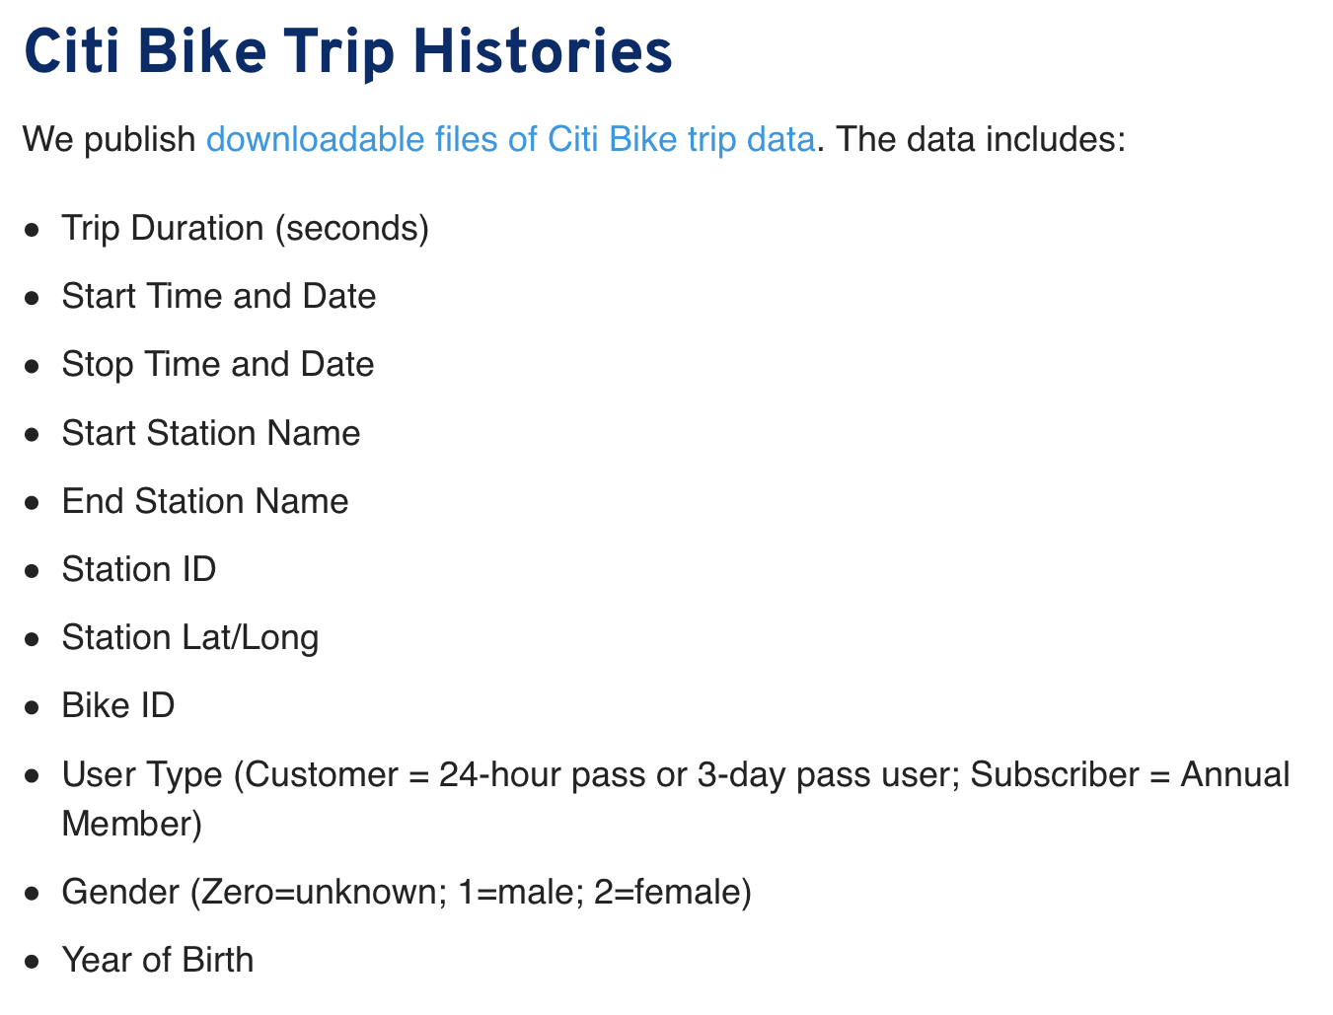





Appendix
Data Dictionary
Tools Used
Data Sources
Source : Citi bike Trip History Data ( Jan 2017 – Dec 2017 )

Slide 13
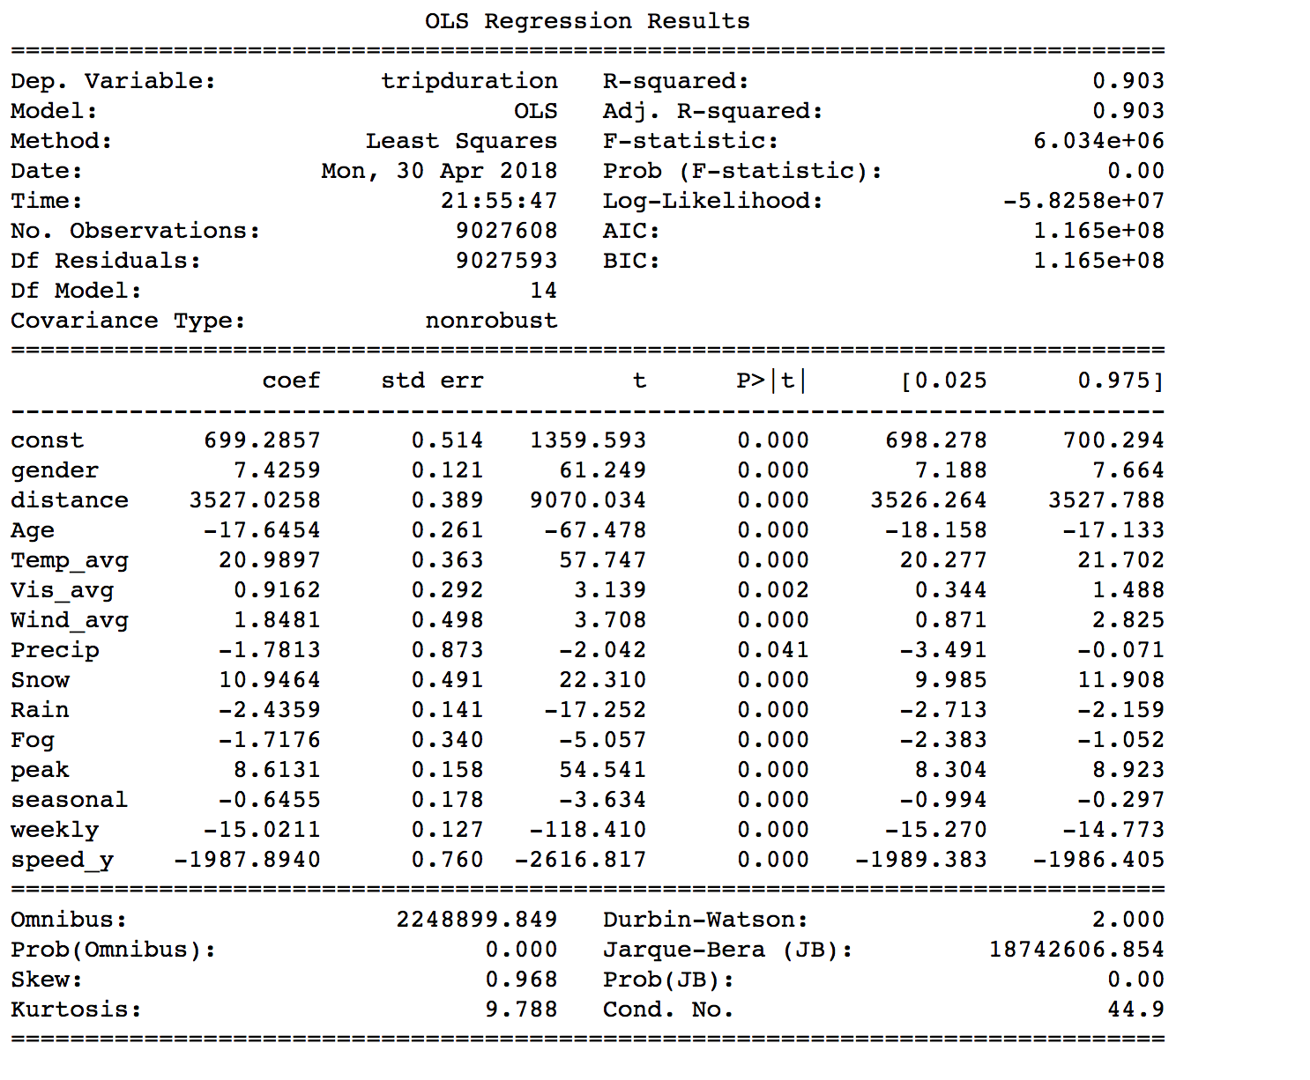
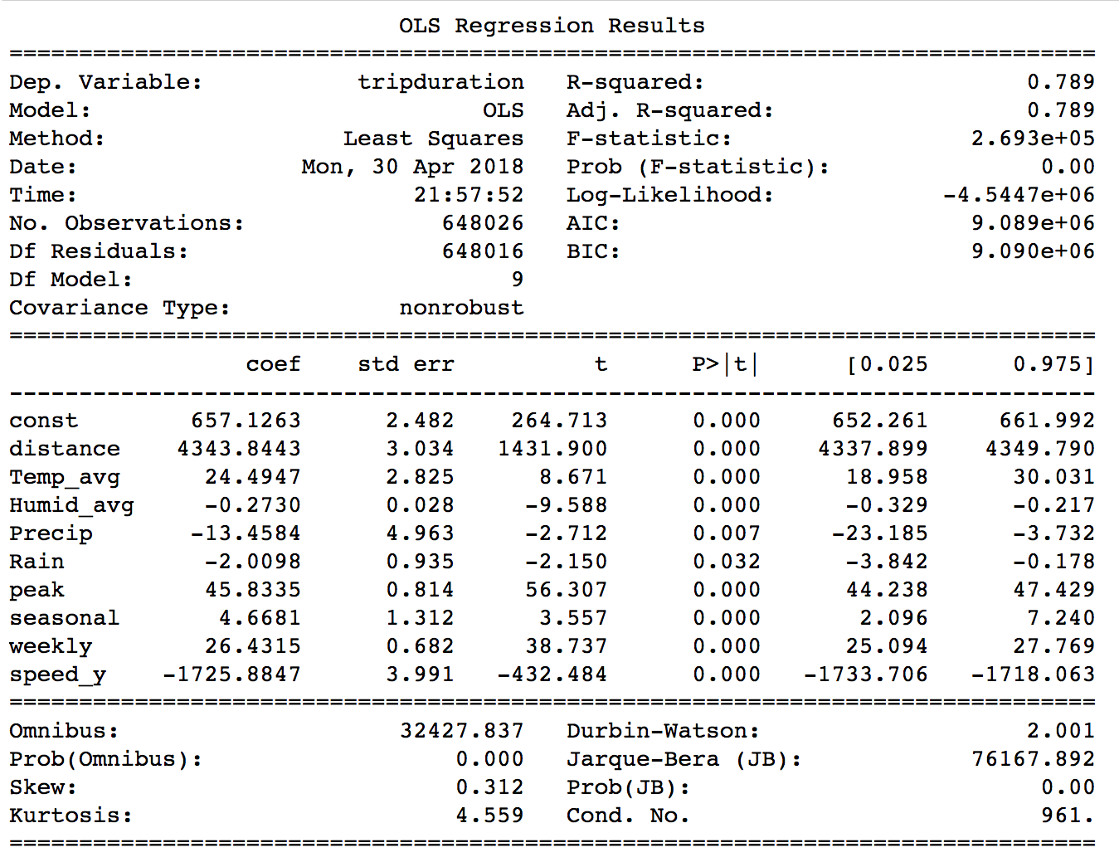
Model Results

