Slide 1
Pneumonia Detection using Convolutional Neural Networks
Deep Learning Project using Chest X-ray Images
By Aishwarya S | April 2025

Slide 2
Project Overview
Objective: Detect pneumonia using chest X-ray images
Approach: Deep Learning (CNN with MobileNetV2)
Deliverable: Web app for real-time pneumonia detection

Slide 3
Dataset Details
Source: Kaggle – Chest X-Ray Images (Pneumonia)
Train: 1,082 Normal / 3,110 Pneumonia
Validation: 267 Normal / 773 Pneumonia
Test: 234 Normal / 390 Pneumonia
Image Size: Resized to 224x224

Slide 4
Model & Tools Used
Model: MobileNetV2 (Transfer Learning)
Libraries: TensorFlow, Keras, Streamlit
Training Setup:
- Loss: Categorical Crossentropy
- Optimizer: Adam
- Epochs: 10
- EarlyStopping applied

Slide 5
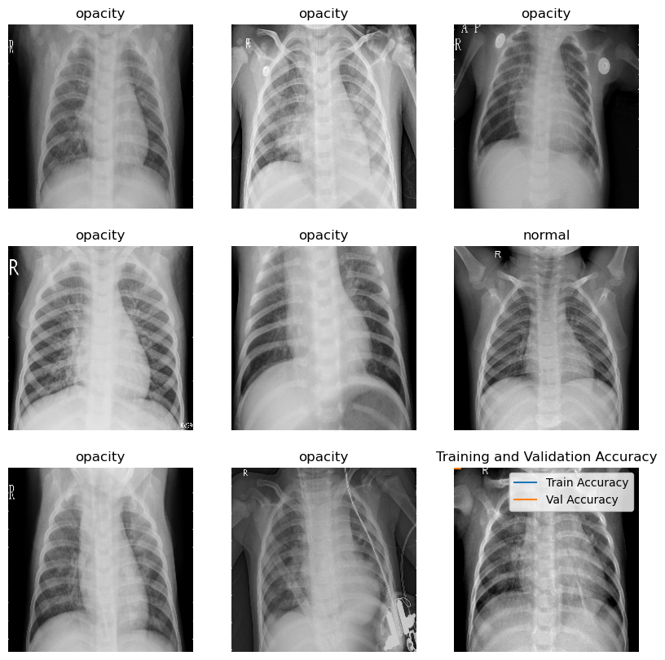
Sample Predictions

Slide 6
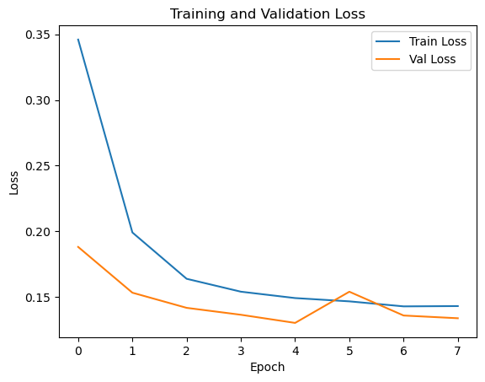
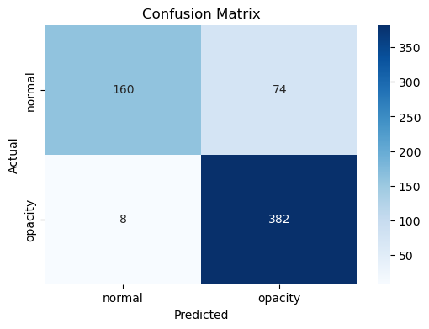
Model Evaluation

Slide 7
Deployment & Future Scope
Deployment: Streamlit web app for local/online usage
Next Steps:
- Grad-CAM visualization
- Flask-based API
- Host on Streamlit Cloud or HuggingFace
- Improve NORMAL class recall

