Slide 1

Unlocking Tourism Potential
Leveraging Data Analytics for Enhanced Traveler Experiences

Slide 2
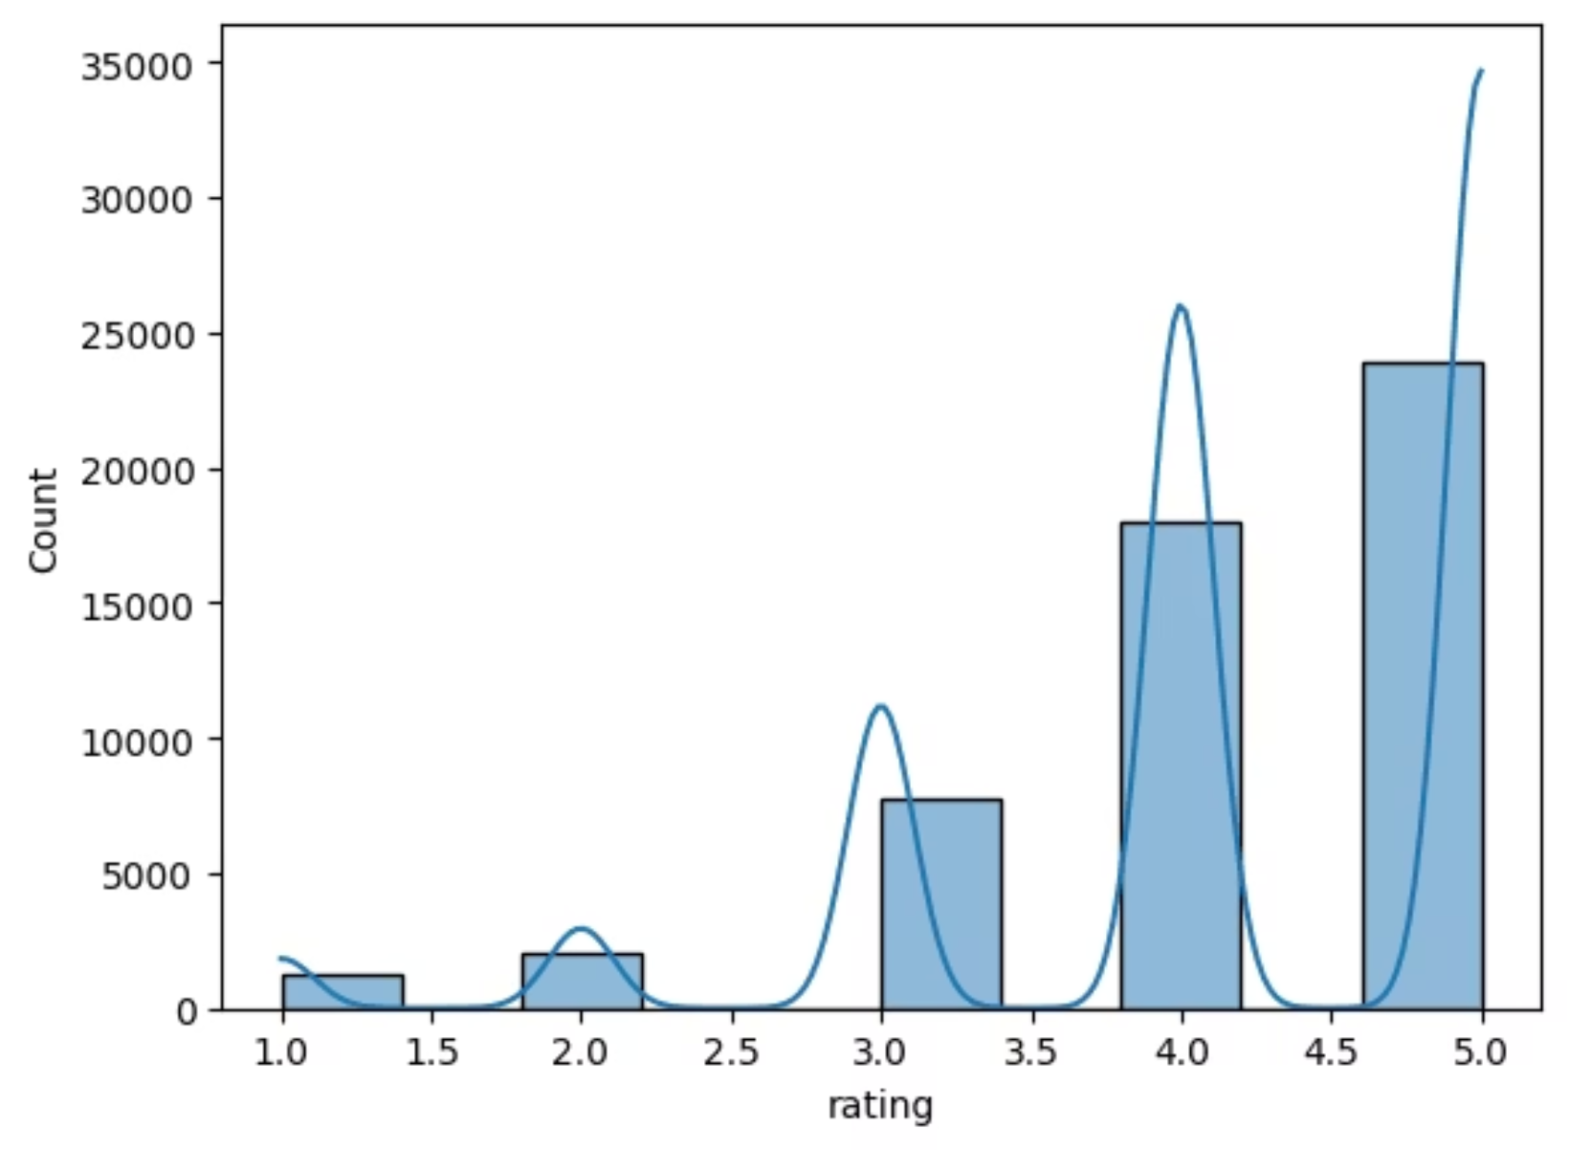
Understanding Traveler Sentiment
Rating the Experience
Our initial exploratory data analysis (EDA) reveals a strong positive trend in tourist ratings. The majority of experiences are rated between 4 and 5 stars, indicating widespread satisfaction. This high satisfaction suggests a robust foundation for tourism growth.
However, the focus now shifts to understanding the nuances behind these high ratings and identifying opportunities to convert high satisfaction into repeat visits and increased spend.

Slide 3
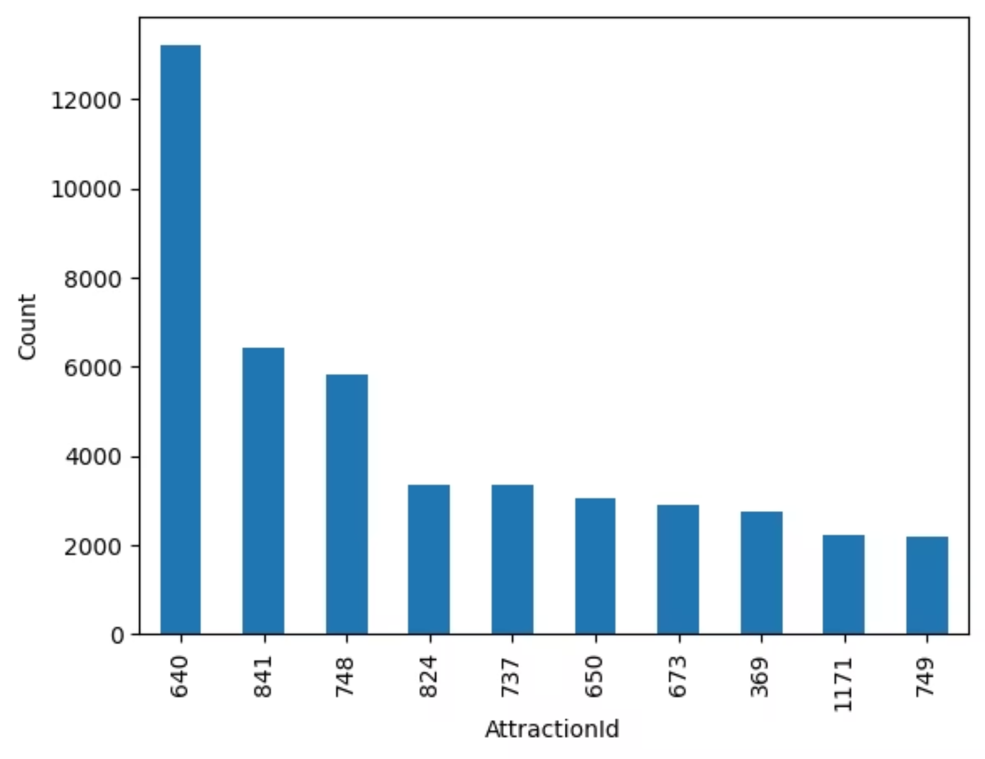
Peak Popularity
Top-Rated Attractions
Analysis of attraction popularity highlights "Attraction ID 640" as a clear outlier, consistently receiving the highest number of ratings. This dominant popularity suggests it serves as a major draw for tourists, likely acting as an anchor destination.
Understanding what makes Attraction 640 so successful can provide valuable insights for other venues. Is it unique offerings, strategic location, or exceptional visitor experience? This data point merits deeper investigation to replicate its success elsewhere.

Slide 4
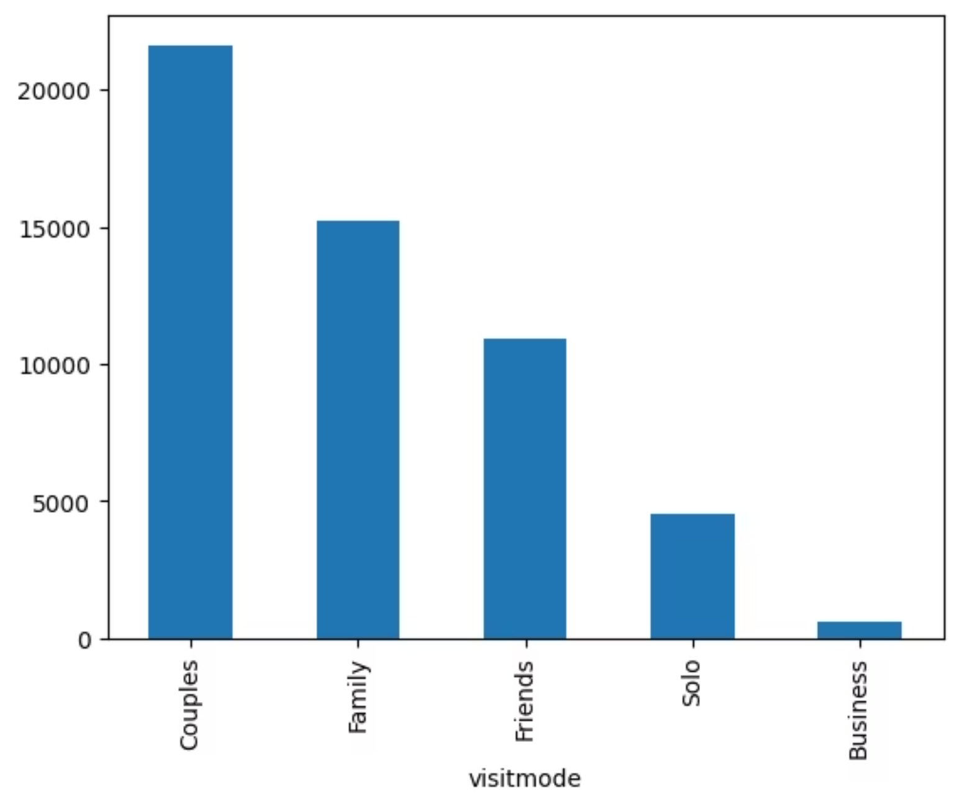
Who's Traveling?
Visit Mode Dynamics
Our analysis shows that couples and families constitute the largest segments of visitors. This insight is crucial for tailoring marketing efforts and developing family-friendly or romantic experience packages.
Conversely, business travel accounts for a minimal share, suggesting a need to explore alternative strategies if this segment is to be targeted. Recognizing these predominant visit modes allows for more precise product development and promotional campaigns.

Slide 5
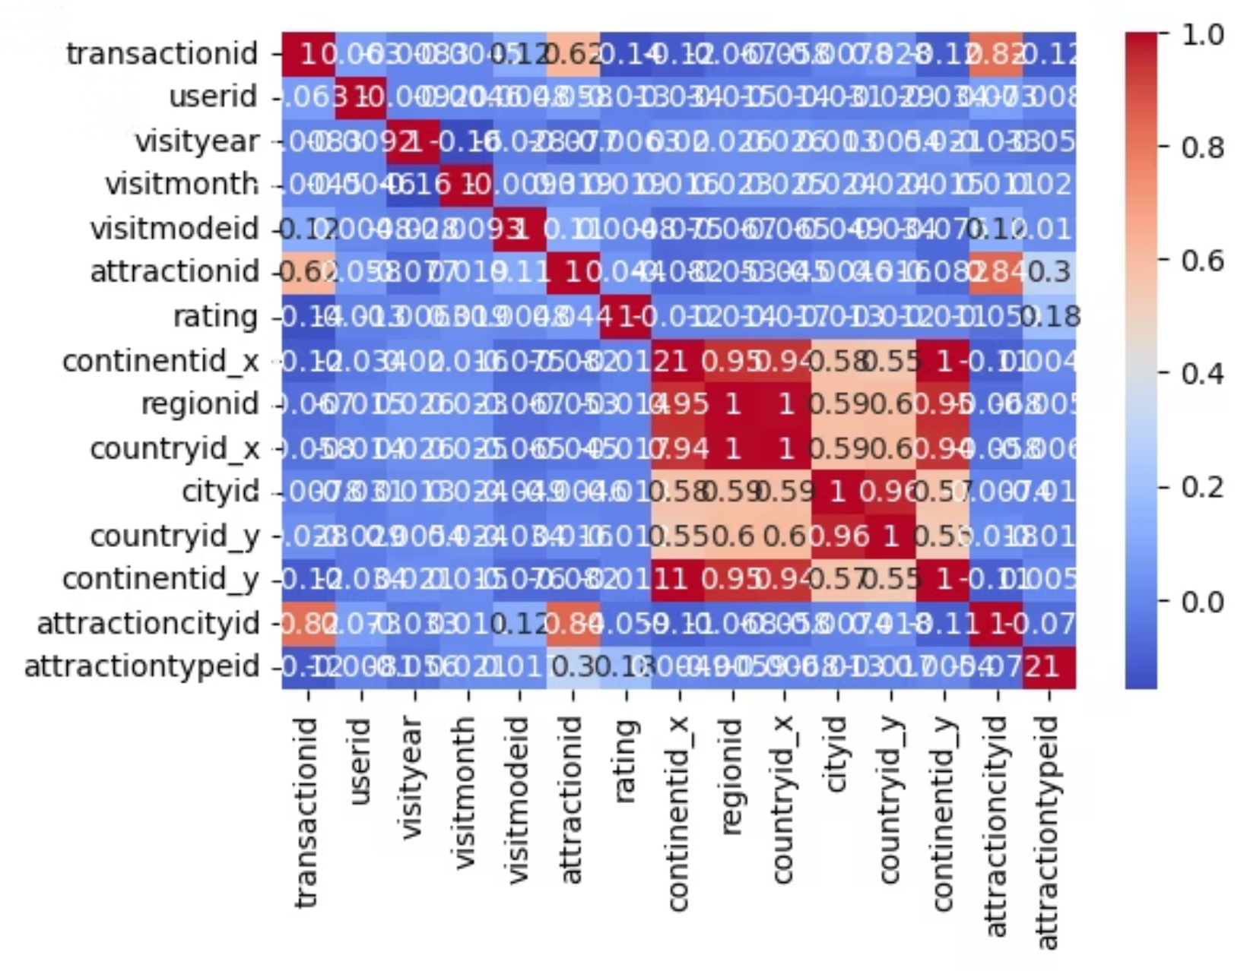
Mapping Relationships
Correlation Insights
The correlation heatmap reveals significant relationships between various data points, particularly strong correlations among specific location IDs. These insights can help identify complementary attractions or common visitor pathways.
Understanding these connections allows for optimized tour planning, bundled offers, and more efficient resource allocation across interconnected sites, ultimately improving the overall visitor journey.

Slide 6
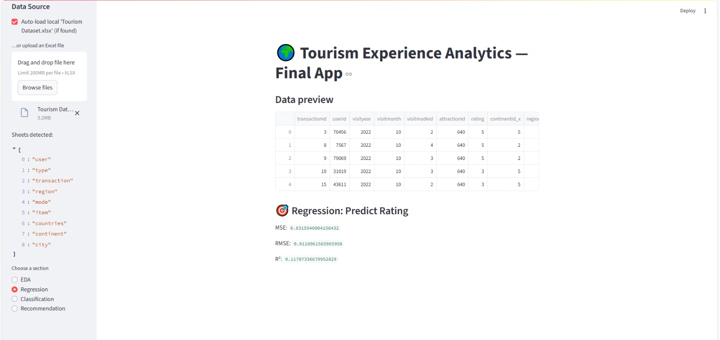
Predicting the Experience
Regression Modeling
Our application incorporates a Random Forest Regression model to predict tourist ratings. This predictive capability enables tourism platforms to anticipate potential satisfaction levels based on various factors, allowing for proactive adjustments.
Key performance metrics, including Mean Squared Error (MSE), Root Mean Squared Error (RMSE), and R², validate the model's accuracy, ensuring reliable predictions that can guide operational decisions and enhance visitor satisfaction.

Slide 7
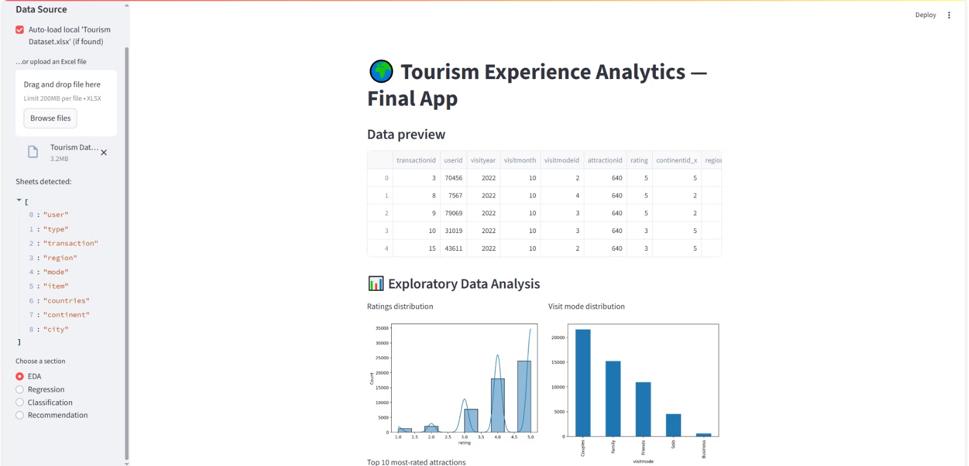
Interactive Data Exploration
Real-time EDA
Our Streamlit interface provides an intuitive platform for Exploratory Data Analysis (EDA). This interactive tool allows analysts and product managers to visualize distribution plots and conduct correlation analysis on demand.
By offering real-time insights, the EDA module empowers users to gain a deeper understanding of the underlying data, fostering data-driven decision-making and rapid hypothesis testing in tourism product development.

Slide 8
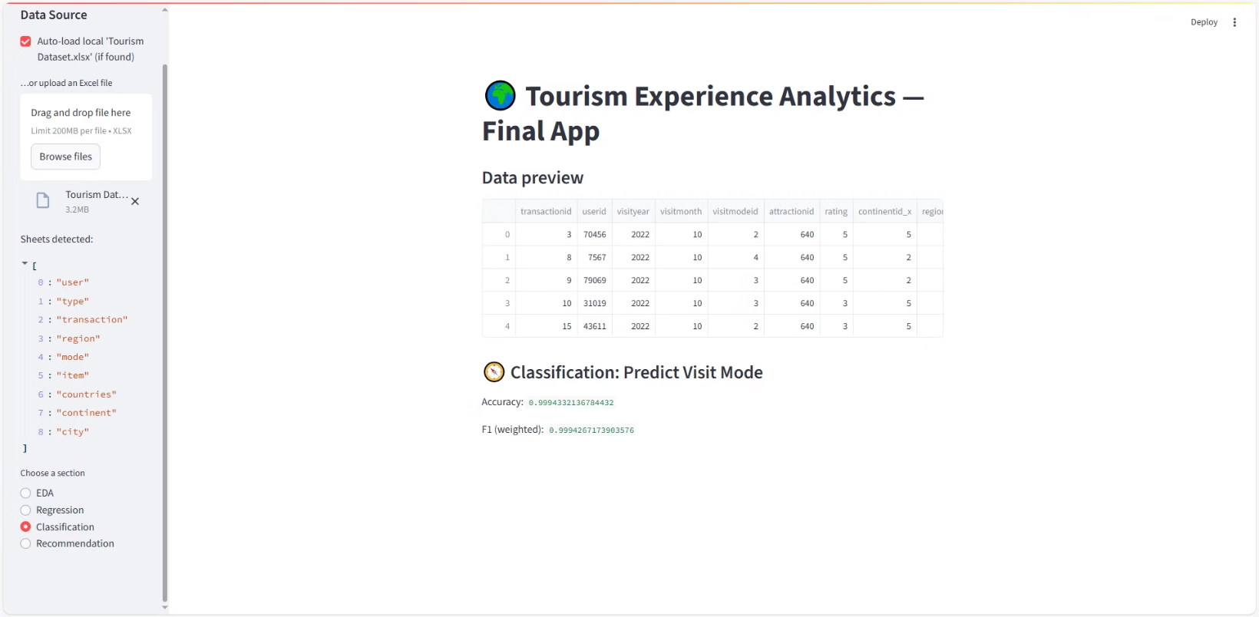
Optimizing Visitor Categorization
Visit Mode Classification
Using Random Forest Classification, our application accurately predicts the visit mode (e.g., solo, couple, family). This classification model boasts high accuracy and F1 scores, confirming its reliability.
Precise visitor segmentation allows travel platforms to tailor experiences, promotions, and packages more effectively, catering to the specific needs and preferences of each identified group, thereby maximizing engagement and satisfaction.

Slide 9
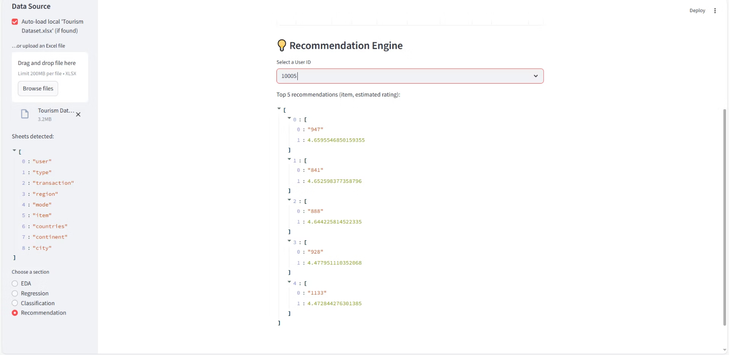
Personalized Journey Creation
Attraction Recommendations
At the core of enhancing traveler experience is our SVD-based recommendation engine. This sophisticated system suggests relevant attractions tailored to individual user preferences, transforming a generic trip into a personalized adventure.
By understanding past behaviors and preferences, the engine can proactively offer attractions that align with a user's interests, leading to higher engagement and satisfaction.

Slide 10
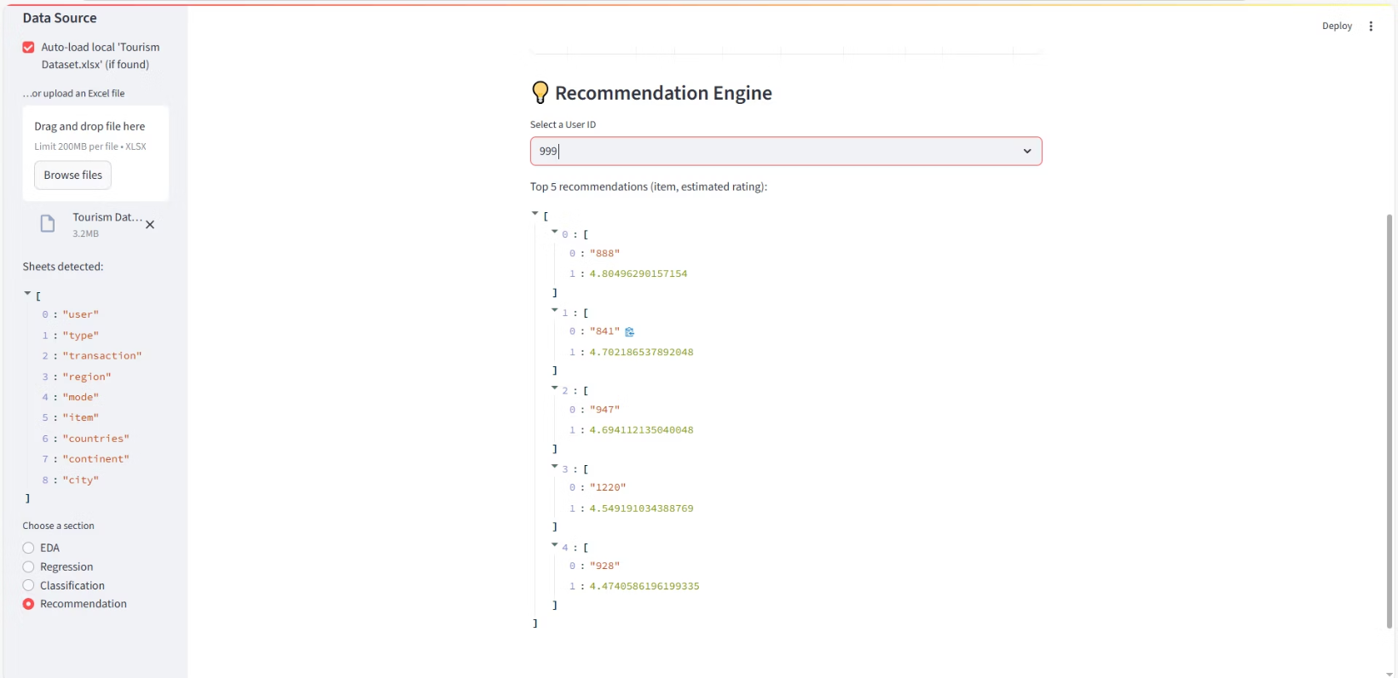
Tailored Experiences
Dynamic Recommendations in Action
The recommendation engine dynamically generates a personalized top 5 list of attractions for each user, as demonstrated in this alternative user case. This feature is critical for travel platforms aiming to deliver truly customized journeys.
By presenting highly relevant options, we empower users to discover experiences they'll love, driving repeat visits and fostering stronger loyalty to the platform.

