Slide 1
Tourism Experience Analytics
EDA, Regression, Classification & Recommendation Results

Slide 2
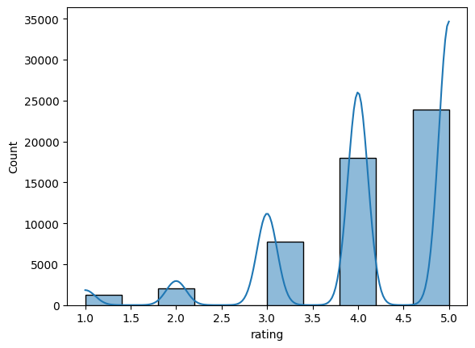
Ratings Distribution

Slide 3
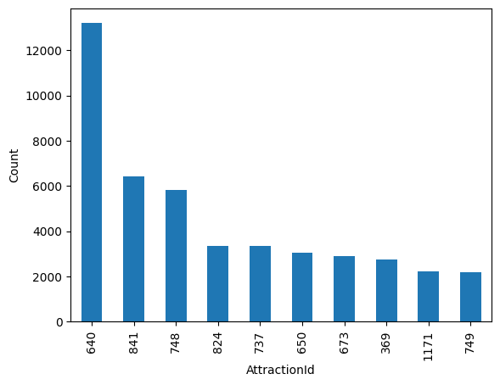
Top 10 Most Rated Attractions

Slide 4
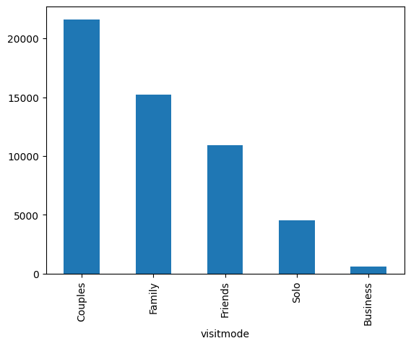
Visit Mode Distribution

Slide 5
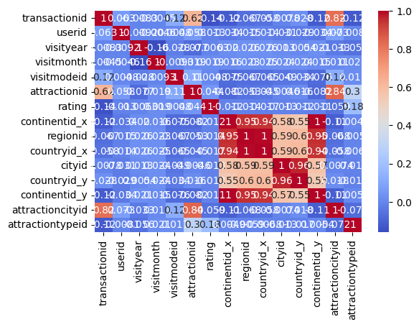
Correlation Heatmap

Slide 6
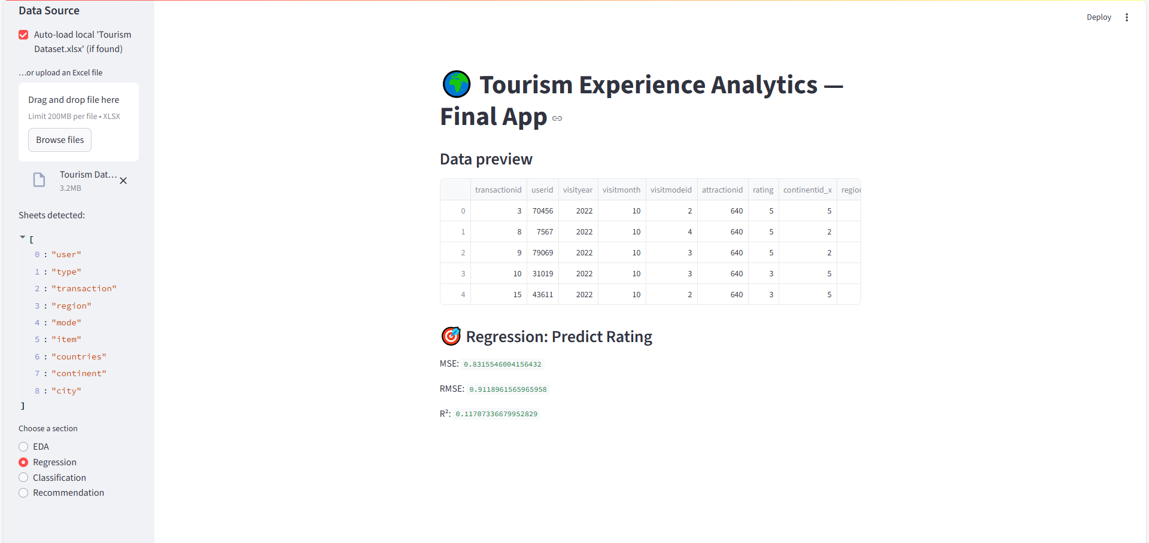
App Preview - Regression

Slide 7
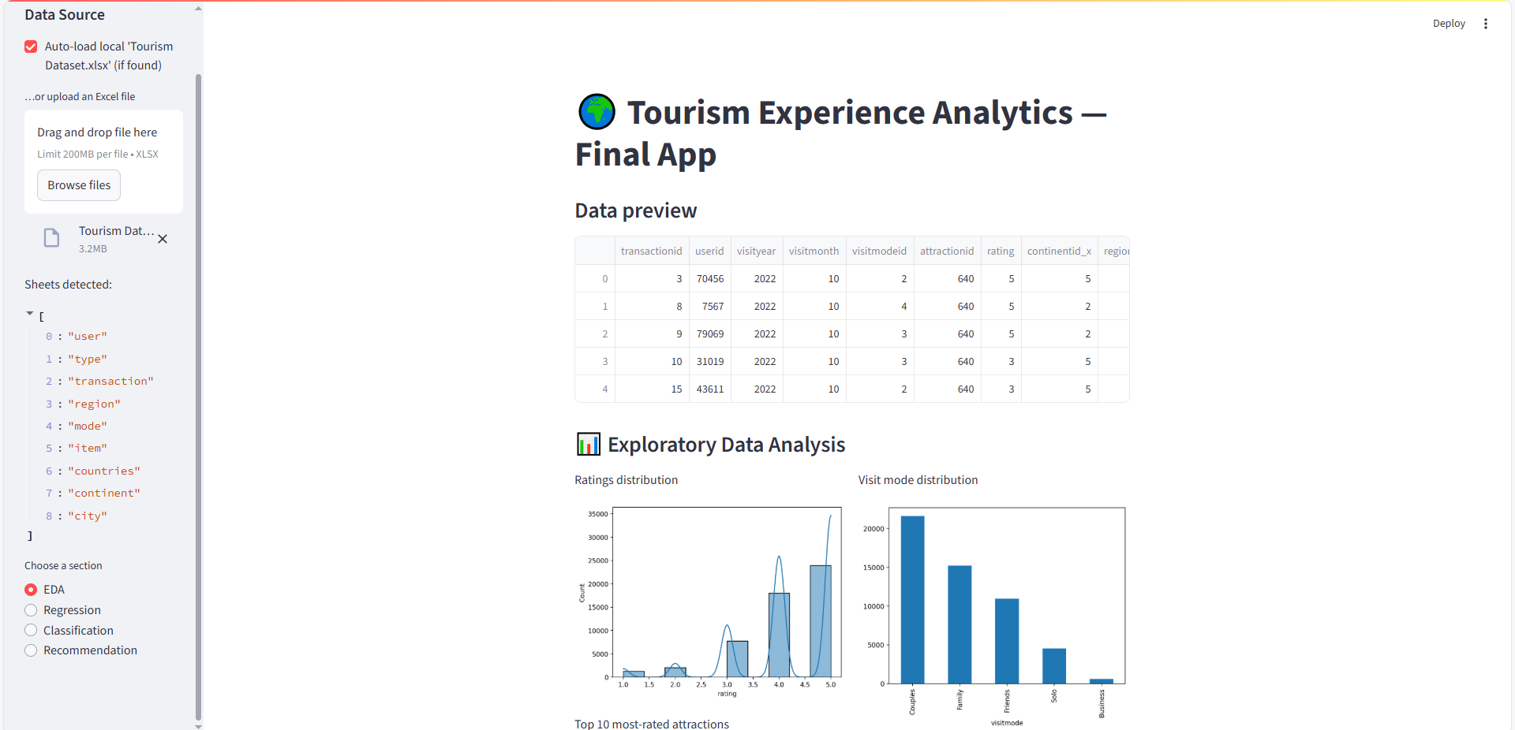
App Preview - EDA

Slide 8
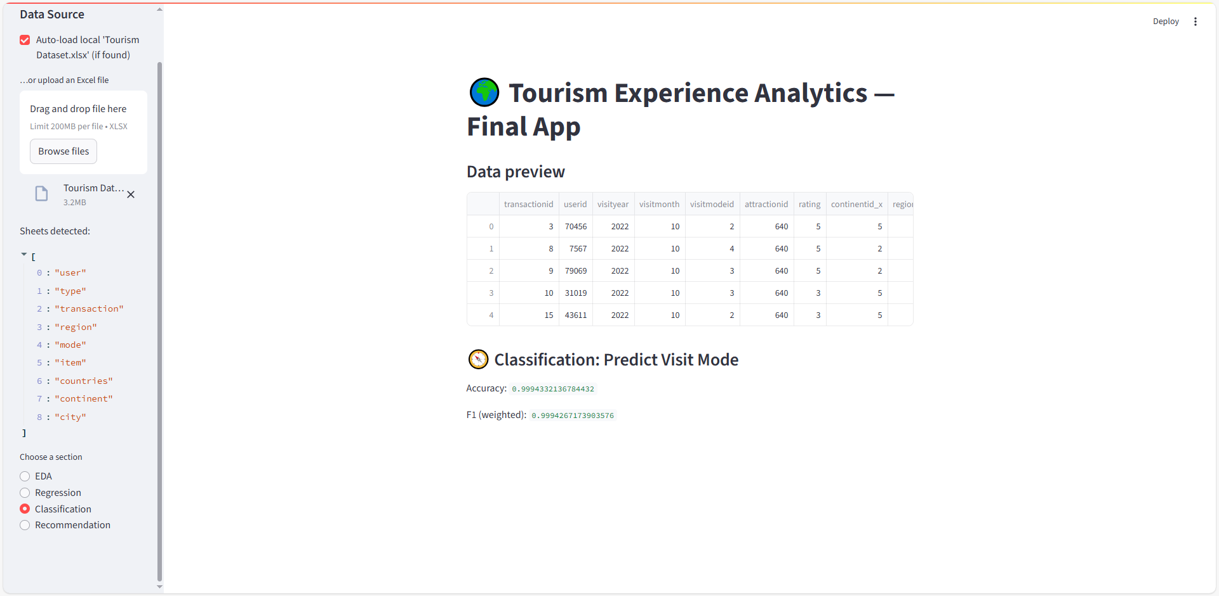
App Preview - Classification

Slide 9
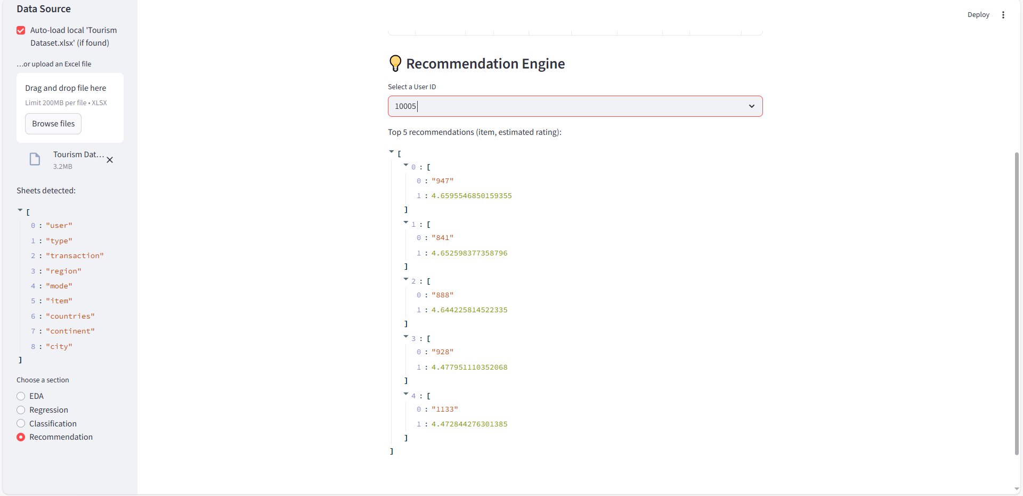
App Preview - Recommendation 1

Slide 10
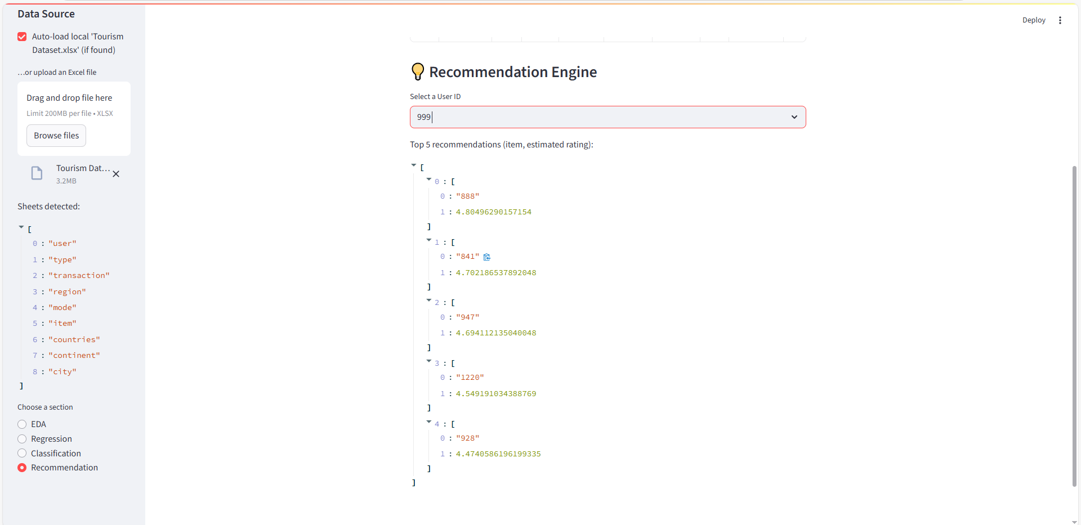
App Preview - Recommendation 2

