Slide 1


“Play Warhammer with your friends, even when you’re Away”

Slide 2
Goal of our App
Warhammer
Our app
Tabletop role-playing game
Need to meet same people several times
Lot of materials (Books, notes, dices)
Complex rules to compute stats
Mobile role-playing game
No need for a meeting place
Only your phone or tablet
All computing in the app
Simply Play!

Slide 3
Business Model
Target
People playing Warhammer (or RPG in general)
English speaking
Competitors
“Individual” RPG
Utilities (stats computing or dice rolling)
Free (no marketing)
Possibility to sell to Edge entertainment?

Slide 4
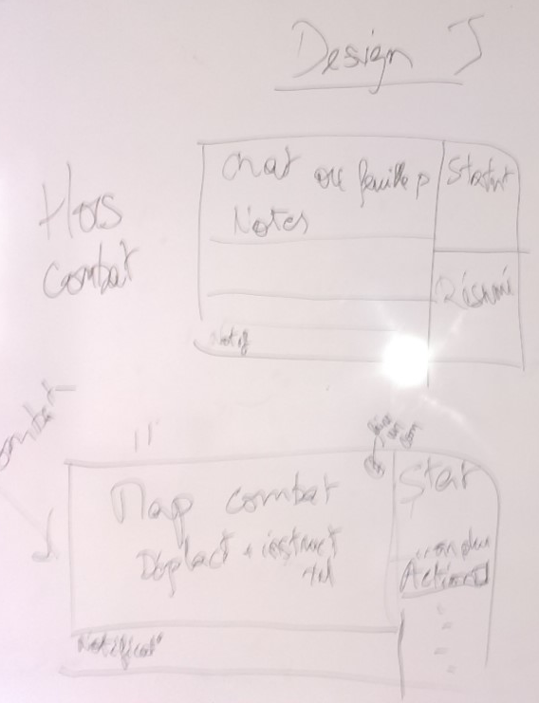
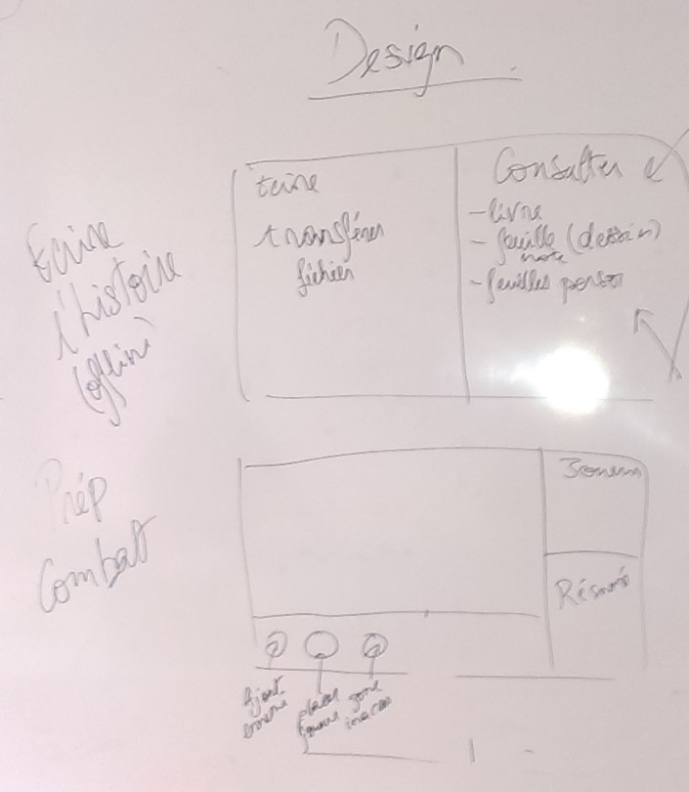
UI Design: In game

Slide 5
Use Case
Group of friends wants to play at Warhammer
Game master create game and send number to all players
Players join the game and start creating their characters, then playing
Stop and continue any number of time

Slide 6
Software Architecture
Activities
Service (in Application context)
listeners
Application (view)
Network
Parser
Model
Server
Direct access
Wifi
Other app

Slide 7
Software Architecture
Player App
GM App
Long term storage
Advertise player
(eventually GM reject it)
Model
(statefull)
Model
(statefull)
View
View
Save change in model
Advertise Game Master
Change view

Slide 8
Software Architecture
GM App
Player App
Player App
Player App

Slide 9
Software Architecture
GM App
Player App
Player App
Player App

Slide 10
Software Architecture
GM App
Player App
Player App
Player App

Slide 11
Software Architecture
Main UI Thread
Network Listnener Thread
Send command
Update UI

Slide 12
Project Advancement: Core Development
Model (Adrien Canuel)
Done
Basic character creation
Skills and jobs implementation
Next to do
Talents and items implementation
Skill usage and fighting rules

Slide 13
Project Advancement: Core Development
Network and Activities (Florian Lugou)
Done
Simple message exchange
File transfer
Simple game management on server side
Automatic reconnection
Next to do
Replay commands when a player reconnect on the server

Slide 14
Project Advancement: UI Design
Layout and style (Elsa Mpondo-Dika)
Done
Style definition (font, color, images)
Game start layouts
Next to do
In game and additional layouts
Amelioration of existing layouts
Distinguish layouts according to size of screen

Slide 15
Demonstration!

