Slide 1
Employee performance data analysis using excel
Student Name: AISHWARYA
Register No : 312218522
Naan mudhalvan: asum1691cc1221691013
Department: Commerce
College: C.M Annamalai arts and science college for women

Slide 2
PROJECT TITLE
Employee Performance Analysis using Excel

Slide 3
Agenda
1. Problem Statement
2. Project Overview
3. End Users
4. Our Solution and Proposition
5. Dataset Description
6. Modelling Approach
7. Results and Discussion
8. Conclusion

Slide 4
Problem Statement
Employee performance employee engagement and job satisfaction is important for every organization.
These attitudes are affected by many variables like intellectual; & physical abilities, their qualification, training, experience, culture, reward system , career progression opportunities, co overload and structure of the organization.

Slide 5
Project overview
An employee performance plan can help you create an ongoing process that providers regular data on how each team members is progressing.

Slide 6
Who the end users?
Performance Indicators such as productivity, quality of work goal attainment, time management, team collaboration, adaptability and innovation can enable you be answer these questions by quantifying individual and organizational goals and evaluating performance

Slide 7
OUR SOLUTION AND ITS VALUE PROPOSITION
Data-Driven Insights: Enables managers to make informed decision based on accurate, real –time performance data.
Improved Efficiency: Automates the data collection and analysis process, saving time and reducing manual error.
Enhanced Employee Development: Identifies training needs and development opportunities, leading to a more skilled workforce.
Better Performance Management: Helps in recognizing top performance and addressing underperformance, ultimately improving overall productivity.
Cost-Effective solution: Leverages the widely accessible excel platform, avoiding the need for expensive software or tools.

Slide 8
Dataset description
Employee data set - Kaggle
26 features
Feature-9 features
Emp id- 3333
Gender- female
Performance-good
Business unit- CCDG
Name- mery
Rating numerical-5

Slide 9
THE”WOW” IN OUR SOLUTION
Performance level calcultion= IFS(Z8>5,”VERY HIGH”, Z8>4,”HIGH”,Z8>=3,”MID”, TURE,”LOW”)

Slide 10
MODELLING
Data collection
Data cleaning
Techniques
Results
Pivot table
Cart graphs

Slide 11
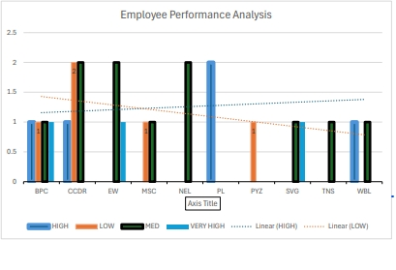
RESULT

Slide 12
CONCLUSION
An Excel-based Employee Performance rating Card and Dashboard is very useful and adaptable tool. It can significantly enhance your performance management process.

