Slide 1
Builder Design Pattern
TEAM 4
Aishvwarya Natarajan Iyer
Gayathree Natarajan Iyer
Barath Naravula Loganathan
Megha Nagabhushan

Slide 2
The builder pattern is an object creation software design pattern.
The intention of the builder pattern is to find a solution to the telescoping constructor anti-pattern. The telescoping constructor anti-pattern occurs when the increase of object constructor parameter combination leads to an exponential list of constructors.
Instead of using numerous constructors, the builder pattern uses another object, a builder, that receives each initialization parameter step by step and then returns the resulting constructed object at once.

Slide 3
Intention
The intent of the Builder design pattern is to separate the construction of a complex object from its representation.
By doing so the same construction process can create different representations.

Slide 4
Advantages & Disadvantages
Advantages
Allows you to vary a product’s internal representation.
Encapsulates code for construction and representation.
Provides control over steps of construction process.
Disadvantages
Requires creating a separate ConcreteBuilder for each different type of Product.

Slide 5
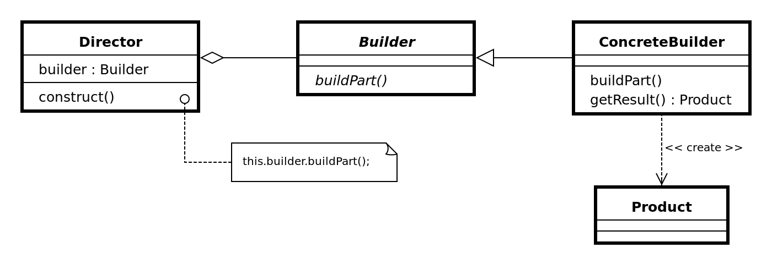
Structure

Slide 6
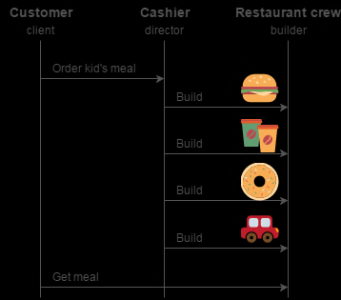
Example
The Builder pattern separates the construction of a complex object from its representation so that the same construction process can create different representations.
This pattern is used by fast food restaurants to construct children's meals. Children's meals typically consist of a main item, a side item, a drink, and a toy (e.g., a hamburger, fries, Coke, and toy dinosaur).
Whether a customer orders a hamburger, cheeseburger, or chicken, the process is the same. The employee at the counter directs the crew to assemble a main item, side item, and toy. These items are then placed in a bag. The drink is placed in a cup and remains outside of the bag. This same process is used at competing restaurants.

Slide 7
RobotPlan.java
// This is the interface that will be returned from the builder
public interface RobotPlan{
public void setRobotHead(String head);
public void setRobotTorso(String torso);
public void setRobotArms(String arms);
public void setRobotLegs(String legs);
}

Slide 8
Robot.java
// The concrete Robot class based on the RobotPlan interface
public class Robot implements RobotPlan{
private String robotHead;
private String robotTorso;
private String robotArms;
private String robotLegs;
public void setRobotHead(String head) {
robotHead = head;
}

Slide 9
public String getRobotHead(){ return robotHead; }
public void setRobotTorso(String torso) {
robotTorso = torso;
}
public String getRobotTorso(){ return robotTorso; }
public void setRobotArms(String arms) {
robotArms = arms;
}
public String getRobotArms(){ return robotArms; }
public void setRobotLegs(String legs) {
robotLegs = legs;
}
public String getRobotLegs(){ return robotLegs; }
}

Slide 10
RobotBuilder.java
// Defines the methods needed for creating parts for the robot
public interface RobotBuilder {
public void buildRobotHead();
public void buildRobotTorso();
public void buildRobotArms();
public void buildRobotLegs();
public Robot getRobot();
}

Slide 11
OldRobotBuilder.java
// The concrete builder class that assembles the parts of the finished Robot object
public class OldRobotBuilder implements RobotBuilder {
private Robot robot;
public OldRobotBuilder() {
this.robot = new Robot(); }
public void buildRobotHead() {
robot.setRobotHead("Tin Head"); }
public void buildRobotTorso() {
robot.setRobotTorso("Tin Torso"); }
public void buildRobotArms() {
robot.setRobotArms("Blowtorch Arms"); }
public void buildRobotLegs() {
robot.setRobotLegs("Rollar Skates"); }
public Robot getRobot() {
return this.robot; }
}

Slide 12
TestRobotBuilder.java
public class TestRobotBuilder {
public static void main(String[] args){
// Get a RobotBuilder of type OldRobotBuilder
RobotBuilder oldStyleRobot = new OldRobotBuilder();
// Pass the OldRobotBuilder specification to the engineer
RobotEngineer robotEngineer = new RobotEngineer(oldStyleRobot);
// Tell the engineer to make the Robot using the specifications of the OldRobotBuilder class
robotEngineer.makeRobot();
// The engineer returns the right robot based off of the spec sent to it on line 11
Robot firstRobot = robotEngineer.getRobot();
System.out.println("Robot Built");
System.out.println("Robot Head Type: " + firstRobot.getRobotHead());
System.out.println("Robot Torso Type: " + firstRobot.getRobotTorso());
System.out.println("Robot Arm Type: " + firstRobot.getRobotArms());
System.out.println("Robot Leg Type: " + firstRobot.getRobotLegs());
}}}

Slide 13
THANK YOU !

