Slide 1



TOPIC: Open Source Data Visualization.
Tribe M:
Aishwarya S Bhandari
Bhavani
Divyashree
Aishwarya
Abhilash
Bhavana
Pallavi
Shambhavi S K
Ambika
Mamata M Nanna
Aishwarya H Nandikoor
SachinKumar
Shreeshail
Kaveri Patil
Vijayalaxmi Kalal

Slide 2
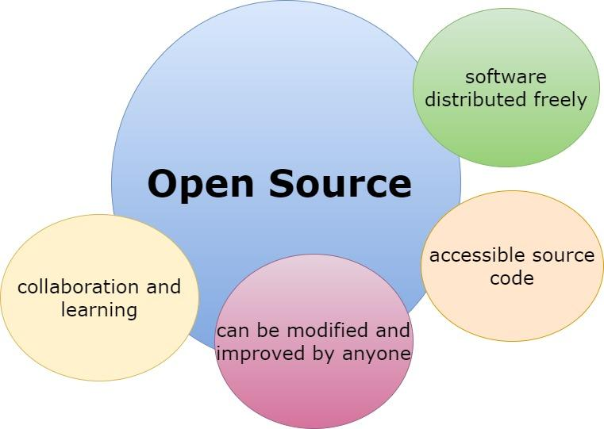

Slide 3
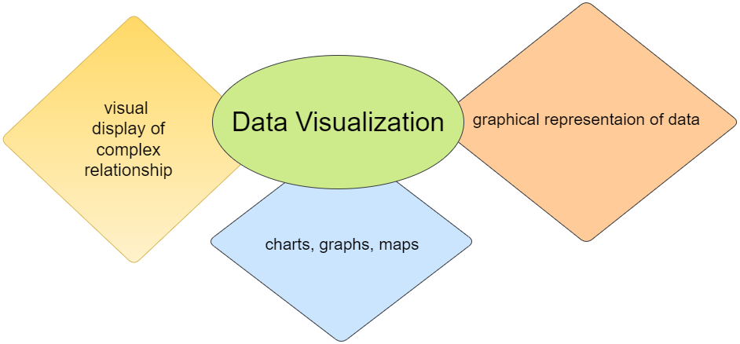
What is data visualization?

Slide 4
Purpose Of Data Visualization
Data visualization is essential to analyze massive amounts of information and make data driven decisions.
Management also applies it to convey organizational structure and hierarchy.
Data Analysts and Scientists study and explain the trends and pattern.

Slide 5



Why Data Visualization?
Analysis of data
Make sense of complicated data
Faster Decision making

Slide 6



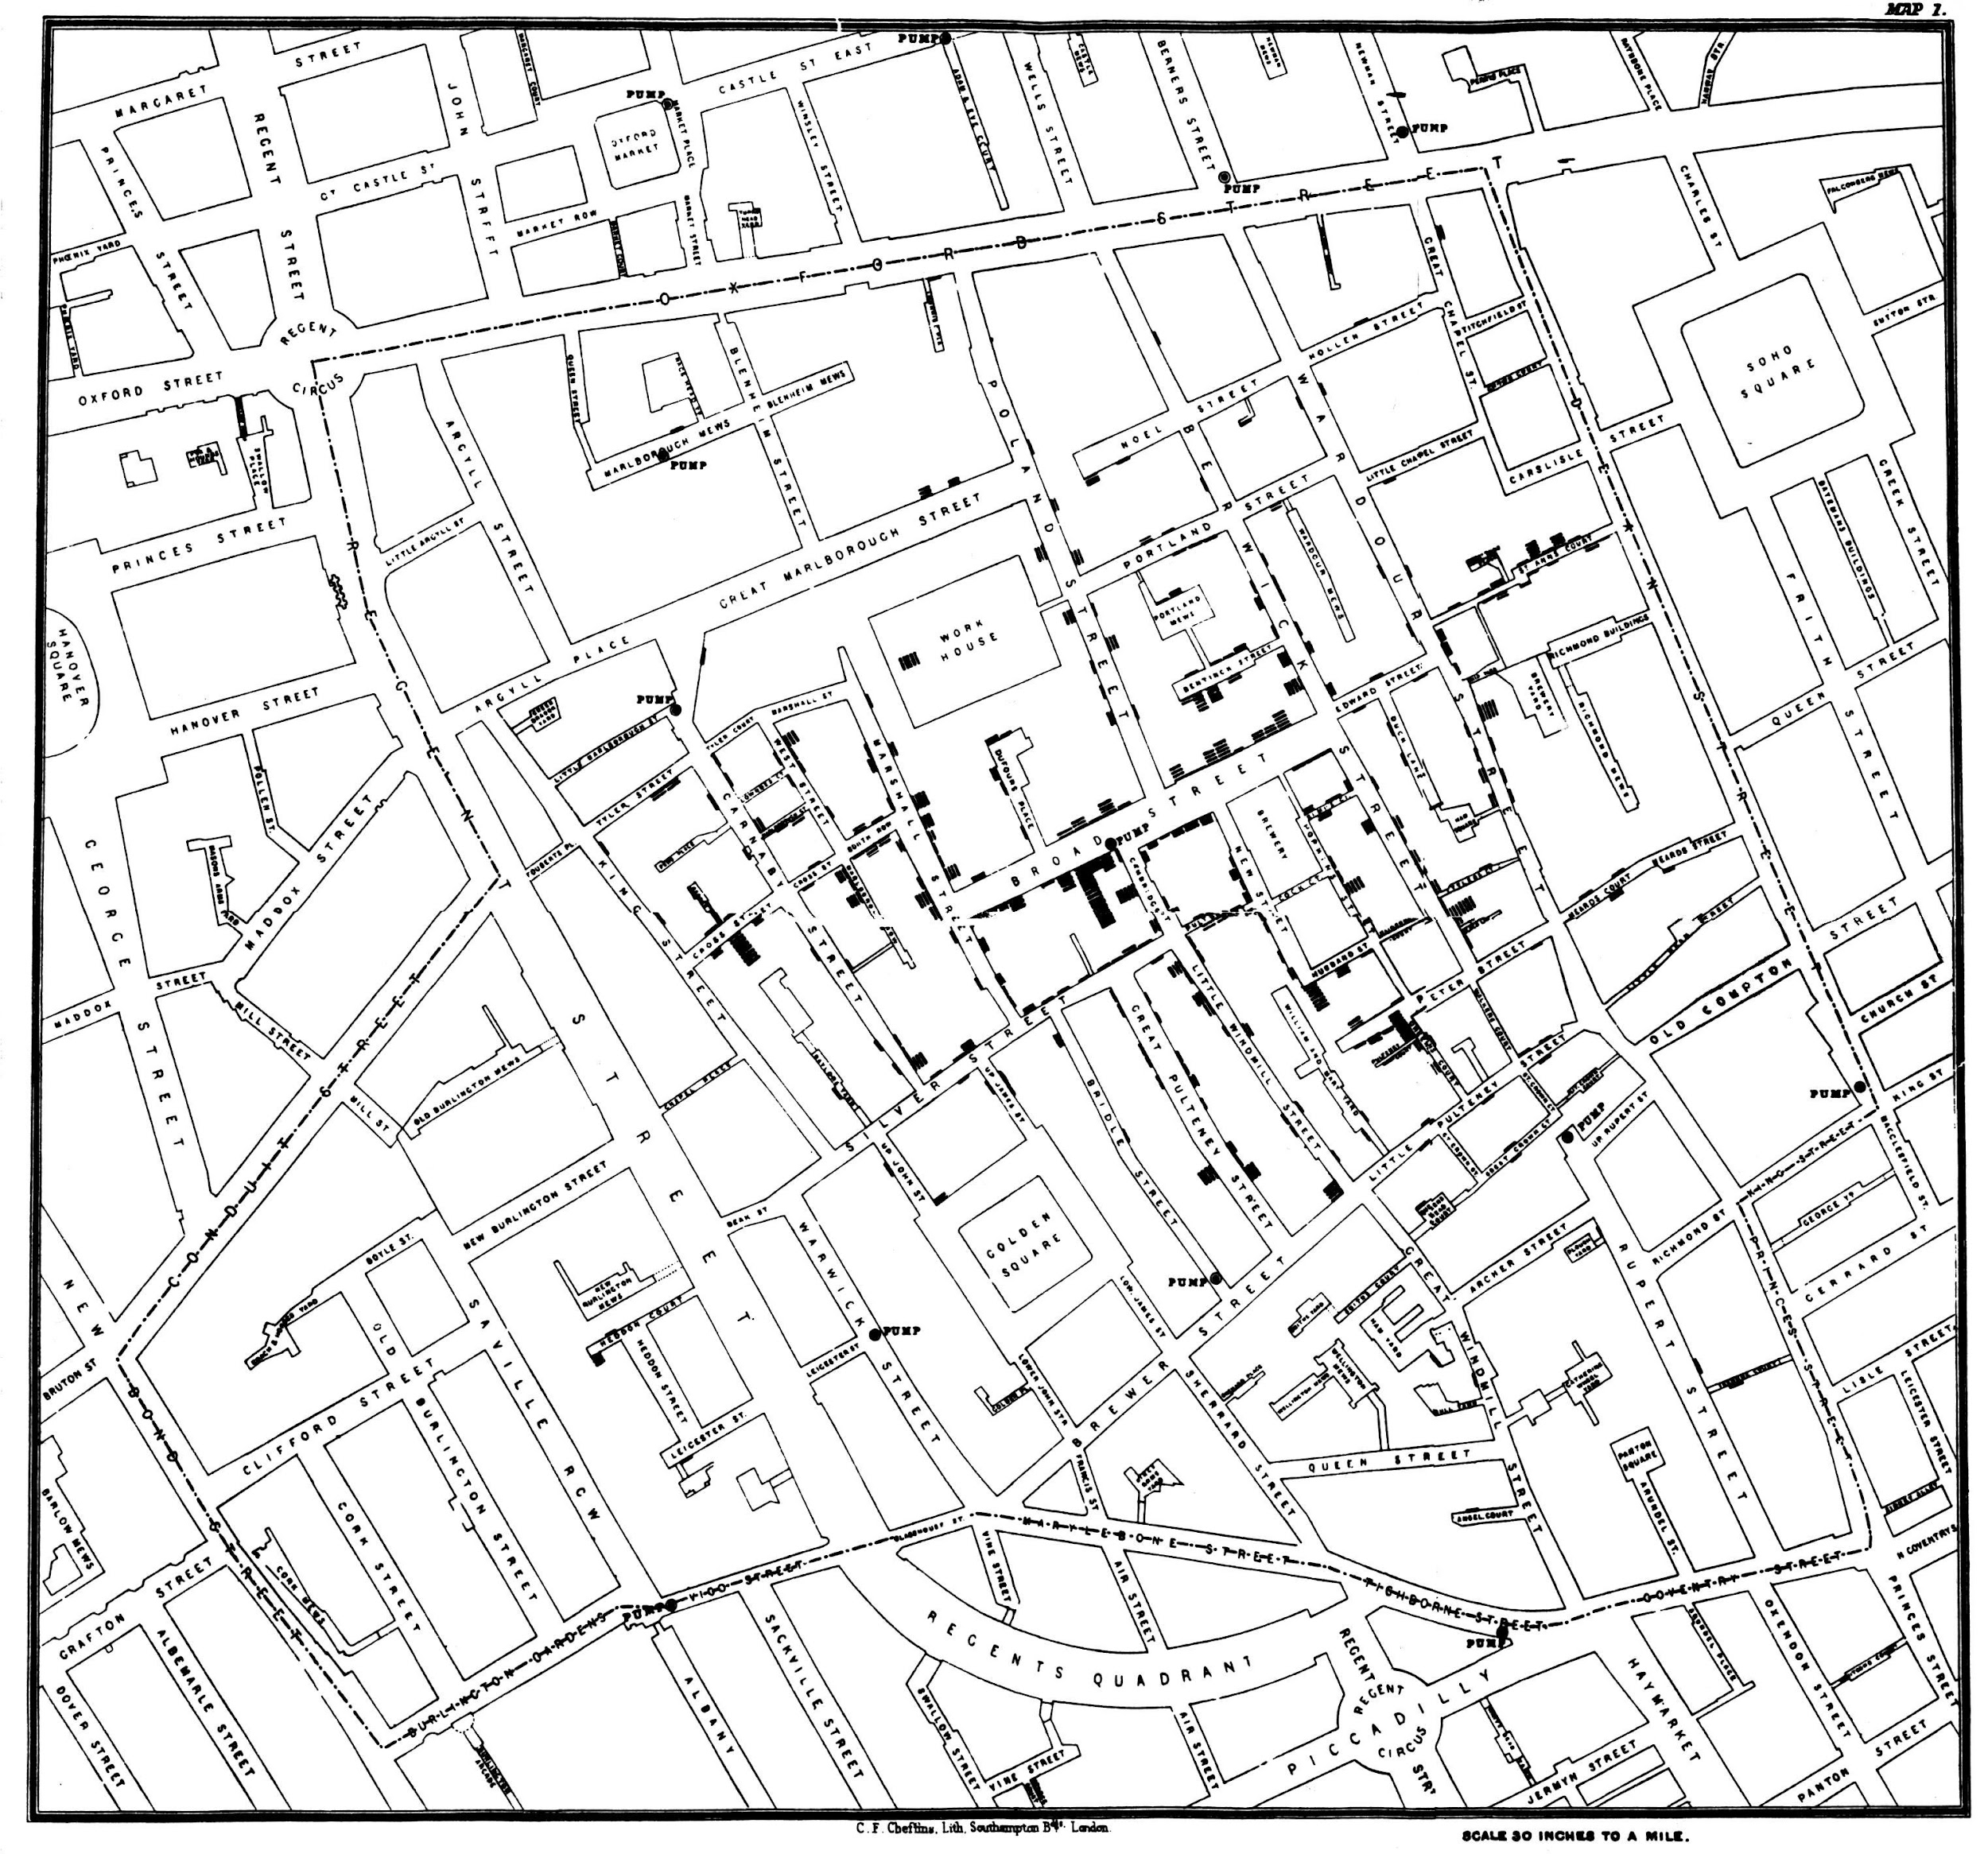
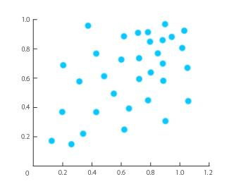
Types Of Data Visualization
Charts
Tables
Dashboards
Scattered plot
Maps

Slide 7
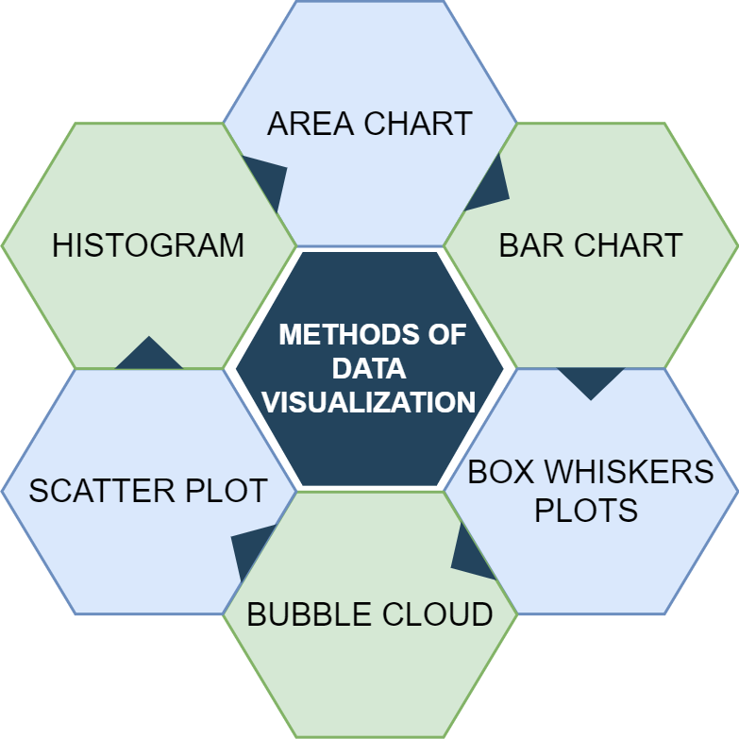
Some Specific Methods Of Data Visualization

Slide 8


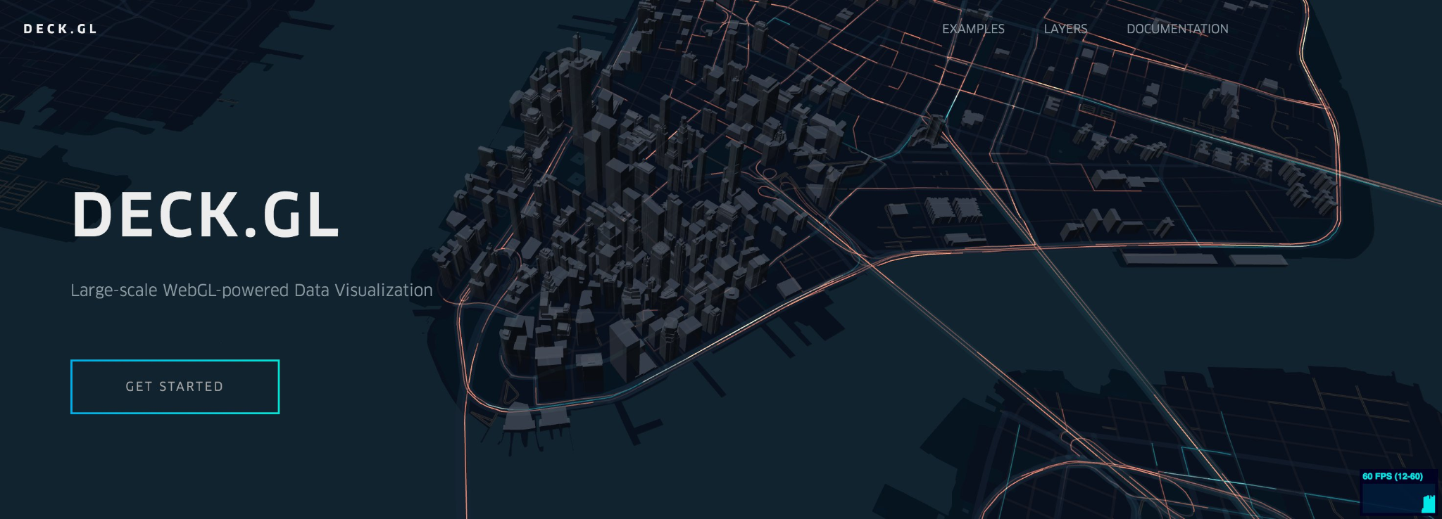

Open Source Data Visualization Tools
ECharts
D3.js
Vega
deck.gl

Slide 9
Open Source Data Visualization Tools
D3.js:
It is a javascript library producing dynamic, interactive visualization in web browsers
ECharts:
A charting library which offers an easy way to add highly interactive and customizable charts.
Vega:
provides support to customize visualization across large dataset which are accessible from web.
deck.gl:
A framework, which is used for exploratory data.
Open source libraries provide a way for analysts to present data in an interactive way.

