Slide 1



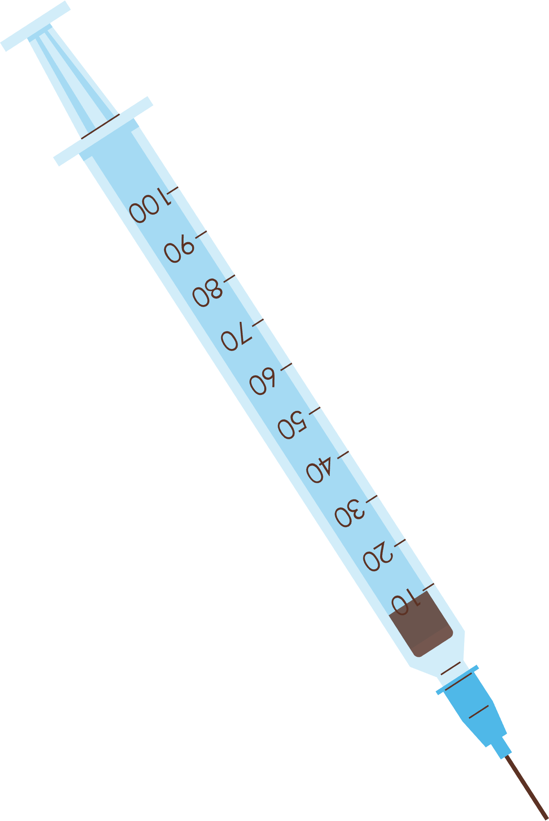


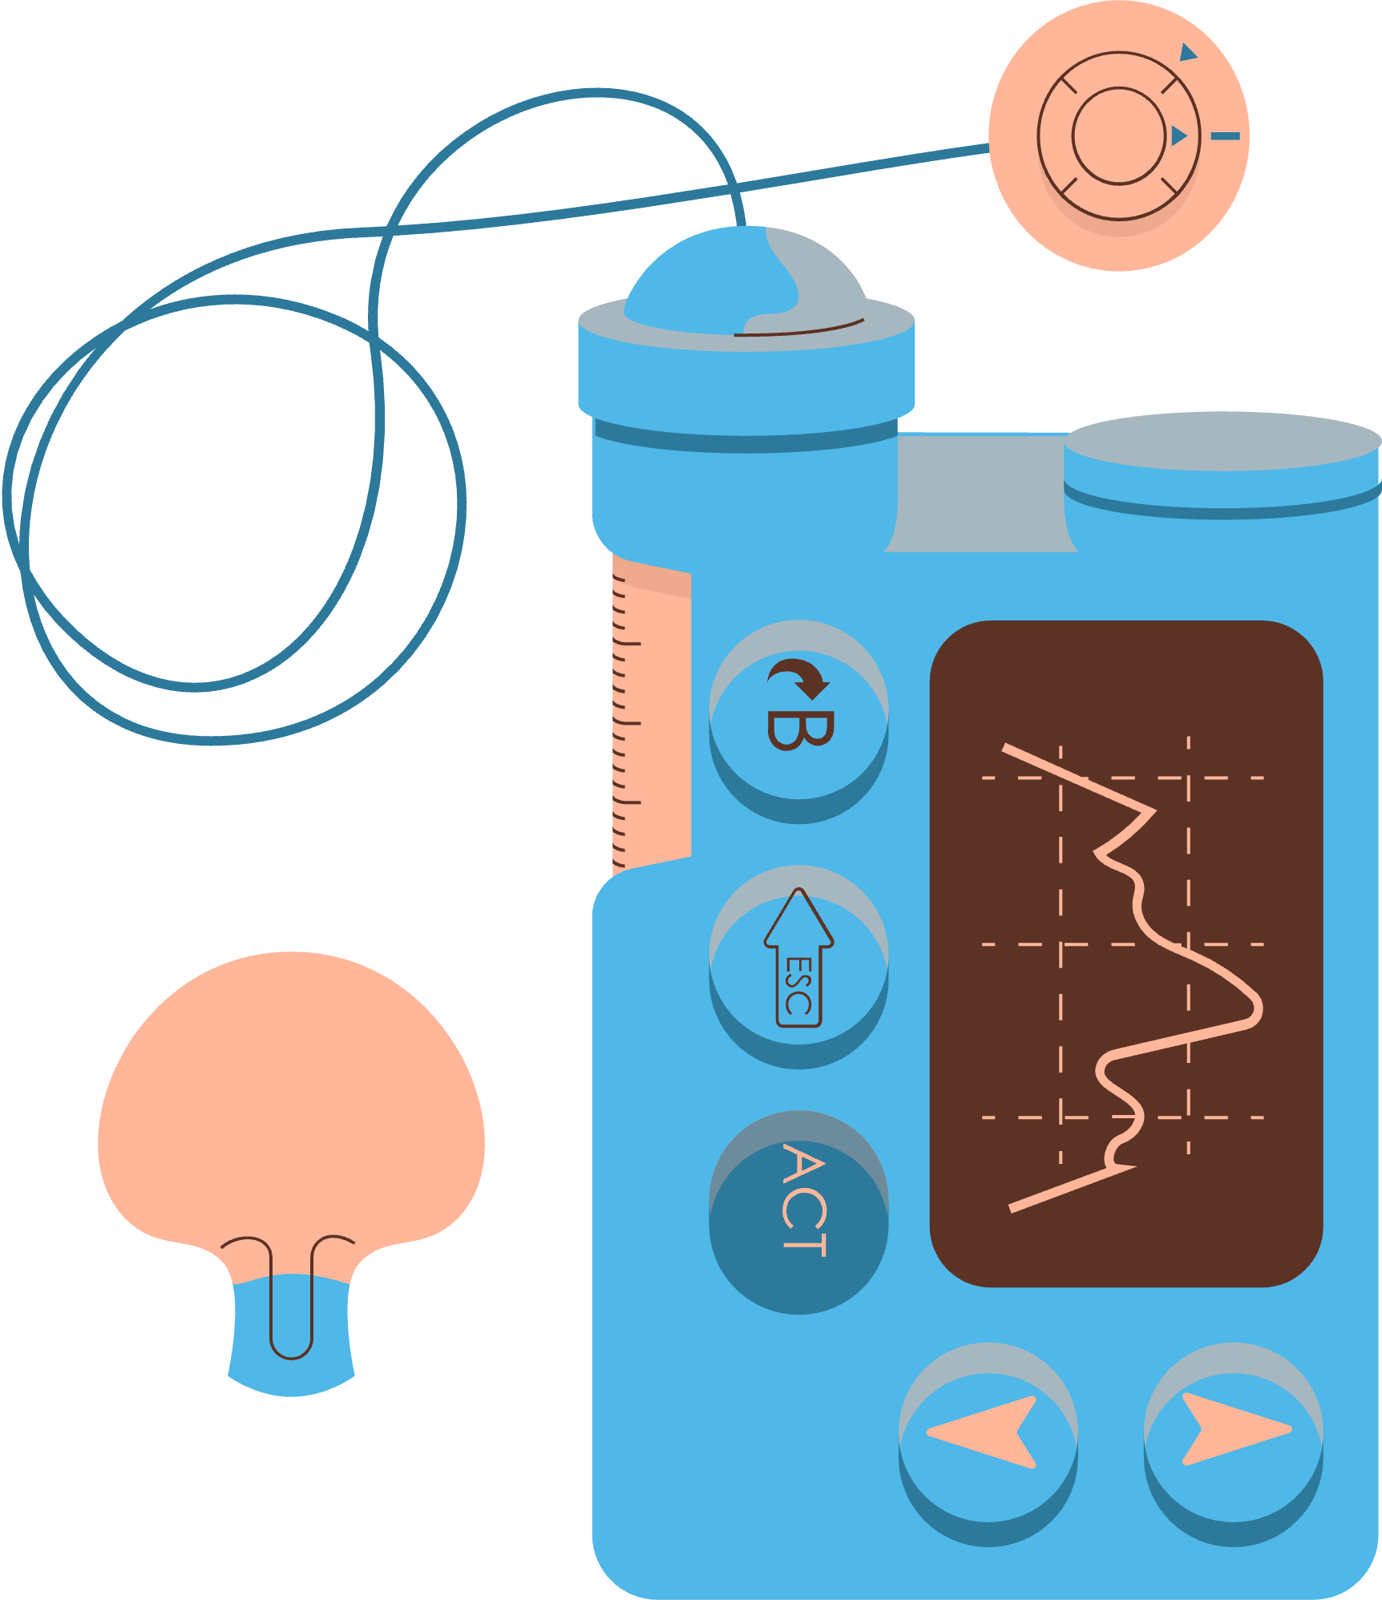

HEALTH CONDITIONS
AMONG
CHILDREN
Group 1

Slide 2
Introduction
Motivation:
The health of children under 18 is a very important statistic for the future of society. So our group decided to use visualization to analyze the data and get important insights and summaries. This analysis is a commitment to further understanding, protection and enhancement of the future development of society.

Slide 3
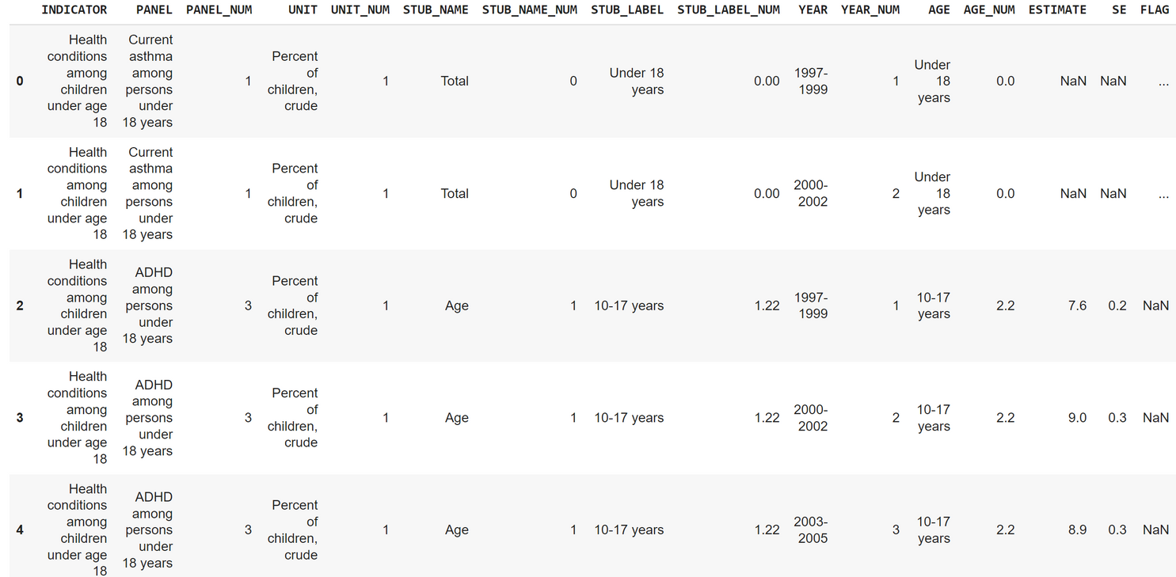
Data Inspection
The dataset is focused on United States and has:
16 columns: the main attributes mainly focused on the indicator, panel, year and age.
2744 rows: the total number of the raw data before data cleaning

Slide 4
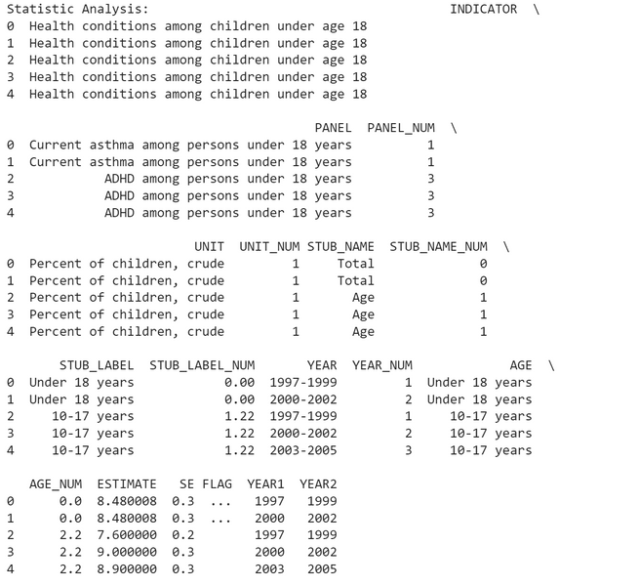
Data Processing & Cleaning
Data Splitting:
Split the YEAR column into YEAR1 and YEAR2 for the further possible analysis(e.g. YEAR: 1993-1997 into YEAR1: 1993 & YEAR2: 1997)
Data Cleaning:
Replace the null data in the column, ESTIMATE, SE, and FLAG with the mean value, median value and the blank space value.
Further Action:
Drop the duplicate value in the dataset to ensue data integrity for subsequent analysis
Detect and remove the outlier data to make the data smoother to ensure further analysis

Slide 5
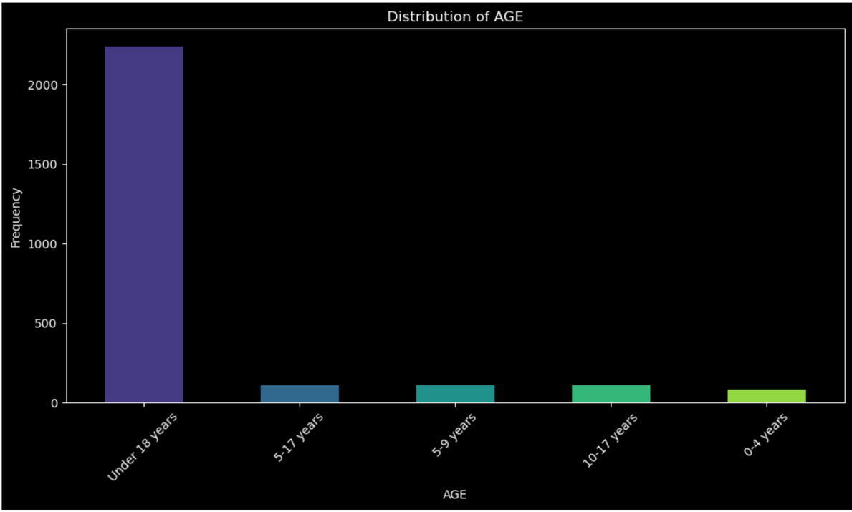
Bar Plot : Distribution of the age and the disease frequency
This bar plot focuses on the relationship between the frequency of disease and age. Each bar represents the number of diseases occurring in each age group. One of the stranger points is that the number of under year 18's takes up basically all of the spots, while others like 5-17, and 5-9 are smaller and more even. This partly explains the inaccuracy of this part of the data, there is less age-specific data and it may not be possible to draw relevant conclusions based on the available data and the bar plot.

Slide 6
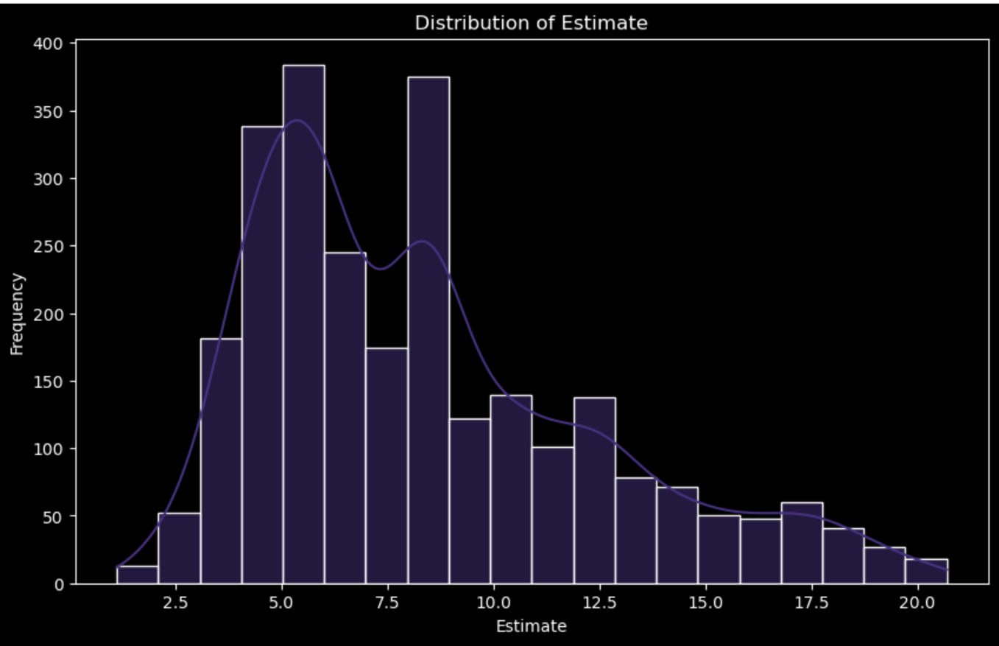
Histogram Plot : Distribution of the estimate and the disease frequency
This historigram plot focuses on how often a disease occurs versus how many are presumed to occur. Each bar represents the frequency of occurrence of the presumed number of occurrences and is paired with a line to show the trend. By looking at this curve it is clear that the peaks occur around the 5.0 portion. This indicates that a large portion of the factors and triggers are clustered in this 5.0 portion of the interval. This could be a important factor that influence the frequency

Slide 7
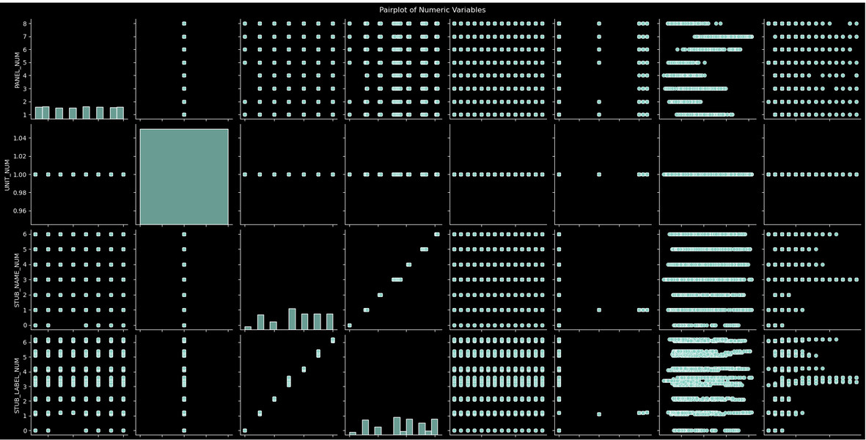
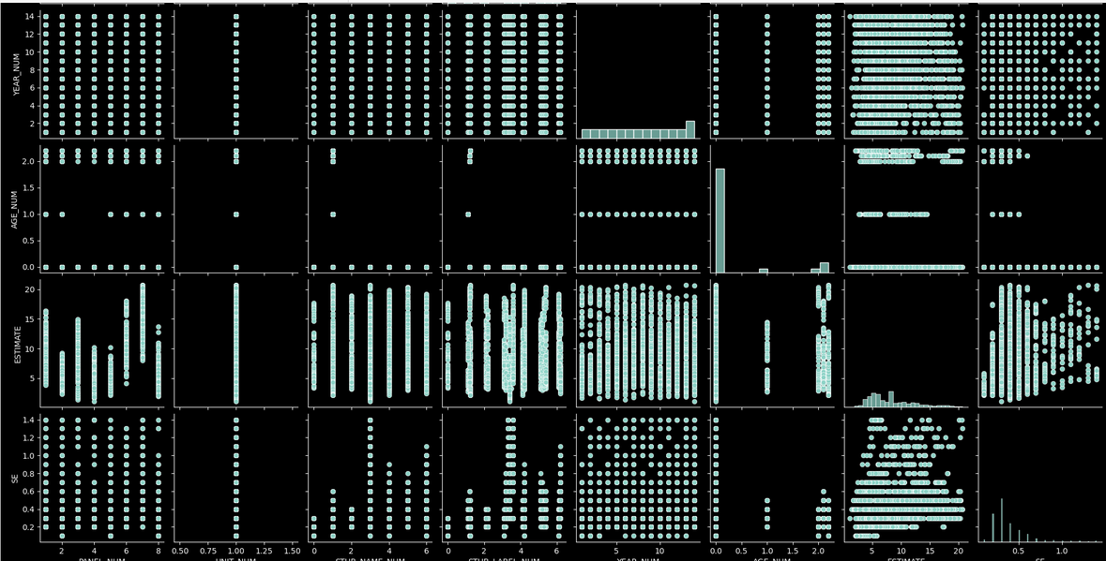
Pair Plot: The relationship of all the numerical variables
This pair plot is used to analyze and display pairwise relationships between variables within a dataset, where a dot plot can visualize the relationship between two variables based on the combination of different columns in the dataset. The dot plots are used to analyze the data based on the combination of different columns in the dataset. However, the pair plots obtained by our group yielded very little useful information, and most of the scatter plots were not regular. Only a few of them are linear and have a positive trend, of course, this is also related to the characteristics of the data itself, for example, STUB_NAME_NUN and STUB_LABEL_NUM have a strong correlation in the dataset itself. So it was decided to use other analysis to compare the data set variables relationship.

Slide 8
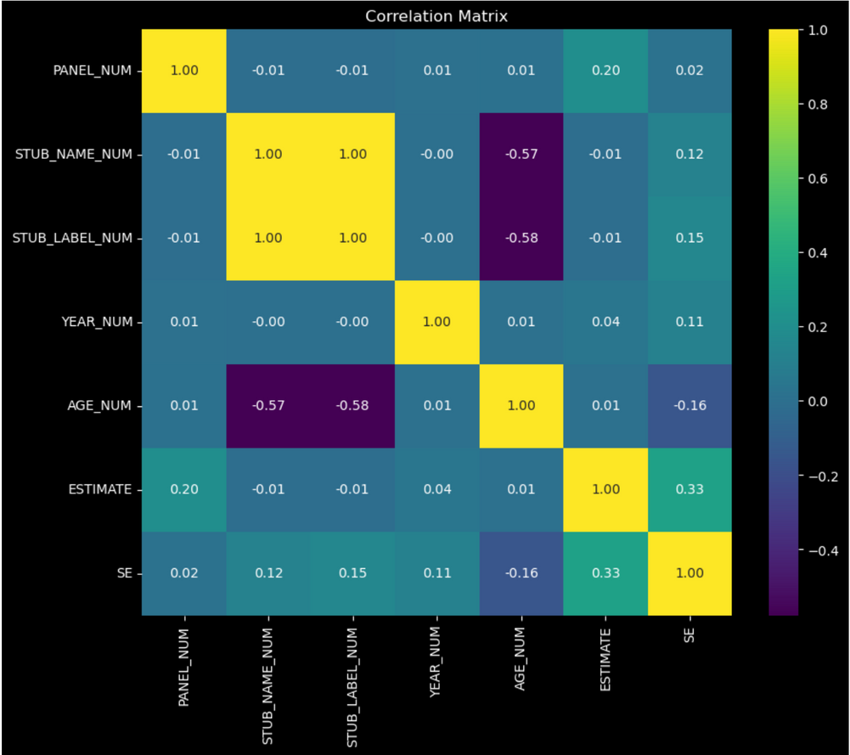
Heatmap: The numerical coefficient based on all the numerical variables
This Heatmap is used to analyze and display the numeric value of the relationships between variables in a dataset. heatmap uses a more concise approach than the previous pair plot, in which the x and y axes are the values of the variables in the dataset. The x and y axes are different numerical variables in a dataset, and the numbers in the boxes range from -1 to 1 to represent the correlation between the variables, where the color of the display is also intuitive for others to feel the strength of the relationship. One of the more striking points is that AGE_NUM has a negative correlation with both STUB_LABELS_NUM and STUB_NAME_NUM, which means that when AGE_NUM increases, STUB_LABELS and NAME both decrease. This could be a pattern based on the AGE_NUM which is a very important trend as well as INSIGHT, may be useful for future analysis.

Slide 9
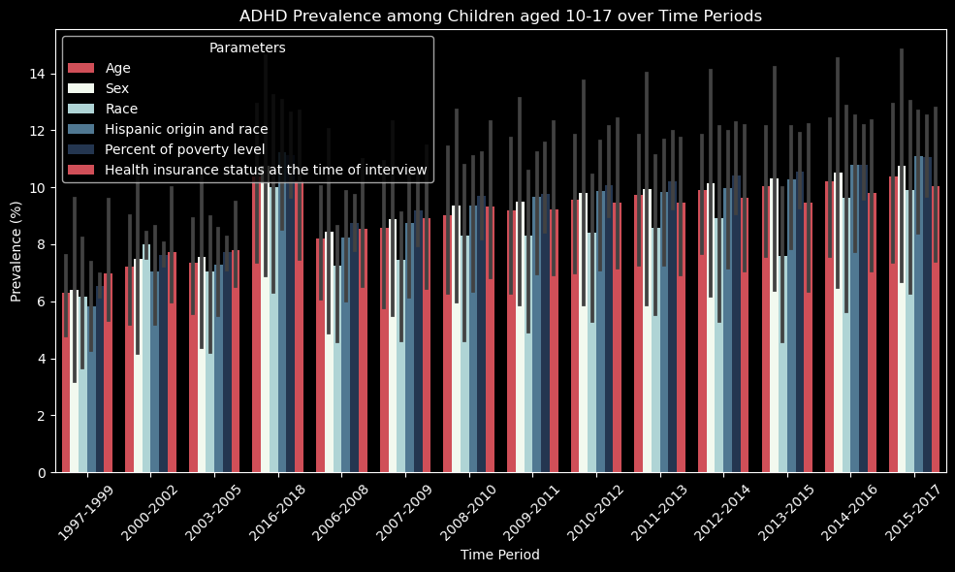
Bar Plot: Examining ADHD Prevalence among Adolescents
This bar plot illustrates the prevalence of Attention Deficit Hyperactivity Disorder (ADHD) among adolescents aged 10-17 years across different time periods. Each bar represents a specific parameter, distinguished by a unique color, enabling comparison of ADHD prevalence across various time intervals. The rotation of x-axis labels enhances readability, particularly for longer time periods. The legend provides clarity on the parameters represented by each bar, facilitating interpretation of the plot.

Slide 10
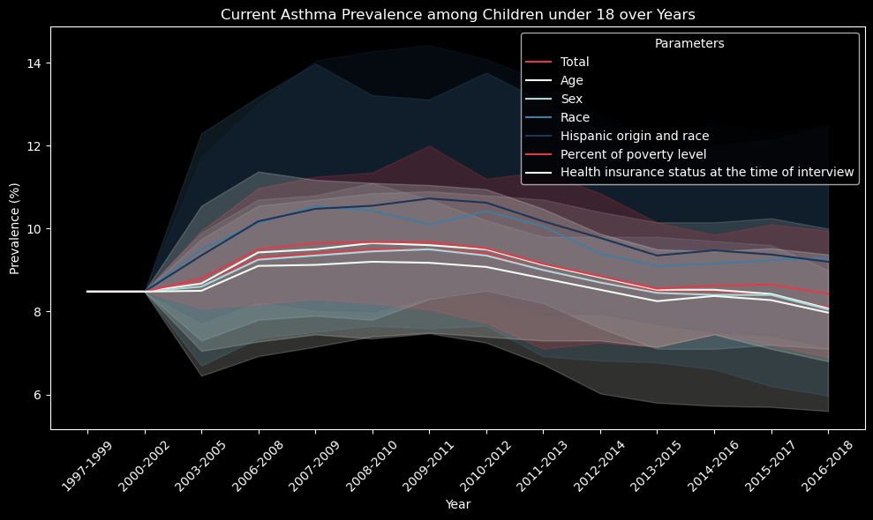
Line Plot: Exploring Current Asthma Prevalence among Children
This line plot visualizes the prevalence of current asthma among children under 18 years of age across different years. Each line represents a specific parameter, distinguished by a unique color, allowing for easy comparison of asthma prevalence trends over time. The dark background enhances the visibility of the plot, while the rotation of x-axis labels improves readability. The legend provides clarity on the parameters represented by each line, facilitating interpretation of the plot.

Slide 11
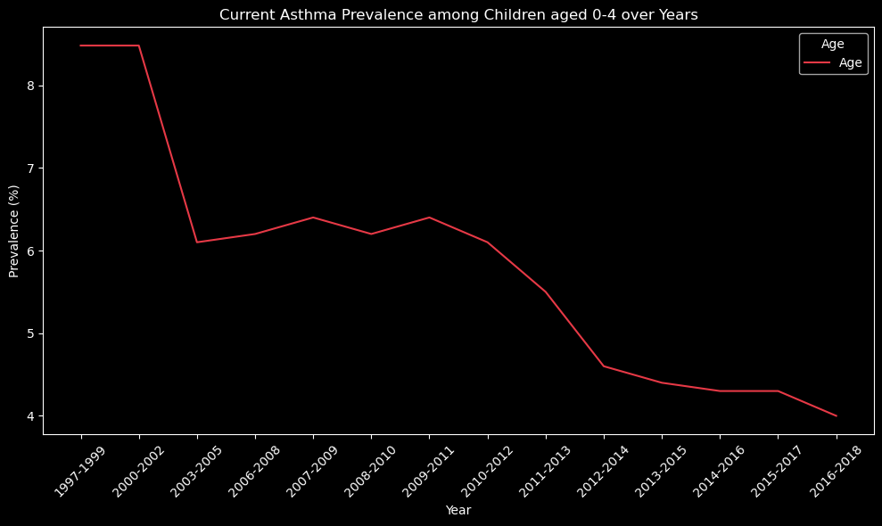
Line Plot: Exploring Current Asthma Prevalence among Young Children
This line plot showcases the prevalence of current asthma among children aged 0-4 years over different years. Each line represents a specific subgroup within the age range, distinguished by different colors. The visualization enables tracking of asthma prevalence trends over time within the specified age group, aiding in understanding potential variations or patterns in asthma prevalence among young children. Rotation of x-axis labels enhances readability, facilitating easier interpretation of the plot.

Slide 12
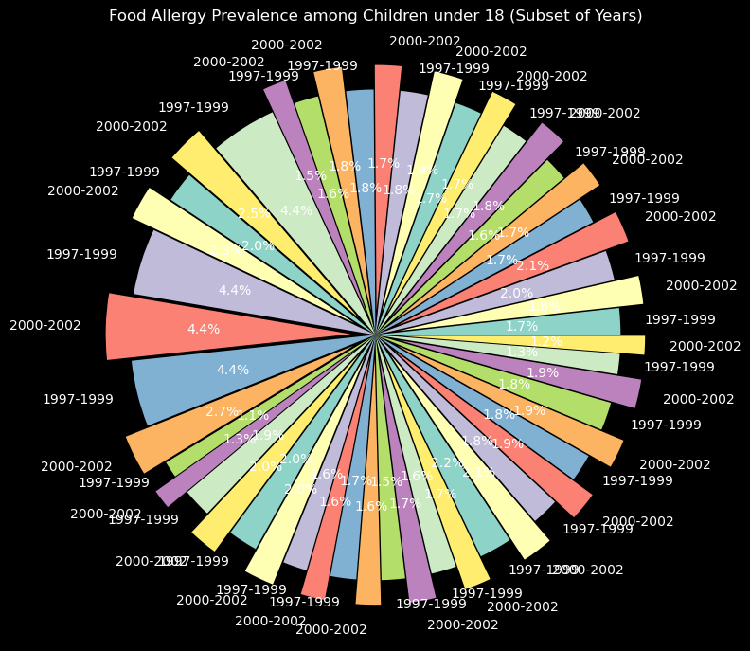
Pie Chart: Exploring Food Allergy Prevalence among Children under 18
This pie chart visualizes the prevalence of food allergy among children under 18 years for the subset of years 1997-1999 and 2000-2002. The explosion effect highlights the prevalence data for the years 2000-2002, drawing attention to any notable changes or trends within this period. The chart offers a concise overview of how food allergy prevalence fluctuates over time, aiding in the understanding of potential variations in health conditions among children.

Slide 13
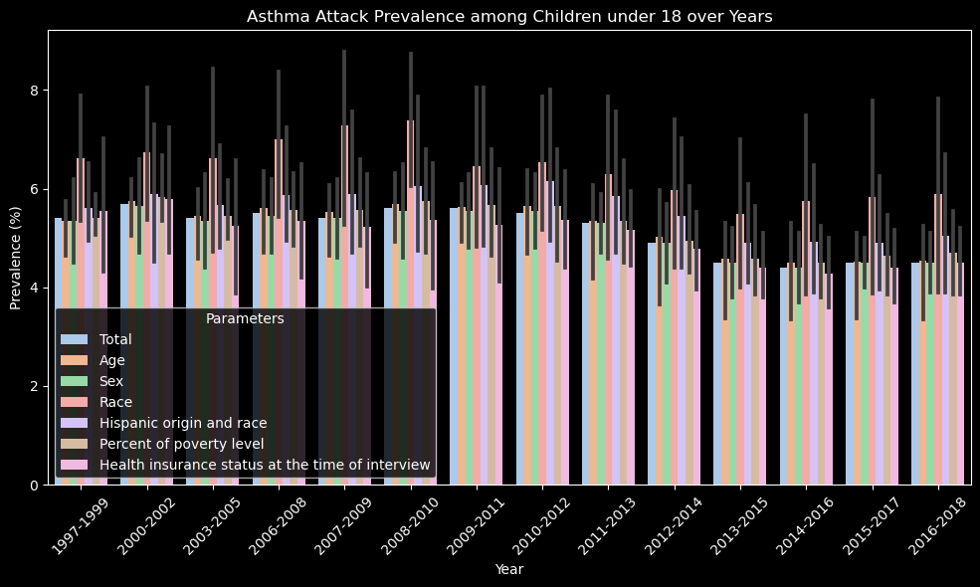
Bar Plot: Exploring Asthma Attack Prevalence among Children under 18
This bar plot showcases the prevalence of asthma attacks among children under 18 years across different years. Each bar represents the prevalence estimate for a specific year, with distinct colors indicating different age groups. By visualizing the prevalence estimates over time, this plot enables the comparison of asthma attack prevalence among different age groups and highlights any trends or variations across the specified time period.

Slide 14
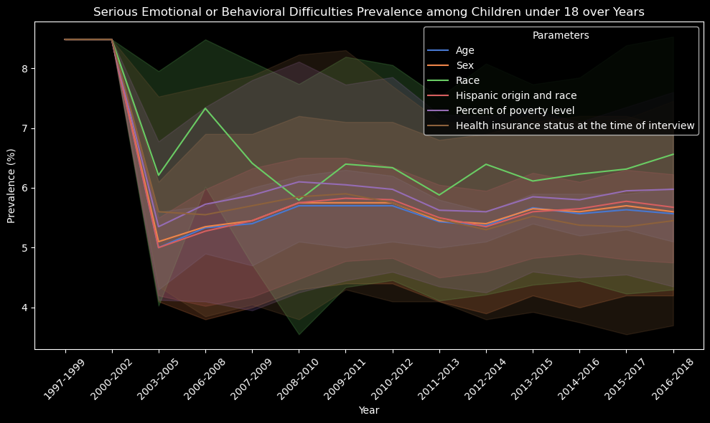
Line Plot: Exploring Prevalence of Serious Emotional or Behavioral Difficulties among Children under 18
This line plot depicts the prevalence of serious emotional or behavioral difficulties among children under 18 years across various years. Each line represents a different parameters, allowing for comparison of prevalence trends over time. The visualization provides insights into potential changes or patterns in the prevalence of these difficulties among different age groups over the specified time period.

Slide 15
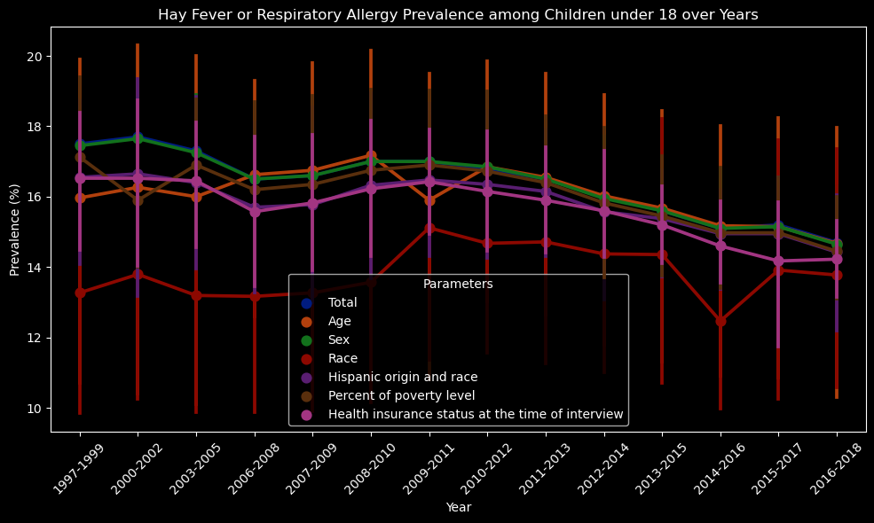
Point Plot: Exploring Hay Fever or Respiratory Allergy Prevalence among Children under 18
This point plot visualizes the prevalence of hay fever or respiratory allergy among children under 18 years across different years. Each point represents the estimated prevalence for a specific year and age group combination, with distinct colors indicating different age groups. By plotting the prevalence estimates over time, this visualization facilitates the identification of trends or patterns in hay fever or respiratory allergy prevalence among children under 18 years.

Slide 16
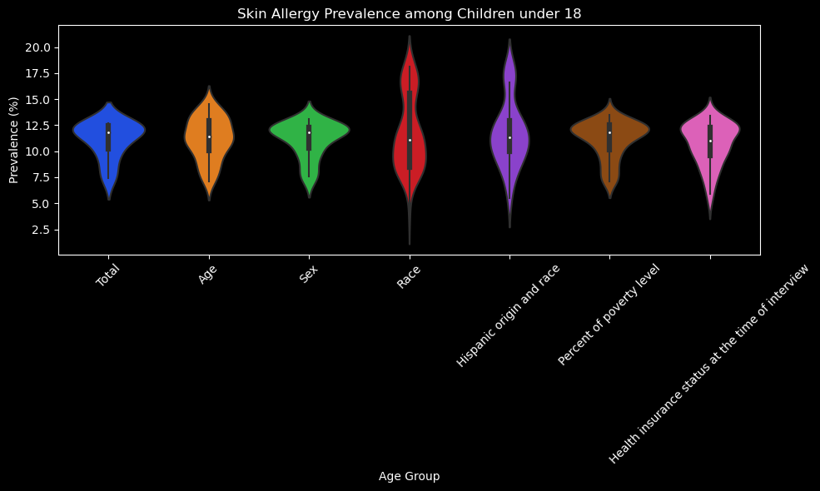
Violin Plot: Exploring Skin Allergy Prevalence among Children under 18
This violin plot illustrates the prevalence distribution of skin allergy among children under 18 years across different age groups. The width of each violin represents the frequency of prevalence estimates within the corresponding age group, while the shape provides insights into the distribution's characteristics, such as symmetry and skewness. By visualizing the prevalence distribution across age groups, this plot aids in understanding the variability and central tendency of skin allergy prevalence among children under 18.

Slide 17
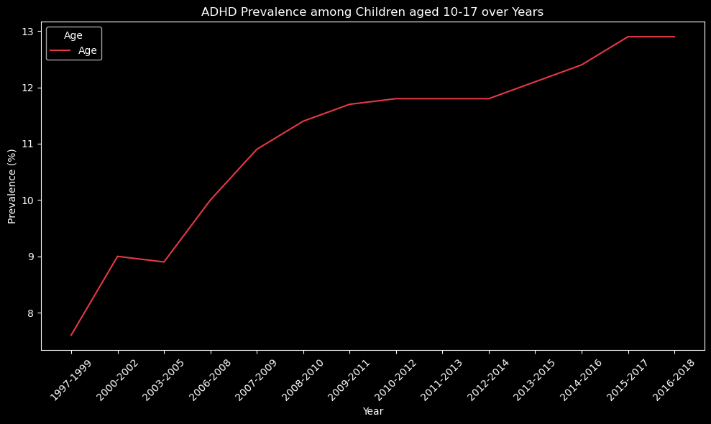
Line Plot: Exploring ADHD Prevalence among Children
This line plot illustrates the prevalence of Attention Deficit Hyperactivity Disorder (ADHD) among children aged 10-17 years over various years. Each line represents a specific subgroup within the age range, distinguished by different colors. The visualization enables observation of ADHD prevalence trends over time within the specified age group, aiding in understanding potential variations or patterns in ADHD prevalence among children aged 10-17 years. Rotation of x-axis labels enhances readability, facilitating easier interpretation of the plot.

Slide 18
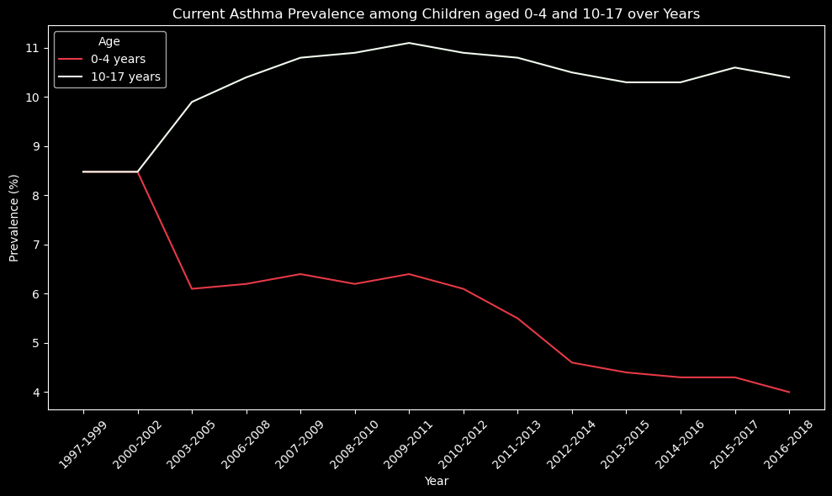
Line Plot: Exploring Current Asthma Prevalence among Children
This line plot depicts the prevalence of current asthma among children aged 0-4 years and 10-17 years across various years. The visualization enables comparison between the two age groups, highlighting potential differences in asthma prevalence trends over time. The distinct colors distinguish between children aged 0-4 years and those aged 10-17 years, facilitating easy interpretation of the plot. Rotation of x-axis labels enhances readability, providing a comprehensive overview of current asthma prevalence among children of different age ranges.

Slide 19
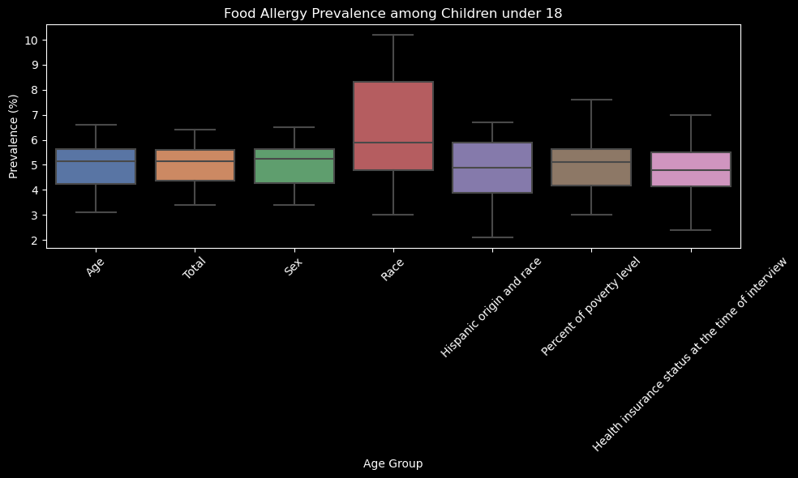
Box Plot: Exploring Food Allergy Prevalence among Children under 18
This box plot visualizes the prevalence of food allergy among children under 18 years across different age groups. Each box represents the distribution of prevalence estimates within a specific age group, offering insights into the variability and central tendency of the data. The plot provides a clear overview of how food allergy prevalence varies among different age groups, aiding in the understanding of potential age-related patterns or differences in prevalence rates.

Slide 20
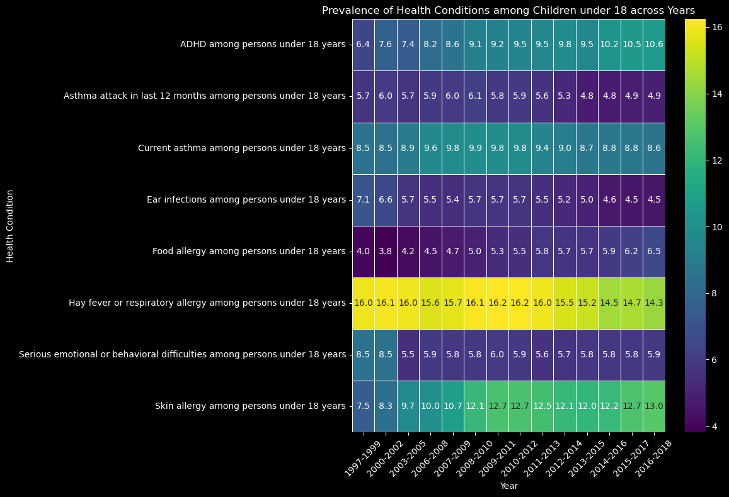
Heatmap: Exploring Prevalence of Health Conditions among Children under 18 Across Years
This heatmap visualizes the prevalence of various health conditions among children under 18 years across different years. Each cell represents the prevalence estimate for a specific health condition in a particular year, with color intensity indicating the prevalence rate. Annotations provide precise prevalence information, facilitating interpretation and comparison of health conditions over time.

Slide 21
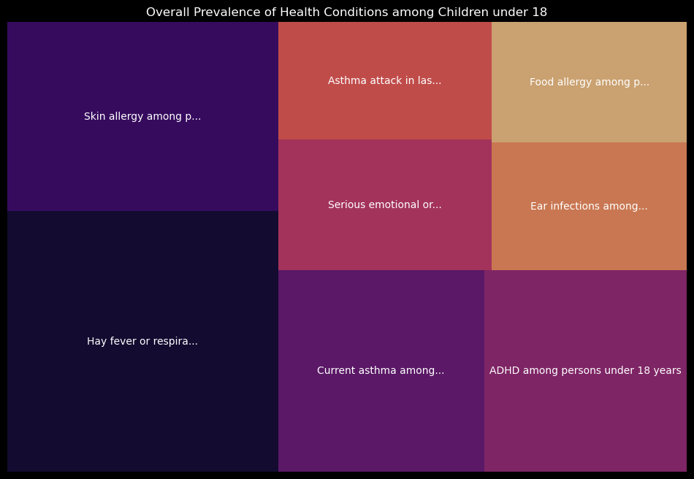
Treemap: Visualizing Overall Prevalence of Health Conditions among Children under 18
This visualization depicts the overall prevalence of different health conditions among children under 18 years old. Each rectangle represents a specific health condition, with its size proportional to the mean prevalence estimate. The color intensity indicates the magnitude of prevalence, with darker shades representing higher prevalence rates.

Slide 22
CONCLUSION
The analysis of pediatric health conditions among children under 18 years has provided valuable insights into the prevalence and patterns of various ailments. Through comprehensive data exploration, visualization, and predictive modeling, we have gained a nuanced understanding of how conditions such as asthma, ADHD, allergies, and others manifest across different age groups and over time. This exploration has not only highlighted the dynamic nature of pediatric health but also underscored the importance of targeted interventions and age-specific healthcare strategies.

Slide 23
THANK
YOU

