Slide 1
Credit Card Fraud Detection

Slide 2
TABLE OF CONTENTS
01
02
03
Introduction
Objectives
Analysis
04
05
06
Machine Learning
Functionalities
Conclusion

Slide 3
01 Introduction

Slide 4
Credit card fraud detection is the process of identifying purchase attempts that are fraudulent and rejecting them rather than processing the order. There are a variety of tools and techniques available for detecting fraud, with most merchants employing a combination of several of them.

Slide 5
02 Objectives

Slide 6
The key objective of any credit card fraud detection system is to identify suspicious events and report them to an analyst while letting normal transactions be automatically processed.

Slide 7
03 Analysis

Slide 8
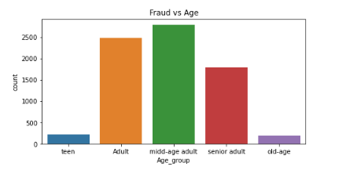
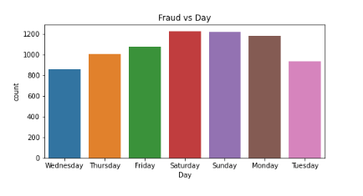
Age wise Fraud Study :-
Mostly fraud happens with people of age 20 to 40
-: Day wise Fraud Study
Mostly fraud happens on weekend that is Saturday Sunday.

Slide 9
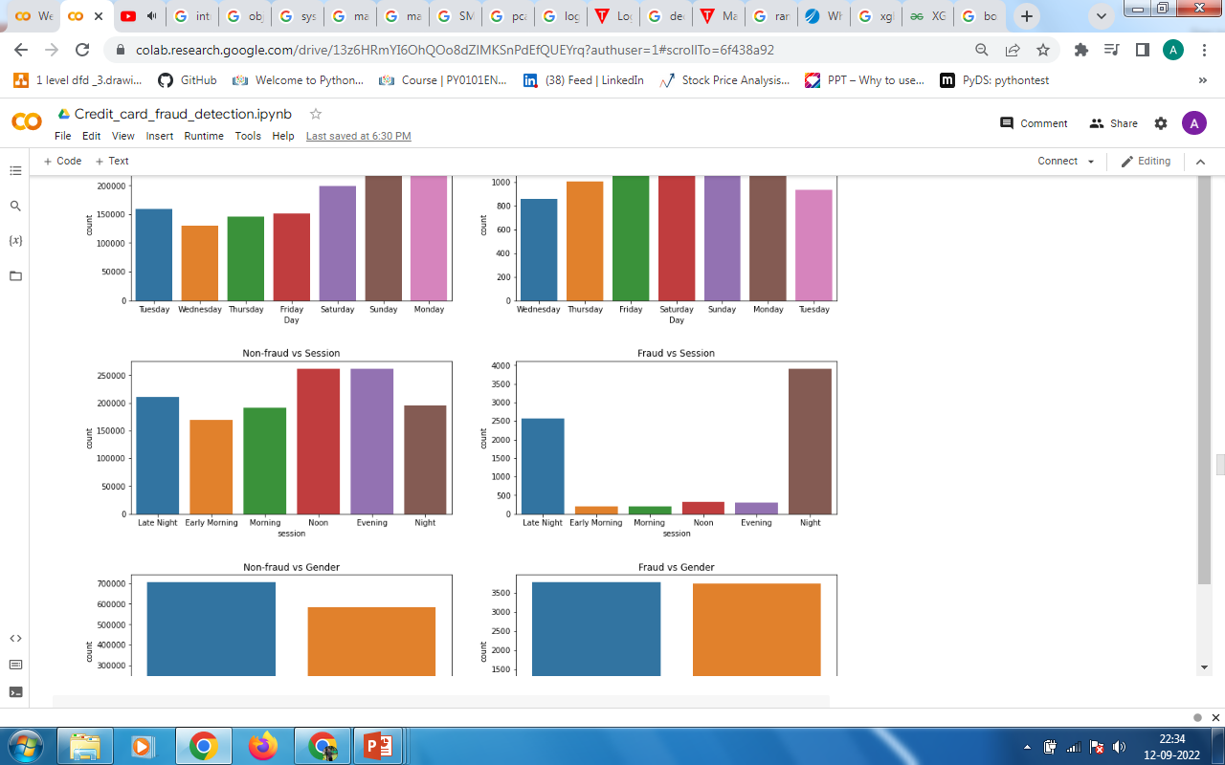
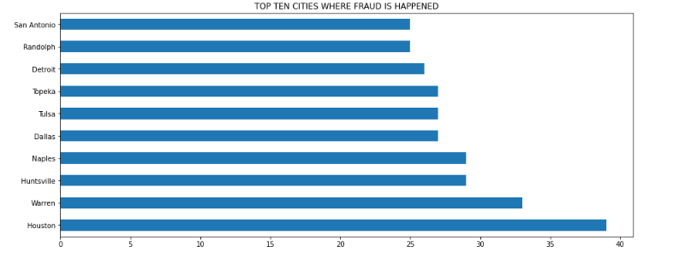
Time wise Fraud Study :-
From Graph we can see that mostly fraud happens at night time.
-: City wise Fraud Study
From Graph we can see that mostly fraud happens in Houston city.

Slide 10
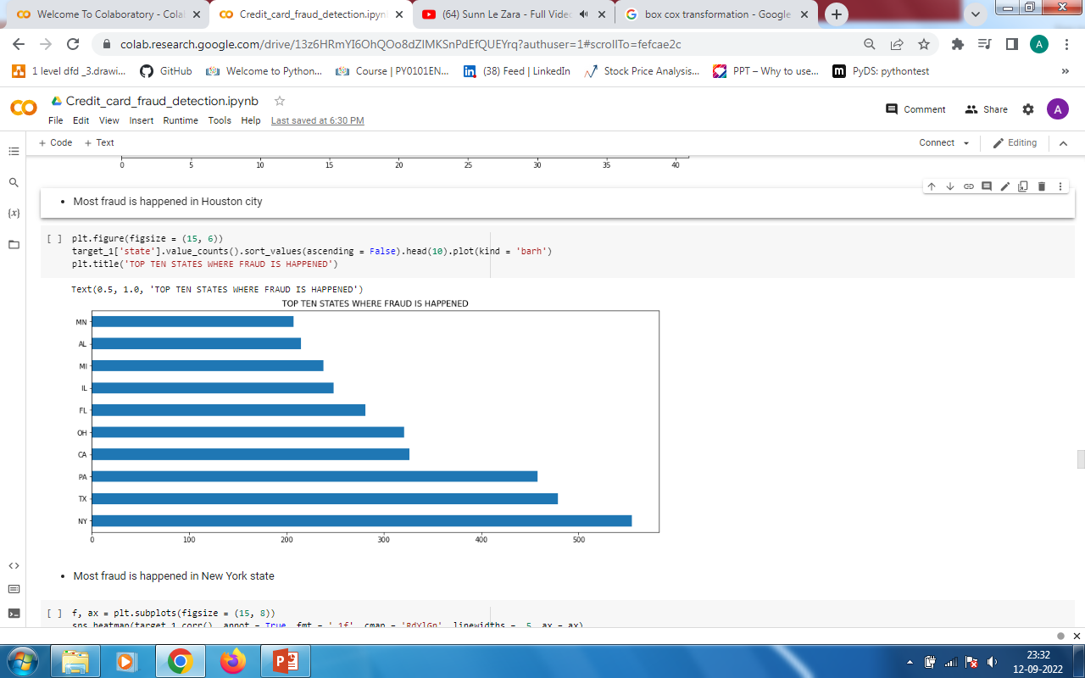
State wise Fraud Study :-
From Graph we can see that mostly fraud happens in New York state.

Slide 11
04 Machine Learning

Slide 12
Machine Learning
Machine learning (ML) is a type of artificial intelligence (AI) that allows software applications to become more accurate at predicting outcomes without being explicitly programmed to do so. Machine learning algorithms use historical data as input to predict new output values.

Slide 13
05 Functionalities

Slide 14
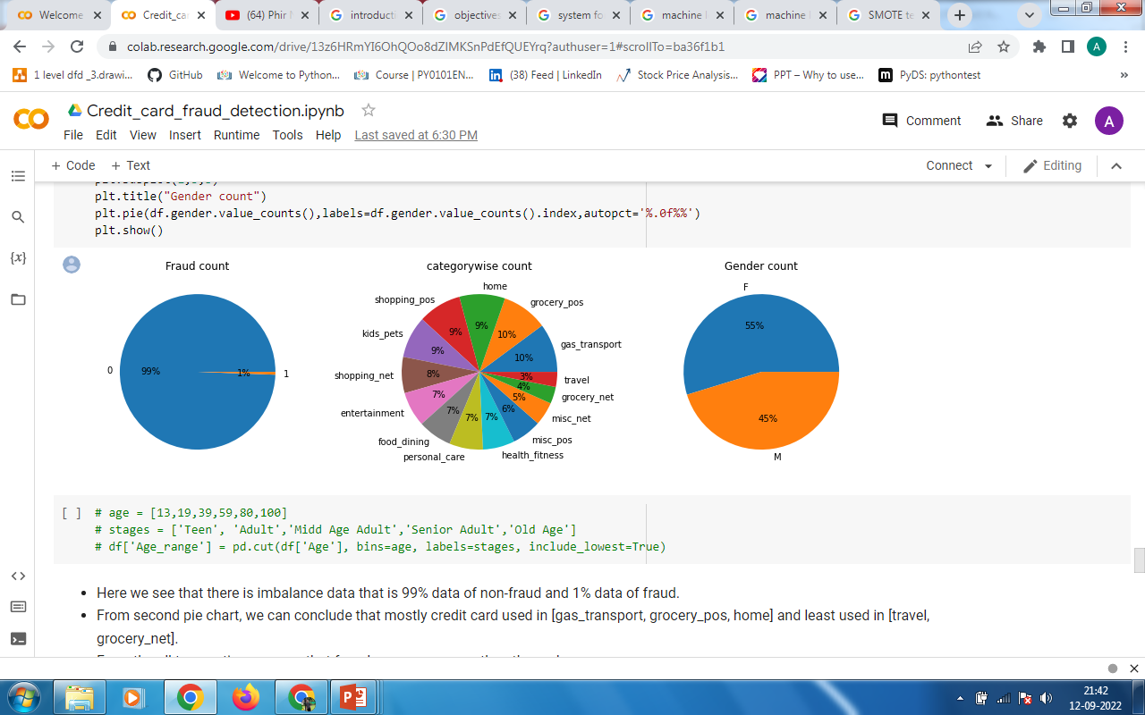
Sampling Technique :
SMOTE
( Synthetic Minority Oversampling Technique )
SMOTE is an oversampling technique where the synthetic samples are generated for the minority class. This algorithm helps to overcome the overfitting problem posed by random oversampling.
SMOTE is used to oversample the minority class that is in this case the fraud transaction data.

Slide 15
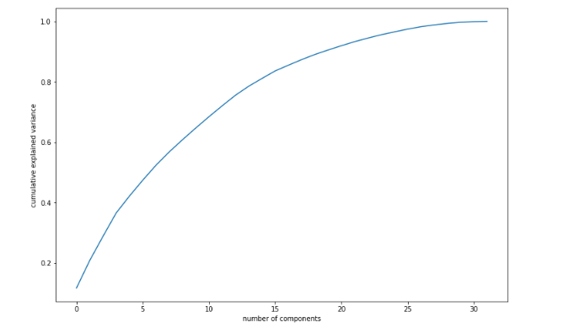
Machine Learning Algorithms :
1. PCA Principle Component Analysis
PCA is an unsupervised machine learning algorithm that attempts to reduce the dimensionality (number of features) within a dataset while still retaining as much information as possible.
Plot shows that 23 components are enough to explain close to 95% variance

Slide 16
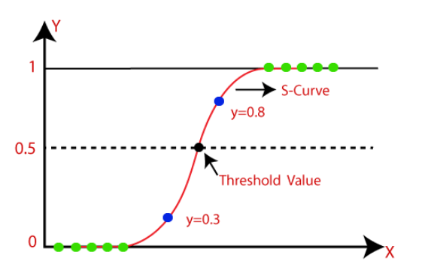
2. Logistic Regression
Logistic regression is an example of supervised learning. It is used to calculate or predict the probability of a binary (yes/no) event occurring.

Slide 17
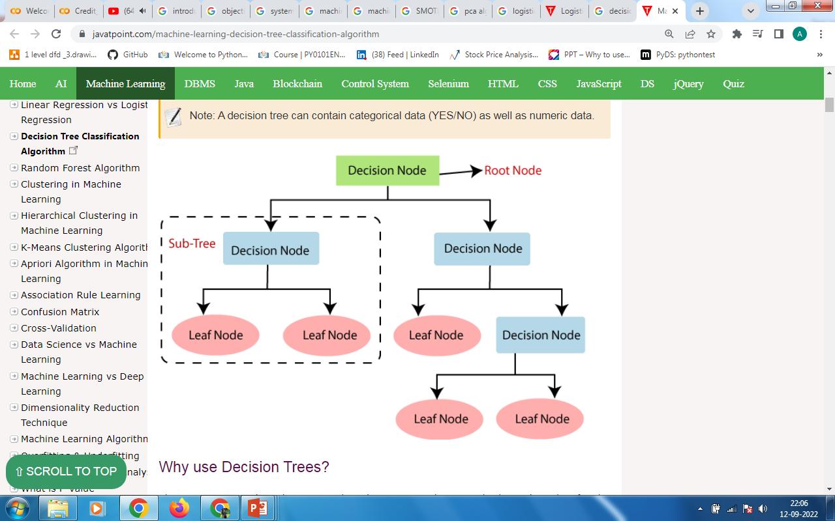
3. Decision Tree
Decision Trees are a type of Supervised Machine Learning (that is you explain what the input is and what the corresponding output is in the training data) where the data is continuously split according to a certain parameter. The tree can be explained by two entities, namely decision nodes and leaves.

Slide 18
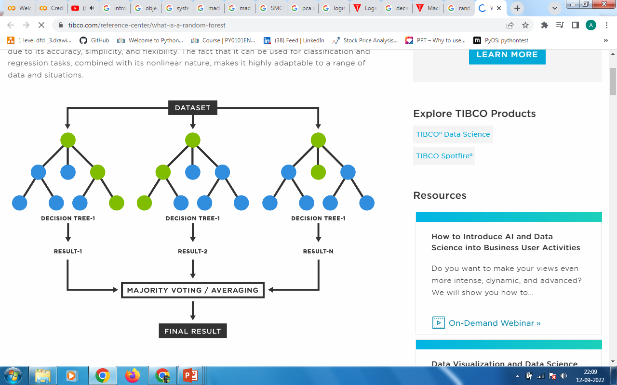
4. Random Forest
Random forest is a Supervised Machine Learning Algorithm that is used widely in Classification and Regression problems. It builds decision trees on different samples and takes their majority vote for classification and average in case of regression.

Slide 19
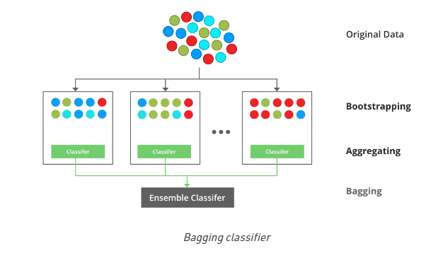
5. XGBoost
XGBoost is a popular and efficient open-source implementation of the gradient boosted trees algorithm. Gradient boosting is a supervised learning algorithm, which attempts to accurately predict a target variable by combining the estimates of a set of simpler, weaker models.

Slide 20
06 Conclusion

Slide 21
Everyday the online banking are growing so fraud is also increased to reduce the risk of being suspect of fraud we developed a machine learning model which will predict type of transaction and if the transaction is fraud then get authentication from the credit card holder. For this The XGBoost algorithm performs best.

Slide 22
Thanks…..

