Slide 1
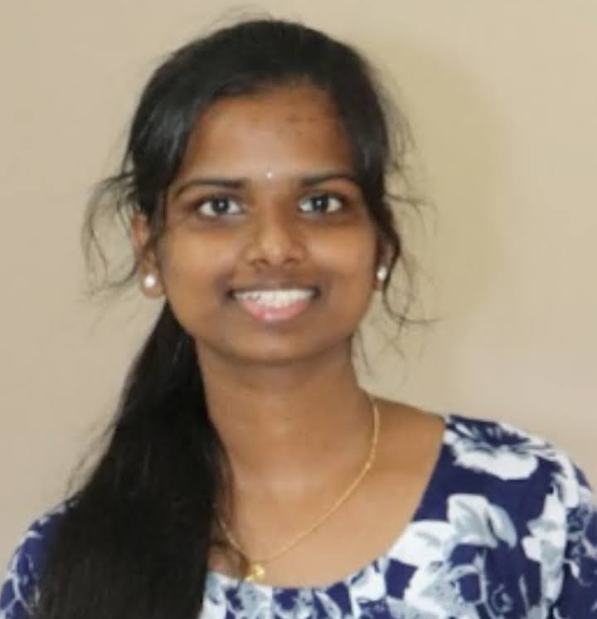
AISHWARYA PEERALLA
Analyst/Software Engineer
Bachelor of Technology
Electrical and Electronics Eng. :2017-2021
Mumbai
Skills Java 8 /J2EE
Spring Boot
Spring MVC
JPA CRUD
React
Database:
SQL database
Postgresql
Web Technologies
HTML5
CSS3
JavaScript
Certification
Completed Agile Fundamentals certification
Additional Details
Leadership
Quick Learner
Team management
peeralla.aishwarya@capgemini.com
+91 7901472464
A4
Proficient in JAVA and OOPs concepts.
Hands on experience in creating Web Application with Spring boot , Java, Rest API, React.
Hands on experience in developing web pages using HTML5, CSS3, Object Oriented Programming, JSON, XML. Good understanding of Document Object Model (DOM) and DOM Functions.
Proficient in creating Web Application in React with Authentication with routing.
Experience in creating documentation with swagger and unit testing using JUnit.
Movie Ticket Booking Application
Completed end to end case study of Movie ticket booking application System . along with API Gateway, Swagger , Postman, responsive UI with HTML5, CSS, Bootstrap and React used as User Interface.

