Slide 1
Demonstration on Adaptive AUTOSAR Advance C++ & Gtest
Aishwarya Srivastava
July 21, 2023

Slide 2
Agenda
AUTOSAR – overview
Adaptive AUTOSAR
Adaptive Platform – Characteristics
Architecture
Advance C++
G-test

Slide 3
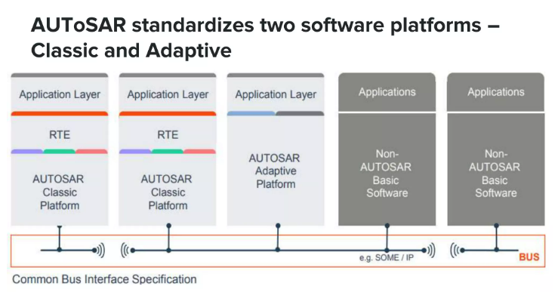
Overview of AUTOSAR

Slide 4

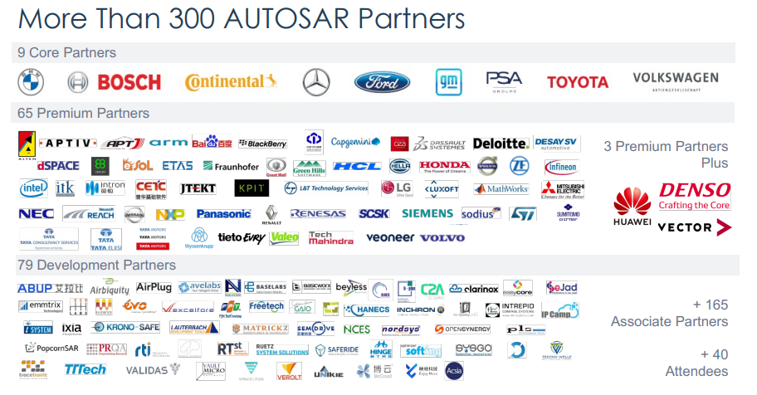

Slide 5
CLASSIC vs ADAPTIVE PLATFORM
CLASSIC PLATFORM | ADAPTIVE PLATFORM
Single Address space (MPU support for safety) | Virtual address space for each application (MMU support)
Statically configured signal-based communication (CAN , FlexRay) | Dynamically configured, service-oriented communication
Based on OSEK | Based on POSIX (PSE51)
Execution of code directly from ROM | Application is loaded from persistent memory into RAM
Statically defined task configuration | Support of multiple (dynamic) scheduling strategies
Specification | Specification as binding standard, code as demonstrator
Pillars of Classic Platform : Functional Safety, Efficiency, Field Proven, Performance | Pillars of Adaptive Platform : Safe and Secure, Connected, Dynamic and Updateable

Slide 6
Why a new platform? Why Adaptive AUTOSAR?
New more powerful Hardware
o Tendency to integrate more ECUs into one
o More and more CPUs (MMUs) are used instead of MCUs
Vehicle-2-X-application and IoT
o High connectivity support
High automated driving
o Additional sensors are needed
o Additional computational power is needed
o Connectivity at scale

Slide 7
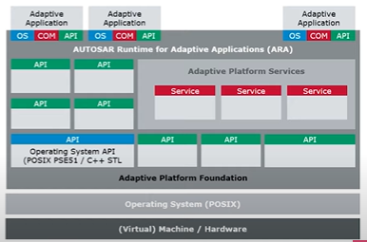
Adaptive AUTOSAR - Architecture Overview
Applications run on the top of the AUTOSAR
Runtime (ARA)
Runtime is a set of APIs
(application programming interfaces)
for different Functional Clusters
Paradigm change due to the use of
C++ as a programming language
Service Oriented Communication as a base
for Service Oriented Architecture(SOA)
POSIX operating system (applications run as processes)
Planned dynamics
Incremental Deployment
Configuration changes during runtime

Slide 8
Basic building blocks
Overview of the different categories of building blocks available in the AUTOSAR Adaptive Platform
Runtime
Communication
Storage
Security
Safety
Configuration
Diagnostics

Slide 9
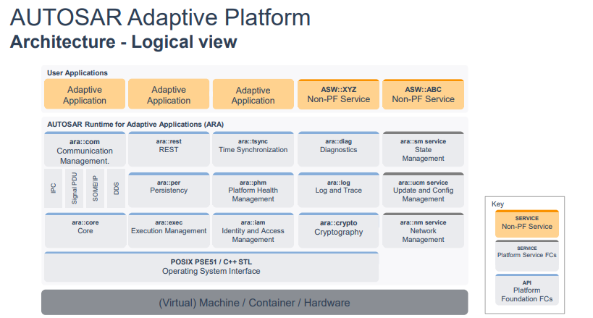

Slide 10
Runtime
Functional Clusters in Runtime category are :
Execution Management
Execution Management is responsible to control Processes of the AUTOSAR Adaptive Platform and Adaptive Applications.
State Management
State Management determines the desired target state of the AUTOSAR Runtime for Adaptive Applications based on various application-specific inputs.
Log and Trace
Log and Trace provides functionality to build and log messages of different severity.
Core
Core provides functionality for initialization and de-initialization of the AUTOSAR Runtime for Adaptive Applications as well as termination of Processes.
Operating System Interface
The Operating System Interface provides functionality for implementing multi-threaded real-time embedded applications and corresponds to the POSIX PSE51 profile.

Slide 11
Communication
Functional Clusters in Communication category are :
Communication Management
Communication Management is responsible for all levels of service-oriented and raw communication between applications in a distributed real-time embedded environment.
Network Management
Network Management provides functionality to request and query the network states for logical network handles, Such network handles can be mapped to physical or partial networks.
Time Synchronization
Time Synchronization provides synchronized time information in distributed applications.

Slide 12
Storage
Functional Clusters in Storage category :
Persistency
Persistency provides functionality to store and retrieve information to/from non-volatile storage of a Machine.

Slide 13
Security
Functional Clusters in Storage category :
Cryptography
Cryptography provides various cryptographic routines to ensure confidentiality of data, to ensure integrity of data (e.g., using hashes), and auxiliary functions for example key management and random number generation.
Identity and Access Management
Identity and Access Management checks access to resources of the AUTOSAR Adaptive Platform, for example, on Service Interfaces and Functional Clusters.
Adaptive Intrusion Detection System Manager
Adaptive Intrusion Detection System Manager provides functionality to report security events.
Firewall
The Firewall is responsible for filtering network traffic based on firewall rules to protect the system from malicious messages.

Slide 14
Safety
Functional Clusters in Safety category :
Platform Health Management
Platform Health Management performs (aliveness, logical, and deadline) supervision of Processes in safety-critical setups and reports failures to State Management.

Slide 15
Configuration
Functional Clusters in Configuration category :
Update and Configuration Management
Update and Configuration Management is responsible for updating, installing, removing and keeping a record of the software on an AUTOSAR Adaptive Platform in a safe and secure way.
Registry
The Registry is an internal component of the AUTOSAR Adaptive Platform that provides access the information stored in Manifests

Slide 16
Diagnostics
Functional Clusters in Diagnostics category :
Diagnostic Management
Diagnostic Management is responsible for handling diagnostic events produced by the individual Processes running in an AUTOSAR Runtime for Adaptive Applications

Slide 17
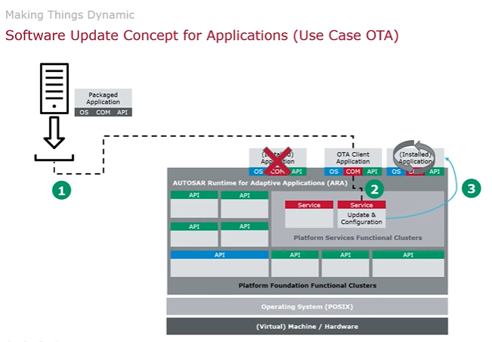
On The Air Update – Use Case -1

Slide 18
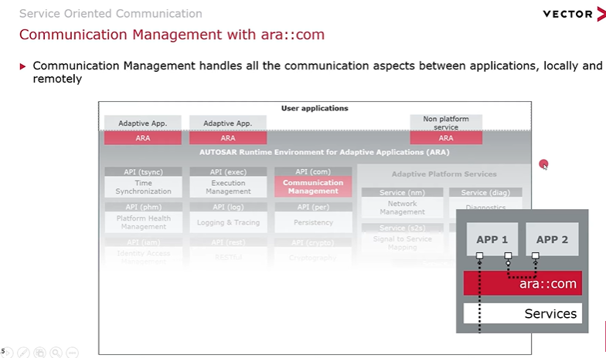
Service Oriented Architecture : Use- Case-2

Slide 19
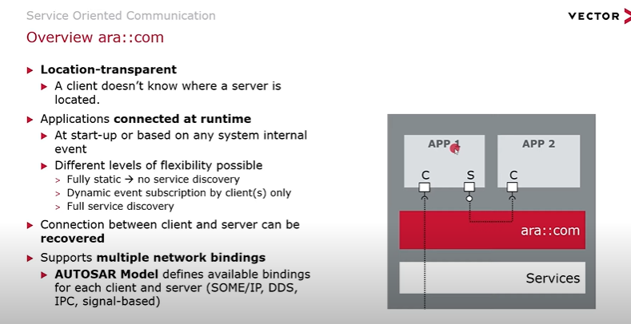
Service Oriented Communication

Slide 20
Features of Adaptive AUTOSAR
Ethernet-based communication (full utilization compared to CP).
Manycore processors, heterogeneous setup, dedicated functions via FPGA( where CP was originally designed for a single core MCU).
Heterogenous computing to achieve best performance-er-watt(not in CP scope).
SoC and NoC (network on chip) with more processing power and faster communication to achieve scalability (not in CP scope).
C++14(and further incarnations) as a language of choice. Leverage existing standards.
Complex model of SOA: system of systems that scale well. Distributed computing and software portability.
Inherent parallelism due to use of manycore-heterogeneous computing.
Full-scope virtualization.
Safety and security in distributed computing.
Dynamic management of resources and communications. Dynamic behavior limited declaratively through Execution manifest.
Increment scalable, changeable after deployment system.
Agile approach

Slide 21
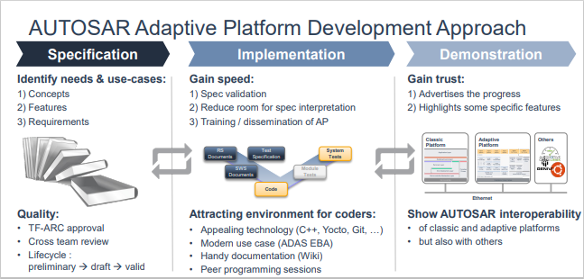

Slide 22
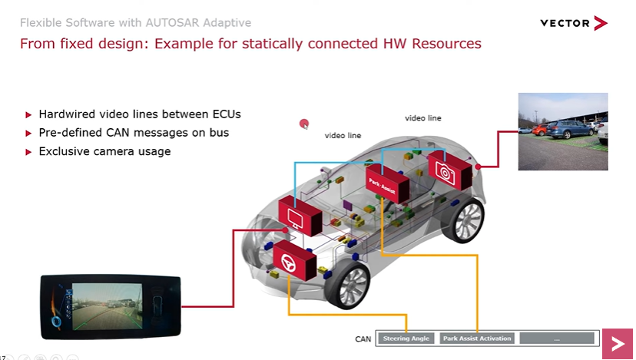
Impact of Added Functionality : Classic Platform

Slide 23
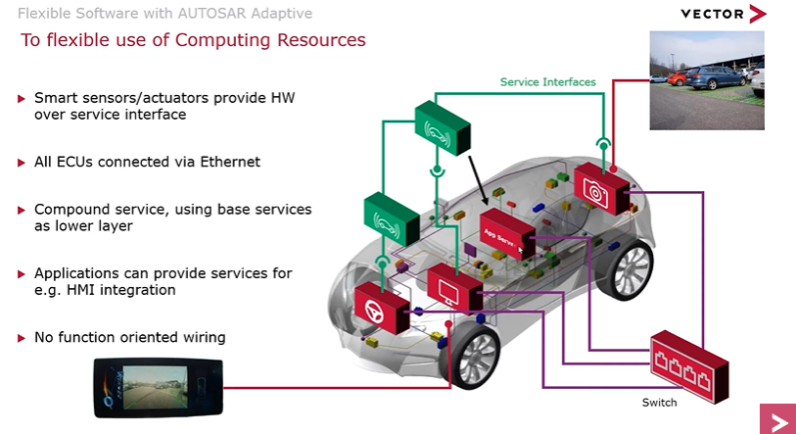

Impact of Added Functionality : Adaptive Platform

Slide 24
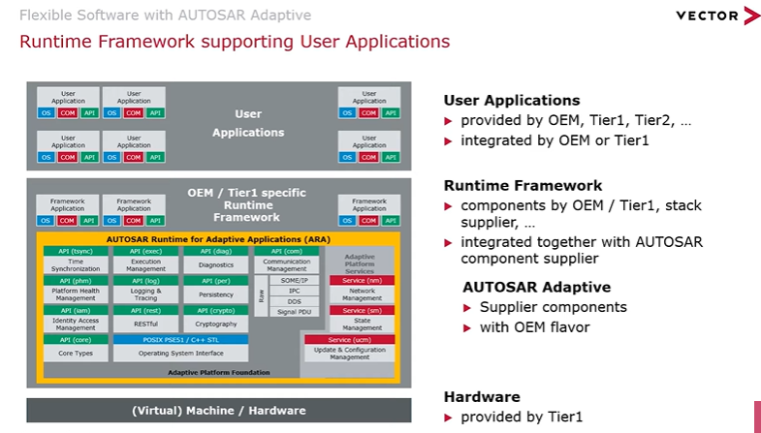
Conclusion

Slide 25
Advance Concepts of C++
Important terms
File handling

Slide 26
Advance Concepts of C++
Object-Oriented Programming (OOP)** - C++ is a powerful object-oriented programming language. - OOP helps in organizing code, making it easier to manage and understand. - Key OOP concepts in C++ include classes, objects, encapsulation, inheritance, and polymorphism.
Templates** - Templates allow writing generic code that can work with different data types. - Function templates and class templates are two types of templates. - They promote code reusability and help in creating flexible and efficient algorithms.
Smart Pointers** - Smart pointers are a safer alternative to raw pointers in C++. - They automatically manage memory, avoiding memory leaks and null pointer dereferencing. - `std::shared_ptr`, `std::unique_ptr`, and `std::weak_ptr` are common smart pointer types.
Move Semantics** - Move semantics optimize the transfer of data between objects, reducing unnecessary copies. - The move constructor and move assignment operator enable efficient resource handling, like in dynamic memory management. - Greatly improves performance and reduces memory overhead.

Slide 27
Exception Handling** - Exception handling allows you to deal with unexpected errors gracefully. - C++ provides try-catch blocks to handle exceptions and ensure a program's stability. - Proper exception handling can prevent crashes and help debug problems.
Standard Template Library (STL)** - The STL is a collection of pre-built classes and functions in C++. - It includes containers (e.g., vectors, lists, maps), algorithms (e.g., sorting, searching), and iterators. - STL promotes code reusability and saves development time.
Lambda Expressions** - Lambda expressions are anonymous functions that can be defined in-place. - They are useful for short and one-time use functions, like in algorithms or event handlers. - Capture lists allow lambdas to capture variables from their surrounding scope.
Multithreading** - C++ provides multithreading support to execute tasks concurrently. - `std::thread` allows creating and managing threads. - Multithreading can enhance performance, especially in CPU-bound tasks.

Slide 28
RAII (Resource Acquisition Is Initialization)** - RAII is an essential C++ idiom for resource management. - It ensures that resources (like memory or file handles) are released automatically when the object goes out of scope. - Smart pointers are an example of RAII in action.
Rvalue References** - Rvalue references, denoted by `&&`, enable move semantics and perfect forwarding. - They are essential for efficient resource management and building generic functions. - `std::move` and `std::forward` are used in conjunction with R-value references.
constexpr** - `constexpr` is used to define values that can be evaluated at compile time. - It allows performing computations during compilation, reducing runtime overhead. - Helpful for constants, template parameters, and performance optimization.

Slide 29
File handling
File handling is used to store data permanently in a computer. Using file handling we can store our data in secondary memory (Hard disk). How to achieve the File Handling.
STEP 1-Naming a file STEP 2-Opening a file STEP 3-Writing data into the file STEP 4-Reading data from the file STEP 5-Closing a file.

Slide 30
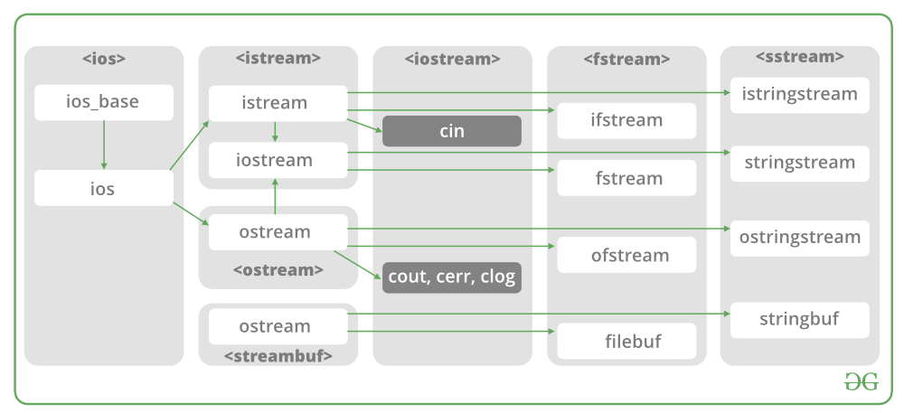
Classes for File stream operations

Slide 31
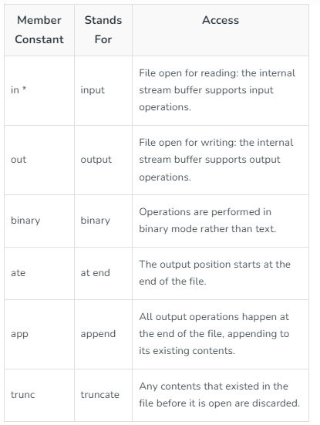
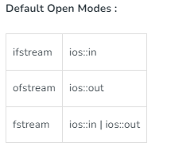
Modes

Slide 32
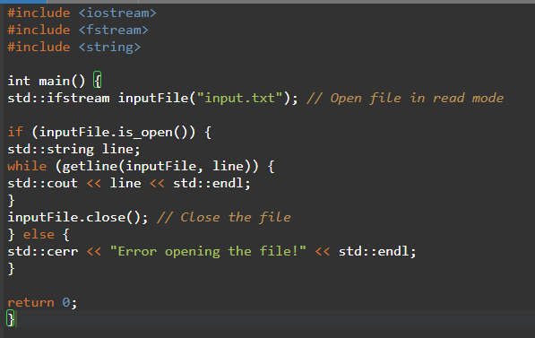
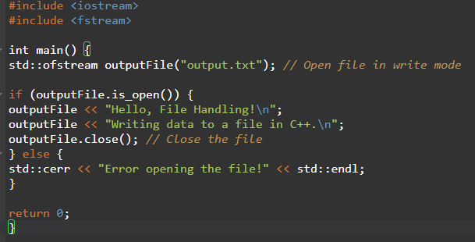


Programs to read and write data in file

Slide 33
Overview*
- What is Google Test?
- Why use Google Test?
- Key Features

Slide 34
What is Google Test?* - Google Test is a C++ testing framework developed by Google. - It is also known as GTest. - It allows developers to write and run unit tests for their C++ code. - Part of Google's C++ Testing Framework (Google Test and Google Mock).
Why use Google Test?* - Ensures code quality: Automated testing helps catch bugs and regressions early. - Easy to write: Simple and intuitive syntax for writing test cases. - Platform independent: Supports various platforms (Linux, Windows, macOS, etc.). - Integrates with CMake and other build systems. - Large community support: Used extensively in the C++ development community.

Slide 35
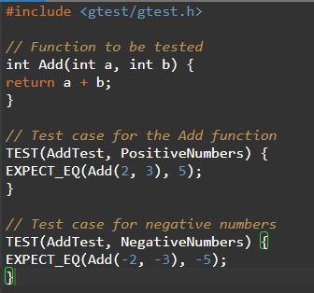
Key Features* - Test Fixtures: Setup and teardown functions for test cases. - Test Suites: Grouping related test cases together. - Assertions: Checking expected outcomes. - Parameterized Tests: Running the same test with different data sets. - Death Tests: Testing program crashes. - Test Discovery: Automatic test discovery.

Slide 36
Running Tests* - Compile the test code with Google Test and link with your project. - Use a test runner to execute the tests. - Test results will indicate whether each test passed or failed.
Assertions* - `EXPECT_EQ(expected, actual)`: Expects the two values to be equal. - `EXPECT_NE(val1, val2)`: Expects the two values to be not equal. - `EXPECT_TRUE(condition)`: Expects the condition to be true. - `EXPECT_FALSE(condition)`: Expects the condition to be false. - And more (check GTest documentation).

Slide 37
Advanced Features* - Test Fixtures: `SetUp()` and `TearDown()` functions for test case setup and cleanup. - Parameterized Tests: Running the same test with different inputs. - Death Tests: Verifying that code crashes when expected. - Test Discovery: Automatically discovers and runs test cases.

Slide 38
Thank You

