Slide 1

NUMBER WRITING MANIPULATOR
TANUJ BL.EN.U4AIE19041
AKHIL BL.EN.U4AIE19049
AISHWARYA BL.EN.U4AIE19068

Slide 2
OUTLINE
Problem Statement
Description of the mechanism
Implementation
Commands used
Code
Results
Conclusion & references

Slide 3
PROBLEM STATEMENT
NUMBER WRITING MANIPULATOR
Design and implement a planar robotic manipulator with suitable degree of freedom to write characters {1, 3, 4, 5, 9, 0}. Input for the system is character to be written.

Slide 4
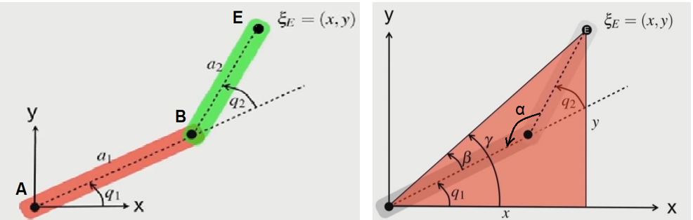
DESCRIPTION OF THE MECHANISM
2 link mechanism with 1 fixed joint at ‘A’.
No. of revolute joints: 3
No. of prismatic joints: 0
Hence, it is a planar robot
Degree Of Freedom (DOF) = 3
E(x, y) is the desired end position of the manipulator

Slide 5
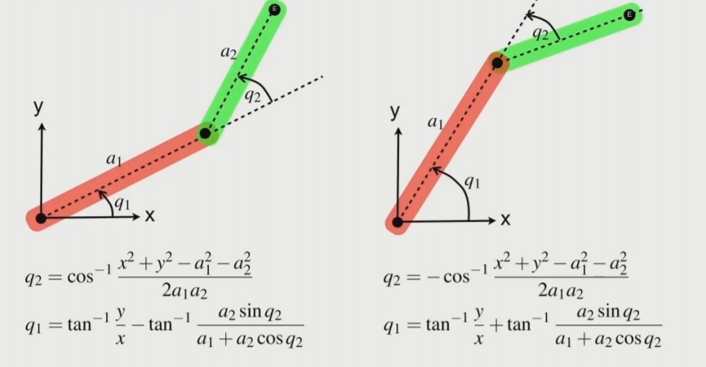
Two possible representations of a planar 2 link robotic manipulator

Slide 6
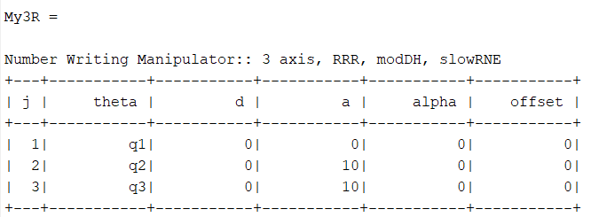
IMPLEMENTATION
DH Parameter Representation

Slide 7
COMMANDS USED
SerialLink( )
R = SerialLink(dh, options)
‘SerialLink’ returns a robot object with kinematics defined by the matrix dh.
ctraj( )
Tt = ctraj(Ti, Td, n)
‘ctraj’ function returns a straight path in cartesian space.
ikine( )
T = My3R.ikine(Tt, m, options)
‘ikine’ function calculates the inverse kinematics of the manipulator.

Slide 8
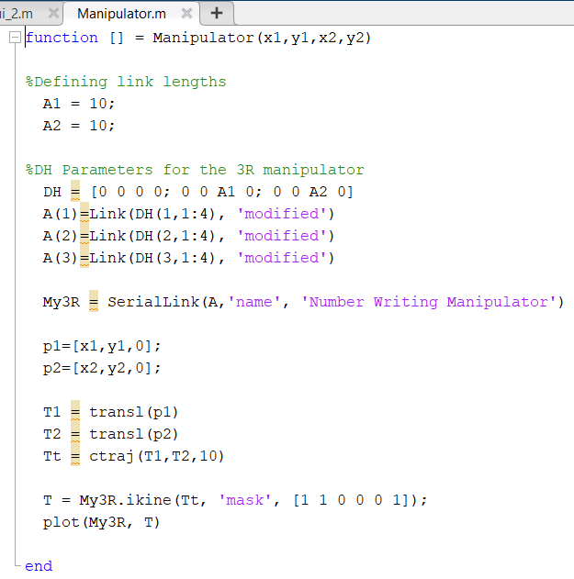
CODE

Slide 9
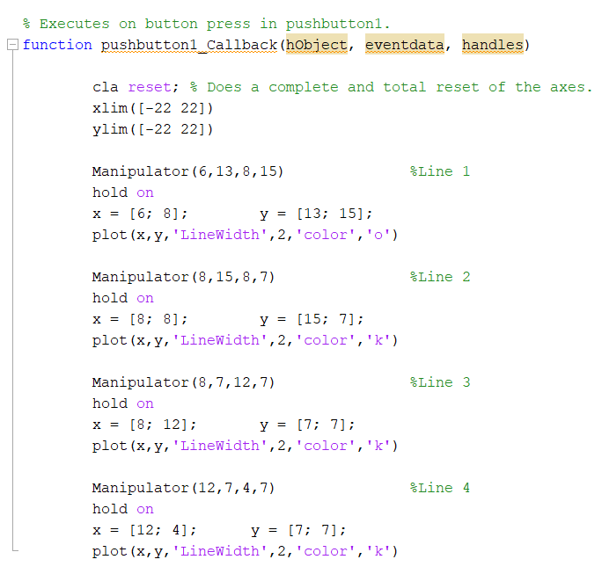
CODE

Slide 10
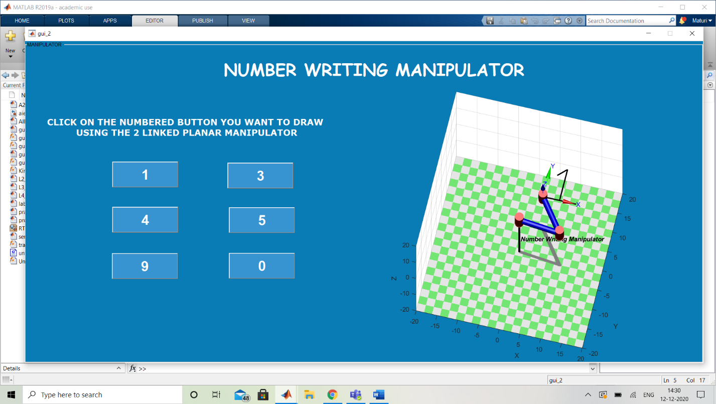
RESULTS

Slide 11
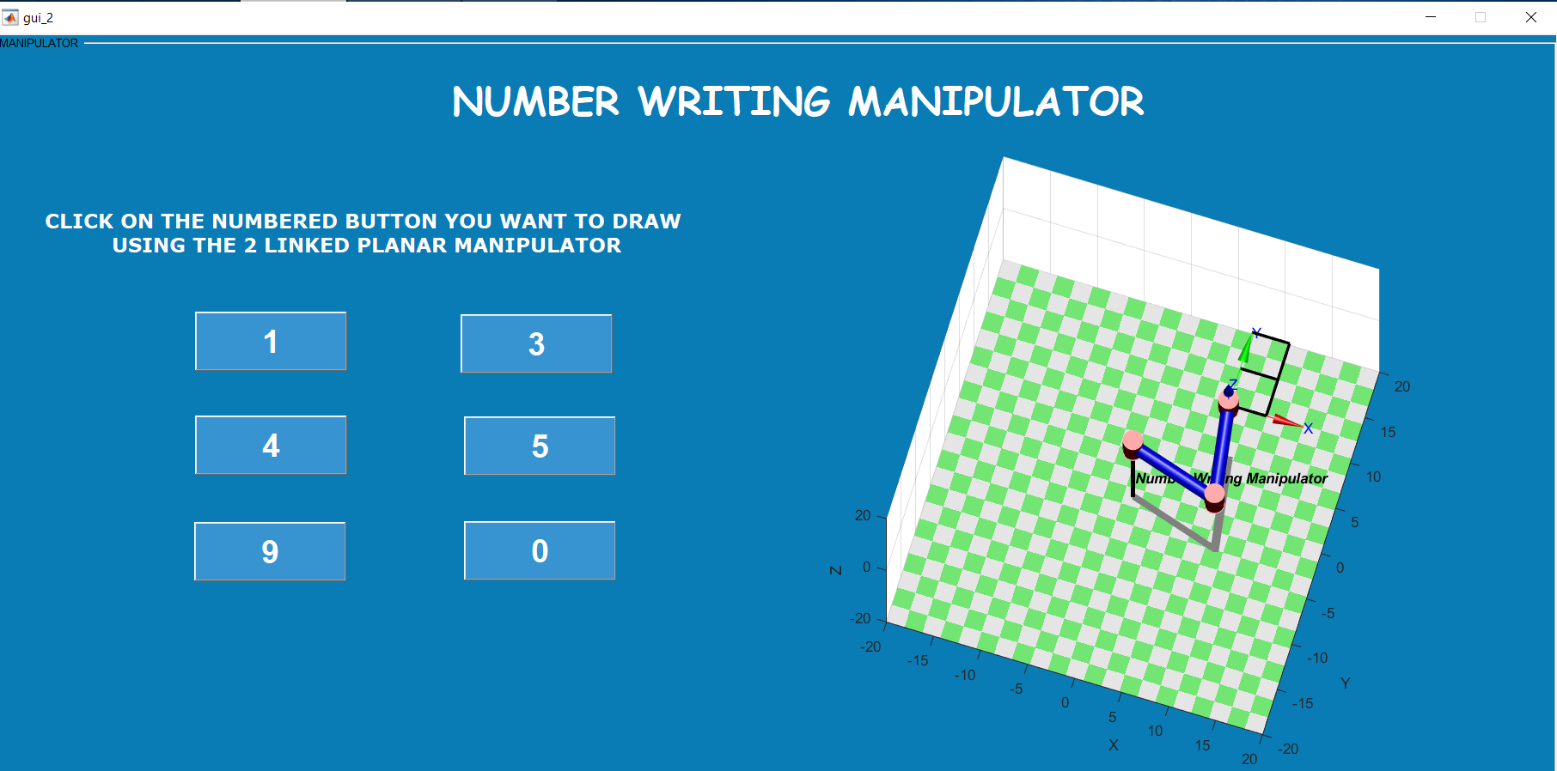

Slide 12
CONCLUSION & REFERENCES
Thus, by performing inverse kinematics and trajectory planning, we are able to build a manipulator that can draw.
By developing Matlab programs, our skills have improved.
Having analyzed the mechanism we will now be able to extend this knowledge to perform the same for any other mechanism.
http://www.sml.ee.upatras.gr/UploadedFiles/InverseKinematics.pdf
https://www.researchgate.net/publication/341070239_Design_of_2-DOF_Robot_Manipulator
https://www.youtube.com/watch?v=Oh68VtdjiLk

Slide 13
THANK YOU

