Slide 1

Sign Language Recognition
Aishwarya, Aparna, Divya Jennifer D’Souza

Slide 2
Sign Language Recognition (Paper id : 129)
Names of the authors :
Aishwarya (4th year student – CS)
Aparna (4th year student – CS)
Divya Jennifer D’Souza (Assistant Professor – CS)

Slide 3
Contents
INTRODUCTION
APPROACHES AND METHODS
STEPS TO BUILD MODEL
RESULT
CONCLUSION AND FUTURE WORK

Slide 4
INTRODUCTION
WHAT, WHY and HOW?
Sign language is a mode of communication for the people with disabilities like hearing and speaking.
It is simply a group of gestures formed by distinct shapes of hand and its movements or orientation. It could also include facial expressions expressing both information and emotions such as happiness, sadness, anger etc.
The majority of the crowd are not often exposed to the world of sign language significantly. This causes issues for people with disabilities which results in deprived communication with the majority.
The purpose of this work is to provide a real-time system which can convert our own set of signs into text.
Machine Learning – Model being able to “learn” without being manually programmed or controlled.
We use CNN model which follows supervised learning connecting our self-made dataset/signs and labels/words.

Slide 5
APPROACHES AND METHODS
Convolutional Neural Network - A CNN model is used to extract features from the frames and to predict hand gestures. It is a multilayered feedforward neural network mostly used in image recognition.
TensorFlow – Widely used in Machine Learning, mainly for Classification, Perception, Understanding, Discovering, Prediction and Creation.
Transfer Learning – Training a model for achieving a task is efficiently modified or optimized in order to accomplish the second related task.
OpenCV – It plays a significant role in real time operations hence helps in the process of detection of gestures, faces or even handwriting from images or videos.

Slide 6
STEPS TO BUILD MODEL
Dataset acquisition - Collecting images using webcam and OpenCV.
Image Pre-processing – Crop out unwanted area of images in-order to enhance image processing
Labelling – Mapping each image to its respective category (hello, bye, okay, yes, no) using LabelImg.
TensorFlow – Setup a tensor flow object detection API (TensorFlow Model Zoo) which works well on coco dataset. Start by downloading the model file further setup the configuration along with the model pipeline.
Transfer Learning – To train the CNN model by setting up paths and creating label maps. Build TF records, download TF pre-trained model and also copy paste model config to training folder. Update config later train the model and finally calculate its accuracy.
Detection – Model classifies each input and displays probabilities for every word along with its classified category in real time.
Fig : Flow Diagram

Slide 7
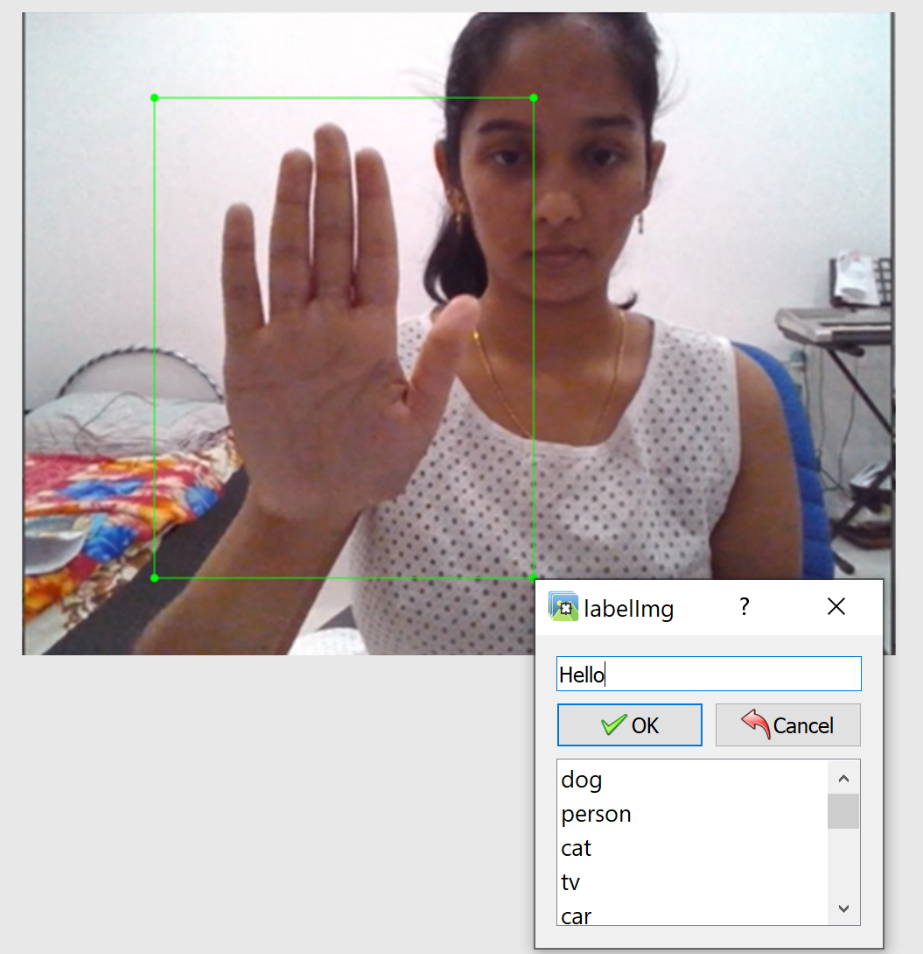
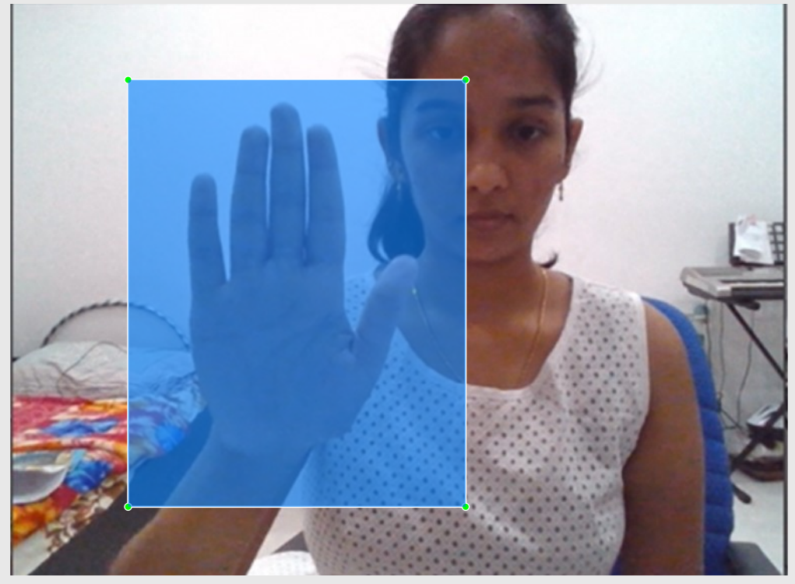
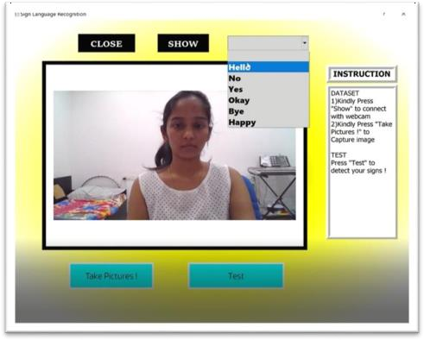
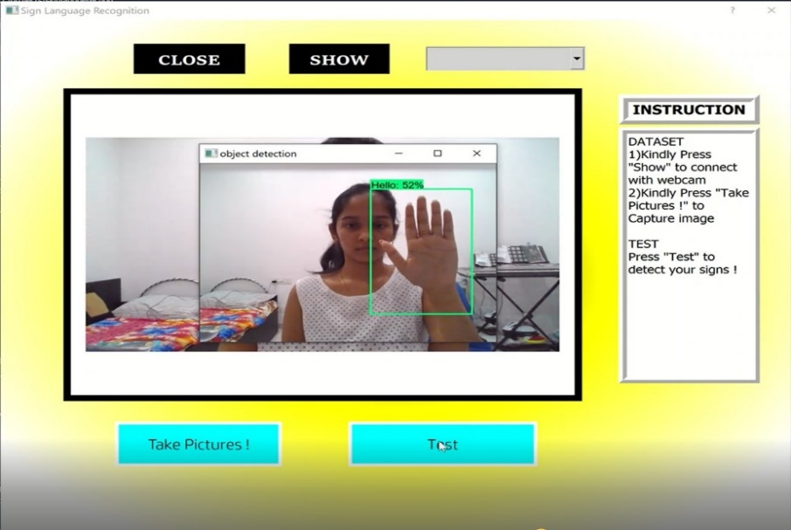

Slide 8
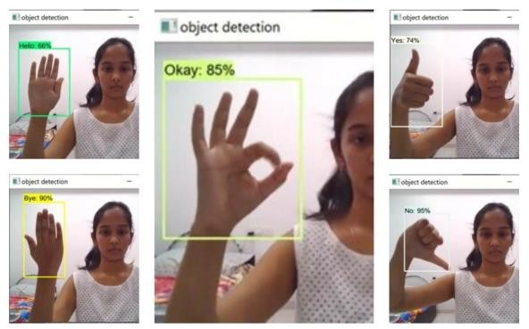
RESULT
Obtain gestures from the user using webcam (input).
Classify every frame in the video to a specific word.
Reconstruct and display the most probable word along with its classification scores/percentage (output).
Time Taken to detect = 0.922s & Accuracy of our model = 97%

Slide 9
CONCLUSION AND FUTURE WORK
According to our understanding by far we consider that the best way to solve this huge problem is by dividing it into few simpler problems.
The system performed reasonably well and it was demonstrated that a first-person sign language translation system can be built predominantly using only cameras and CNN.
Yet the challenge of improving efficiency still remains in the stems of Transfer Learning.
We focused our efforts on optimizing Mobile Net, exploring other efficient nets would be worth a try.
Classification task could be simplified by massive pre-processing for example, contrast adjustment, background subtraction and potentially cropping.

Slide 10
THANK YOU!

