Slide 1

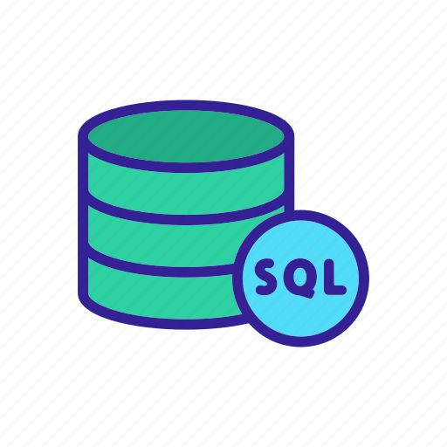
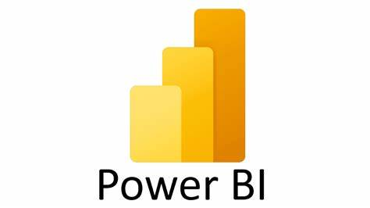
Supermarket Sales Analysis Project
Using Python SQL-Sever and Power BI
-Aishwarya Badakh

Slide 2
Project Overview
This project analyzes supermarket sales data to identify trends and insights.
It includes sales analysis, customer behavior, and payment trends.
The Power BI dashboard visualizes the key metrics for decision-making.

Slide 3
Architecture/Design Diagram
Data is collected from the supermarket point of sales system.
Data is cleaned and transformed using SQL/Python.
Power BI is used for visualization and generating insights.

Slide 4
Data Source
Dataset: Supermarket sales data from a POS system.
Contains details like product category, sales amount, payment method, and customer demographics.
Data collected from different supermarket branches.

Slide 5
Data Cleaning & Transformation
Removed missing and duplicate values.
Standardized column names and formatted data types.
Created calculated fields for total revenue, profit margin, and average ratings.
Transformed categorical data into numerical format for analysis.

Slide 6
Data Insights
Highest sales category: Food & Beverages (12.8K sales from female customers).
Most used payment method: Cash (31% of transactions).
Fashion accessories received the highest male customer ratings (196).
Health & Beauty products are more popular among male customers.

Slide 7
Power BI Dashboard Overview
Interactive dashboard displaying key sales metrics.
Gender-based sales analysis for different product categories.
Customer rating insights to understand product satisfaction.
Payment method analysis to identify preferred transaction types.

Slide 8
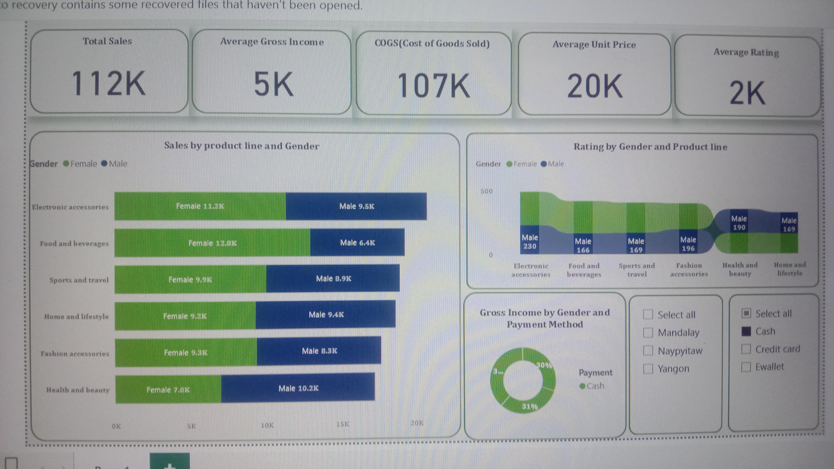
Supermarket Sales Dashboard

Slide 9
Conclusion & Next Steps
The analysis helps in identifying sales trends and customer preferences.
Power BI dashboard provides dynamic insights for business decisions.
Next steps: Enhance data with predictive analytics for forecasting future sales.

Slide 10
Architecture/Design Diagram & Technologies Used
Data stored in SQL Server.
Data extracted, cleaned, and processed using Python (Jupyter Notebook).
Transformed data is loaded into Power BI for visualization.

Slide 11
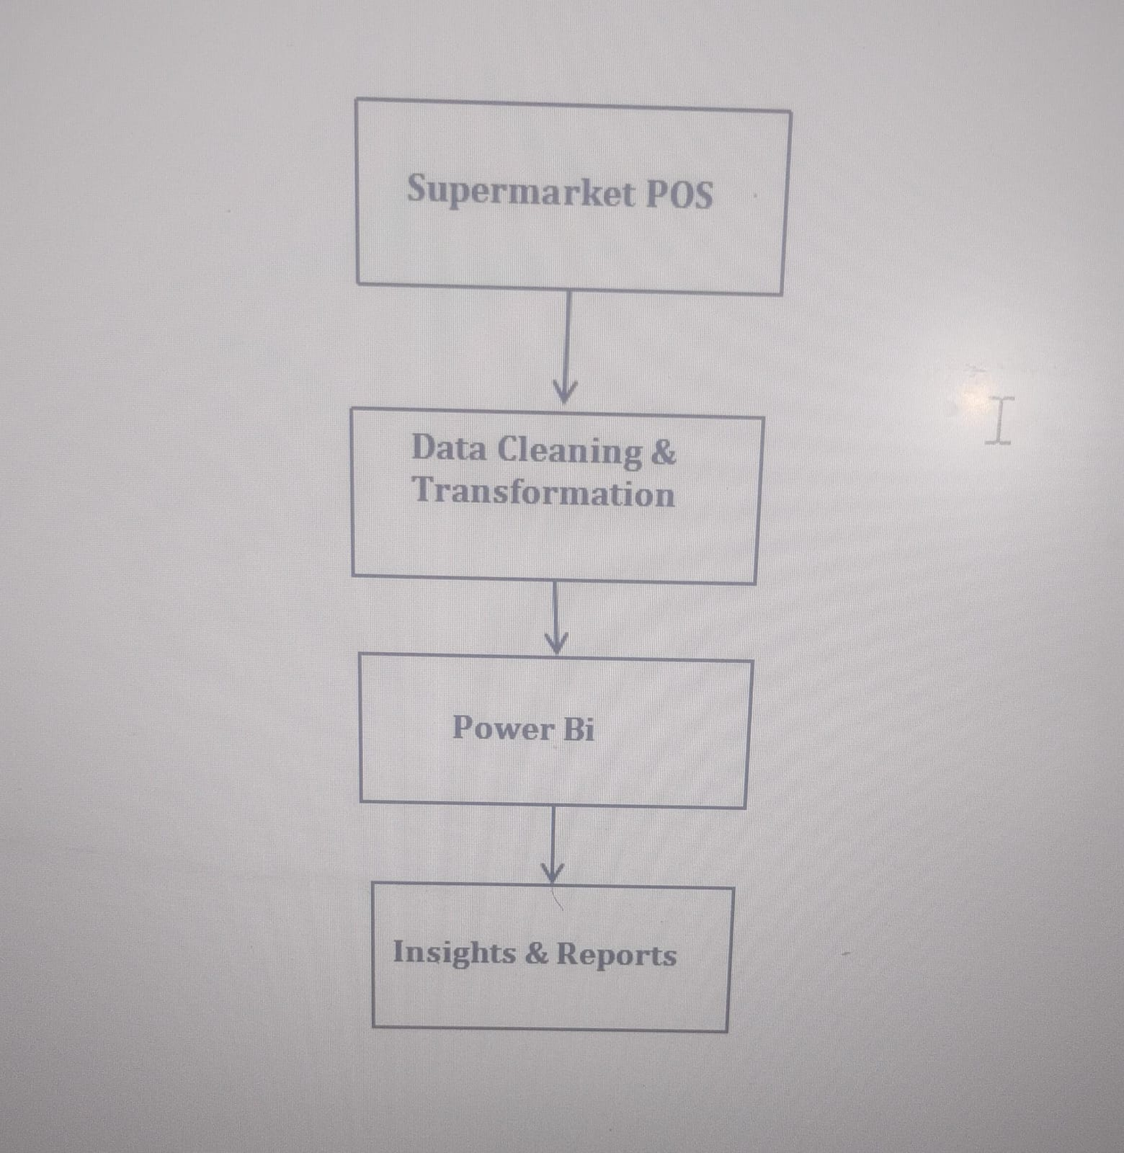
Data Flow Diagram
<-- Data Source (Sales, Transactions
<--- using SQL/Python(Filtering, Transforming))
<--Data Loaded for Visualization
<-- Decision Making & Analysis

Slide 12
Data Source & Technologies Used
Database: SQL Server stores raw supermarket sales data.
Python (Jupyter Notebook): Used for data cleaning, transformation, and exploratory analysis.
Power BI: Used for interactive visualizations and dashboard creation.
SQL Queries: Extracted relevant data for analysis and reporting.

Slide 13
Thank you

