Slide 1
Digital Portfolio
STUDENT NAME: Aishwarya Senapati
REGISTER NO AND NMID: 222410840 & asunm1719222410840
DEPARTMENT: BSC Computer Science with Data Science
COLLEGE: Peri College of Arts and Science

Slide 2
INTERACTIVE DIGITAL PORTFOLIO

Slide 3


AGENDA
Problem Statement
Project Overview
End Users
Tools and Technologies
Portfolio design and Layout
Features and Functionality
Results and Screenshots
Conclusion
Github Link
3/21/2024 Annual Review

Slide 4

PROBLEM STATEMENT
“The lack of comprehensive and easily accessible online platform makes it challenging to effectively present my diverse skill set and project experience to prospective employers, potentially hindering my job search.”
HTML is the foundation technology used to implement the solution to this problem. The problem statement defines why you are building the portofolio, and HTML is how you build it.

Slide 5

PROJECT OVERVIEW
This project is a personal portfolio website created using HTML, along with CSS and JavaScript. It showcases my skills, previous projects, and contact information in a clean and responsive layout. HTML was used to structure the content of the website, including sections like About Me, Education, Skills, and contact. The goal of the project was to build a professional online presence and demonstrate my front-end development skills

Slide 6


WHO ARE THE END USERS?
In a web development project using HTML, the end users are the people who interact with the website or web application once it’s live. Depending on the purpose of the sites, end users can vary, but generally include:
Common End users in web development projects
1. People who browse the website for information, services, or products.
2. Example: Visitors to a personal portfolio, blog, or company website.

Slide 7

TOOLS AND TECHNIQUES
Tools used in project
Text Editors or IDE
Eg : VS code, Subline Text, Atom.
2. Web Browsers
Eg : Chrome, Firefox, Edge.
3. Repository Hosting services
Eg : GitHub, GitLab, BitBucket.
4. Browser DevTools
Eg : Built in tools in browsers like Chrome DevTools.

Slide 8
POTFOLIO DESIGN AND LAYOUT
A well-structured portfolio should be clean, responsive, easy to navigate, and highlight your skills, projects, and contact information effectively.
Common Layout Section
Header
Includes your name or logo and navigation menu.
2. Hero Section
A strong introduction with a headline(e.g., “Hi, I’m a web developer”).
3. About Me Section
A short bio
Optional photo or avatar
4. Projects section
Grid or list of your best projects.
8

Slide 9
FEATURES AND FUNCTIONALITY
Responsive design
The website adjusts to different screen sizes(desktop, tablet, mobile).
2. Navigation bar
A fixed or scrollable menu to help users navigate between pages and sections.
3. About Section
A section introducing the website owner, company, or purpose of the project.
Project or services showcase
Displays a list or gallery of completed work, services offered, or products.
Contact form
Allows users to send a message or inquiry directly from the website.
Social Media Links
Clickable icons linking to social media profiles.
Interactive Buttons and Links
Buttons that respond to user actions (hover effects, click events).

Slide 10
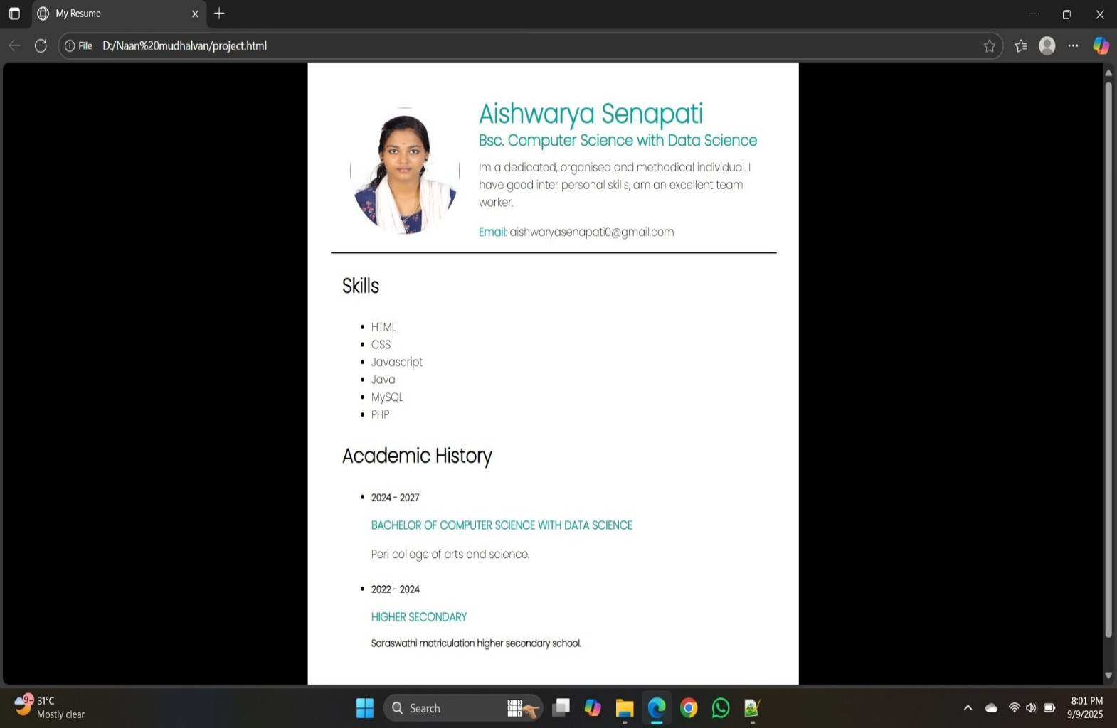

RESULTS AND SCREENSHOTS
3/21/2024 Annual Review
10

Slide 11
CONCLUSION
This project provided a strong foundation in front-end development by focusing on the use of HTML for structuring content effectively. It demonstrated how semantic HTML can be combined with CSS and Java script to create a responsive, user-friendly, and visually appealing website.
GitHub Link:
https://github.com/Aishwarya13082007/Naan-mudhalvan.git
11

