Slide 1
CATEGORIZING SOFTWARE PROJECTS
Presented By –
AISHWARYA S [4GW23CI003]

Slide 2
Changes to the Characteristics of Software Projects
Earlier, most software systems were developed entirely from scratch.
Limited code reuse in the early years due to lack of available libraries
and frameworks.
Today, extensive reuse of existing code, libraries, and frameworks is common.
Modern programming languages enable dynamic linking, customization,
and extension of existing code.
As a result, project durations are shorter, and development is more efficient.
Increasing trend of customer participation throughout the project life cycle.

Slide 3
Users / System Types
Compulsory vs Voluntary Users
Compulsory users: Must use the system to perform their work (e.g., payroll, sales systems).
Voluntary users: Choose whether to use it (e.g., entertainment or gaming apps).
Information Systems vs Embedded Systems
Information systems: Support office and business operations (e.g., stock control).
Embedded systems: Control machines or physical processes (e.g., air conditioning systems).

Slide 4
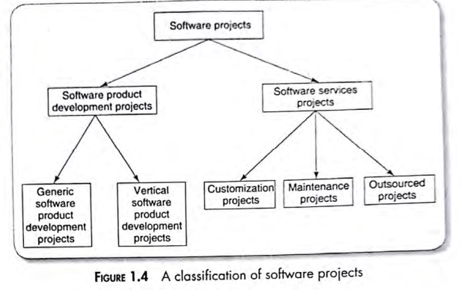
Software Products vs. Software Services
Software Products:
Concern developing software for general or specific market needs.
Two main types:
Generic products: Sold to a broad audience (e.g., Windows, Oracle DB).
Domain-specific products: Built for a particular sector (e.g., banking, telecom).
Software Services:
Include customization, maintenance, outsourcing, testing, and consultancy.
Dominant form of software projects today due to code reuse and shorter development cycles.
Examples: customization of existing ERP or payroll systems.

Slide 5
Types of Software Services Projects
Customization projects: Modify existing software to meet customer needs.
Maintenance projects: Update, correct, or enhance existing systems.
Outsourced projects: Assign part of the work to another company.
Common for large systems where cost or expertise makes outsourcing efficient.
Indian companies are recognized globally for excellence in outsourced software.
Objective-driven projects:
Focus on achieving a particular business goal rather than building a product.
Here the projects are done in two stages : ANALYSIS and DEVELOPMENT.

Slide 6
THANK YOU...

