Slide 1

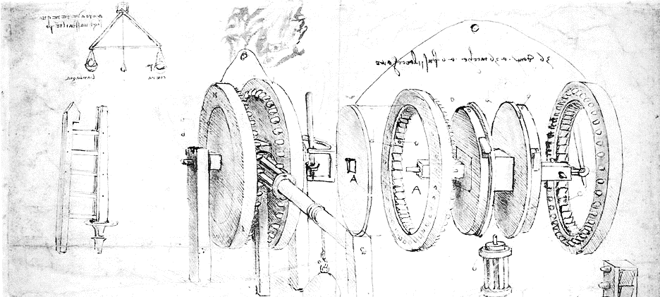

Cloud Computing for Science
Orienting

Slide 2
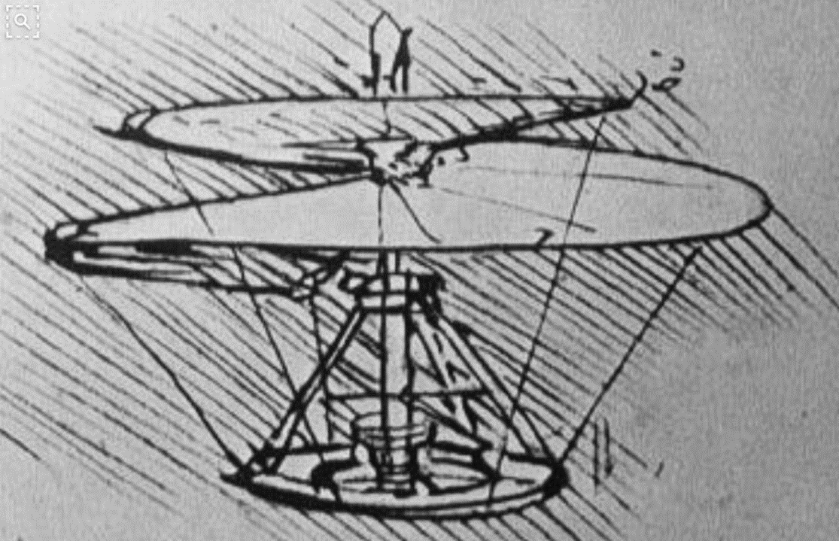

Tutorial Goals
An exploration of cloud computing for researchers
Scientists who need to go beyond their current resources
Computer science students who need to know what is possible
Data scientists who want to understand the potential of the cloud
What will be covered
Cloud data services
VM and Container basics
Ways to scale: clusters, mapreduce, microservices
Data analytics in the cloud
Streaming data
Machine learning in the cloud

Slide 3
First Steps – Let’s get you on the cloud
Instructions for how to start your Azure account here
We will discuss three different public cloud and a bit about a science private cloud
They are:
Amazon Web Services (AWS) - 40% of all cloud resources on the planet.
Microsoft Azure – about 1/3 of AWS but growing
Google Cloud – third place
NSF JetStream – an OpenStack private cloud for US science researchers.
Each has a user portal for managing your access.
Let’s take a look at AWS, JetStream and Azure

Slide 4
Pros & Cons of Public vs Private Cloud
Public cloud pros
Massive scale
Huge and growing list of services
Highly competitive on pricing due to economies of scale
Security is strong
Freedom from managing hardware
Hardware constantly upgraded
Cons
Rules prohibit data moving to cloud
Funding models may make it hard to use
Fear of “vendor Lock-In”
Private cloud pros
May be cheaper
You can keep it off the Internet so data can be very safe.
You can optimize your own hardware
You control everything
Cons
You are responsible for everything
Not as many high level services
May not really be cheaper
You manage physical and system security

Slide 5
Portals and SDKs
Two ways to access the cloud
Web Portals
Dashboard that allow you to see and manage your cloud resources.
Software Development Kits (SDKs)
Libraries that give you the tools to manage cloud resources from a program or script.
Based on REST web service calls
We will use both

Slide 6
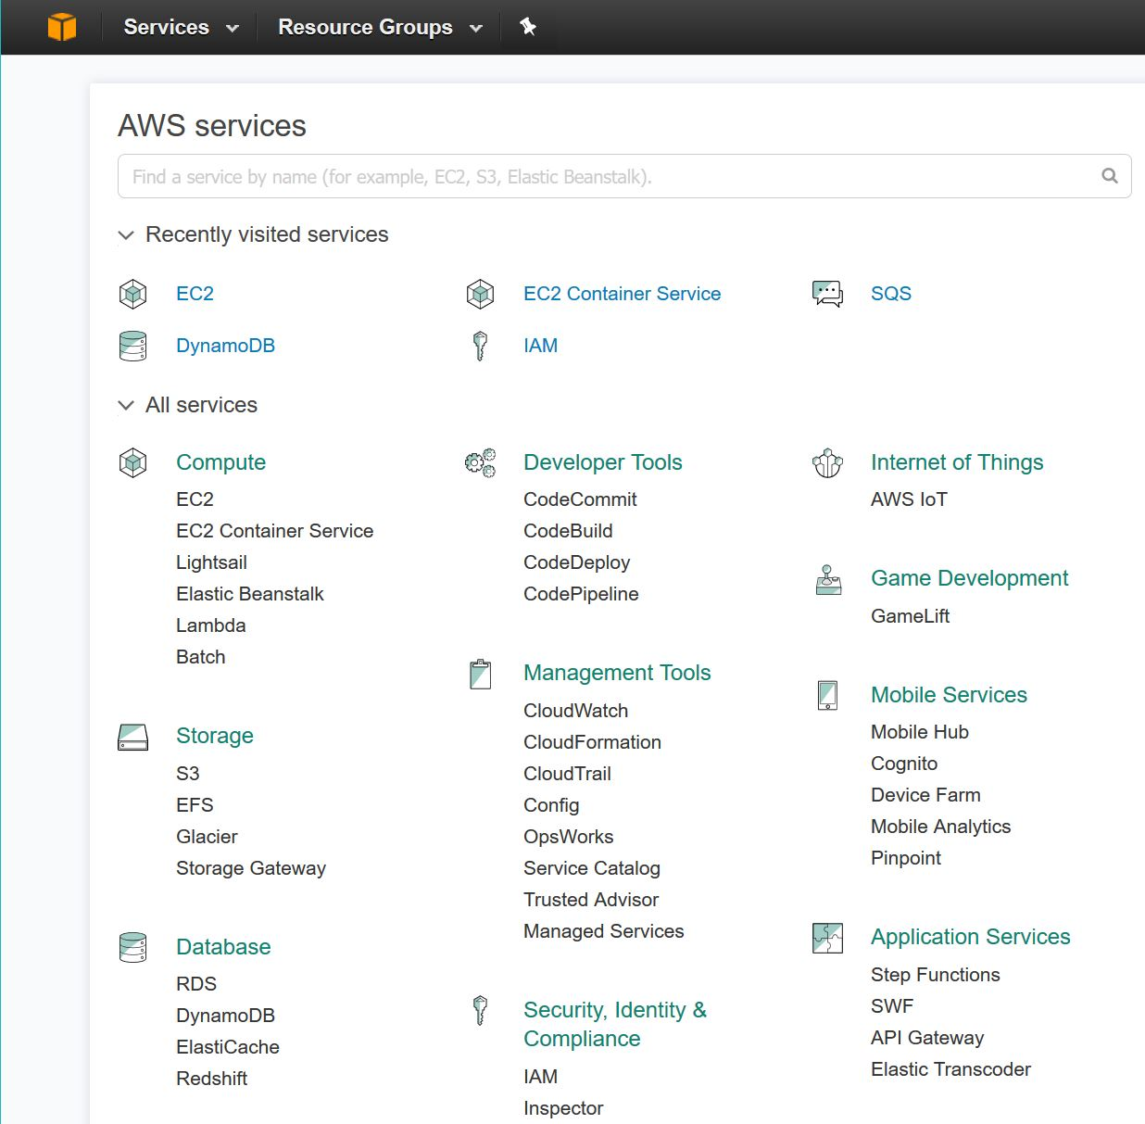
Amazon AWS Portal
You see links to all the standard services
You also have a search bar to find others.
To create a storage account go to S3
To launch a Virtual Machine go to EC2

Slide 7
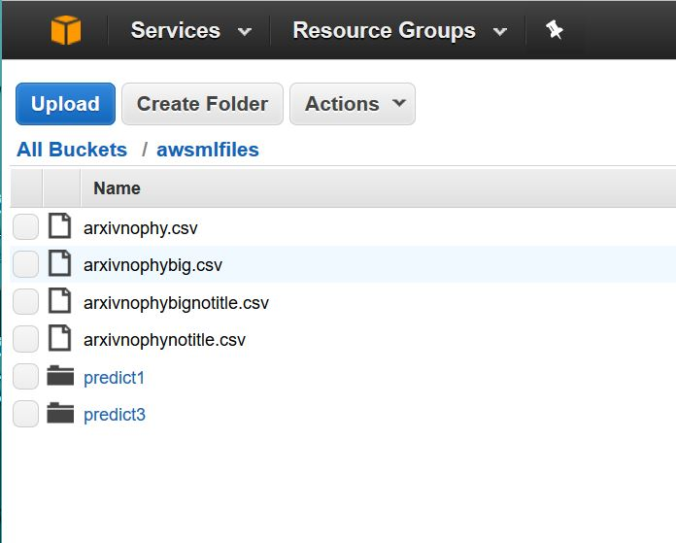
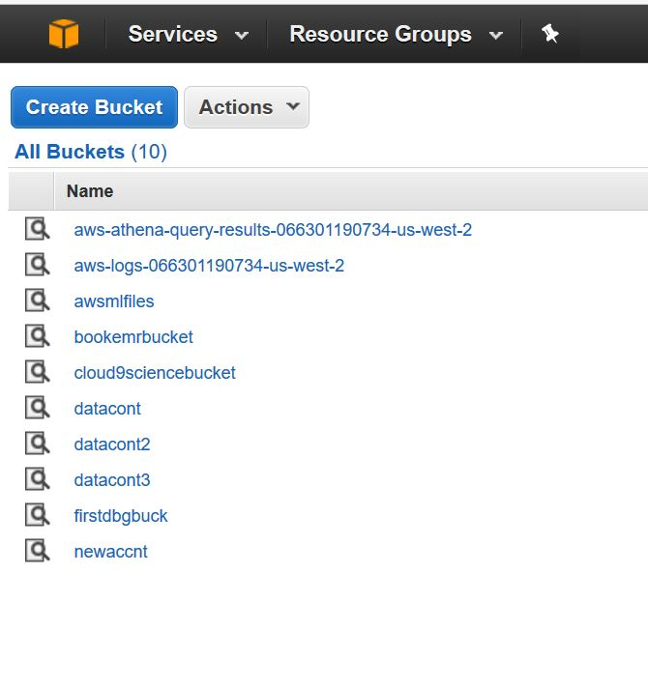
Selecting S3 we get the bucket list
Selection “awsmifiles” gives us the a list of the contents
Notice that it has regular objects AND folders.

Slide 8
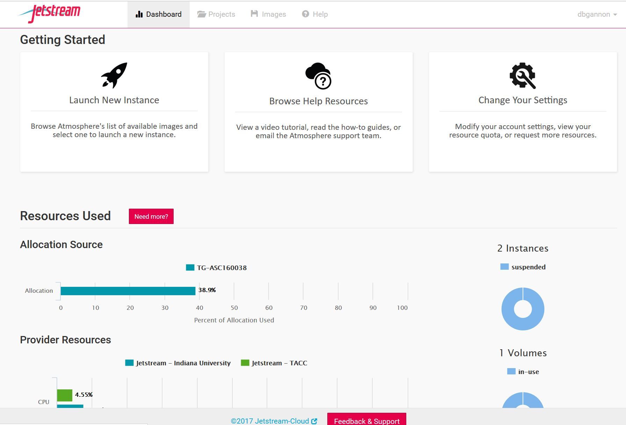
Jetstream –NSF Science Cloud (OpenStack)

Slide 9
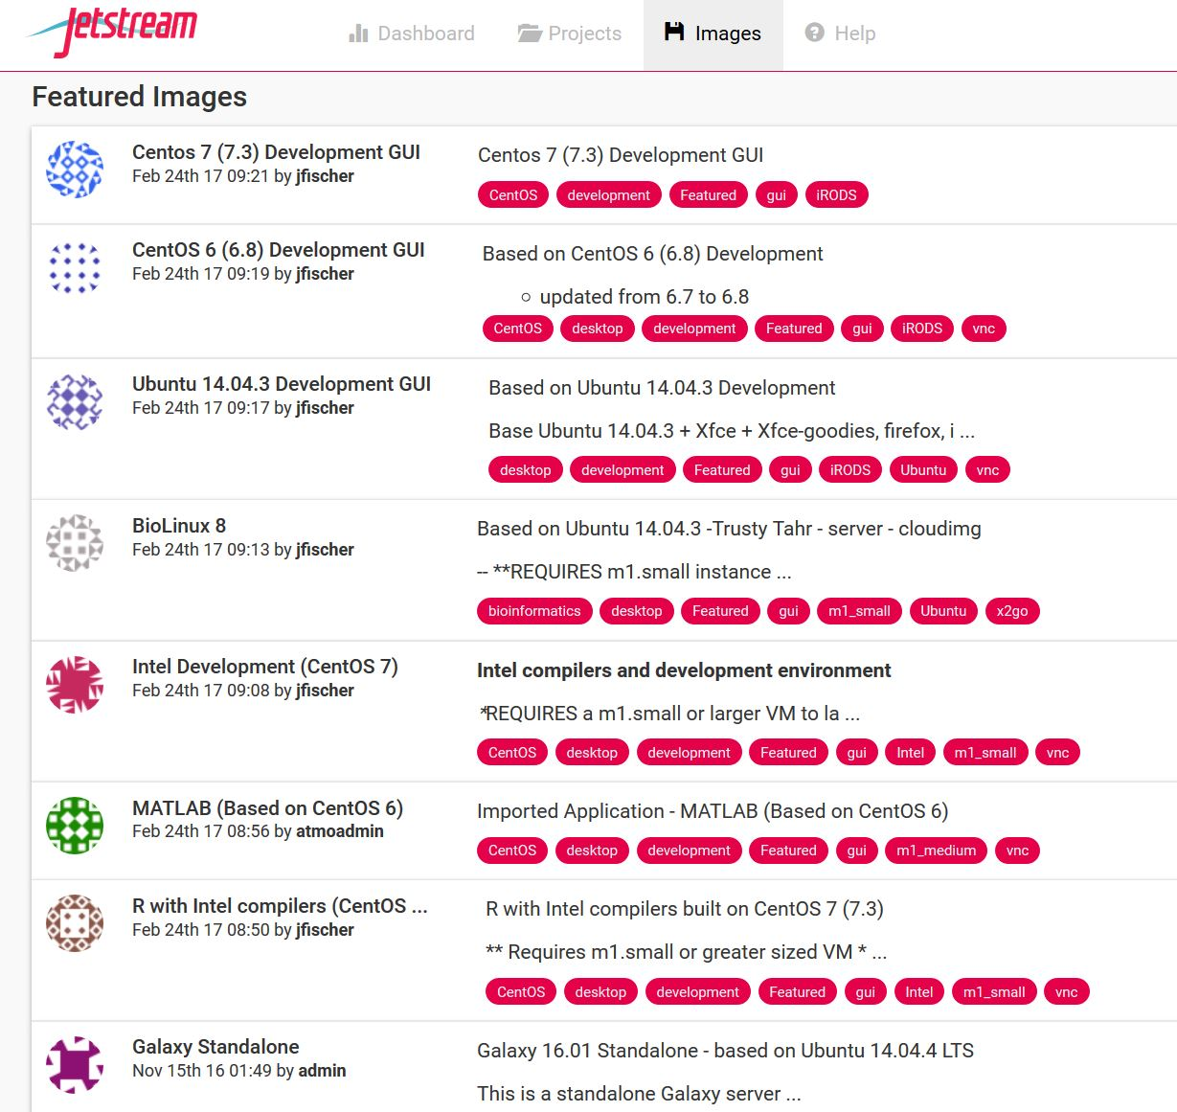
Jetstream is about virtual
Machines for science
Generic Linux
Bioscience
MATLAB
R

Slide 10
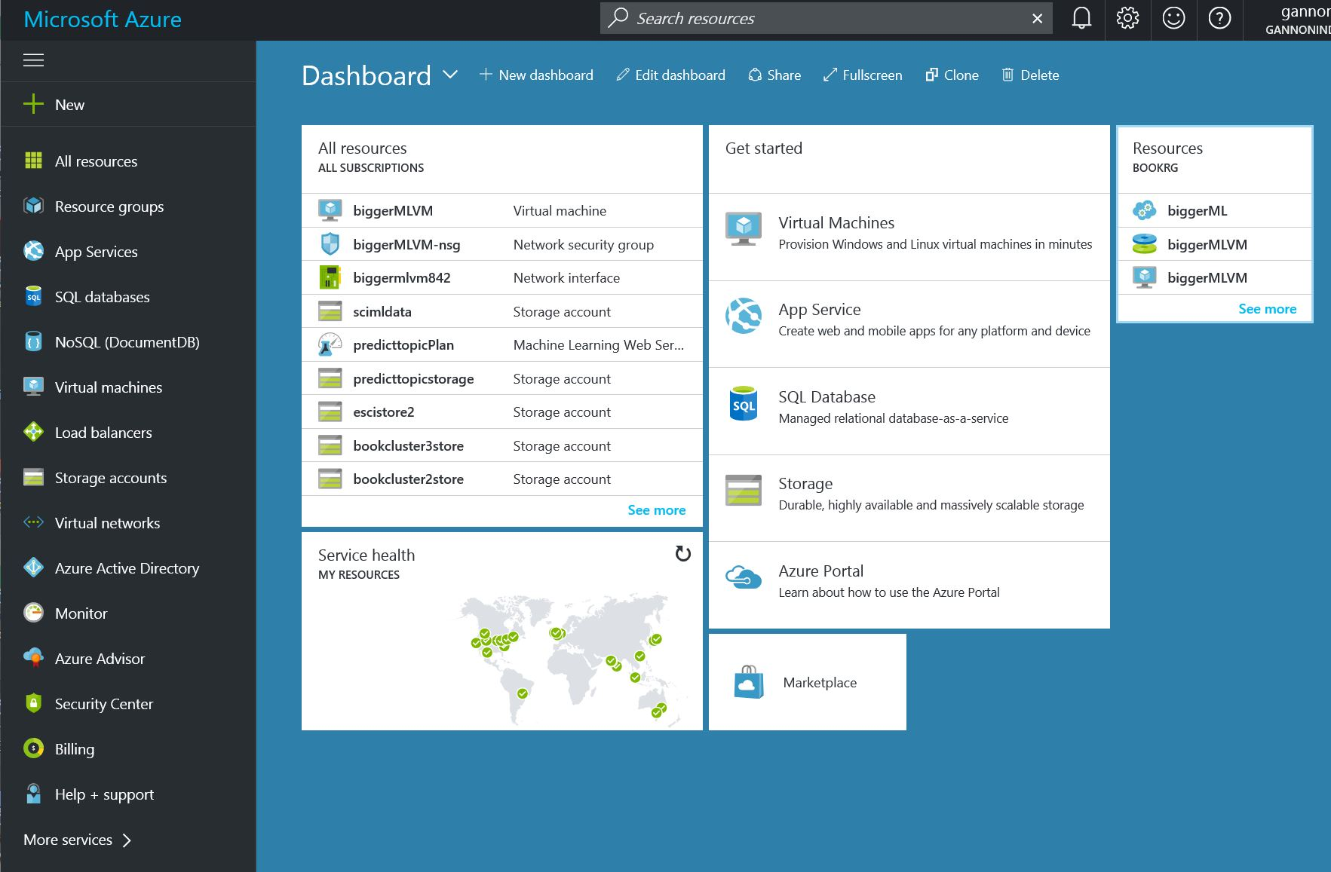
The Azure Portal
Select “+ New”

Slide 11
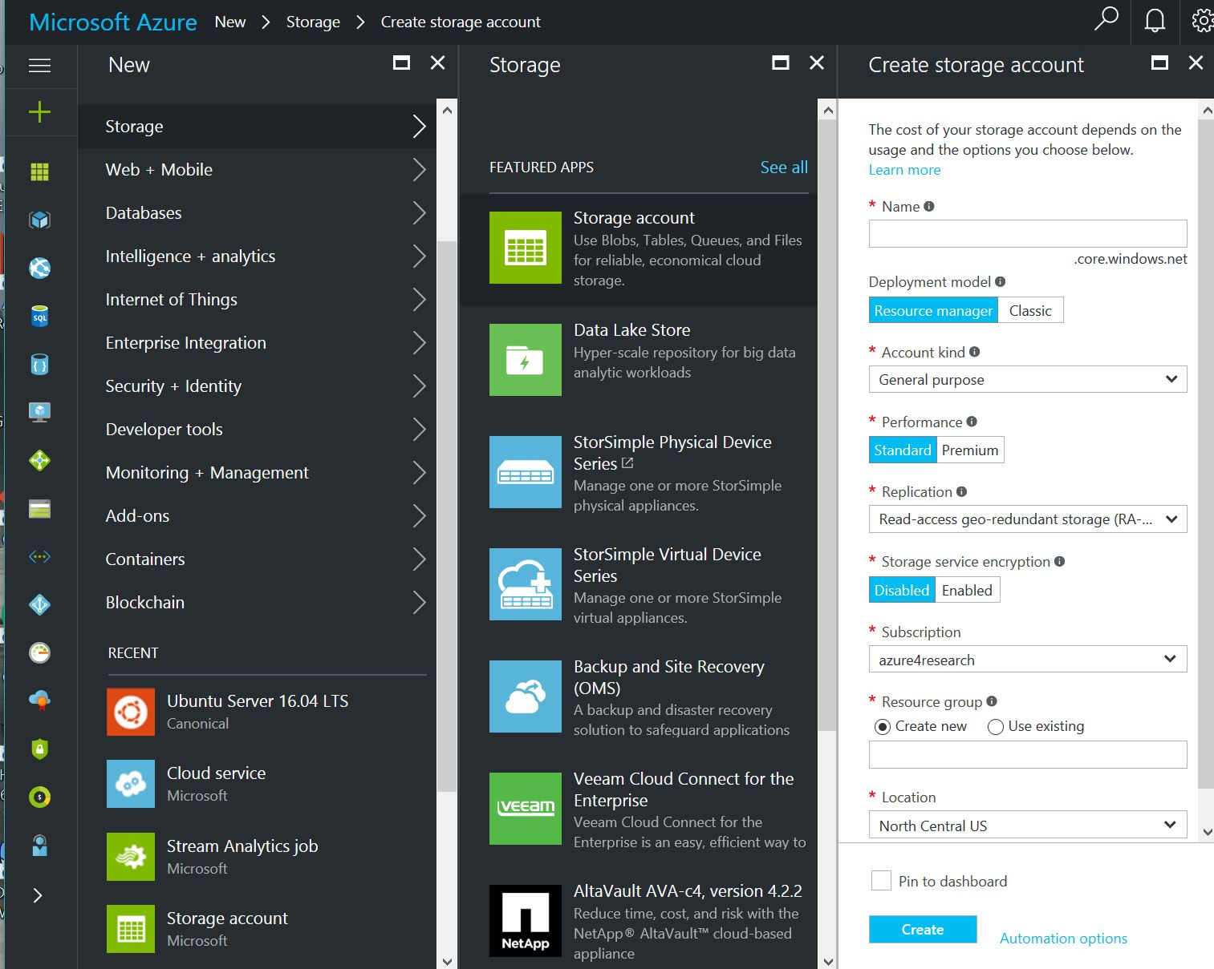
Selecting “+” gives this list of options.
Selecting “Storage” gives the secondary menu of types of storage apps.
To create a storage account select the top one.
- give it a name, research group and location.

Slide 12
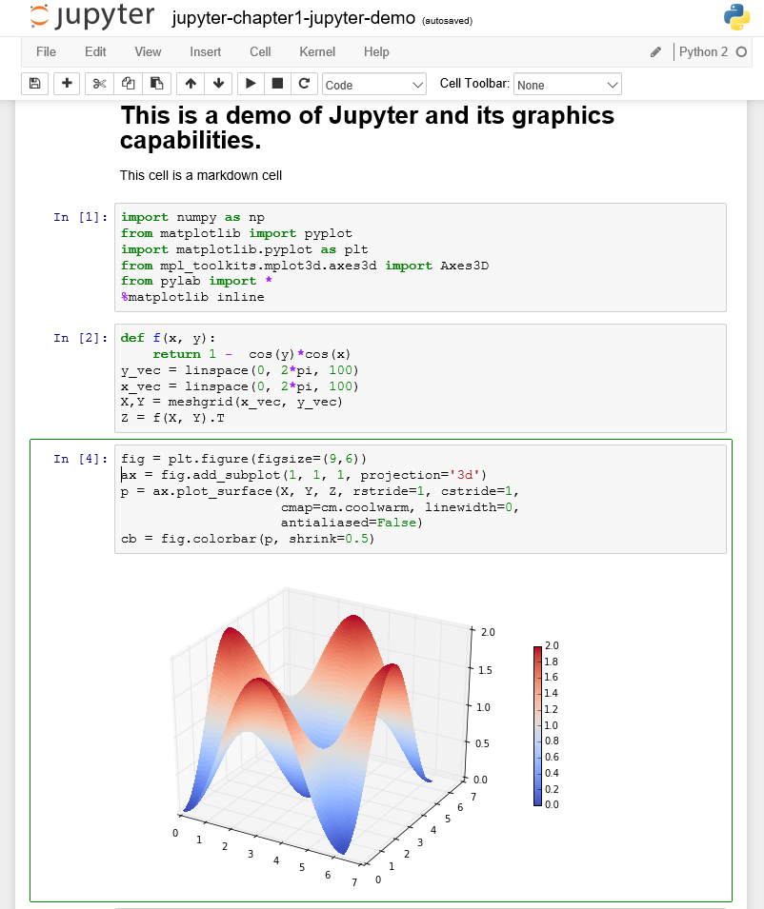
We will be using Python and Jupyter
Jupyter in the cloud
Go to https://notebooks.azure.com
Signup – it’s free.
If you are new to Jupyter do Welcome.ipynb
If you are new to Python do Python.ipynb
Installing Jupyter on your laptop
Go to https://docs.continuum.io/anaconda/install
Do it. Then “Jupyter notebook” at the shell
Jupyter in a container (if you have docker)
docker run -it --rm -p 8888:8888 -v /Users/you:/mac \ jupyter/all-spark-notebook
Or
docker run –it -p 8888:8888 dbgannon/tutorial2

