Slide 1

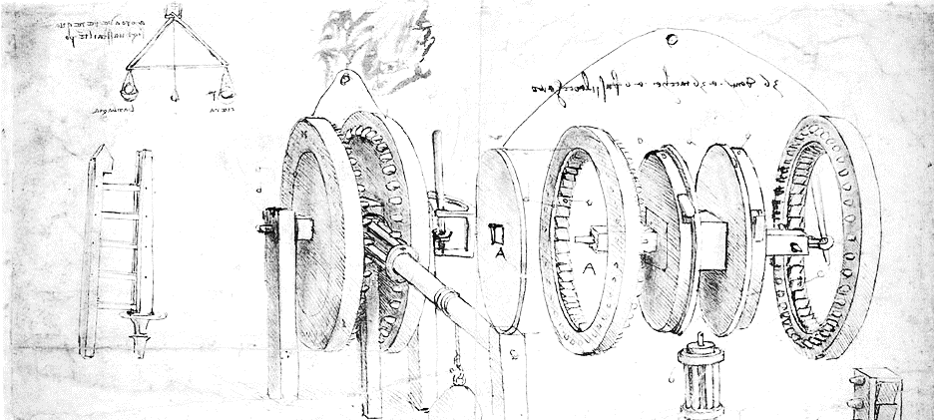

Cloud Computing for Science
Part 2 Virtual Machines and Containers

Slide 2
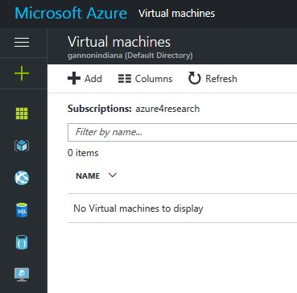
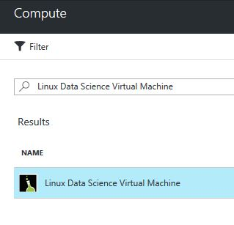
Using the Azure portal to create a VM
In the search box enter “data science” and you will see this choice. Pick this one and click here
Click this
To bring up
The VM page
Then click
Add

Slide 3
The Linux Data Science VM
This Linux-based virtual machine contains popular tools for data science and development activities,
including Microsoft R Open, Anaconda Python, Azure command line tools, and Jupyter notebooks
for Python, R and Julia. It also has machine learning tools and algorithms like mxnet, CNTK,
Vowpal Wabbit and xgboost.
What's new
The Linux data science virtual machine now includes Microsoft R Server 9.0, now with Microsoft R Open 3.3.2 and new options for operationalizing R models
Weka for easy graphical exploration and machine learning
Apache Drill for querying non-relational data using SQL
Spark local 2.0.2 with a PySpark Jupyter kernel
Single node local Hadoop (HDFS, Yarn)
Visual Studio Code IDEs, IntelliJ IDEA, PyCharm, Atom
mxnet for deep learning
JuliaPro - a curated distribution of Julia Language and tools

Slide 4
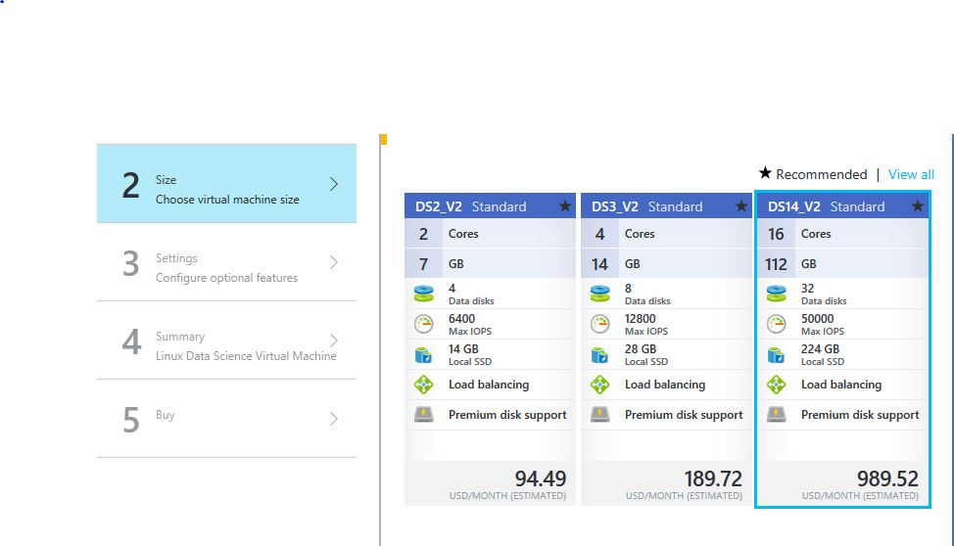
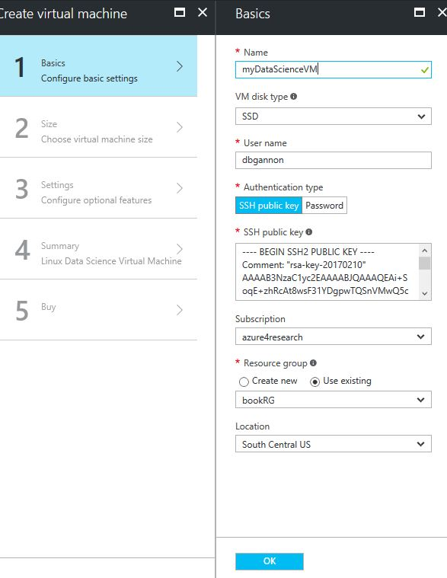
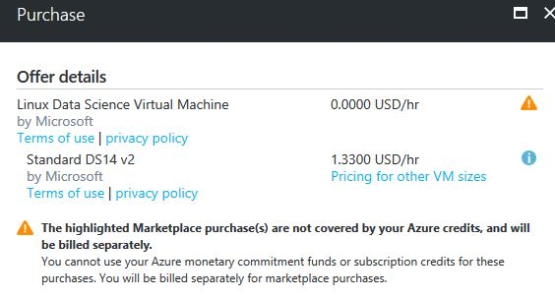
Configuring and launching

Slide 5
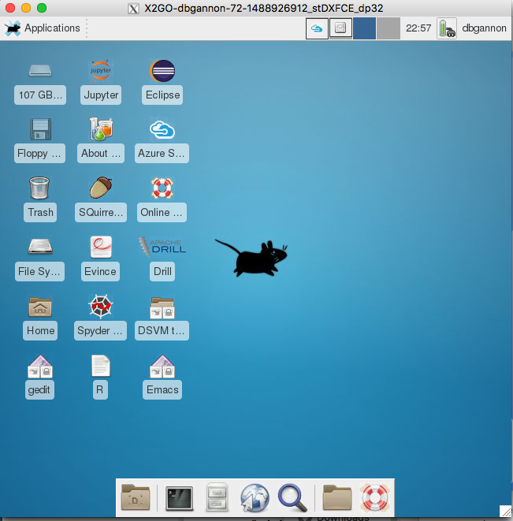
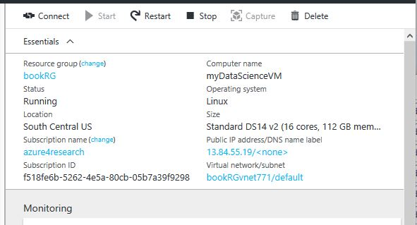
Once created login with ssh or password
Azure portal view and IP address
Running X2GO on PC or mac.

Slide 6
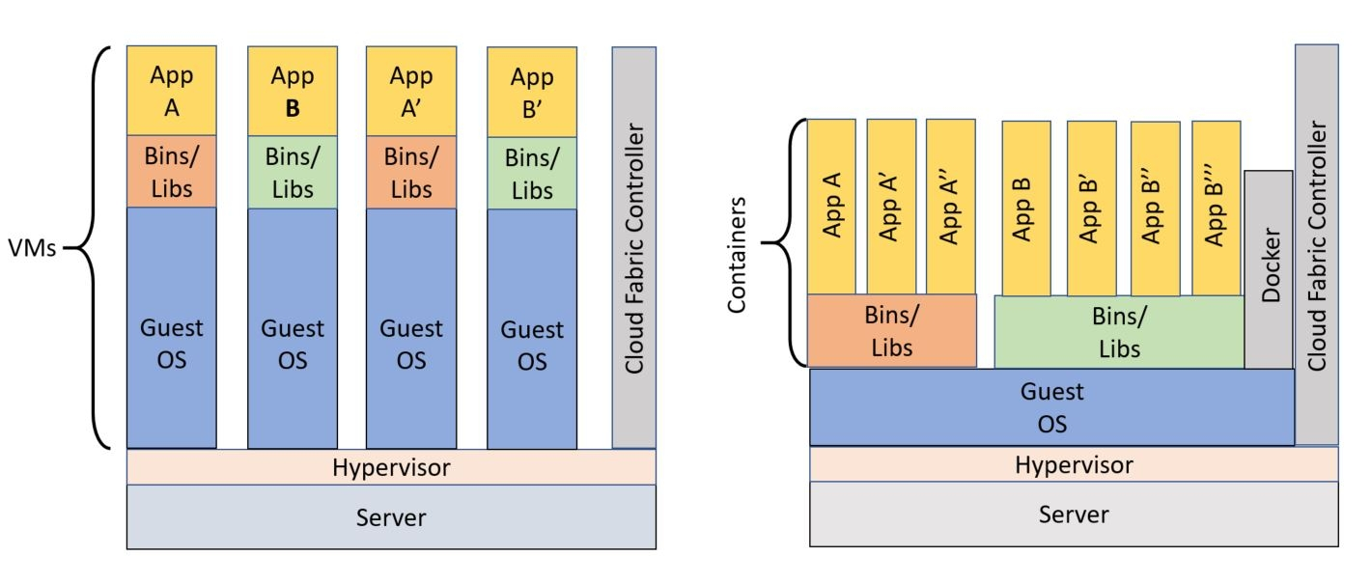
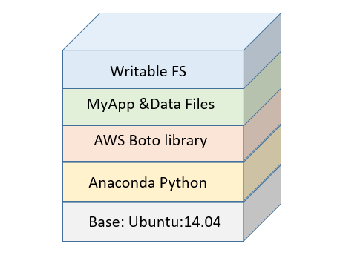
What are VMs? containers?
Virtual machines use a “hypervisor” to provide a complete virtualization of the hosts hardware. A VM is an instance of a complete operating system and file system running on the virtualized hardware.
Containers share components of the hosts OS and file system and are more similar to a process.

Slide 7
Using Docker to manage containers
Download Docker for your pc or mac
https://docs.docker.com/engine/installation/
Or login to your Azure data science linux vm
Type sudo docker ps
Type sudo docker run –it ubuntu
You are now running Ubuntu linix in a container. -it give you the io for the shell.

Slide 8
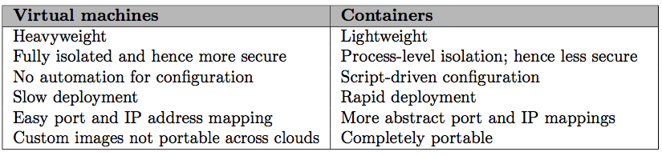
Advantages

Slide 9
Creating a container from other containers
A directory with
A “Dockerfile”
Things you want in the container
A script
A directory of data file: datadir
A directort of the notebook examples
To build it run
docker build –t=“dbgannon/tutorial” .
Docker file for tutorial
# Version: 0.1.0
FROM continuumio/anaconda
MAINTAINER your name "dennis gannon"
RUN pip install azure-storage
RUN pip install boto3
RUN easy_install pika
RUN easy_install bottle
COPY book-notebooks /tutorial_notebooks
COPY datadir /datadir
COPY script /
CMD ["bash", "/script"]
Script file is
/opt/conda/bin/conda install jupyter -y --quiet
mkdir /opt/notebooks
cp /tutorial_notebooks/* /opt/notebooks
/opt/conda/bin/jupyter notebook --notebook-dir=/opt/notebooks --ip='*' --port=8888 --no-browser

