Slide 1

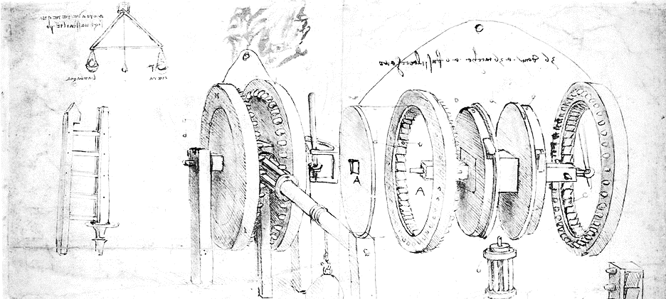

Cloud Computing for Science
Part 1. Managing Data in the Cloud
Dennis Gannon

Slide 2
Motivating Examples
BIG objects
Climate scientists with big simulation output files in NetCDF.
Assume 10 TB in big objects
Many small CVS files
Environmental Engineers with 1 Million records of observations each in CSV format
May be 100 TB total
Streams
Scientists with a distributed collection of several thousand instruments.
Each generates a stream of records that must be collected and analyized every few hours or continuously

Slide 3
Types of Cloud Data Storage Systems
Basic Blob Object store
Buckets of immutable objects
Highly scalable & reliable
Databases
SQL Style relational databases
NoSQL storage
Data warehouses
Attached File stores
Graph databases
Streaming systems

Slide 4
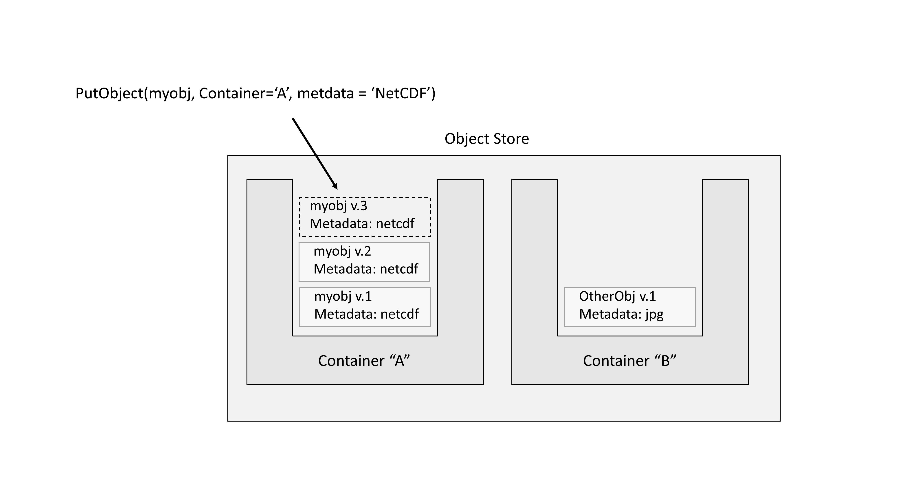
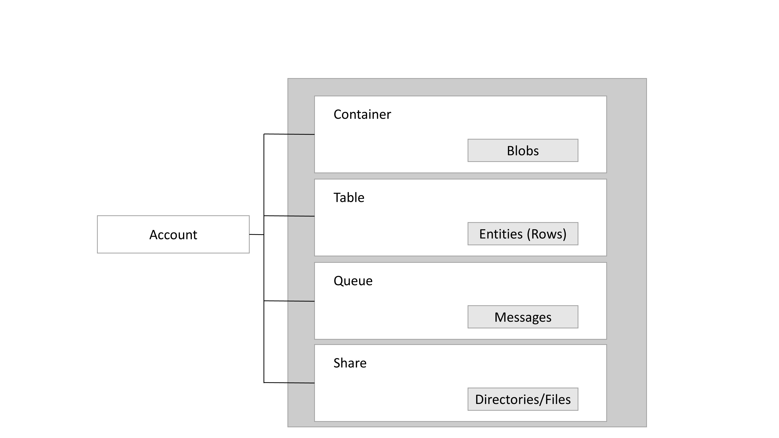
Object stores
Amazon AWS
S3- buckets of immutable objects
Organized in a 2-level folder system
Each object has associated metadata
Microsoft Azure
Storage accounts contain blob storage along with tables, queues and file shares.
Blob containers are similar to S3
Google Cloud Storage
Different models based on availably and cost
OpenStack does not have a standard but semi-standards exist and various ones are used in various deployment
Azure storage account structure

Slide 5
Relational Databases
Amazon AWS
Relational Data Services (RDS)
Aurora
Microsoft Azure
Azure SQL
3 service tiers
Premium tier up to 1TB
Up to 30000 concurrent sessions
Azure Data Lake
Google Cloud Storage
Cloud Spanner (beta)
Full relational
Strongly consistent
Scalable to thousands of servers
Aurora is distributed
Scalable from 2 vCPUs to 32 vCPUs
Data up to 64TB
MySQL compatible
Fully geo-replicated
Data Lake is a platform
Structured & unstructured data
Scalable to petabytes
Distributed and designed to support analytics

Slide 6
NoSQL Storage Systems
Relational table
Name | Job | Salary | age
Bill | Sales | $20000 | 18
Beth | Research | $1m | 35
Carl | CEO | 0 | 93
Jill | Prof | $100000 | 24
Main Concepts
Designed for massive scale
Distributed over many storage nodes
Support some SQL operations (not joins)
May be only eventually consistent
Different types
Key-value
Column oriented
Document style
Graph
NoSQL Key-value system
row
partition
Sales
Research
MGMT
Faculty
bill | Salary = 20000 | Age =18
bob | Salary = 40000 | Age =38
row
Beth | Salary = 1M | Age =18
row
Carl | Role = CEO | Age =93
Key-value NoSQL examples similar to
Amazon AWS DynamoDB
Azure Tables
Google BigTable and Cloud DataStore

Slide 7
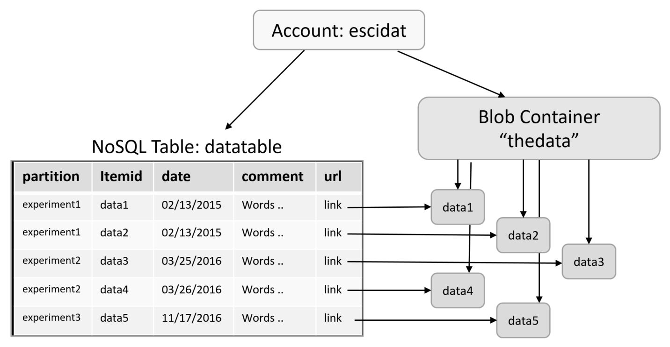
A simple example
A table and data blobs
Suppose you have a set of experiment data containing
An experiment number
A data item number
A date
Some comment data
A very large binary object
Build a table of the experiments with a url link to the data in blob store.

Slide 8
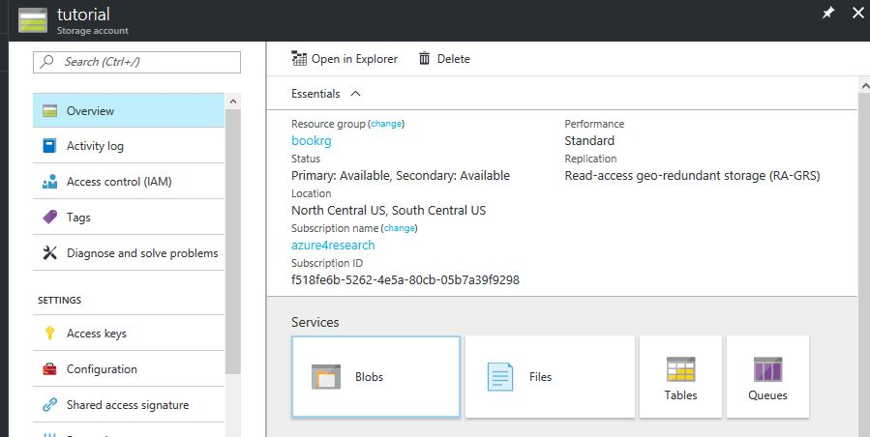
Azure Solution
Let’s create a new storage account “tutorial” to hold the blobs and table
To get an access key
Click here

Slide 9
Get the container for the demo
Make sure you have docker installed on your machine
Download Docker for your pc or mac
https://docs.docker.com/engine/installation/
Then do
docker run -i -t -p 8888:8888 dbgannon/tutorial
This will take a while
When it is up go to https://localhost:8888
You will need to add security exceptions in the browser. It is safe.
Password is “tutorial”
Open azure.ipynb in Jupyter
Or, if using a different jupyter, download https://SciengCloud.github.io/azure.ipynb
Using the azure portal create a storage account and have the key ready

Slide 10
Azure Solution – now create table and blob container
import csv import sys import azure.storage from azure.storage.table import TableService, Entity from azure.storage.blob import BlockBlobService from azure.storage.blob import PublicAccess
block_blob_service = BlockBlobService(account_name='tutorial', account_key=‘biglongaccesskey')
block_blob_service.create_container('datacont', public_access=PublicAccess.Container)
table_service = TableService(account_name='tutorial', account_key=‘samebiglongkey’)
if table_service.create_table('DataTable'):
print "table created"
else:
print "table already there"

Slide 11
Azure Solution
Assume data objects are stored in files in /home/me/ and there is a CSV file “thedata” with rows
Experiment name, item id, date, filename, comment string
with open('/datadir/experiments.csv', 'rb') as csvfile:
csvf = csv.reader(csvfile, delimiter=',', quotechar='|')
for item in csvf:
print item
block_blob_service.create_blob_from_path(
'datacont', item[3],
"/datadir/"+item[3]
)
url = "https://"+account+".blob.core.windows.net/datacont/"+item[3]
metadata_item = {'PartitionKey': item[0], 'RowKey': item[1],
‘description' : item[4], 'date' : item[2], 'url':url}
table_service.insert_entity('DataTable', metadata_item)

Slide 12
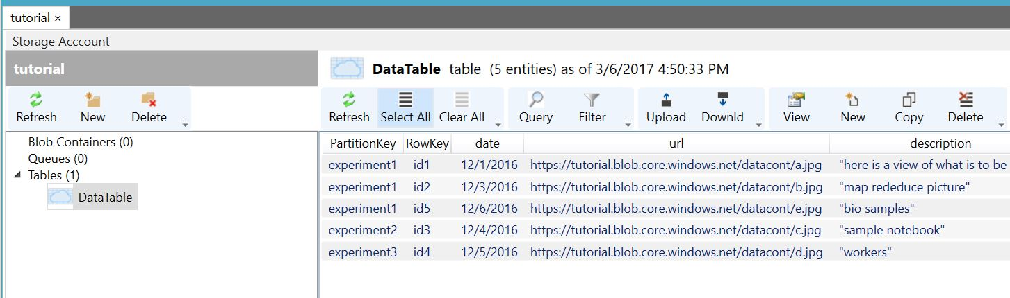
Use Azure Storage Explorer to inspect the table

Slide 13
Next VMs and Containers

