Slide 1

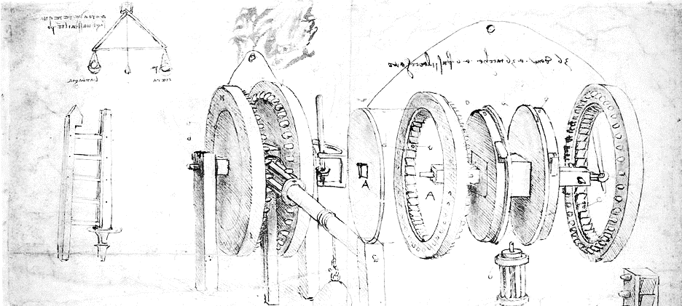

Cloud Computing for Science
Orienting
Dennis Gannon

Slide 2
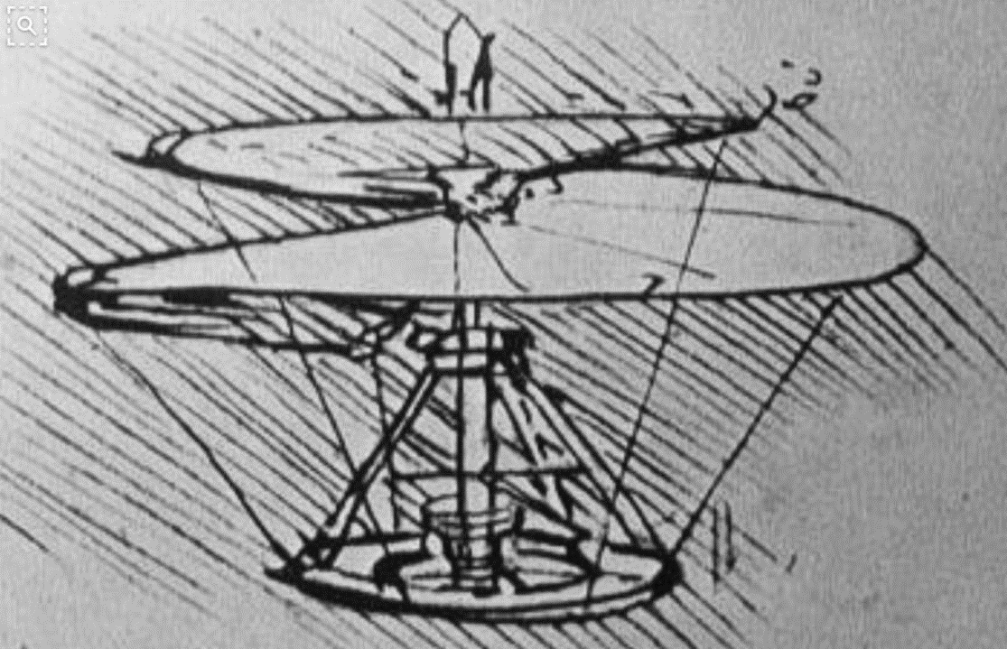

Tutorial Goals
An exploration of cloud computing for researchers
Scientists who need to go beyond their current resources
Computer science students who need to know what is possible
Data scientists who want to understand the potential of the cloud
What will be covered
Cloud data services
VM and Container basics
Ways to scale: clusters, mapreduce, microservices
Data analytics in the cloud
Streaming data
Machine learning in the cloud

Slide 3
Preliminaries
We will use Microsoft’s Azure for Hands-on Exercises
Initializing your account
Download Azure Storage Explorer http://storageexplorer.com/
Access tutorial tarball https://SciEngCloud.github.io/tutorial.tar.gz
On mac:
gunzip tutorial.tar.gz
tar –xf tutorial.tar
on PC use something like 7-zip or other decompression and extractor.
Access to these slides and Jupyter Notebooks are also available
From the book “Cloud Computing for Science and Engineering” by Ian Foster an Dennis Gannon, to be published soon by MIT Press.
The link to the book is here
https://Cloud4SciEng.org

Slide 4
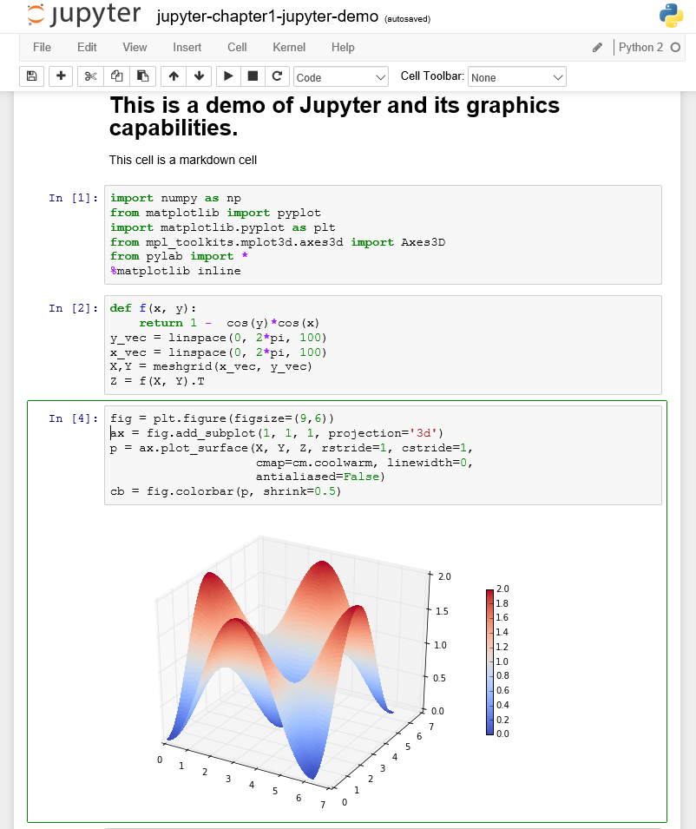
We will be using Python and Jupyter
Jupyter in the cloud
Go to https://notebooks.azure.com
Signup – it’s free.
If you are new to Jupyter do Welcome.ipynb
If you are new to Python do Python.ipynb
Installing Jupyter on your laptop
Go to https://docs.continuum.io/anaconda/install
Do it. Then “Jupyter notebook” at the shell
A Better solution: install Docker
https://docs.docker.com/engine/installation/
and run Jupyter in a container
docker run –it -p 8888:8888 dbgannon/tutorial
Accept security exceptions and login with “tutorial”
Open notebook jupyter.ipynb to see the one on the right

Slide 5
Orienting in the Cloud
We will discuss three different “public clouds” and a bit about a “science private clouds”
Public = anybody with a credit card has access. (aka commercial cloud)
Private = restricted to a special group of users. (aka Community Cloud or Academic Cloud)
(In Europe these terms are often reversed based on ownership.)
They are:
Amazon Web Services (AWS) - 40% of all cloud resources on the planet.
Microsoft Azure – about 1/3 of AWS but growing
Google Cloud – third place
NSF JetStream – an OpenStack private cloud for US science researchers.
There are many more clouds.
Public: IBM, DigitalOcean, Rackspace, 1&1, UpCloud, CityCloud, CloudSigma, CloudWatt, Aruba
Private Research Clouds: Aristotle, Bionimbus, Chameleon, Jetstream, RedCloud, indigo-datacloud, EU-Brazil Cloud, European Open Science Cloud
What are the pros and cons of public vs private

Slide 6
Pros & Cons of Public vs Private Cloud
Public cloud pros
Massive scale
Huge and growing list of services
Highly competitive on pricing due to economies of scale
Security is strong
Freedom from managing hardware
Hardware constantly upgraded
Cons
Rules prohibit data moving to cloud
Funding models may make it hard to use
Fear of “vendor Lock-In”
Private cloud pros
May be cheaper
You can keep it off the Internet so data can be very safe.
You can optimize your own hardware
You control everything
Cons
You are responsible for everything
Not as many high level services
May not really be cheaper
You manage physical and system security

Slide 7
Two ways to access the cloud
Portals and SDKs
Web Portals
Dashboard that allow you to see and manage your cloud resources.
Software Development Kits (SDKs)
Libraries that give you the tools to manage cloud resources from a program or script.
Based on REST web service calls
Let’s look at several Cloud Web Portals

Slide 8
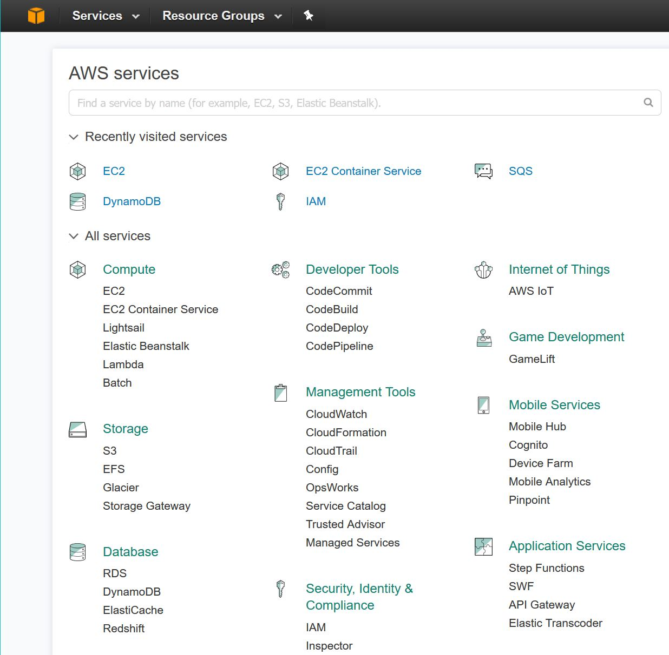
Amazon AWS Portal
You see links to all the standard services
You also have a search bar to find others.
To create a storage account go to S3
To launch a Virtual Machine go to EC2
Let’s look at the S3 storage system

Slide 9
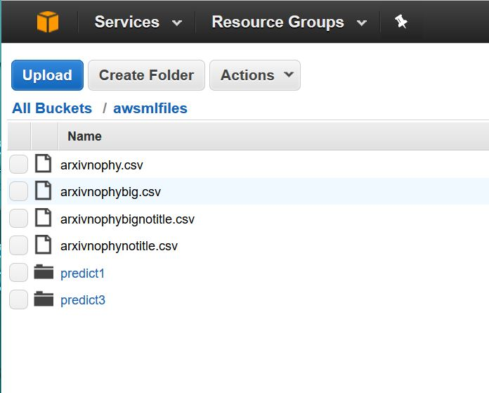
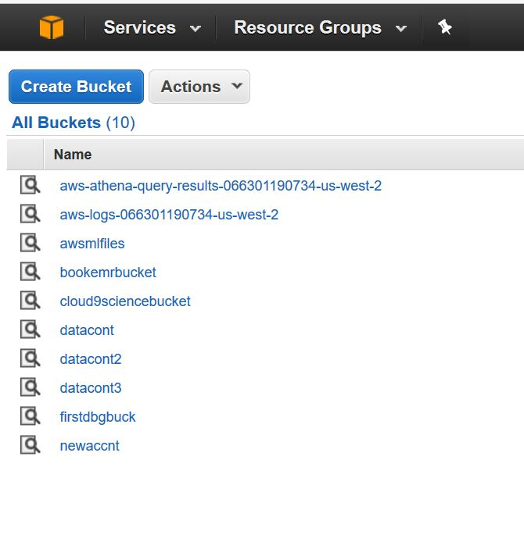
Selecting S3 we get the bucket list
Selection “awsmifiles” gives us the a list of the contents
Notice that it has regular objects AND folders.

Slide 10
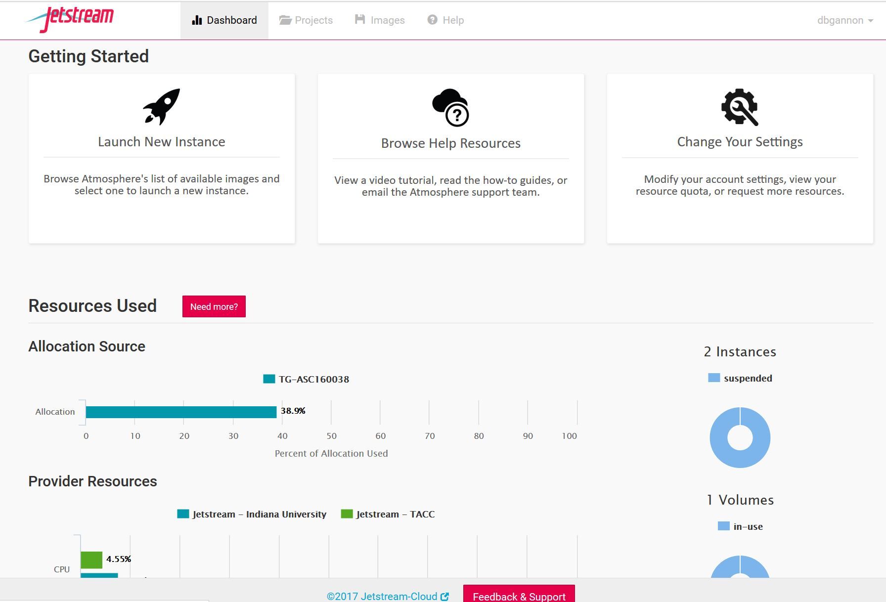
Jetstream –NSF Science Cloud (OpenStack)

Slide 11
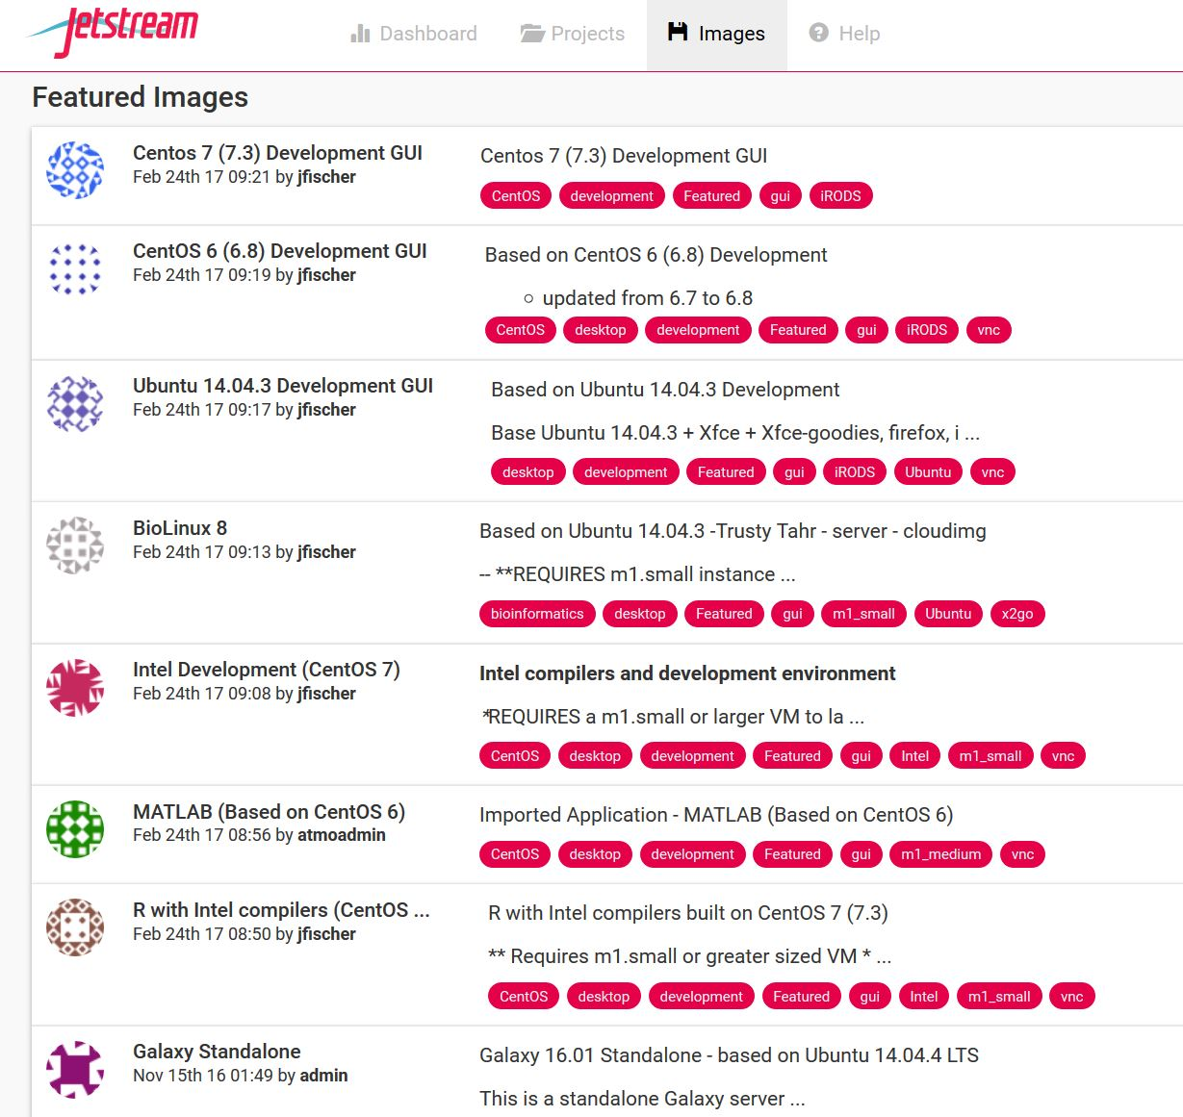
Jetstream is about virtual
Machines for science
Generic Linux
Bioscience
MATLAB
R

Slide 12
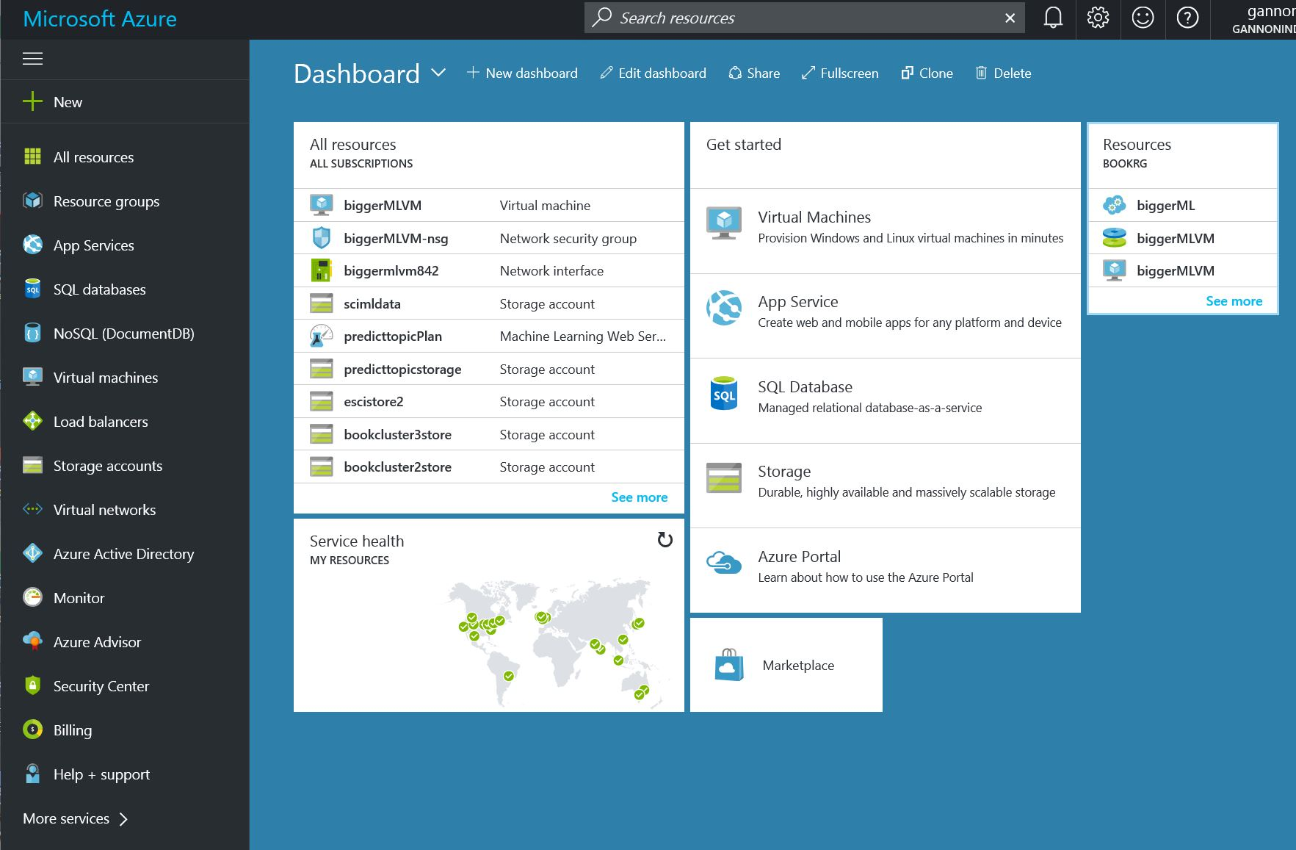
The Azure Portal
Select “+ New”

Slide 13
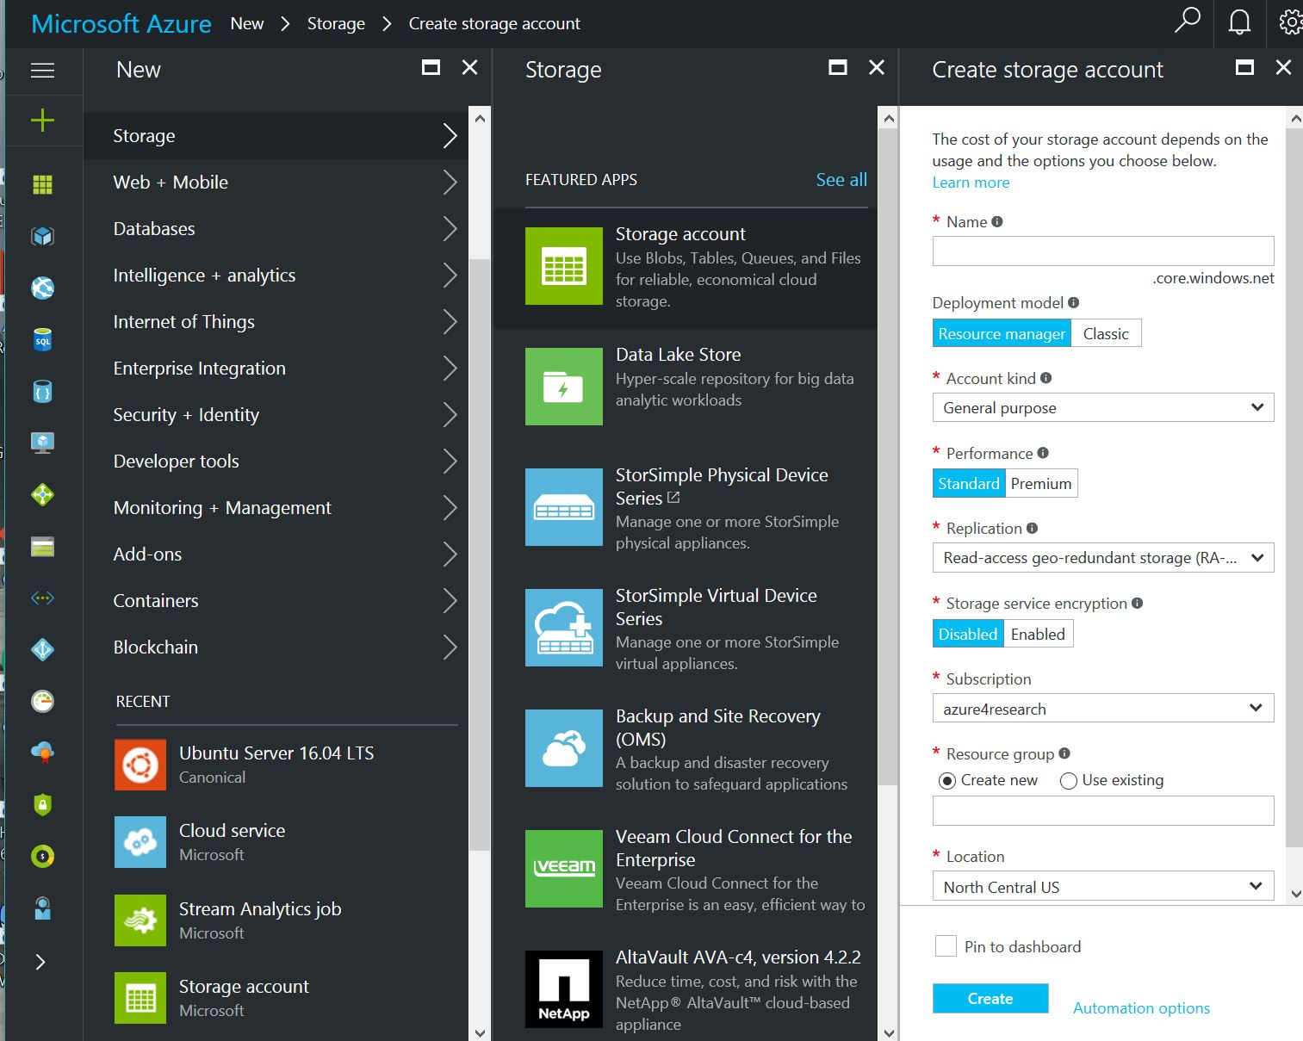
Selecting “+” gives this list of options.
Selecting “Storage” gives the secondary menu of types of storage apps.
To create a storage account select the top one.
- give it a name, research group and location.

Slide 14
Next
A deeper look at storage
Virtual Machines and Containers
Scaling deployments and Microservices demo
Analytics
Machine Learning in the cloud

