Slide 1

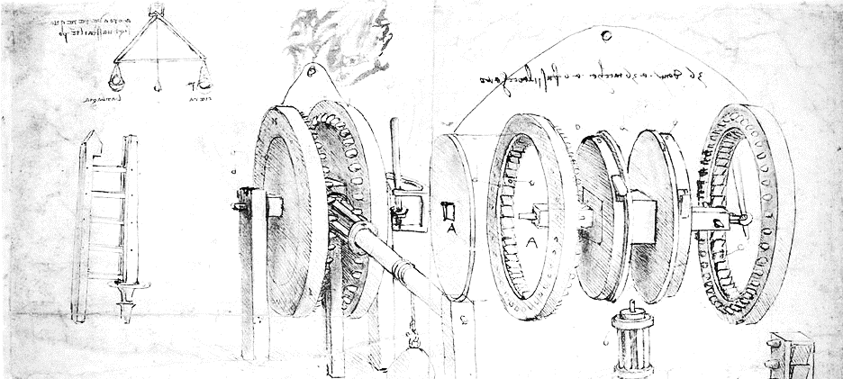

Cloud Computing for Science
Part 2 Virtual Machines and Containers
Dennis Gannon

Slide 2
What is a Virtual Machine?
The foundation of Infrastructure as a Service (IaaS) Clouds
Operating Systems manage multiple user processes by trapping “privileged” instructions they attempt to execute.
If safe to proceed the OS hands the process a “virtual” safe version of the instruction to execute.
In the 1970 IBM and others figured out how to virtualize the entire computer.
A Hypervisor (or virtual machine monitor) is a manager of this virtualization that allows multiple distinct OSs to use the hardware simultaneously.
This is the key to managing thousands of computer “VMs” for customers
A VM is a object that can be managed by a “fabric controller” and virtualized networks.

Slide 3
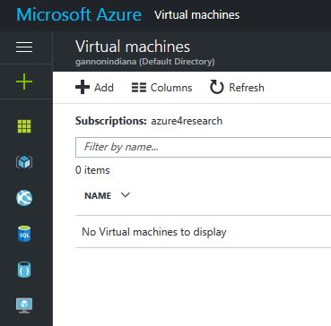
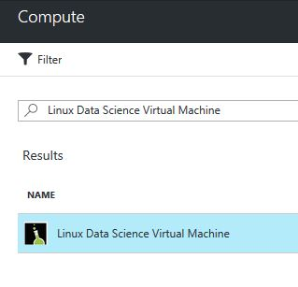
Using the Azure portal to create a VM
In the search box enter “data science” and you will see this choice. Pick this one and click here
Click this
To bring up
The VM page
Then click
Add

Slide 4
The Linux Data Science VM
This Linux-based virtual machine contains popular tools for data science and development activities,
including Microsoft R Open, Anaconda Python, Azure command line tools, and Jupyter notebooks
for Python, R and Julia. It also has machine learning tools and algorithms like mxnet, CNTK,
Vowpal Wabbit and xgboost.
What's new
The Linux data science virtual machine now includes Microsoft R Server 9.0, now with Microsoft R Open 3.3.2 and new options for operationalizing R models
Weka for easy graphical exploration and machine learning
Apache Drill for querying non-relational data using SQL
Spark local 2.0.2 with a PySpark Jupyter kernel
Single node local Hadoop (HDFS, Yarn)
Visual Studio Code IDEs, IntelliJ IDEA, PyCharm, Atom
mxnet for deep learning
JuliaPro - a curated distribution of Julia Language and tools
Also Jupyter hub running on the ip address:8000

Slide 5
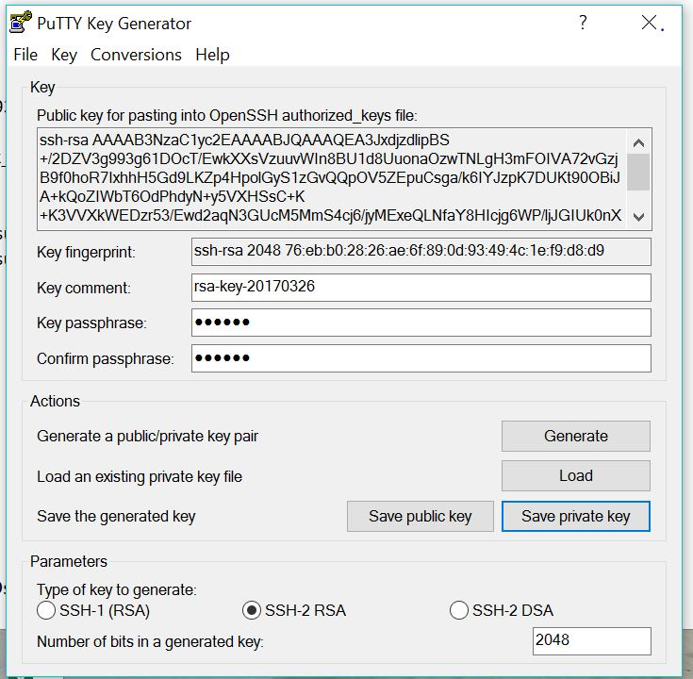
You need a public-private RSA key pair
Linux/Mac
Windows
>ssh-keygen
Will create a password protected private key and a public key
When machine is up, login with
>ssh –i privatekey user@ipaddress
(it will ask for the password)
On Windows10 you can use linux subsystem and follow linux method
Or Install Putty
Run PuTTYGen
Runn Putty to log in.
After you log in you need to set your user password
> sudo passwd YourID
>enter your password twice
We will need this later.

Slide 6
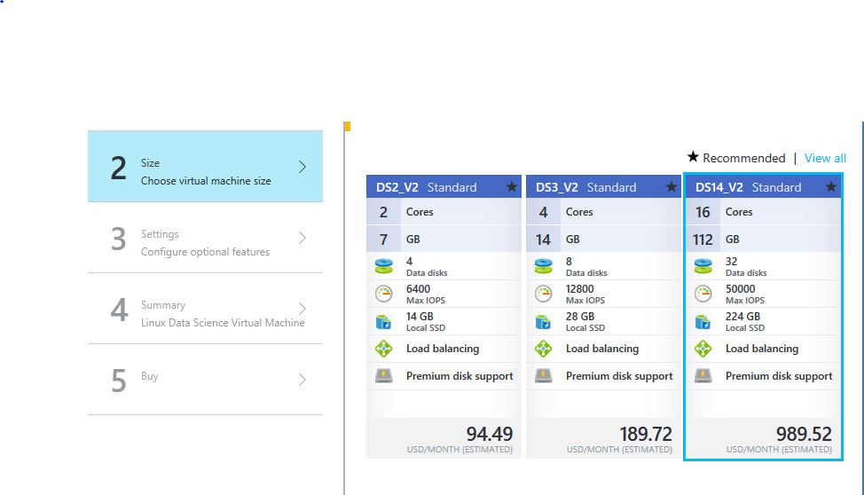
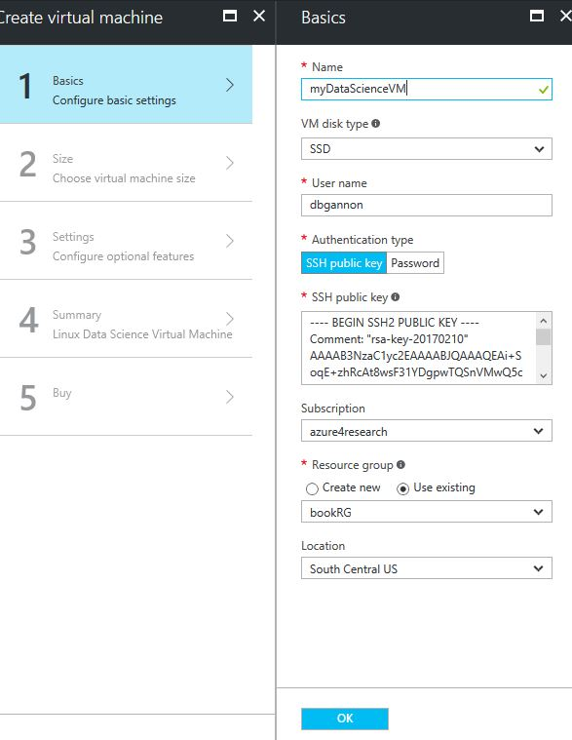
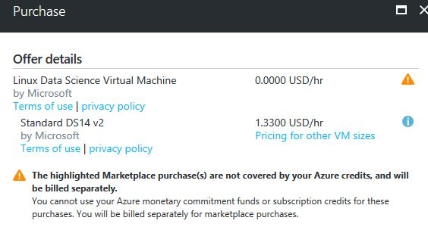
Configuring and launching

Slide 7
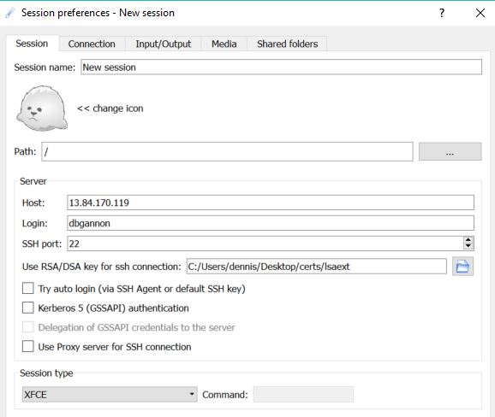
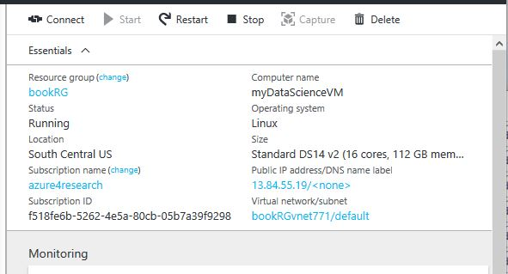
Install X2GO Client
http://wiki.x2go.org
A client to show the desktop of the Linux Data Science VM
When VM up Start X2GO client
Path to your private key
Set to this
Azure portal view and IP address

Slide 8
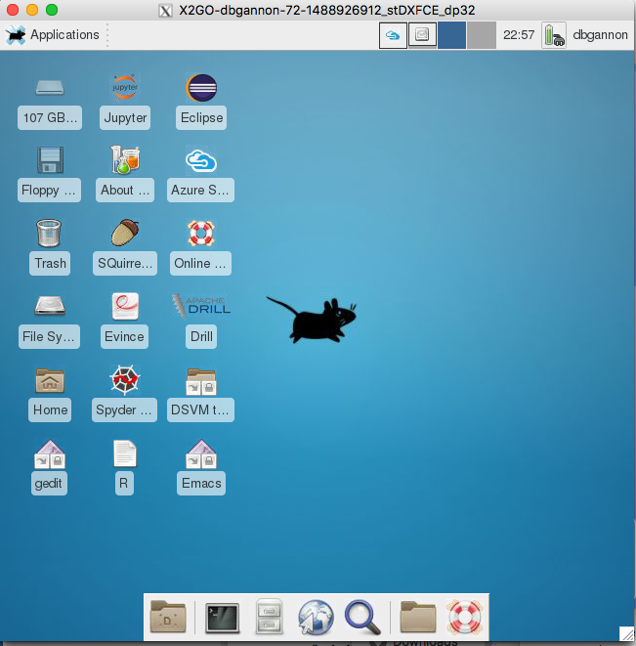
X2GO XFCE Desktop
To run jupyter use JupyterHub.
First you need to set you linux passwd
Open the shell tool
>sudo passwd yourID
Add the password twice
Go to https://yourDSVMip:8000
Enter you ID and password
Or launch a local Jupyter by clicking on the icon.
Running X2GO on PC or mac.

Slide 9
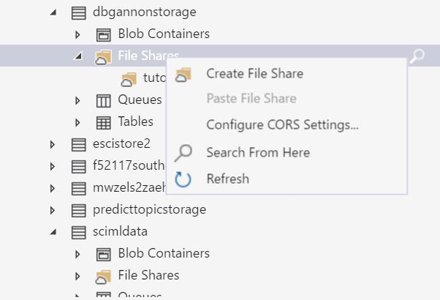
Adding a fileshare disk
This is a disk in blob storage that you can see with AzureExplorer
Create a storage account in same location as your DSVM.
Create a file share in that account named XXX
Grab the storage account key
Run these commands
>sudo yum install samba-client samba-common cifs-utils
>sudo mkdir /mnt/tutorialshare
>sudo chmod 0777 /mnt/tutorialshare
>sudo mount -t cifs //yourstorageaccnt.file.core.windows.net/XXX /mnt/tutorialshare -o vers=3.0,user=yourstorageaccnt,password=you accntpasswrd ending in==,dir_mode=0777,file_mode=0777,serverino
>sudo vi /etc/fstab
Add this line at the end
//yourstorageaccnt.file.core.windows.net/XXX /mnt/tutorialshare vers=3.0,user=yourstorageaccnt,password=you accntpasswrd ending in==,dir_mode=0777,file_mode=0777,serverino

Slide 10
Containers
An alternative to virtual machines for encapsulating software

Slide 11
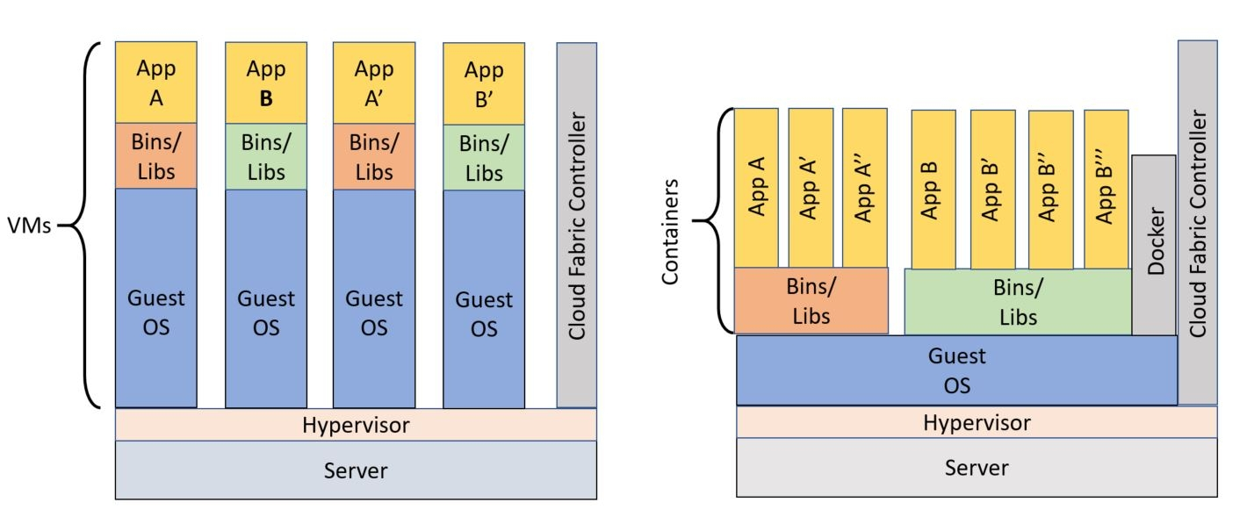
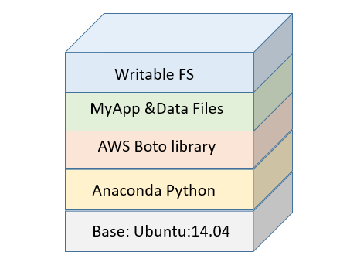
What are VMs? containers?
A VM is an instance of a complete operating system and file system running on the virtualized hardware.
Containers share components of the hosts OS and file system and are more similar to a process. (Uses special Linux features “control groups” and “name space isolation” to partition process space and layer new private file system components on the host filesystem.)

Slide 12
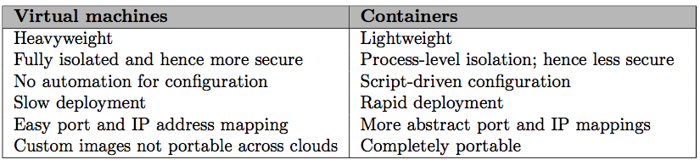
Advantages

Slide 13
Using Docker to manage containers
Download Docker for your pc or mac
https://docs.docker.com/engine/installation/
Or login to your Azure data science linux vm
Type sudo docker ps
Type sudo docker run –it ubuntu
You are now running Ubuntu linix in a container. -it give you the i/o for the shell.

Slide 14
Containers as a way to share science
Lots of our sample jupyter notebooks
For this tutorial we have a container
>docker run –it –p 8888:8888 dbgannon/tutorial
password = tutorial
contains lots of our sample jupyter notebooks
Many other Science containers:
Bio - Galaxy and Hamburg genome toolkit
Geosciences – geoserver
Astronomy – LOFAR, PyImager, MegTree
Engineering – Ubercloud project (theubercloud.com)
Math – Matlab, Axiom

Slide 15
Creating a container from other containers
Docker file for tutorial
A directory with
A “Dockerfile”
Things you want in the container
A script
A directory of data file: datadir
A directory of the notebook examples
An openssl certificate and key file
A secure hash of a password “tutorial” as a ‘sha1:….” string
To build the container I ran
docker build –t=“dbgannon/tutorial” .
# Version: 0.1.0
FROM jupyter/all-spark-notebook
MAINTAINER your name "dennis gannon"
RUN pip install azure-storage ==0.32.0
RUN pip install boto3
RUN easy_install pika
RUN easy_install bottle
COPY book-notebooks /tutorial_notebooks
COPY datadir /datadir
COPY script /
COPY mycert.pem /
COPY mycert.key /
CMD ["bash", "/script"]
Script file is
mkdir /home/jovyan/work/notebooks
cp /tutorial_notebooks/* /home/jovyan/work/notebooks
start-notebook.sh --certfile=/mycert.pem --keyfile=/mycert.key \
--NotebookApp.password='sha1:c02ed938ef17:0934044bb76008a364781d85db149a65fe9bb480'

Slide 16
Much more about containers
You can mount your own directory in the container so data generated in the container can persist.
Docker run –v your_director:container_director -it –p …..
Containers can share mounted directories
Docker compose – allows for container composition
Singularity – a container system for supercomputer applications.

Slide 17
Section Summary
Brief look at Virtual Machines
Installed Linux Data Science VM on Azure
Containers
Some examples
An introduction to Container archeticture
Containers vs VMs
Building a container
NEXT – swarms of containers in the cloud

