Slide 1

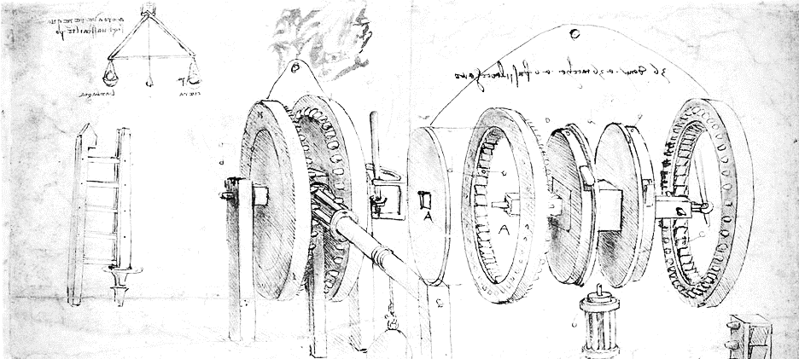

Cloud Computing for Science
Part 3. Scaling Computation
Dennis Gannon

Slide 2
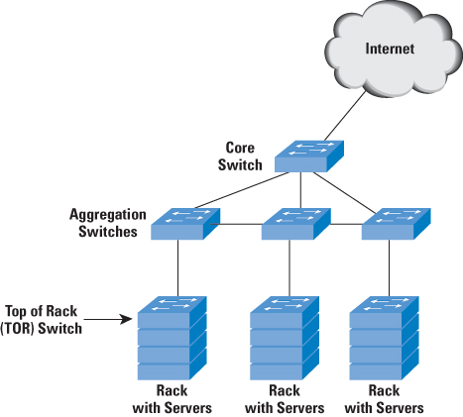
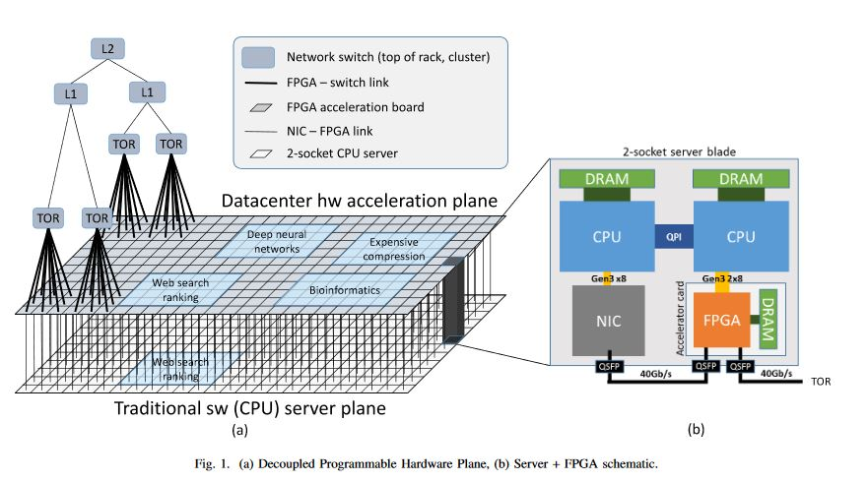
The Cloud Data Center Evolution
Early days: 2005
Very simple servers
Network outward facing poor interconnect
2008-2016
Software defined networks
Special InfiniBand sub networks
Many different server types
2 cores to 32 cores to GPU accelerations
Efficiency experiments
Geothermal, wind, wave
Containerized server
2017
Azure FPGA accelerated mesh
Google Tensor Processing Unit
Facebook – Open Compute Project
ARM based servers

Slide 3
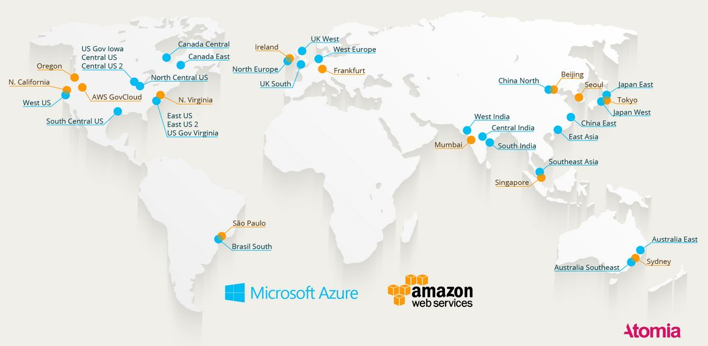
Azure and AWS Global Data Center Network

Slide 4
How to scale: Models of Parallelism
Classic HPC
SPMD MPI programming
Task Parallel
Also called “embarrassingly parallel”
MapReduce
Hadoop style
Graph Execution
Spark and streaming systems
Microservices
Similar to actor model

Slide 5
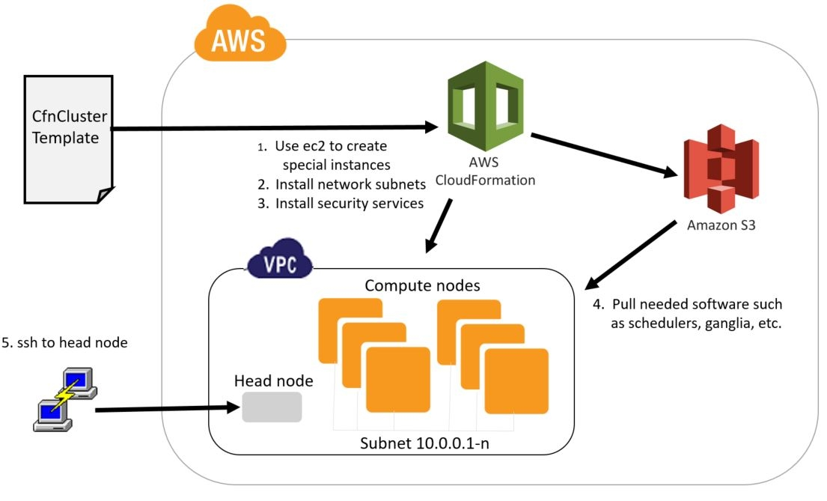
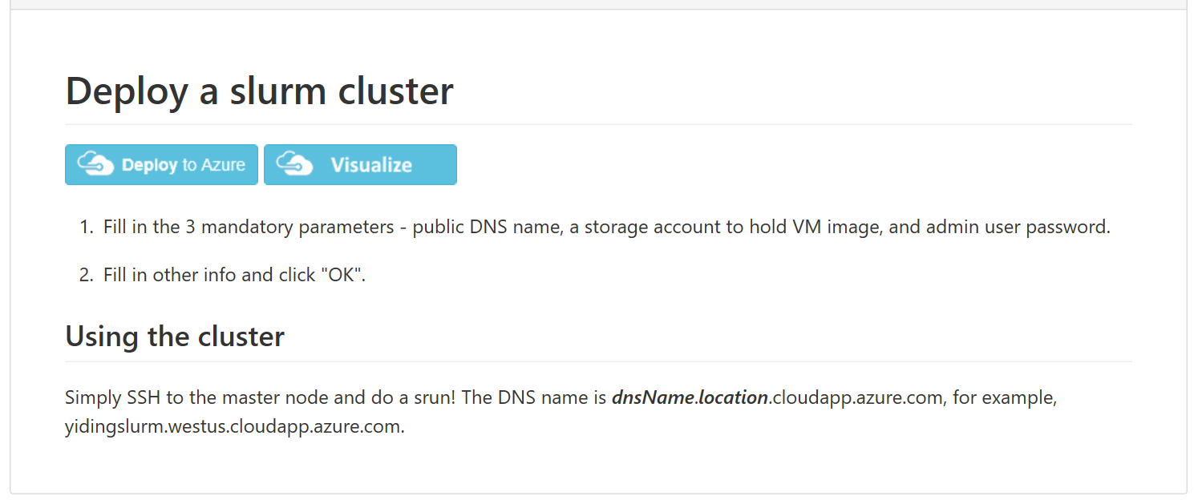
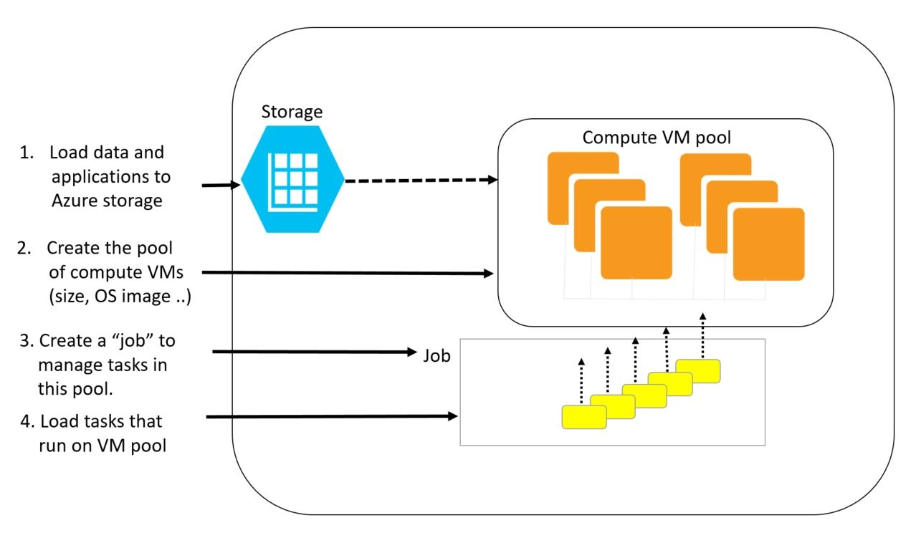
Classic HPC
AWS CloudFormation Cluster
Fill out CfnCluster template
Use aws command line to submit
Log into head node
Azure create a slurm cluster
See Azure slurm tutorial
Or use Azure Batch
Similar to AWS batch

Slide 6
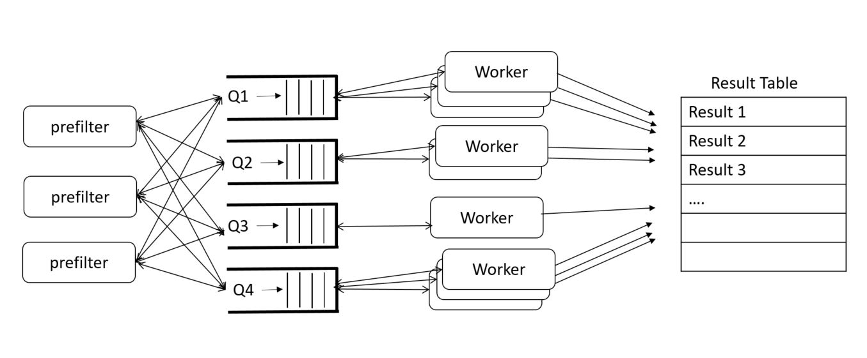
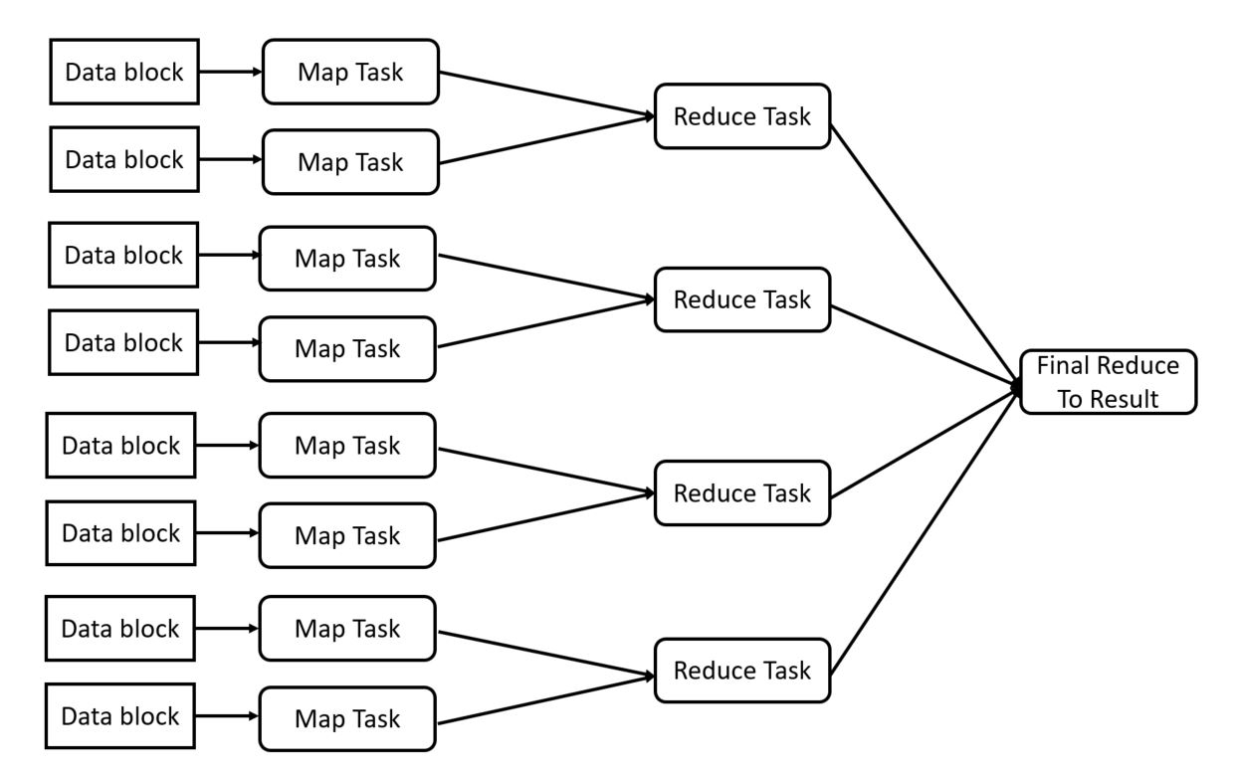
Task Parallel and Map Reduce
Task parallel model is great for solving problems that involve doing many independent computations.
Map Reduce
Bulk Synchronous Parallel (BSP)
Map Task = an operation applied to blocks of data in parallel
Reduce Task- when maps are “done” reduce the results to a single result
Examples of both later

Slide 7
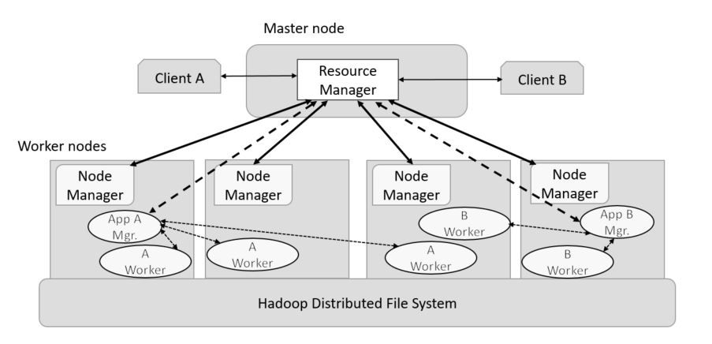
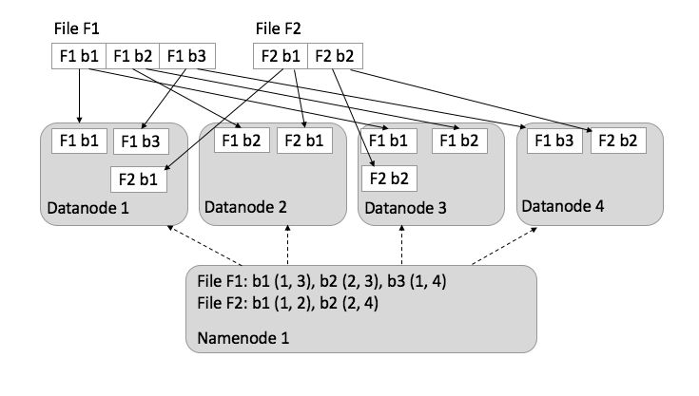
The Hadoop- Yarn ecosystem
Yarn is the name of a project containing many elements
The runtime system is distributed
Hadoop, Spark run in distributed mode
Multiple clients can access the resource manager
Jupyter and Zeppelin are interactive clients
HDFS is the Hadoop File system
Distributed over data node servers
Files are blocked, distributed and replicated
Files are write-once.

Slide 8
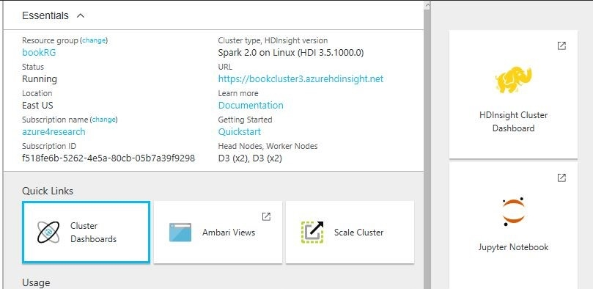
Azure HDInsight is a Yarm Environment

Slide 9
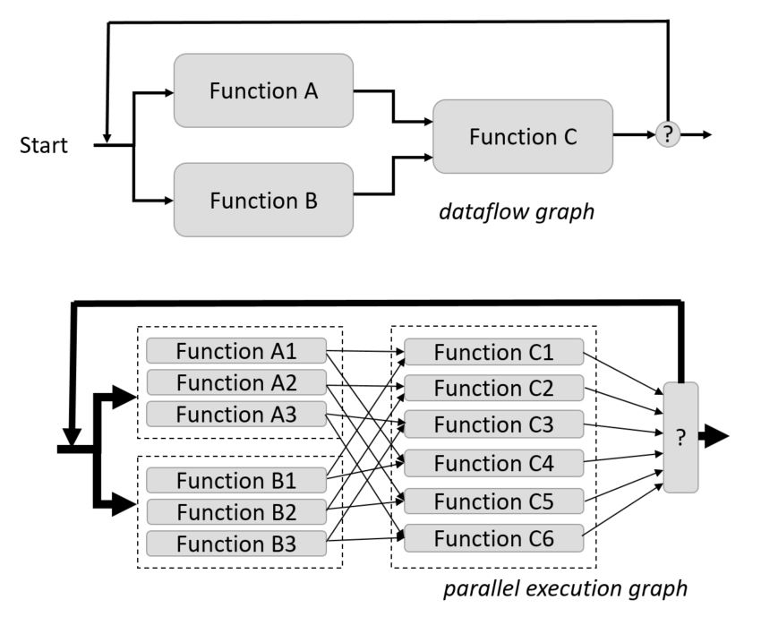
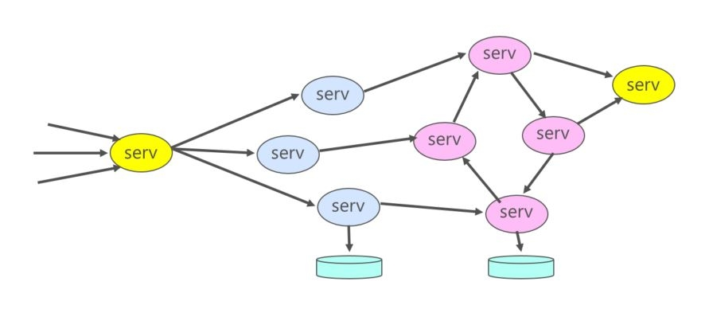
Graph Parallel and Microservices
Graph Parallel
The data is in distributed arrays or streams.
build a data flow graph of the algorithms functions.
The graph is compiled into parallel operators that are applied to the distributed data structures.
Microservices
Divide a computation into small, mostly stateless components that can be
Easily replicated for scale
Communicate with simple protocols
Computation is as a swarm of communicating workers.

Slide 10
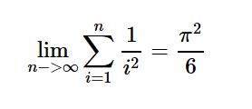
Graph computation example: Spark
A simple map reduce: Compute
For n = 10,000,000
In Spark on Python is:
import numpy as np
ar = np.arange(n)#an array from 0 to 9999999 nump = 100 rdd = sc.parallelize(ar,nump)
x = rdd.map(lambda i: 1.0/(i+1)**2) .reduce(lambda a,b: a+b)
print(“x=%f”%x) print(“pi**2/6=%f”%(np.pi**2/6))
1.644934 1.644934
Spark Resilient Distributed Dataset (RDD)
….
0 .. 99999
100000 .. 199999
200000 .. 399999
900000 .. 999999
map
map
map
map
+
+
Graph executed on distributed cluster
+
Value returned to python
x

Slide 11
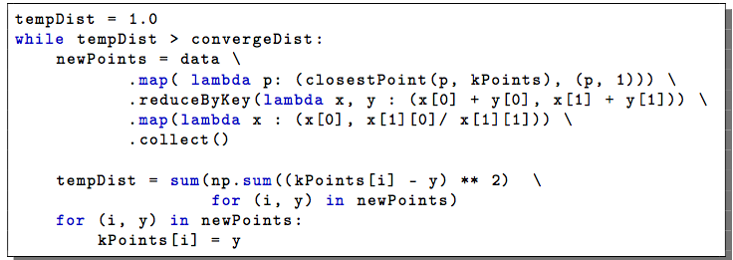
More interesting example: k-means clustering
The algorithm basics
n=1000000
Start with a vector P of n 2-d points and a vector kPoints of k random cluster centroids.
Iterate until kPoints don’t move:
For each j in [0,k-1] pick q[j] from kPoints. Then find all the points p in P near q[j] and create the tuples (j, (p, 1) for p nearest to q[j])
For each j compute the centroid of all points “near” q[j] in kPoints” (j, (sum(p)/sum(1)))
Set q[j] to be the new centroid sum(p)/sum(1)

Slide 12
Exercises
If you have Docker installed
run dbgannon/tutorial run -it --rm -p 8888:8888 dbgannon/tutorial
You should see the spark.ipynb in the notbooks. Fire it up. Make sure it is running with kernel python 2 and shutdown other big apps. This needs memory!
If you don’t have docker, but do have the data science vm:
Go to https://your-vm-ip:8000 and login.
Upload spark.ipynb from the tutorial tarball folder
For something different: Signup for https://notebooks.azure.com
Do the twitter analysis demo

Slide 13
Microservices
Container Service Cluster
Divide a computation into small, mostly stateless components that can be
Easily replicated for scale
Communicate with simple protocols
Computation is as a swarm of communicating workers.
Typically run as containers using a service deployment and management service
Amazon EC2 Container Service
Google Kubernetes
DCOS from Berkeley/Mesosphere
Docker Swarm
core 1
core 2
core 3
core ..
core n

Slide 14
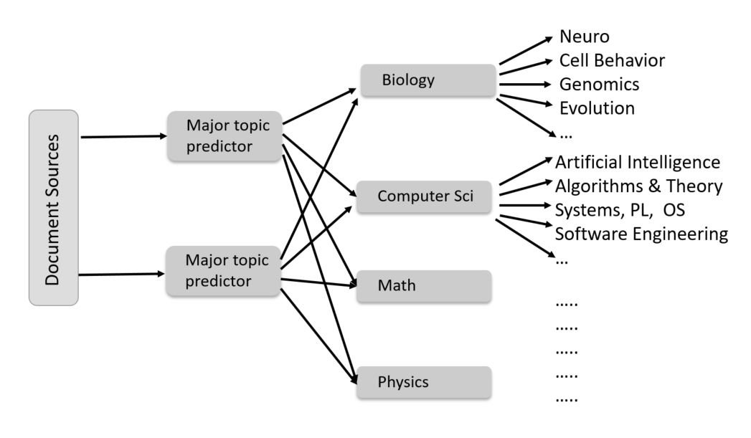
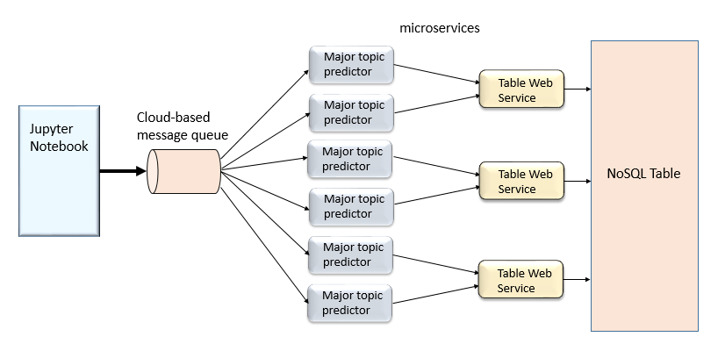
Examples
Full doc classification
Netflix, Google Docs, Azure services, eBay, Amazon, the UK Government Digital Service, Twitter, PayPal, Gilt, Bluemix, Soundcloud, The Guardian
JetStream Genomics Docker swarm to spinup container instance of Galaxy for users on demand
Processing Document streams
Lots of RSS feeds describing recent scientific documents
Let’s classify them by topic
Physics, Math, CS, Biology, Finance, …
By reading the abstracts and using a little machine learning.
Simplified version

Slide 15
Demo - Using Amazon AWS and Azure Together
Create
An instance of a message Queue based on AWS SQS
An dynamoDB table BookTable
An Azure table called BookTable
Create 3 services
Predictor – one parameter (port)
TableServiceAWS
TableServiceAzure
1st step: create a AWS elastic container service cluster
Queue
Predictor
AWS BookTable
Predictor
TS-AWS
Predictor
Predictor
Azure BookTable
Predictor
TS-Azure
Predictor

Slide 16
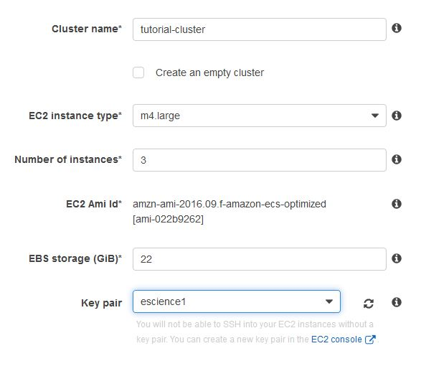
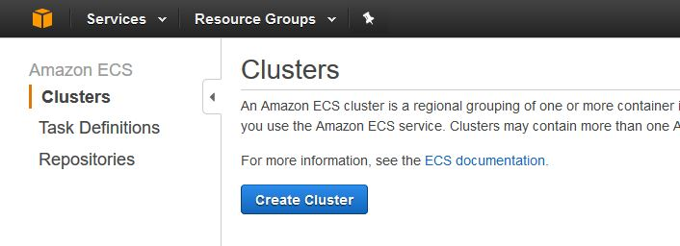
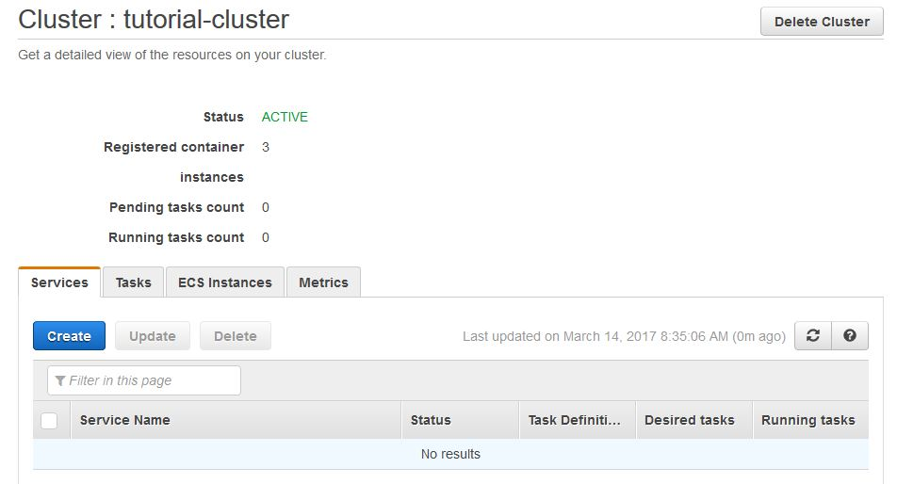
Create a cluster

Slide 17
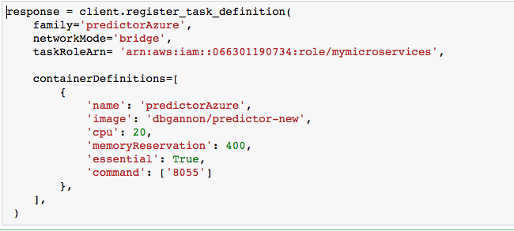
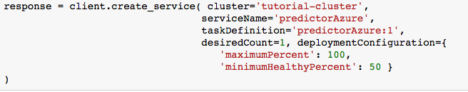
Code to create a service

Slide 18
Go to Demo

Slide 19
Section Summary
The cloud data centers are designed to scale
Traditional HPC MPI programming is possible, but a Cray is better.
The cloud is best at distributed scale, interactive computation
Spark in Yarn with Jupyter is a good example
MapReduce and Graph models are well supported
Microservices provide a means to support very large scale parallelism in continuously running applications.

