Slide 1
A Roommate Finder app
Bhavik Patel, Arpita Shekhar, Amulya Varote and Aishwarya Sundararajan
Group A- CSC510, Spring 2018

Slide 2
Problem statement
Problems with traditional Roommate Finding:
Too much user input
Reliability
Lack of awareness about such platforms
Making roommate search easier for students looking for off-campus housing.
By matching student profiles based on selected preference tags.
Suggesting profiles based on the best match for the user.

Slide 3
Proposed solution
Search based on tags: Location, Budget, Dietary Habits, Alcoholic Habits, Gender and Move-in-date etc.
Flexibility: Allows search tags to change without editing profile
Availability: Priority given to “Location” and ”Budget” to display the next best match
Allows scalability due to architectural advantage (Load Balancing in the future)
Security: “Send request” allows the requestor to view email address of receiver only after the receiver accepts request
Reliability: Exclusively for NCSU students
Notes:
(improved hassle-free UI)

Slide 4

Technology Stack
mLab DbaaS(backend)
Deployment via Heroku
Expressjs routing & MVC
Angular js for dependency Injection
Node js to handle multiple Connections (non-blocking I/O)

Slide 5
Architecture Diagram
1

Slide 6
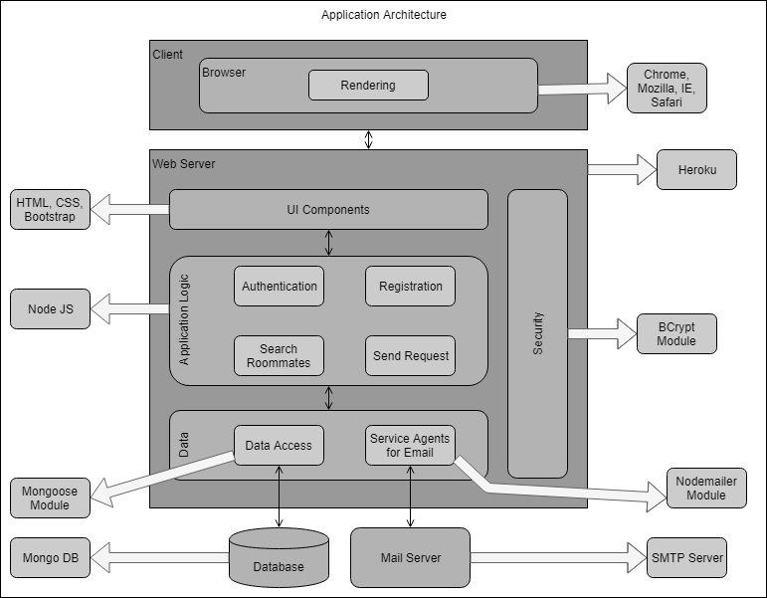
Notes:
Secure registration via SMTP Mail server
MongoDB Db-as-a-Service at AWS Sandbox (free 0.5 GB)
Password encrypted (BCrypt)
Cross-browser compatibility

Slide 7
Application Flow
2

Slide 8
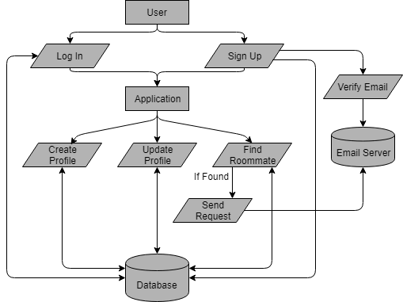

Slide 9
Implementation
3

Slide 10
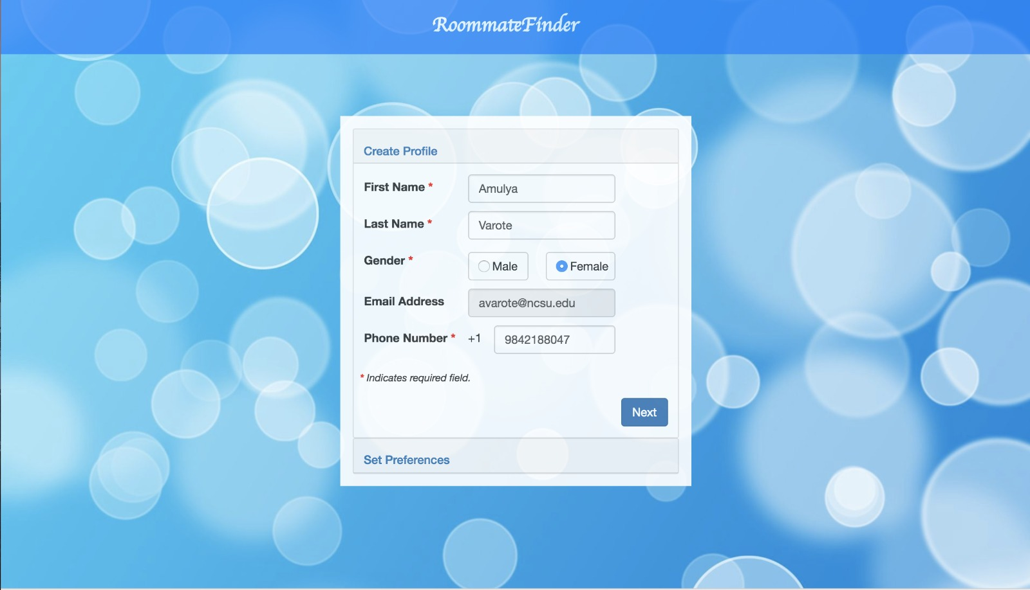
Create profile
Place your screenshot here

Slide 11
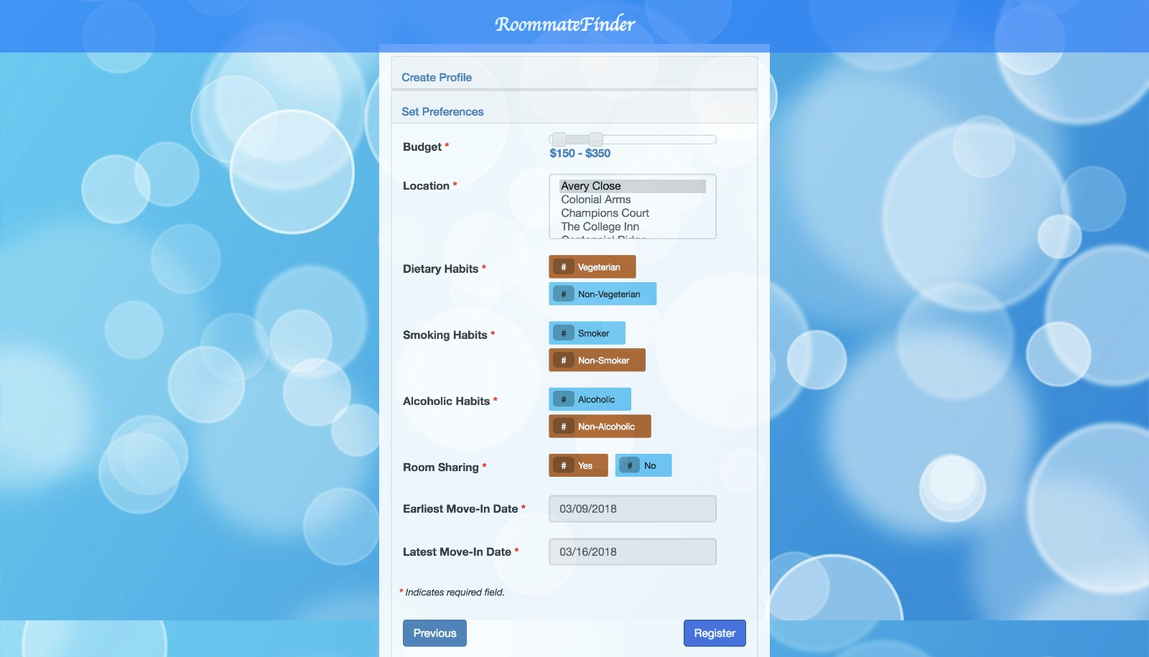
Set preferences
Place your screenshot here

Slide 12
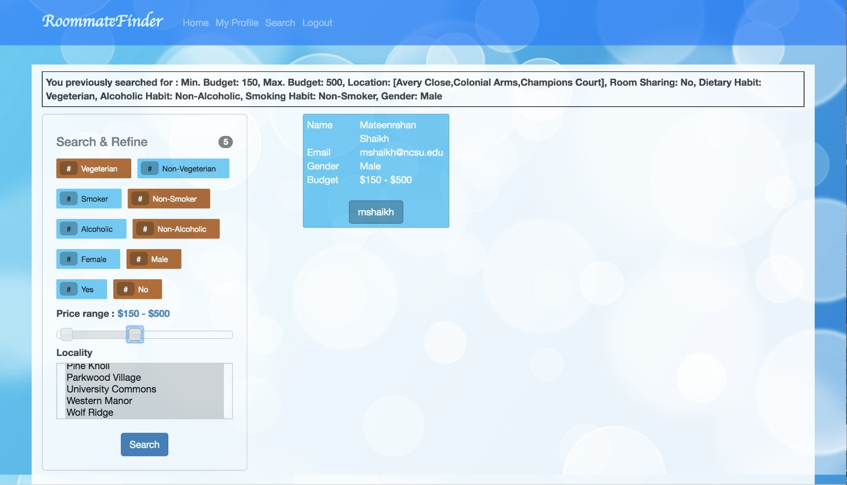
Search
Place your screenshot here

Slide 13
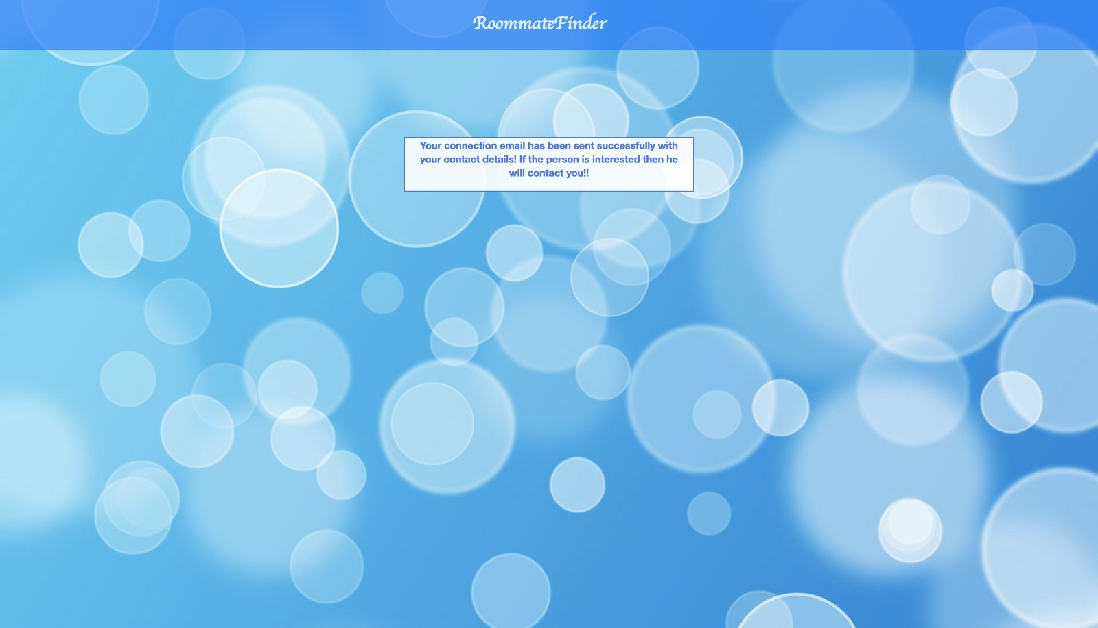
Send request
Place your screenshot here

Slide 14
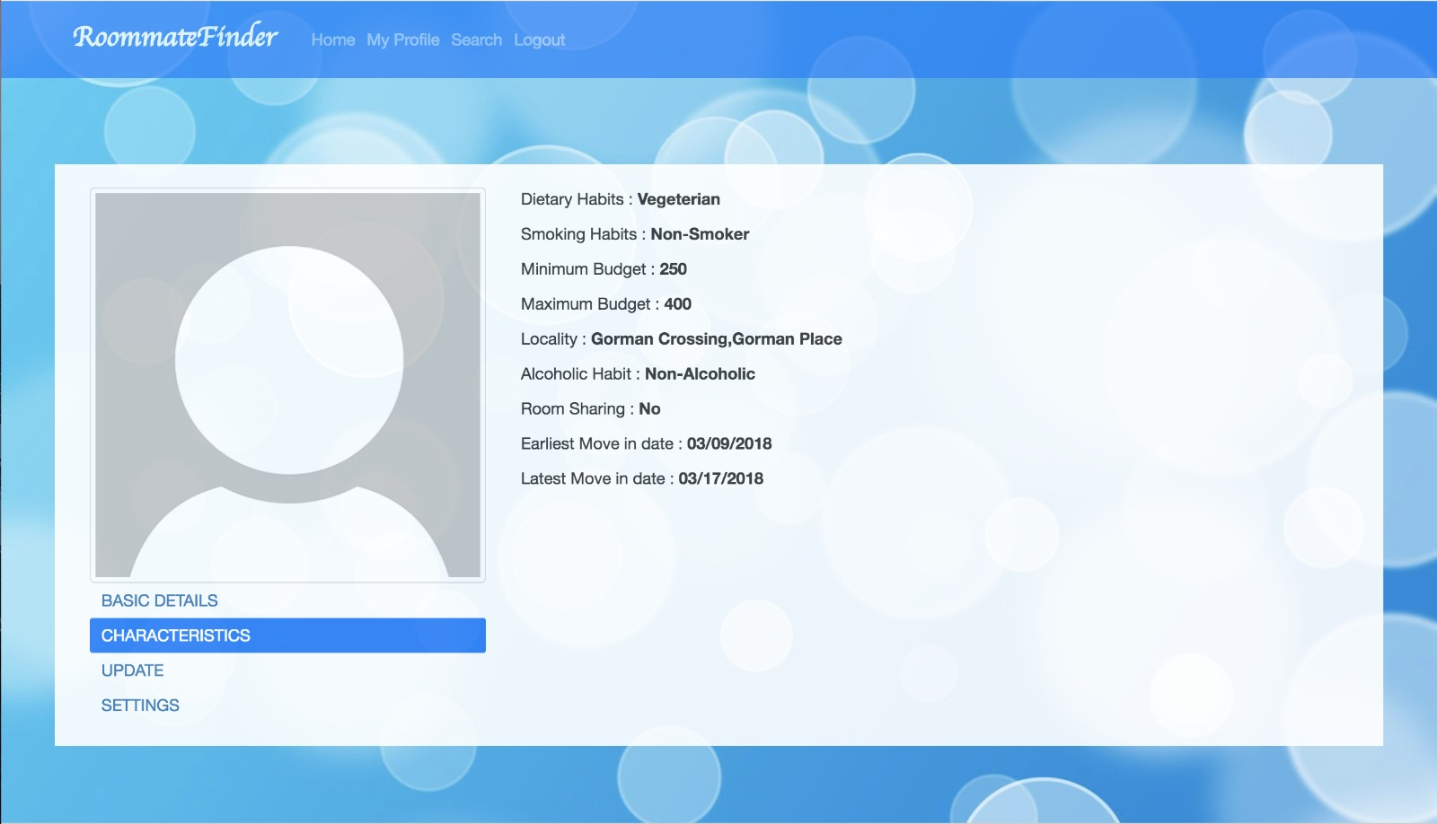
View/Edit Profile
Place your screenshot here

Slide 15
Evaluation results
4

Slide 16
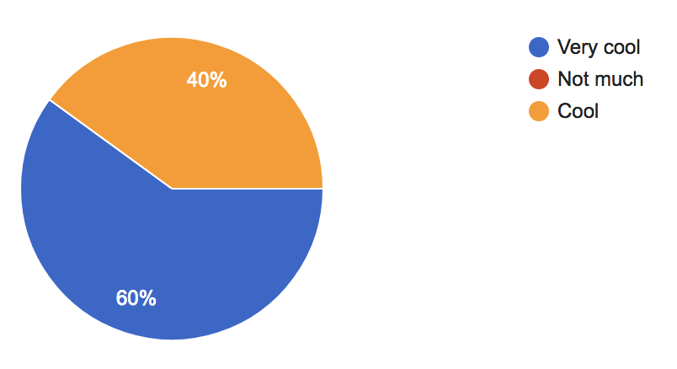
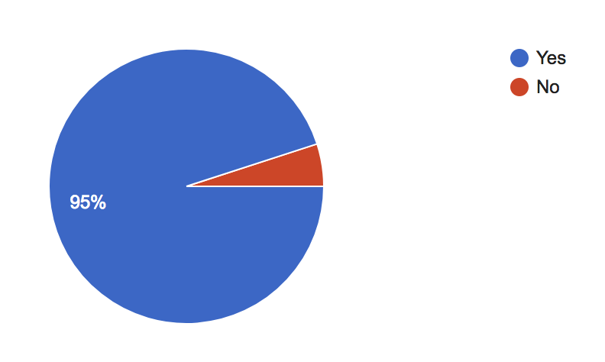
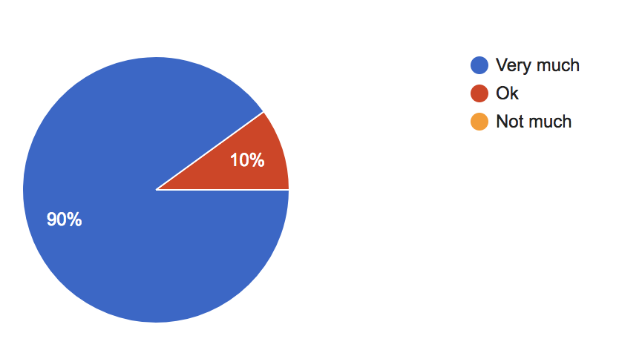
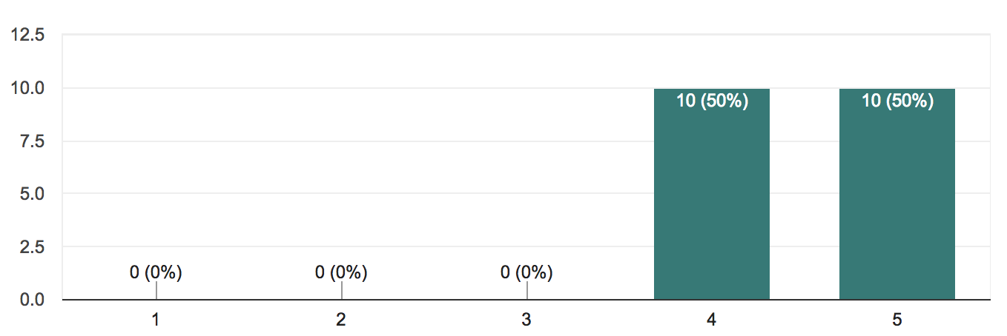
How cool is the idea to you
Are you able to navigate to the pages without reading the readme file
How do you rate the UI of the application
Did you feel that basic categories of preferences have been included

Slide 17
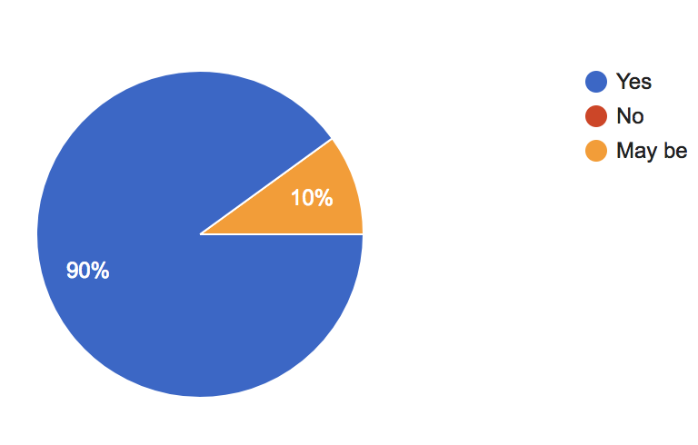
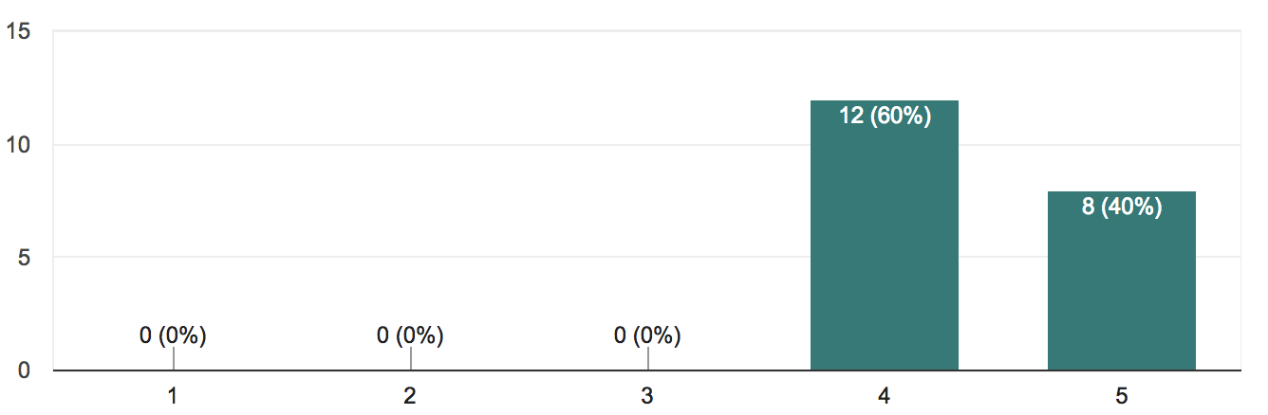
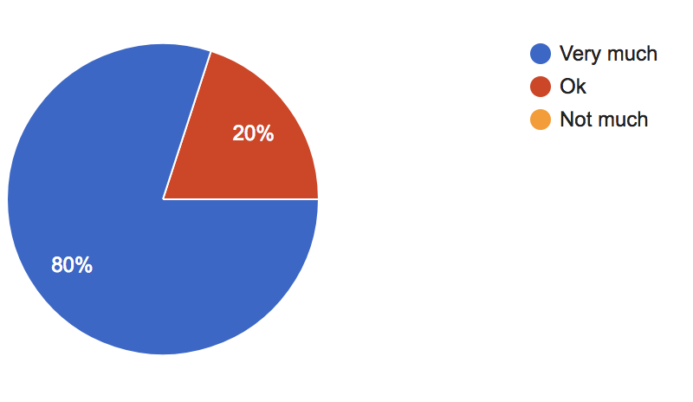
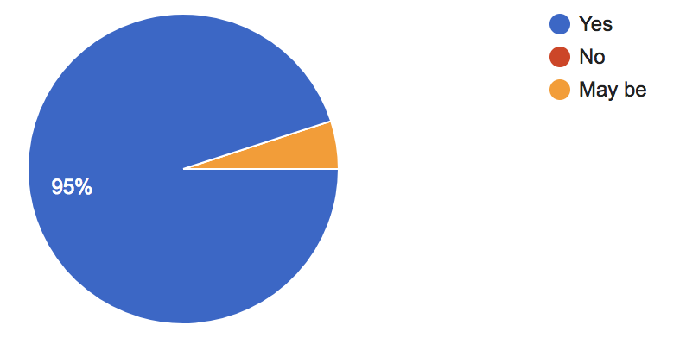
Rate the tagging system
Did the application fulfill your expectations
Did you find it easy to search roommates
How useful do you think this system will be to find roommates

Slide 18
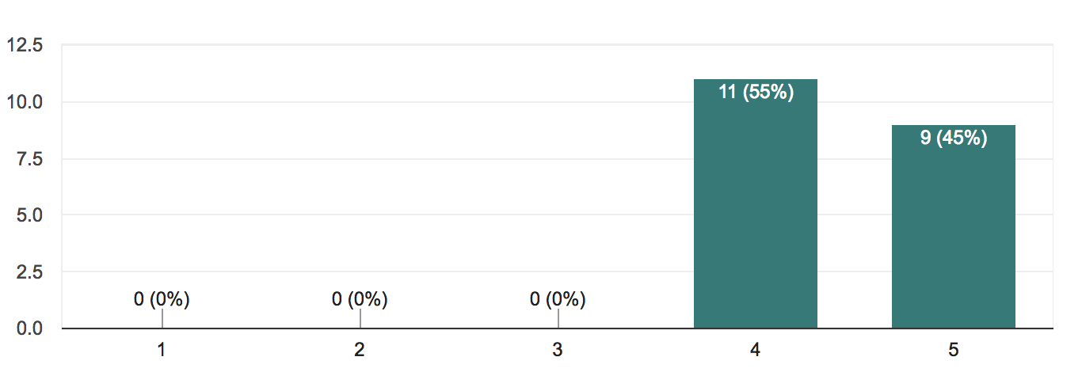
Overall rating of the application
4.2/5

Slide 19

Future Scope
Integration with Social Media.
Predicting frequently occuring combinations of preferences.
Sending the request through application.
Integration with chat.
Combined roommate search.
Review and Recommend roommates.

Slide 20
Thanks!
Any questions?

