Slide 1


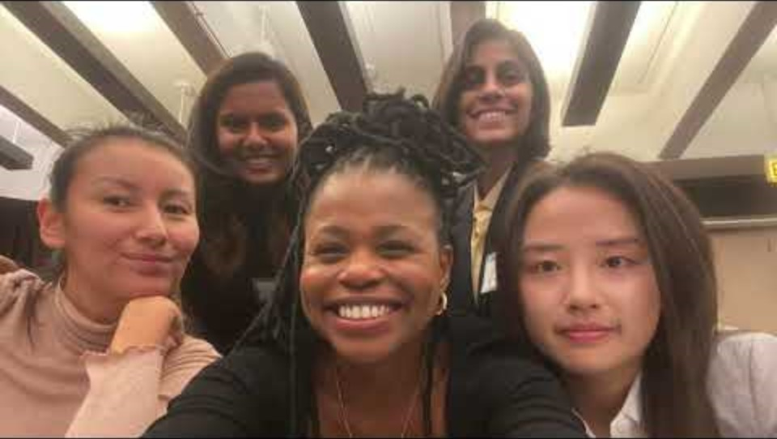

Aishwarya Chourasia

