Slide 1
ACADAMIC RESEARCH DATABASE MANAGEMENT SYSTEM
BY..,
AISHWARYA LAKSHMI | C
GOPIKA | G
ROSELIN | M

Slide 2
OBJECTIVE
This project aims to create a robust and scalable platform that efficiently organizes, stores, and retrieves academic resources, facilitating easy access for researchers, educators, and students.
Key objectives include the development of an intuitive web interface, implementation of advanced search functionalities, and ensuring secure user authentication and authorization.
The system is designed to support the seamless ingestion of academic content, provide robust search capabilities, and maintain data integrity and security.
This digital library system is intended to enhance the accessibility and usability of academic resources, contributing to more effective research and knowledge

Slide 3
Tables
Books
Journals
PrimarySources
Authors
Author_Book (junction table to handle many-to-many relationships between books and authors)
Author_Journal (junction table to handle many-to-many relationships between journals and authors)
Author_PrimarySource (junction table to handle many-to-many relationships between primary sources and authors)

Slide 4
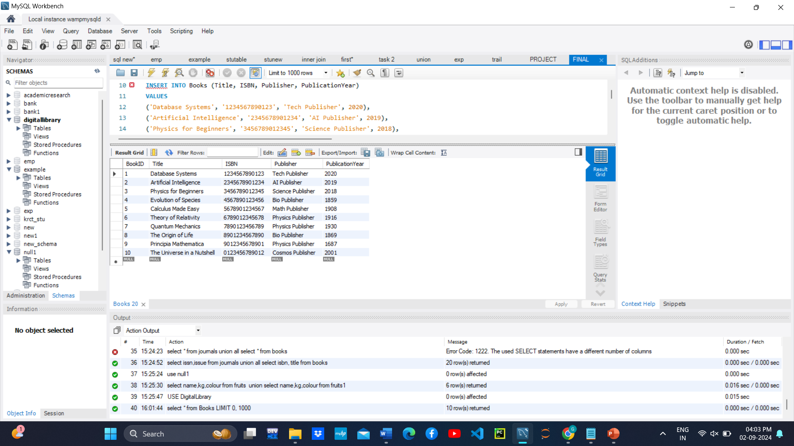
BOOKS TABLE
CREATE TABLE Books (BookID INT AUTO_INCREMENT PRIMARY KEY, Title VARCHAR(255), ISBN VARCHAR(13), Publisher VARCHAR(255), PublicationYear INT)
INSERT INTO Books (Title, ISBN, Publisher, PublicationYear) VALUES ('Database Systems', '1234567890123', 'Tech Publisher', 2020),('Artificial Intelligence', '2345678901234', 'AI Publisher', 2019),('Physics for Beginners', '3456789012345', 'Science Publisher', 2018),('Evolution of Species', '4567890123456', 'Bio Publisher', 1859),('Calculus Made Easy', '5678901234567', 'Math Publisher', 1908),('Theory of Relativity', '6789012345678', 'Physics Publisher', 1916),('Quantum Mechanics', '7890123456789', 'Physics Publisher', 1930),('The Origin of Life', '8901234567890', 'Bio Publisher', 1869),('Principia Mathematica', '9012345678901', 'Physics Publisher', 1687),('The Universe in a Nutshell', '0123456789012', 'Cosmos Publisher', 2001)

Slide 5
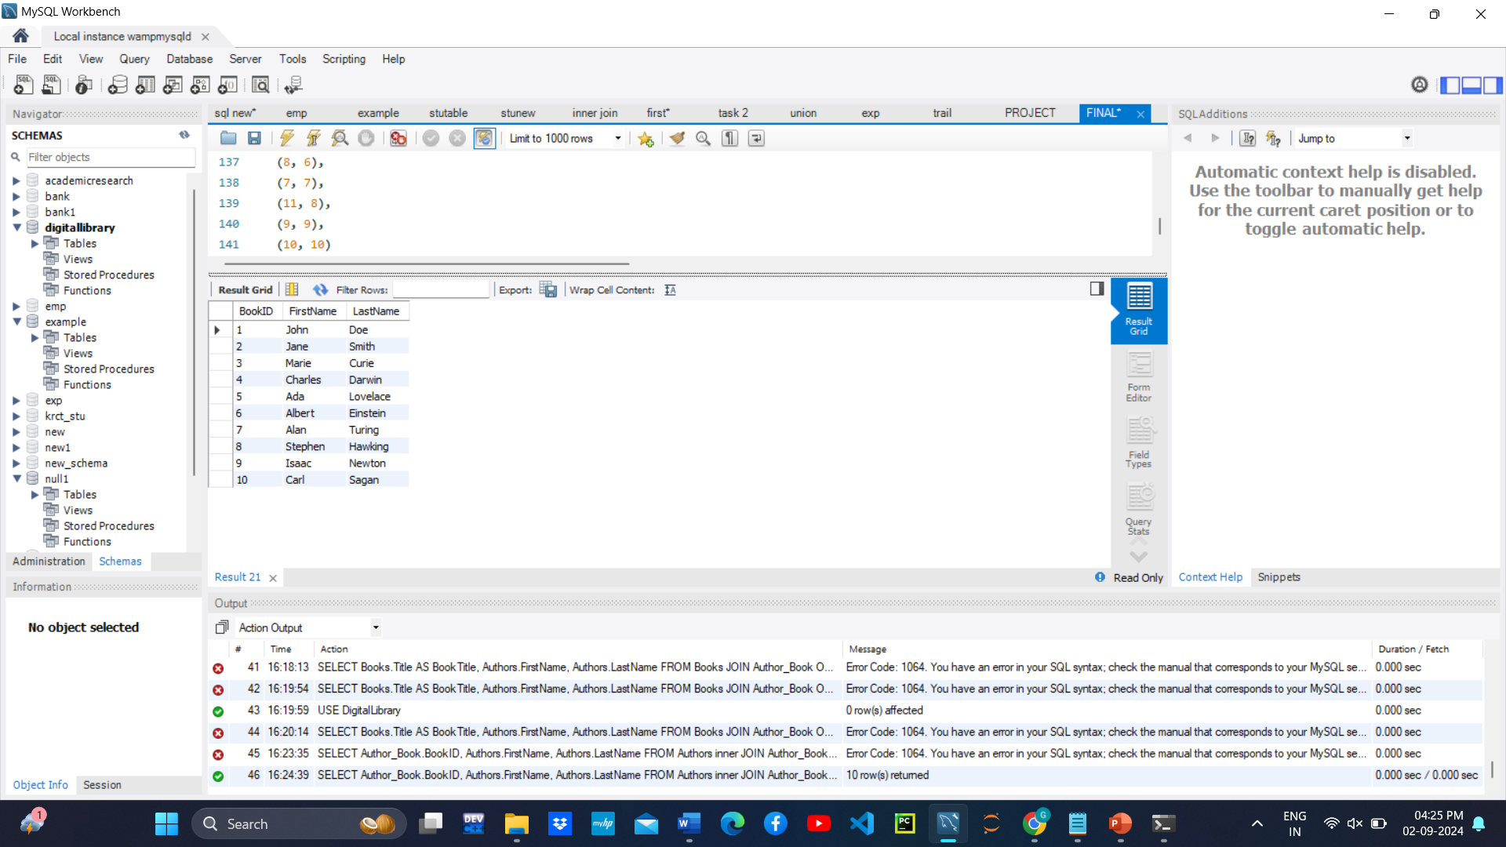
AUTHORS WITH AUTHOR_BOOK USING JOINS
Select Author_book.Bookid, Authors.Firstname, Authors.Lastname FROM Authors Inner JOIN Author_book ON Author_book.Authorid = Authors.Authorid;
Select A.Firstname,a.Lastname,b.Authorid,b.Bookid From Authors As A Left Join Author_book As B On A.Authorid=b.Authorid
Select A.Firstname,a.Lastname,b.Bookid From Authors As A Right Join Author_book As B On A.Authorid=b.Authorid
Select A.Title,a.Type,b.Authorid,b.Sourceid From Primarysources As A Cross Join Author_primarysource As B
Select A.Title,a.Publicationyear,b.Isbn From Journals As A,books As B Where A.Publicationyear=b.Publicationyear

Slide 6
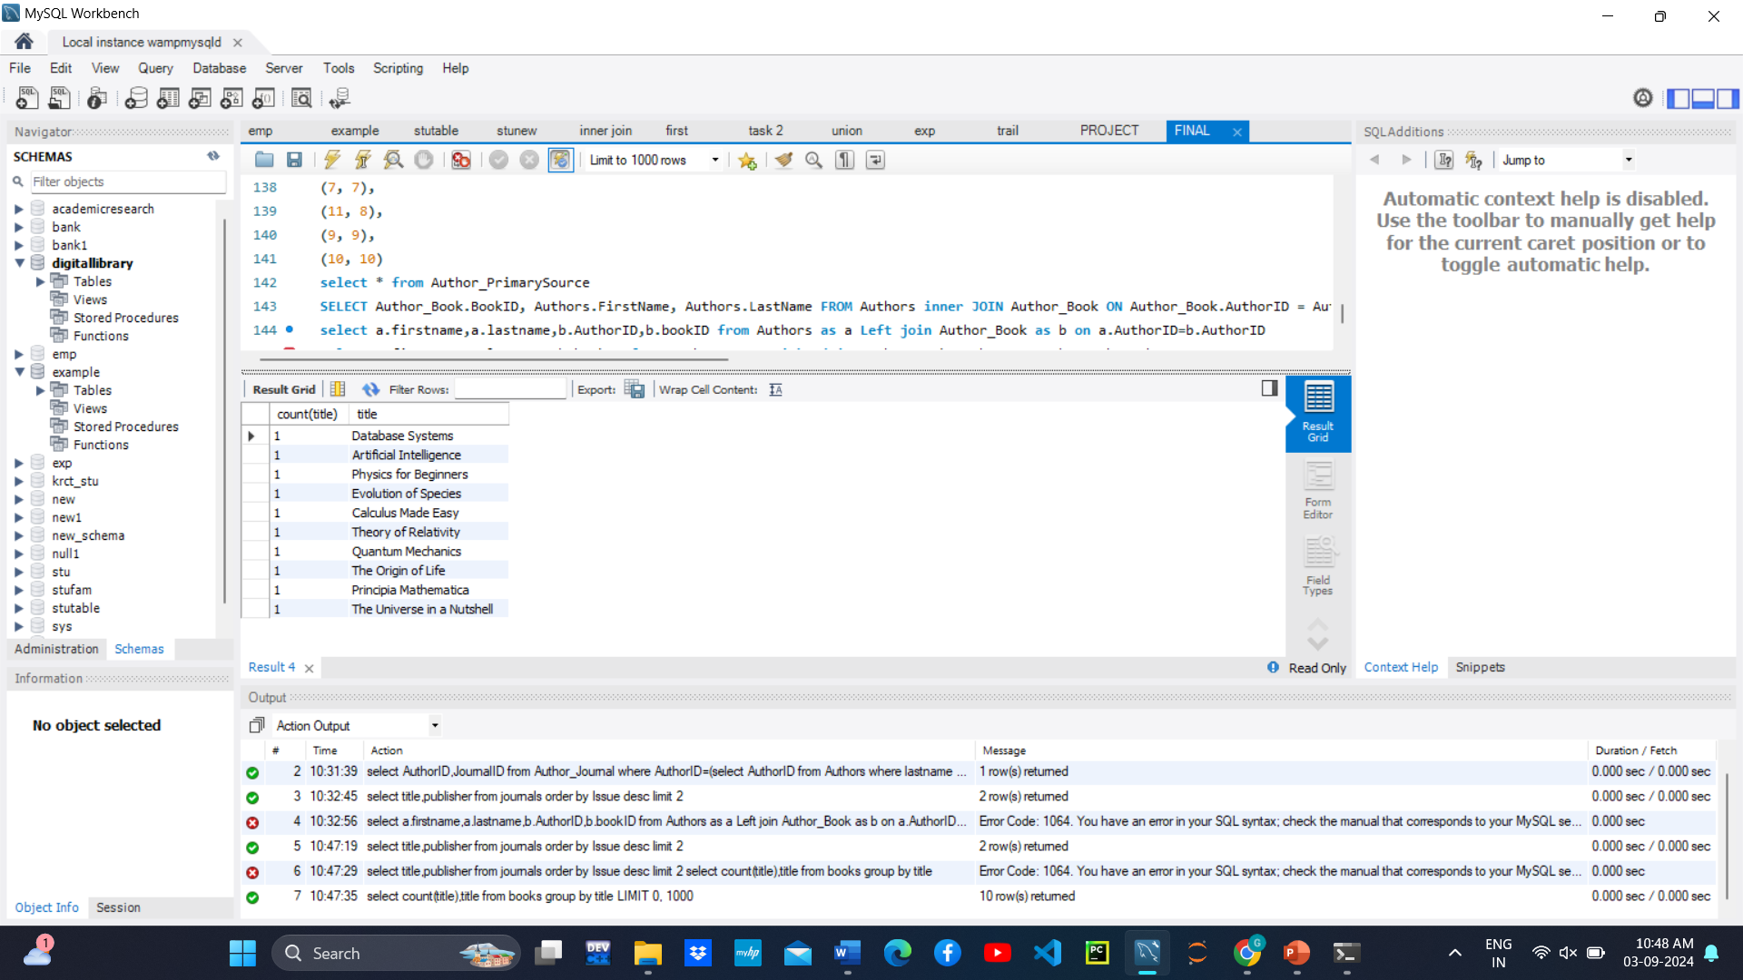
AGGREGATE FUNCTIONS
select count(title) from books;
select count(title),title from books group by title

Slide 7
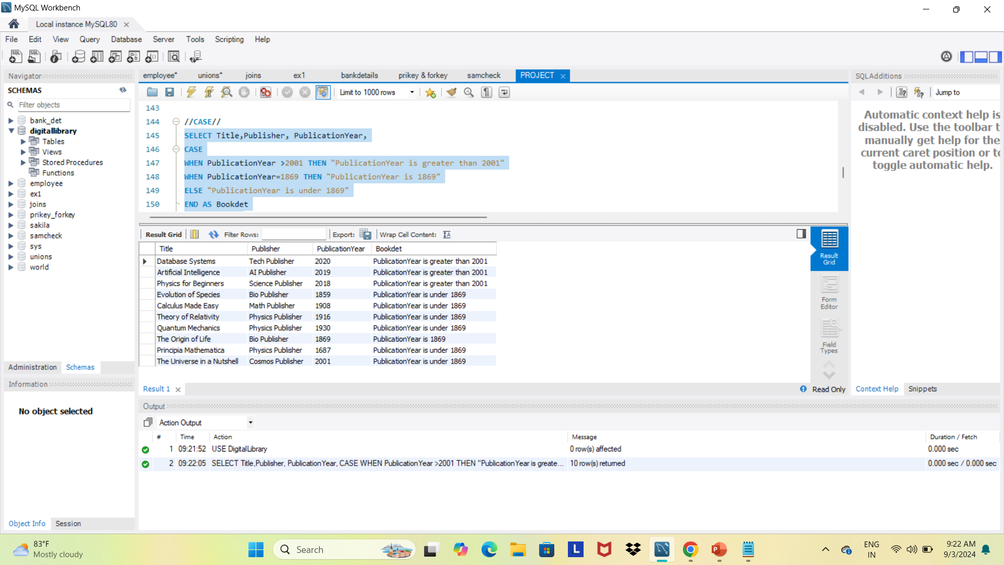
CASE STATEMENT
//CASE//
SELECT Title,Publisher, PublicationYear,
CASE
WHEN PublicationYear >2001 THEN "PublicationYear is greater than 2001"
WHEN PublicationYear=1869 THEN "PublicationYear is 1869"
ELSE "PublicationYear is under 1869"
END AS Bookdet
FROM Books;

Slide 8
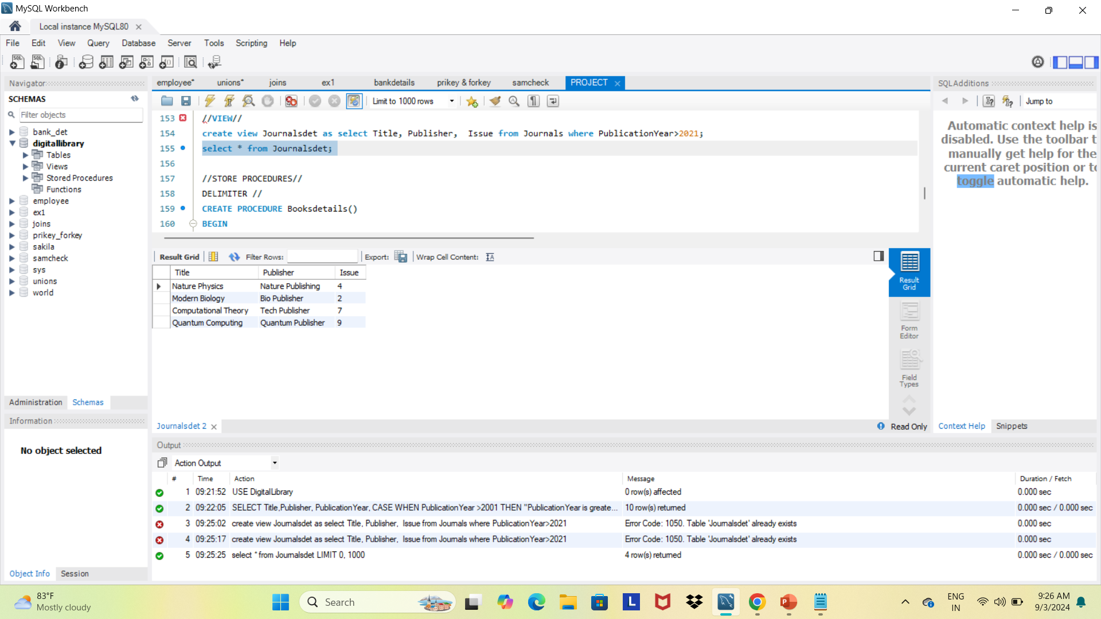
VIEW
//VIEW//create view Journalsdet as select Title, Publisher, Issue from Journals where PublicationYear>2021; select * from Journalsdet;

Slide 9
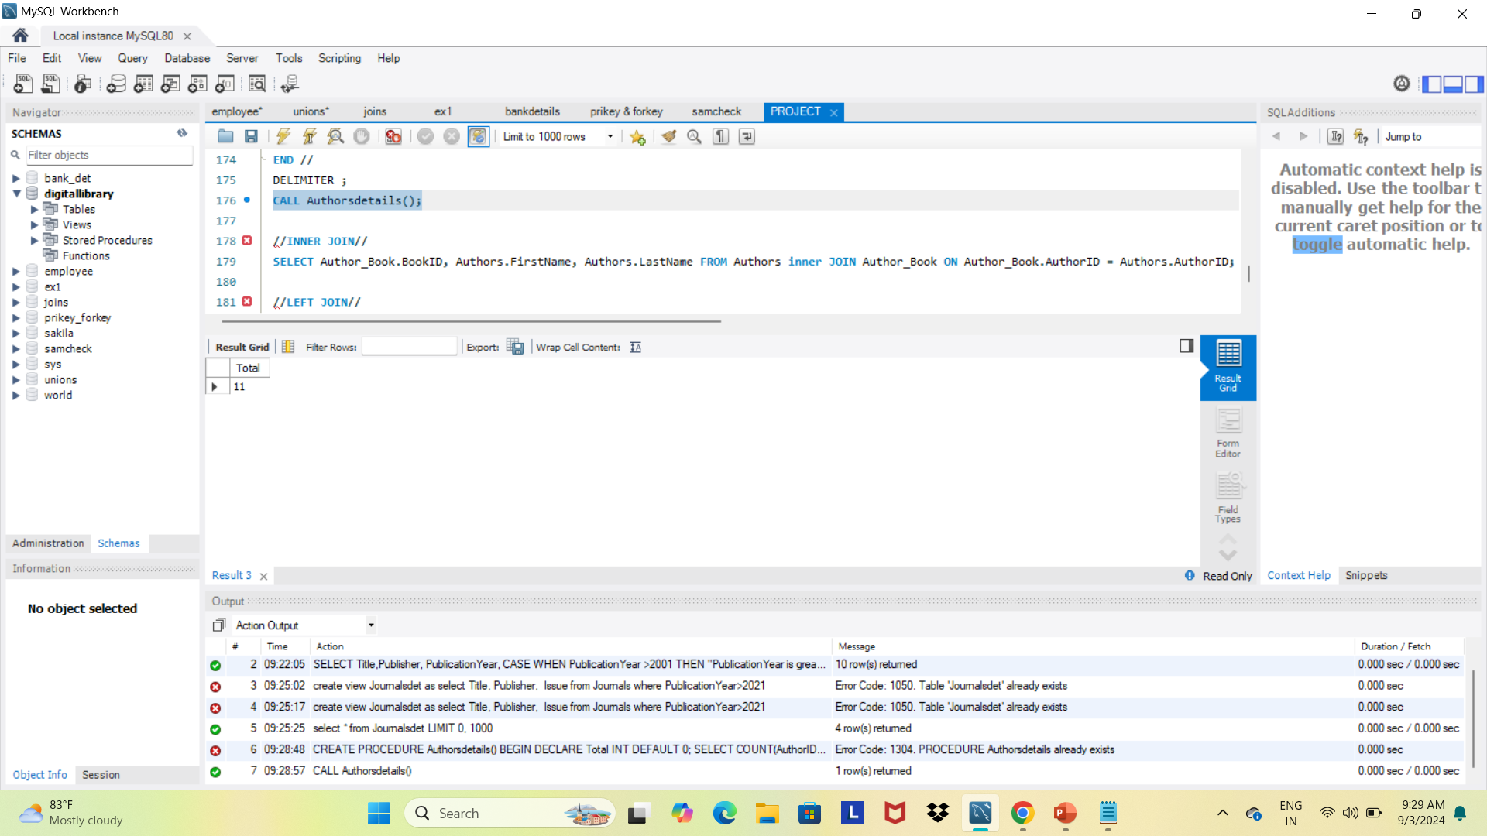
DELIMTER
DELIMITER //
CREATE PROCEDURE Authorsdetails()
BEGIN
DECLARE Total INT DEFAULT 0;
SELECT COUNT(AuthorID)INTO Total
FROM Authors;
SELECT Total;
END //
DELIMITER ;
CALL Authorsdetails();

Slide 10
THANK YOU

