Slide 1
License Plate Recognition and Detection

Slide 2
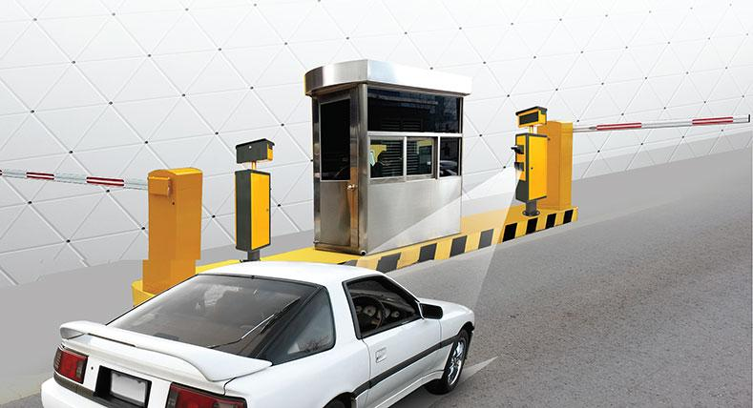
Submitted By:
Aishwarya Bhargava (169105019) Upadhi Modi (169108152)

Slide 3


1. Introduction
This project aims to tackle the manual work for noting down the license plate for manually authenticating it. There is a great loss of time due to the manual work, this time loss has a significant impact on the daily errands. This system aims to eradicate this loss of time by automatically detecting and recognizing the license plate. This system uses KNN algorithm for the character recognition. We propose the adoption of a windows based software solution that has ANPR capabilities to aid in vehicle identification and vehicle registration. The software application that was developed adopted an object oriented analysis and design methodology, the software developed implements K-Nearest Neighbour(KNN) using the windows device camera to detect and capture the vehicle number plate.

Slide 4

Introduction(contd.)
The proposed solution reduced registration time from 30 seconds to 6 seconds in addition to other benefits. It was recommended that the system be adopted and implemented to address the current challenges in vehicle registration and surveillance. The system can be implemented anywhere where there is a need to capture the license plate of a stationary vehicle.

Slide 5
Motivation
With an everyday increase in the number of cars on our roads and highways, we are facing numerous problems, for example:
Identification of stolen cars.
Smuggling of cars.
Invalid license plates.
Usage of cars in terrorist attacks/illegal activities.
Identifications of the cars that are violating the traffic rules.
Identifying cars if they get into accidents.

Slide 6
Requirement Analysis

Slide 7

Development Environment
System Type: 64-bit operating system, x-64 based processor
Programming Language: Python
OS Installed: Windows XP or higher
Technology Used:
1. Machine Learning
2. OpenCV
Environment: Python IDLE
Python Libraries used:
1. OpenCv
2. Numpy

Slide 8
Functional Requirements:
Software should process the image and extract characters.
If software is not giving proper output, there should be a way for training the database of software.
Image should not be blurry.

Slide 9
Non-Functional Requirements
Reliability: The system is highly reliable
Accessibility: It can be easily accessible i.e. click and run.
Efficiency: Resource consumption for given load is quite low.
Fault tolerance: Our system is not fault tolerant due to insufficient hardware.
Robustness: Our system is not capable to cope with errors during execution.
Scalability: Our project is scalable i.e. we can add more resources to our project without distributing the current scenario.

Slide 10
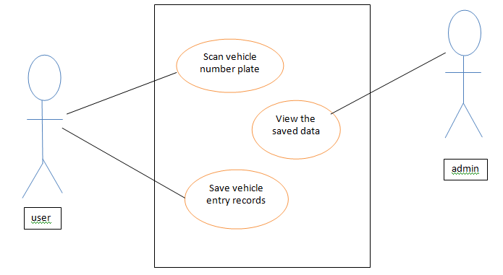
Use-Case Diagram

Slide 11
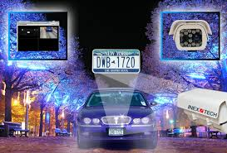
SYSTEM DESIGN

Slide 12
System Architecture
Find plates
imgOriginalScene
listOfPossiblePlates
Find chars within plates
preprocess()
listOfPossiblePlates
imgGrayScaleScene, imgThreshScene
preprocess()
detectPlatesInScene()
findPossibleCharsInScene()
imgGrayScaleScene, imgThreshScene
listOfPossibleCharsInScene
findListOfListsOfMatchingChars()
findPossibleCharsInPlate()
listOfPossibleCharsInPlate
listOfListsOfMatchingCharsInScene
findListOfListsOfMatchingChars()
extractPlate()

Slide 13
listOfListsOfMatchingCharsInPlate
possiblePlate.strChars
removeInnerOverlappingChars()
listOfListsOfMatchingCharsInPlate
listOfPossiblePlates
Within each possible plate, suppose the longest list of potential matching chars is the actual list of chars
Suppose the plate with the most recognized chars is the actual plate
longestListOfMatchingCharsInPlate
licPlate
loadKNNDataAndTrainKNN() recognizeCharsInPlate()

Slide 14
DETAILED DESIGN METHODOLOGY
This research adopted on Object-Oriented System Development methodology An Object-oriented software design is a design strategy where system designers think in terms of “things” instead of operations or functions.
terms of ‘things’ instead of operations or functions.
Object-oriented development methodology ensures that the system being developed is refined and transformed through analysis, design, code and test phases. Details and modifications are added in successive iterations (changes and improvements are introduced as needed) and incremental releases of software modules are delivered.

Slide 15

DETAILED DESIGN METHODOLOGY (contd.)
The methodology followed behind the working of this system is as follows. We start by system capturing the image. The image is then converted to grayscale image and then to a threshold image. After this we identify all the possible contors and also find the vectors of all the possible characters. The system then shortlists the vectors of the matching characters and identifies the plates that can exist due to these vectors. After this all the possible plates are converted to grayscale images and then to threshold images. The system then finds the characters in each license plate and removes any overlapping. Within each possible plate, suppose the longest list of matching characters is the actual list of characters. The system then recognizes the characters using the KNN algorithm and then prints the desirable license plate characters on the original image and saves it on the system.

Slide 16
Product Scenario

Slide 17
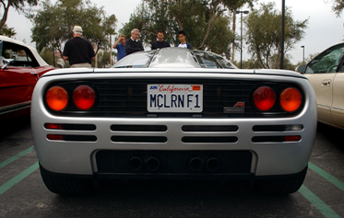
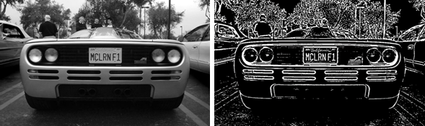
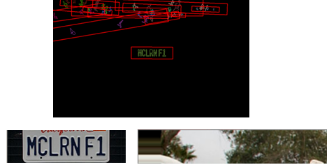

Slide 18

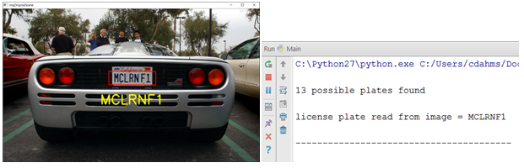

Slide 19
Future Scope
The application can be improved in many ways and can be extended to support more devices like mobiles, tablets and IOS devices. The application will also support blurry images or not so good quality images. More detailed information regarding the number plate will be available. The application can further be extended for moving vehicles.

Slide 20


