Slide 1
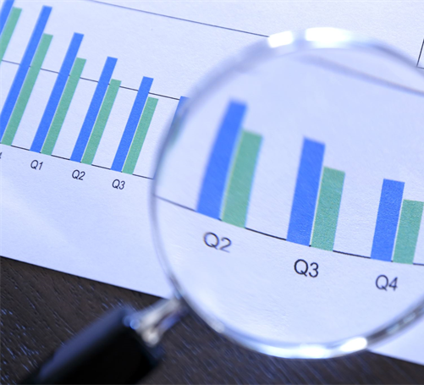


Presenation on Applied Data Science Capstone
Aishwarya Chennadi
12-Apr

Slide 2


OUTLINE
Executive Summary
Introduction
Data Collection and Data Wrangling
Exploratory Data Analysis and Interative visual analytics
Predictive Analysis
EDA with Visualization Results
EDA with SQL Results
Interactive Map with Folium
Plotly with Dash
Conclusion

Slide 3

EXECUTIVE SUMMARY
In this presentation we will discuss about Data collection, data wrangling, EDA and its test results performed using SpaceXTable datasheet on Jupyter lab, and generated graphs using Folium and seaborn. We will also concentrate on what is predictive analysis and dashboard generated using plotly dash.

Slide 4

INTRODUCTION
We will focusing on generating results for easy data visualization and data analysis using Plotly, Seaborn, SQL, Dash using some real time datasets executed on labs environment on Jupyter lab.

Slide 5

DASHBOARD
https://github.com/AishwaryaChennadi/DataScience/tree/main

Slide 6
Data Collection and Data Wrangling
Data Collection:
Data Collection is nothing but collecting data.
We will use URL to target a specific endpoint of the API to get required data.
We need to perform a get request using the requests library, which we will use to get the data from the API. This result can be viewed by calling the .json() method.
Response returned will be in the form of a JSON, specifically a list of JSON objects.
To convert this JSON to a dataframe, we can use the json_normalize function.
data = pd.json_normalize(response.json())
Normalize function will allow us to “normalize” the structured json data into a flat table.
Data Wrangling:
Data Wrangling is the process of gathering, collecting, and transforming Raw data into another format for better understanding, decision-making, accessing, and analysis in less time. Data Wrangling is also known as Data Munging.

Slide 7
Exploratory Data Analysis and Interative visual analytics
EDA :
Exploratory Data Analysis is the first step of any data science project.
This process involves studying, exploring, and visualizing information to derive important insights.
To find patterns, trends, and relationships in the data, it makes use of statistical tools and visualizations.
Interactive Visual Analytics :
We use this to build a Dashboard for stakeholders.
Interactive visual analytics enables users to explore and manipulate data in an interactive and real-time way.
Common interactions including zoom-in and zoom-out, pan, filter, search, and link.
With interactive visual analytics, users could find visual patterns faster and more effectively.
Instead of presenting your findings in static graphs, interactive data visualization, or dashboarding, can always tell a more appealing story.
We can use Folium and Plotly Dash to build an interactive map and dashboard to perform interactive visual analytics.

Slide 8
Predictive Analysis
This involves Preprocessing, allowing us to standardize our data, and Train_test_split, allowing us to split our data into training and testing data.
We will determine the model with the best accuracy using the training data.
We will test Logistic Regression, Support Vector machines, Decision Tree Classifier, and K-nearest neighbors.

Slide 9
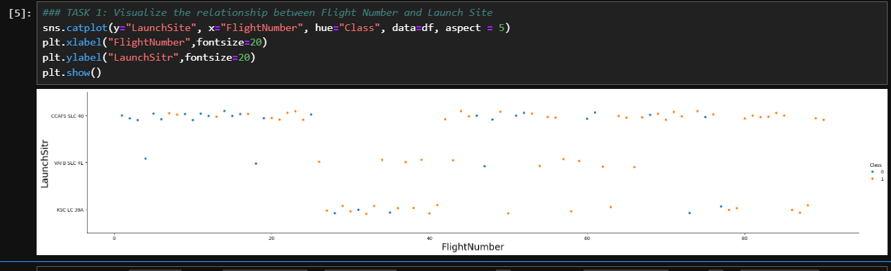
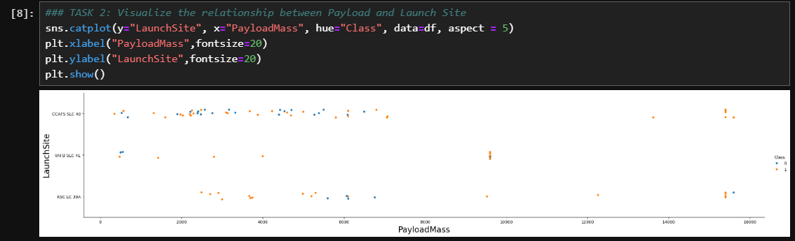
EDA with Visualization Results

Slide 10
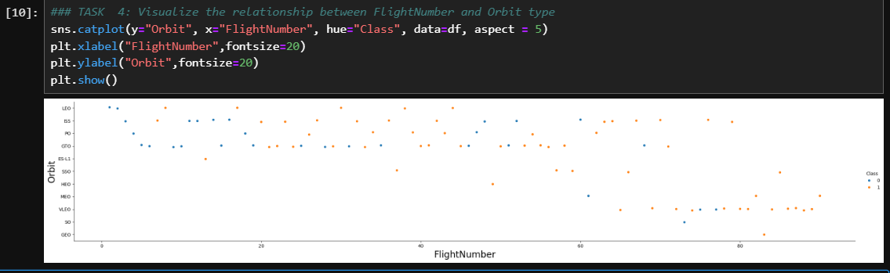
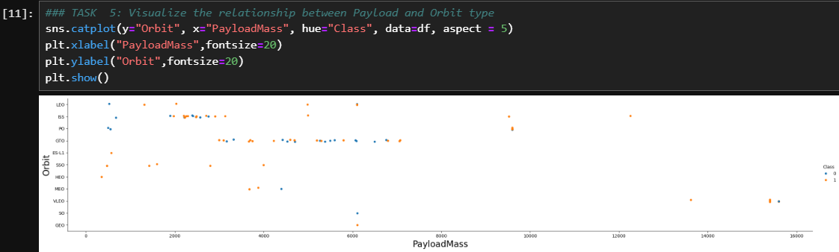
EDA with Visualization Results

Slide 11
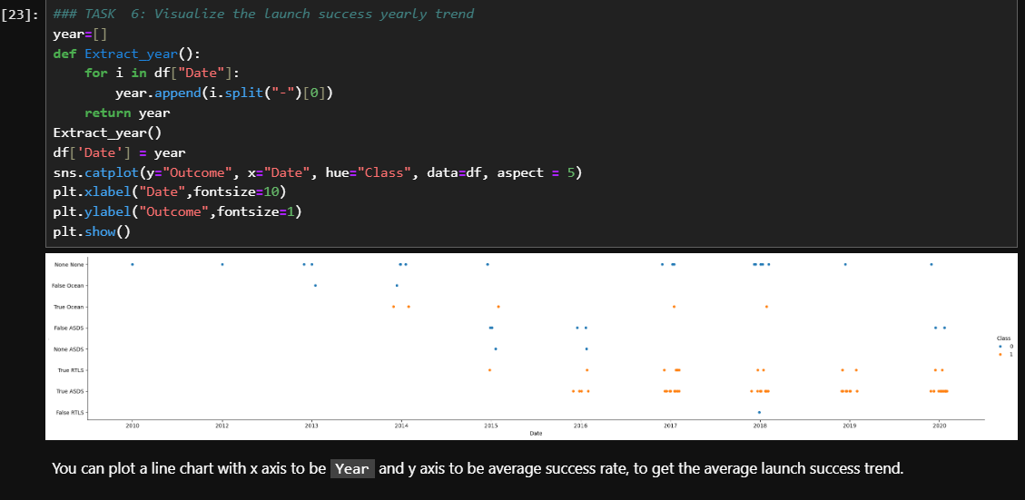
EDA with Visualization Results

Slide 12
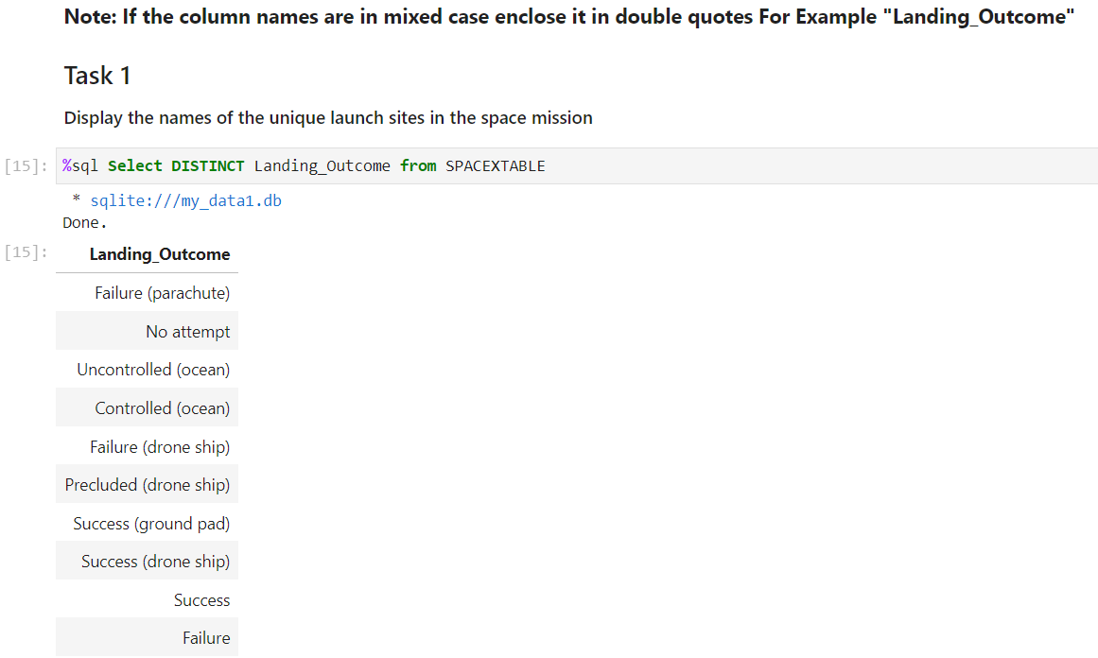
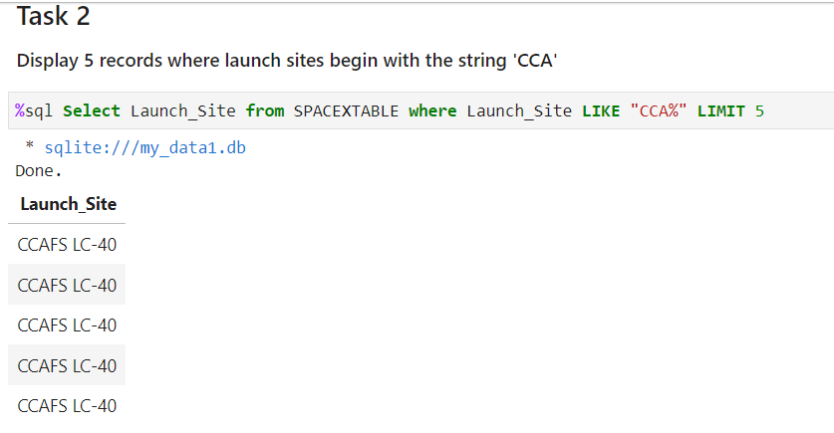
EDA with SQL Results

Slide 13
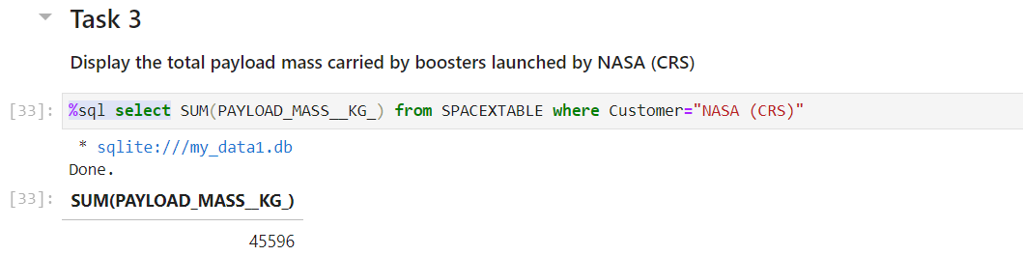
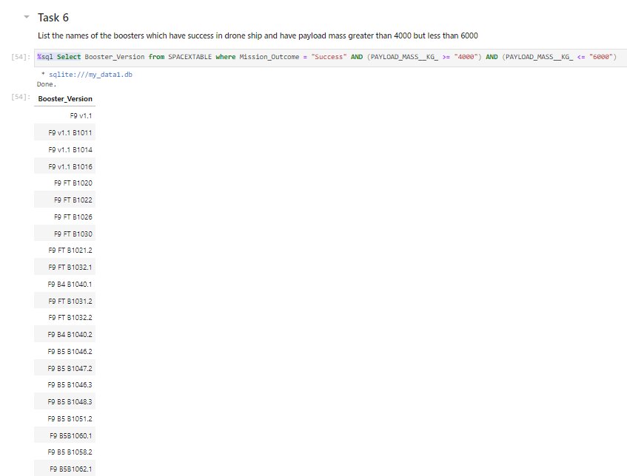
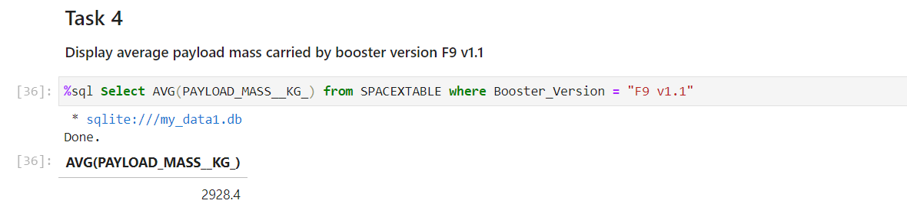
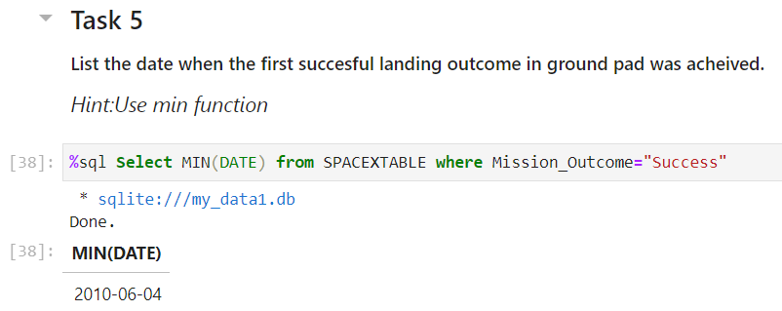
EDA with SQL Results

Slide 14
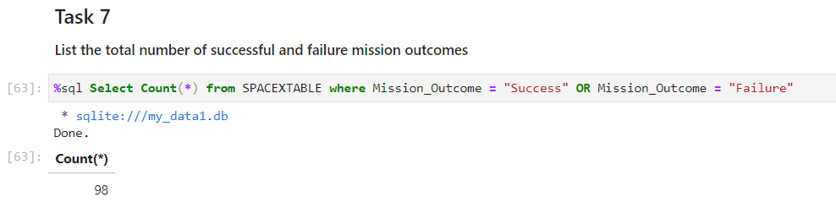
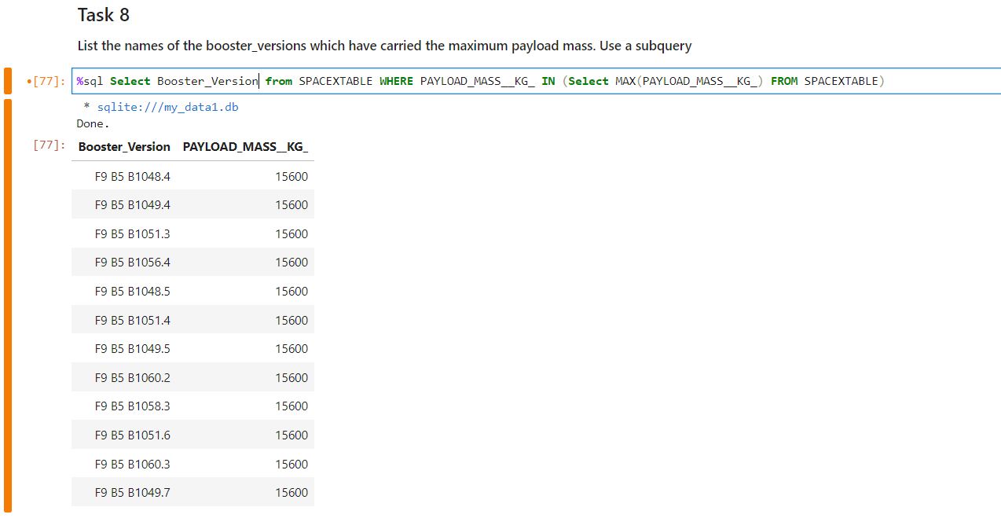
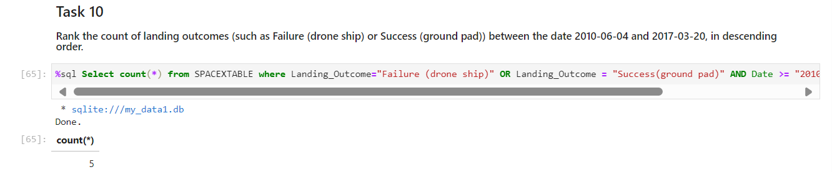
EDA with SQL Results

Slide 15
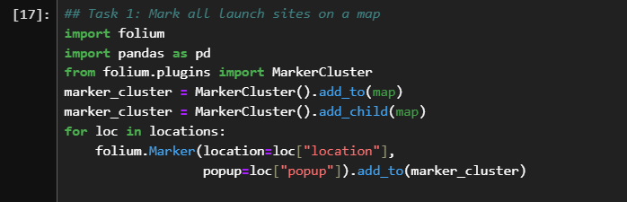
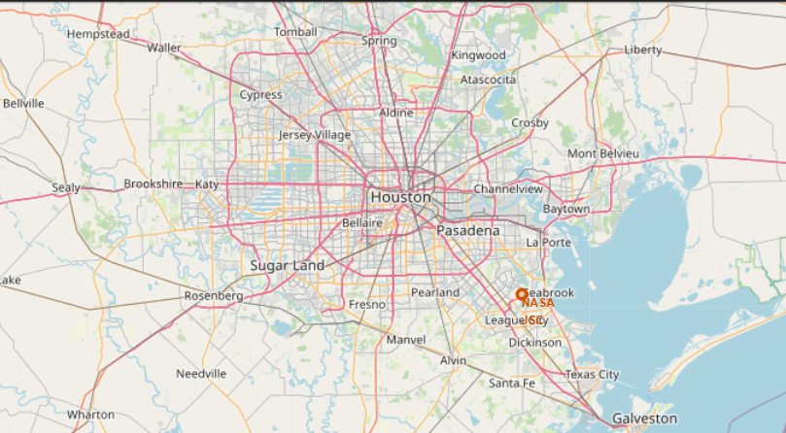
Interactive Map with Folium

Slide 16
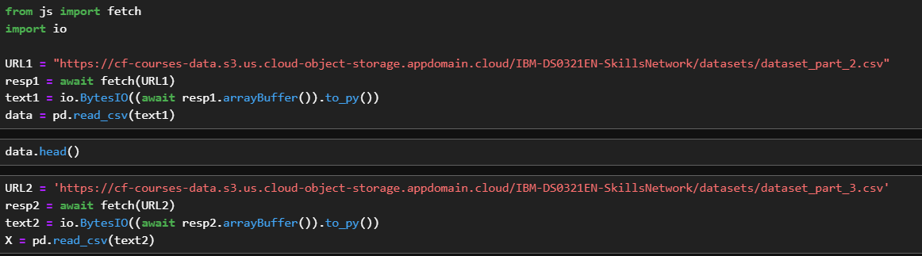
PlotLy Dash Results

Slide 17

CONCLUSION
In this presentation, we discussed about Data collecting, data wrangling, EDA, Interactive visual analysis, Predictive analysis. We are concluding this presentation by theorithal overview and handson results captured from the tab.

Slide 18

THANK YOU

