Slide 1
Assignment Key Take Away

Slide 2
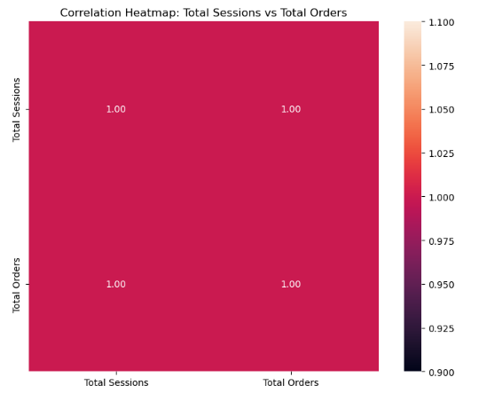

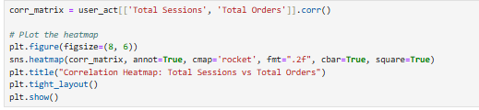
Relationship Between Cooking Sessions and User Orders
A strong positive correlation (correlation coefficient: 1) exists between cooking sessions and the number of orders, indicating that users who cook more often tend to place more orders.

Slide 3
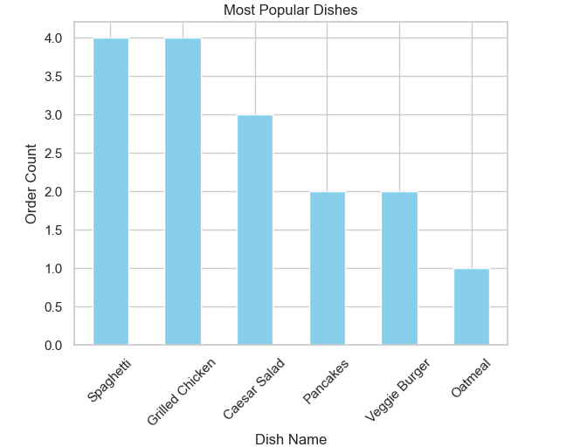
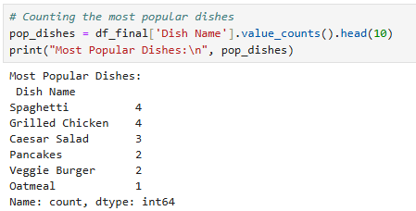
Popular Dishes
The Most Popular Dishes That Can Be seen Through analysis and visualizations are:-
Spaghetti
Grilled Chicken
Caesar Salad

Slide 4
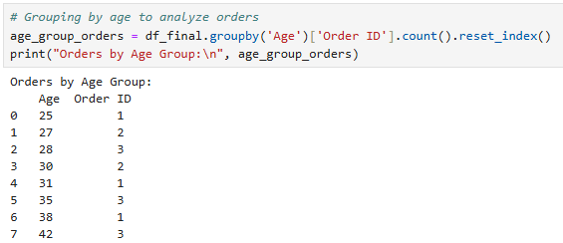
Exploring Demographic Factors That Influence User Behavior
Age of People Ordering Most Are 27,28,30,35,42 grouping it the most orders made by the group of people are from age 27-42.

Slide 5
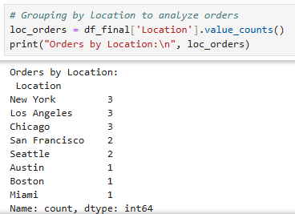
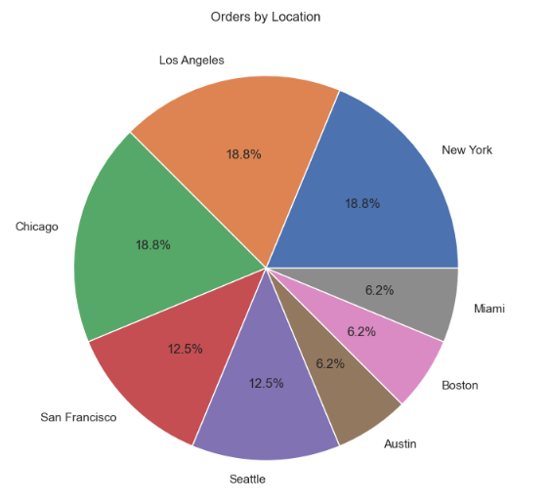
Locations At Which most Orders are Made Are :- New York, Los Angeles, Chicago, San Francisco and Seattle.

Slide 6
Business Recommendations
Personalized Campaigns:
Target younger audiences with promotions for quick and easy recipes.
Design campaigns to attract older demographics by emphasizing traditional and family-style meals.
Regional Promotions:
Leverage insights into regional preferences to create location-specific campaigns.
Cross-Promotional Opportunities:
Reward users for participating in cooking sessions with discounts on food orders.
Menu Optimization:
Expand offerings of consistently popular dishes and bundle them into combo deals.
User Retention Programs:
Introduce loyalty rewards for repeat orders, encouraging sustained engagement.

