Slide 1


K. L. E. Society’s
K.L.E. INSTITUTE OF TECHNOLOGY
HUBBALLI - 580027, KARNATAKA STATE, INDIA
Department of Master of Computer Applications
Seminar On:
“Haptic Glove”
Submitted by:
Aishwarya Neminath Jalli
USN: 2KE23MC002
Under the Guidance of
Mrs. ANUPAMA S N
Associate Professor, Department of Master of Computer Applications,
K.L.E. Institute of Technology, Hubballi-27

Slide 2
Content
Introduction
What is MANUS
Sensors and its types
Components
Applications
References
Conclusion

Slide 3
Haptic Glove: Technology & Components
Focusing on MANUS Sensors and Components

Slide 4
Introduction to Haptic Feedback Gloves
Haptic Feedback Gloves provide tactile sensations to users, simulating the sense of touch.
Commonly used in VR, AR, robotics, and training simulations.
Enables users to feel virtual objects, enhancing immersion and interaction.

Slide 5
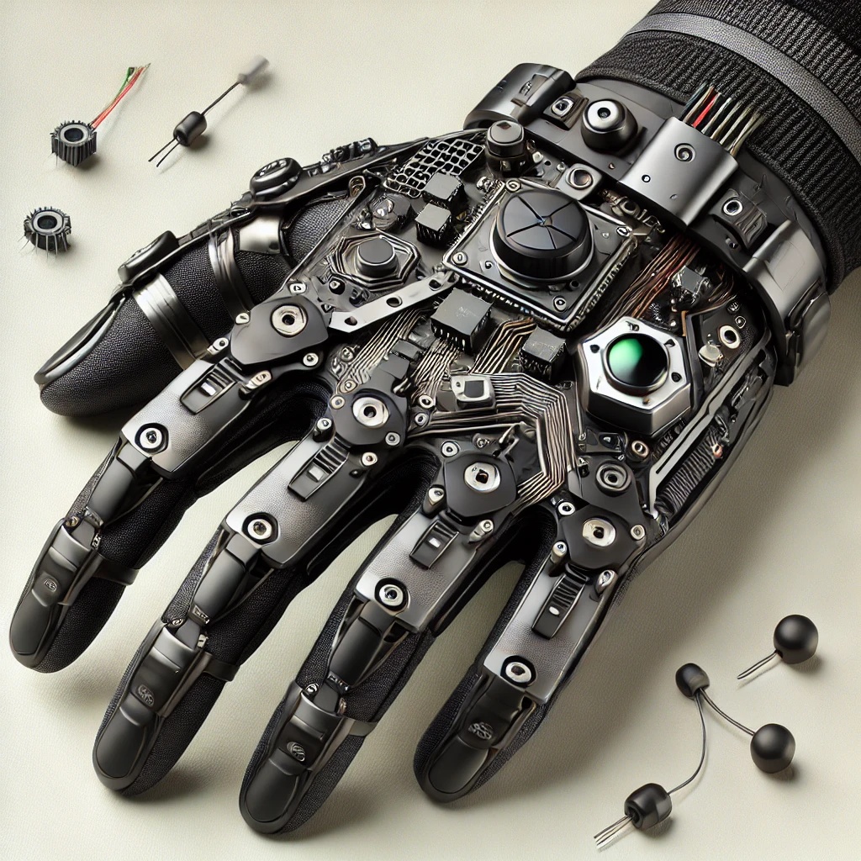
What is MANUS
MANUS is a leading provider of haptic feedback gloves.
Known for advanced sensing technology and ergonomic designs.
Applications include gaming, VR training, and professional simulation.

Slide 6
Sensors Used in Haptic Feedback Gloves
The MANUS glove uses multiple sensors to track motion and provide feedback.
Sensors include:
- Force sensors
- Flex sensors
- Accelerometers
- Gyroscopes
- Touch sensors

Slide 7
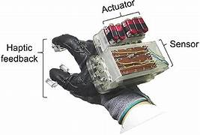
Force Sensors
Measure the amount of force exerted by fingers.
Helps simulate resistance, weight, and texture in virtual environments.
Essential for realistic haptic feedback.

Slide 8
Flex Sensors
Detect bending of fingers and hand movements.
Used to capture precise finger positions.
Important for gesture recognition and detailed hand tracking.
Functionality: Flex sensors measure the angle and extent of finger bends, which allows the glove to track complex gestures.
Applications: Important for applications that require hand dexterity, such as remote manipulation in hazardous environments or virtual object manipulation in VR training.
gesture recognition and allow detailed interactions, such as pinching, grabbing, or pointing.

Slide 9
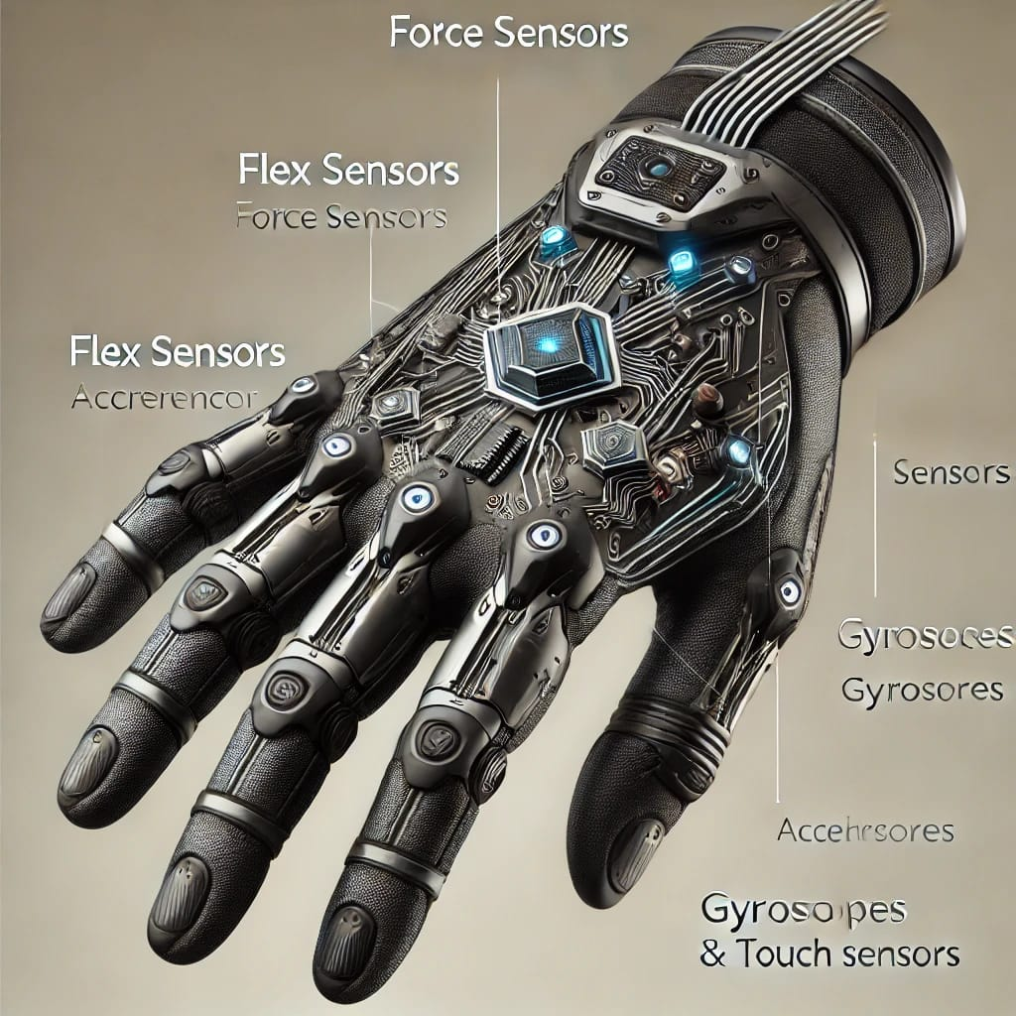
Accelerometers
Measure the speed and direction of hand movements.
Enhance accuracy in dynamic motion tracking.
Useful for real-time interaction with VR environments.

Slide 10
Gyroscopes
Track the orientation and rotation of the hand.
Complement accelerometers to provide full 3D motion tracking.
Essential for simulating realistic hand movements.
Functionality: Gyroscopes detect rotational movement, allowing the glove to track how the hand is turned or tilted.
Applications: Essential for realistic simulations where hand orientation matters, such as flight simulations or virtual drawing.
In combination with accelerometers, provide a full range of motion tracking, which is critical for an immersive experience.

Slide 11
Touch Sensors
Detect when and where the glove makes contact with objects.
Allows for pressure-sensitive interaction.
Key for simulating touch sensations.
Functionality: These sensors detect contact and pressure at various points on the glove, allowing for detailed interaction with virtual objects.
Applications: Ideal for tasks that require tactile feedback, such as virtual sculpting or training applications where precise touch is needed.
Touch sensors simulate the feeling of different textures, improving the sensory experience and allowing users to distinguish between various surfaces.

Slide 12
Components of Haptic Feedback Gloves
Haptic gloves comprise multiple components, including:
- Actuators
- Electronics
- Power Source
- Communication Interface

Slide 13
Actuators
Create physical sensations by exerting force on the hand.
Simulate textures, resistance, and vibrations.
Provide feedback for enhanced realism in VR/AR.
Types of Actuators:
Vibration Actuators: Produce vibrations that simulate texture and impact.
Linear Actuators: Create resistance and pressure sensations by moving in a straight line.
Applications: Used in VR gaming for immersive experiences, training simulations to replicate real-world tasks, and therapy applications for rehabilitation. actuator type can influence the user's experience, particularly in terms of realism and responsiveness.

Slide 14
Electronics
Process data from sensors and control actuators.
Include microcontrollers and processors for real-time response.
Ensure seamless integration with software.
Functionality: Electronics within the glove process the data collected from sensors and control the actuators to provide real-time feedback.
Key Components:
Microcontrollers: Serve as the brain of the glove, processing data and managing communications between sensors and actuators.
Wireless Modules: Allow for communication with VR systems or computers, enabling real-time interaction.
Integration: The electronics are designed to be compact and lightweight to maintain the glove's usability and comfort.

Slide 15
Power Source
Power is provided by rechargeable batteries.
Determines the glove's runtime and portability.
Considerations include battery life and weight.
Functionality: The power source provides energy to all components of the glove, including sensors, actuators, and electronics.
Types of Power Sources:
Rechargeable Batteries: Commonly used for their convenience and ability to provide a decent runtime.Battery Life Considerations: Discuss factors that affect battery life, such as usage intensity and the number of active sensors and actuators.
Importance of Portability: The design must balance battery capacity with weight to ensure the glove remains comfortable for prolonged use.

Slide 16
Communication Interface
The communication interface allows the glove to connect with VR systems, computers, or other devices, facilitating data exchange and feedback.
Types of Communication:
Bluetooth: Common for wireless communication, offering convenience and flexibility in movement.
USB Connections: Provide a stable and fast connection, particularly useful for stationary setups.
Wi-Fi: Enables high-bandwidth connections for applications requiring large data transfers.
Real-time Feedback: Discuss how low-latency communication is crucial for maintaining immersion in VR environments.
The importance of interoperability with various devices and platforms, enhancing the glove's versatility.

Slide 17
Applications of Haptic Feedback Gloves
Used in VR training for medical, military, and industrial applications.
Essential for realistic gaming experiences.
Valuable in remote robotic control and telepresence.

Slide 18
Conclusion
Haptic Feedback Gloves enhance VR/AR experiences by simulating touch.
MANUS technology uses advanced sensors and actuators to provide precise feedback.
A growing technology with wide-ranging applications in various fields.

Slide 19
References
https://www.researchgate.net/publication/324562855_Touching_Virtual_Reality_a_Review_of_Haptic_Gloves
www.springer.com on Haptic Simulators for Medical Training​(SpringerLink)
www.senseglove.com on Haptics in Healthcare​(SenseGlove)

Slide 20
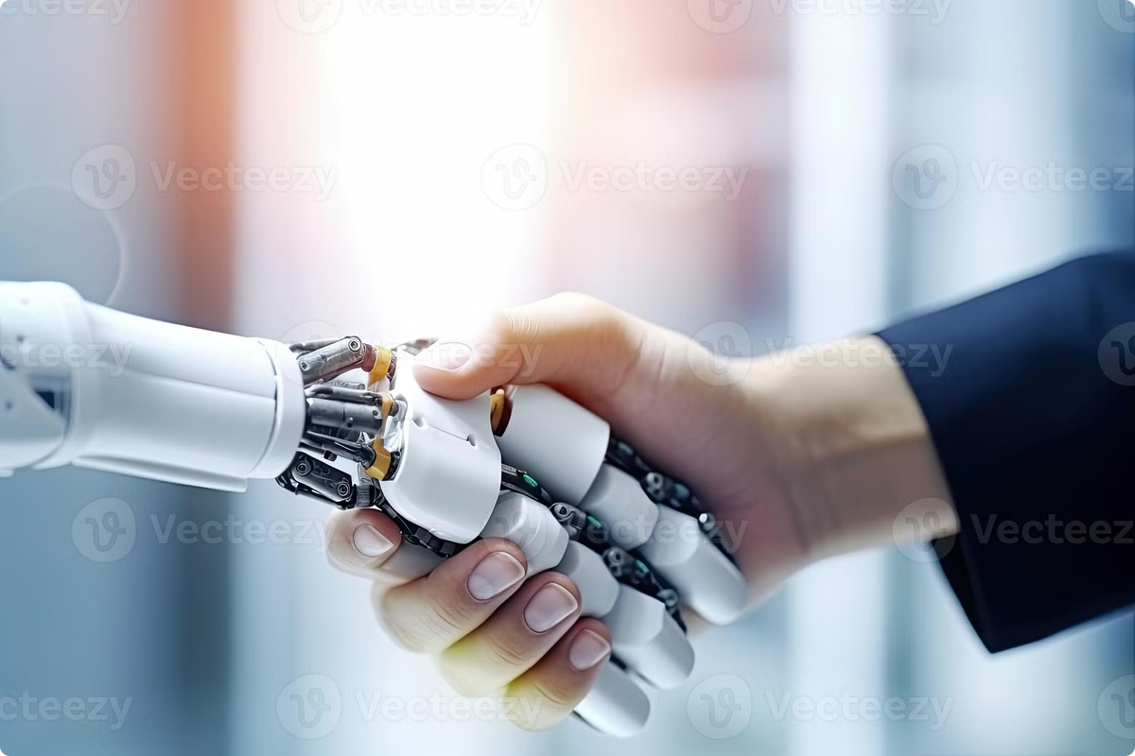
THANK YOU

