Slide 1
Cloudboard
By:
Aditya Srivastava
Aishwarya Jayaramu
Harsh Gupta

Slide 2
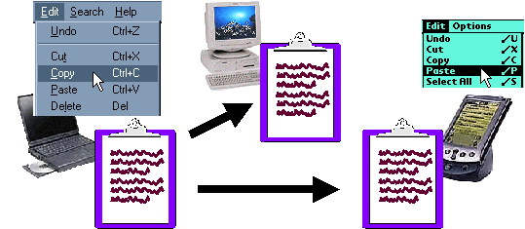
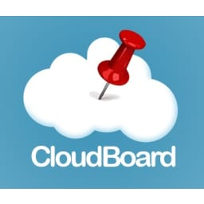
Cloudboard – A cloud-based clipboard
A convenient and seamless way for users to copy and paste content between devices
Uses :
- 2-factor authentication
- Quick share of link
A user-friendly and intuitive interface
Improves the user experience when working with multiple devices

Slide 3
Software and hardware components
Software Components
REST APIs - User Registration, Device Registration, Copy/Paste
Client application
Web application
Hardware Components
Server - Runs on the Google Cloud Platform
client app - Runs on personal computing devices
web app – Runs in-browser

Slide 4
Components
GCP Virtual machine
API interfaces
Storage services – GCP Buckets
Database - SQLite
Flask REST server, User interface

Slide 5
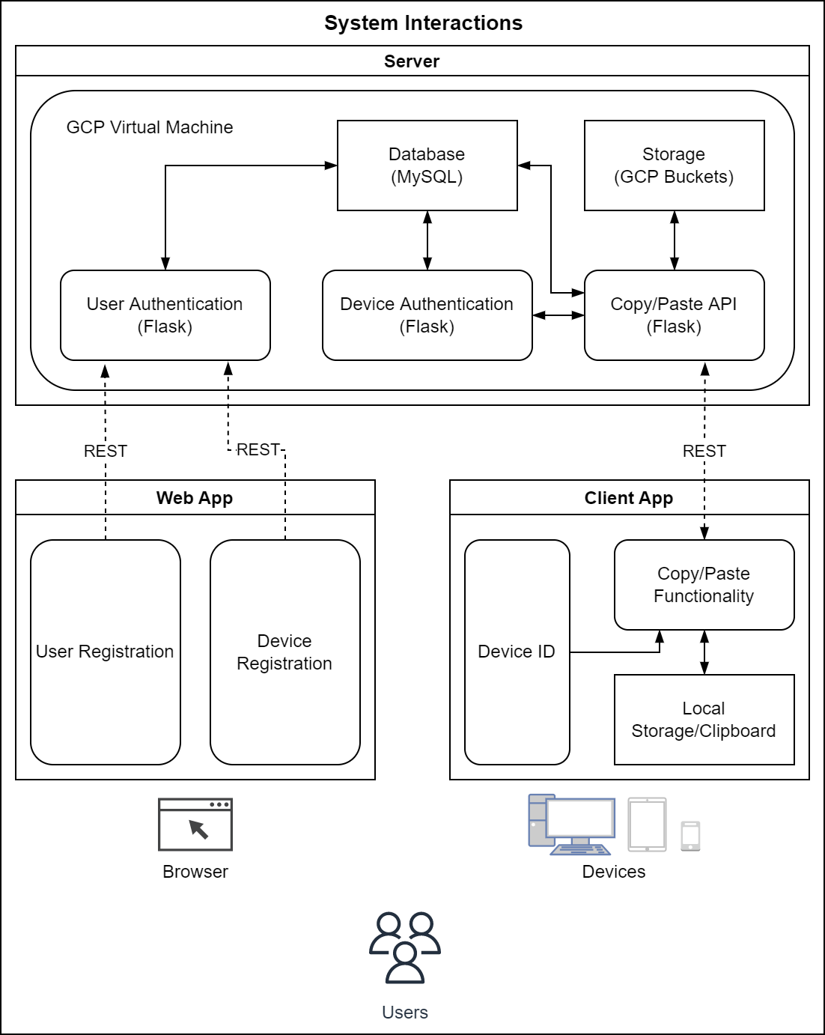
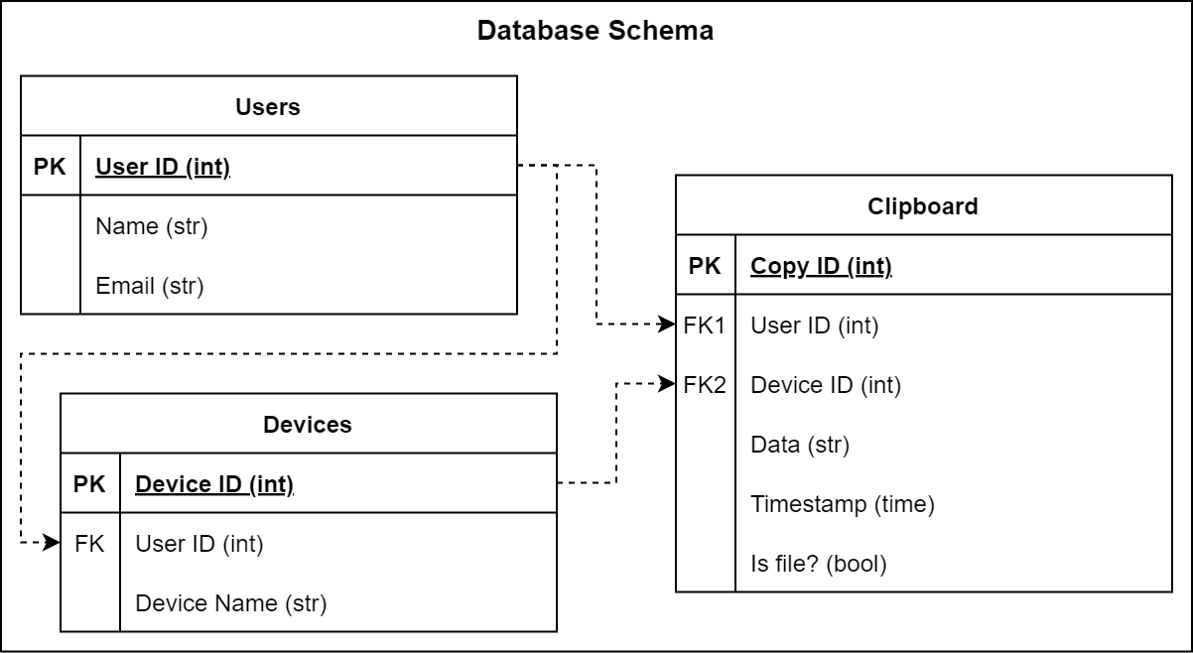
Architectural Diagram

Slide 6
Debugging
Functionality and Interface Testing
Website - Validate the REST API carrying the authentication credentials
Client Application - Test if requests are sent correctly to the server and the output at the client for the paste command is displayed correctly and show any errors
Server - Test if the server is handling all application requests without any service denial
Database Server: To make sure queries sent to the database give expected results
Database Testing
Check for errors while executing queries and ensure data integrity while creating or updating data in the database
Verify that the client application displays accurate test data retrieved from the database and the response times of queries

Slide 7
Learnings
How to Debug, Design, and operate REST API’s
Design Databases schemas
Secure authentication
How to run Remove virtual servers

Slide 8
Stretch Goals
A way for users to clear their clipboard and/or view their copy history.
Data encryption on the copied objects for privacy.

Slide 9
Thank You!

