Slide 1

G2M insight for Cab Investment firm
Company Name : XYZ Location: UAE Team: Data and Analytics Date: 15-November-2023

Slide 2

Agenda
Executive Summary
Problem Statement
Approach
EDA
EDA Summary
Hypothesis Testing
Building Models
Recommendations

Slide 3
Description:
XYZ is a US-based private equity firm. It is considering an investment in the taxi sector due to the industry's spectacular expansion over the past few years and the presence of several major participants in the market.
Provide actionable insights to help XYZ firm in identifying the right company for making investment.
Cab Companies:
Yellow Cab
Pink Cab
The Analysis include :
Data Understanding,
Data Visualization,
Creating multiple hypothesis,
Building models and finding the best fit model based on Accuracy.

Slide 4
Data Preparation:
There are 4 datasets:
Cab_Data.csv – this file includes details of transaction for the cab companies.
Customer_ID.csv – this is a mapping table that contains a unique identifier which links the customer’s demographic details.
Transaction_ID.csv – this is a mapping table that contains transaction to customer mapping and payment mode.
City.csv – this file contains list of US cities, their population and number of cab users.

Slide 5
EXPLORATORY
DATA
ANALYSIS

Slide 6
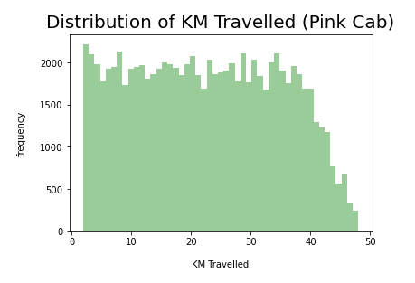
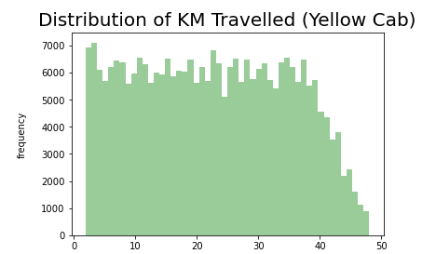
Distribution of KM Travelled for both Cabs:
According to the graphs above, the majority of Pink and Yellow Cab rides are between 2 and 48 kilometers long.

Slide 7
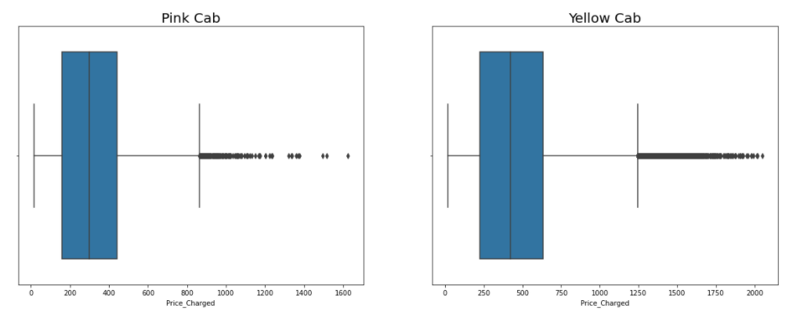
Distribution of Price Charged for both Cabs:
The Yellow cab has a higher price range than the Pink cab.
The outliers are caused by the use of high-end vehicles.

Slide 8
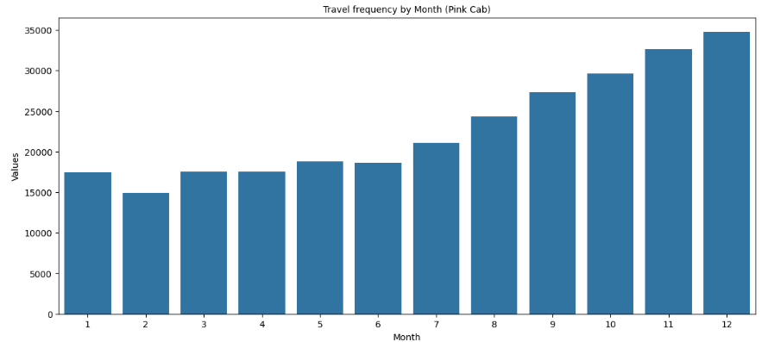
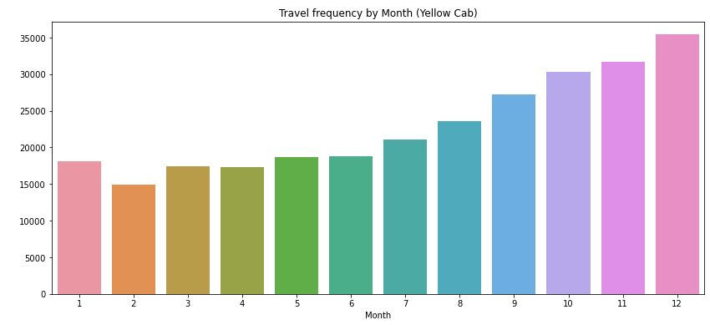
Travel Frequency per Month:
Yellow Cab has higher travels (35000) in the month of December which is the holiday season compared to Pink Cab (11000).

Slide 9
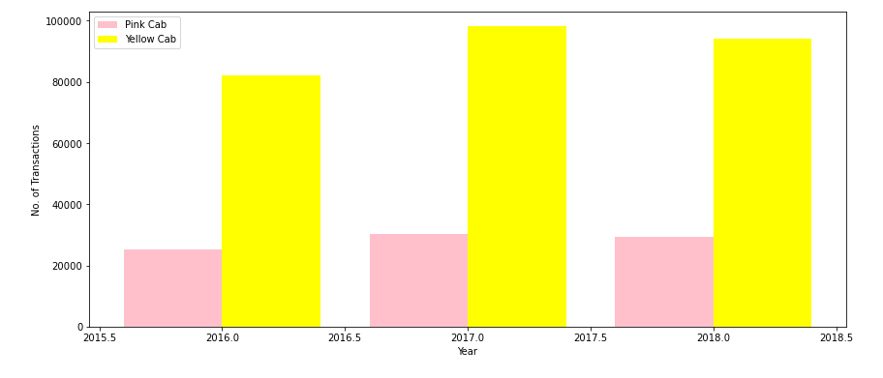
Transaction per Year for both Cabs:
According to the graph, the number of transactions for Yellow cab is higher than for Pink cab on a yearly basis.

Slide 10
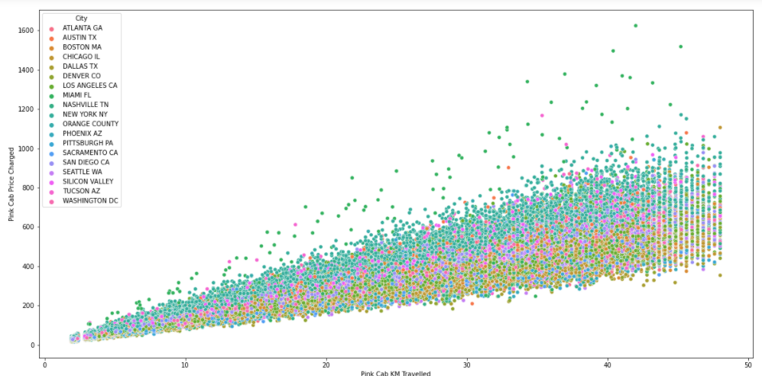
Pink Cab: Price Charged per KM per City
All cities have the same increase in pricing charge with increasing distance for Pink cab.

Slide 11
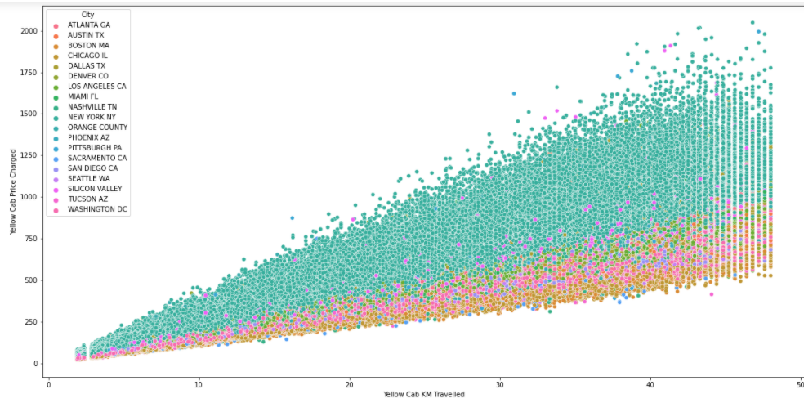
Yellow Cab: Price Charged per KM per City
In New York City the Price charged for Yellow Cab is more in comparison to the other cities

Slide 12
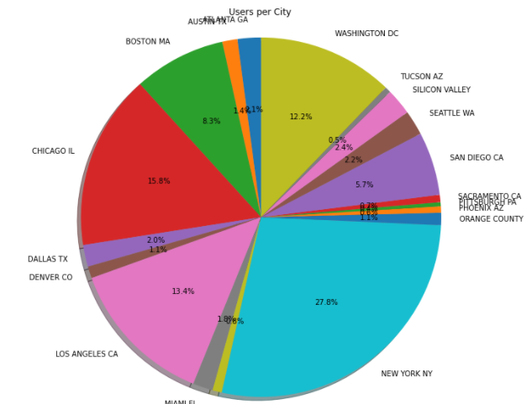
Cab Users

Slide 13
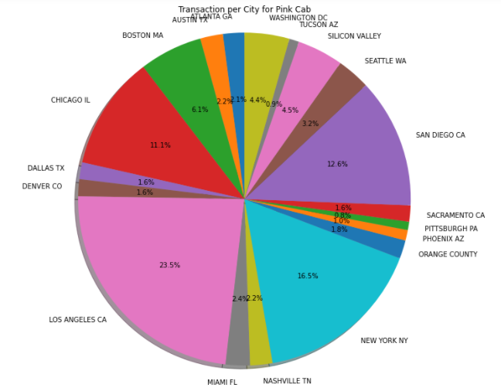
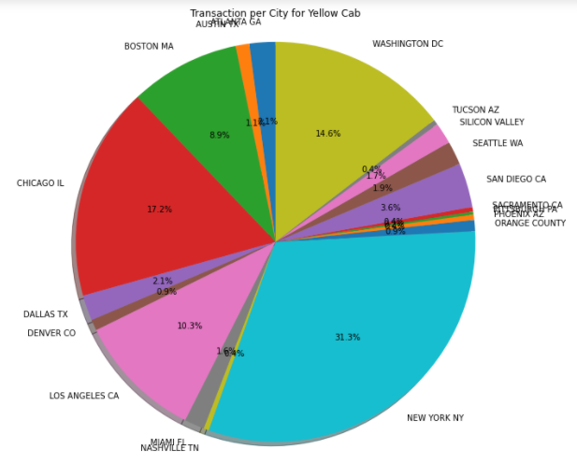
Transaction per City for both Cabs:
According to the previous slide, New York City has the greatest Yellow Cab transaction (31%), as well as the highest Cab User (28%).
Pink Cab transactions are highest in Los Angeles.

Slide 14
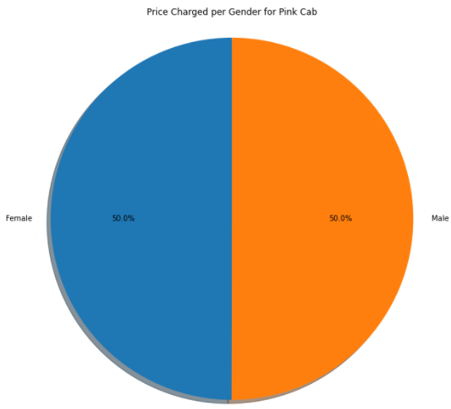
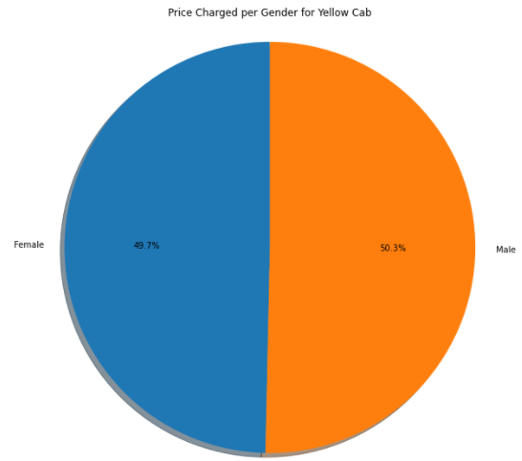
Price Charged per Gender
Yellow Cab charge less from Female Customers whereas Pink Cab charges same for both Male and Female Customers.

Slide 15
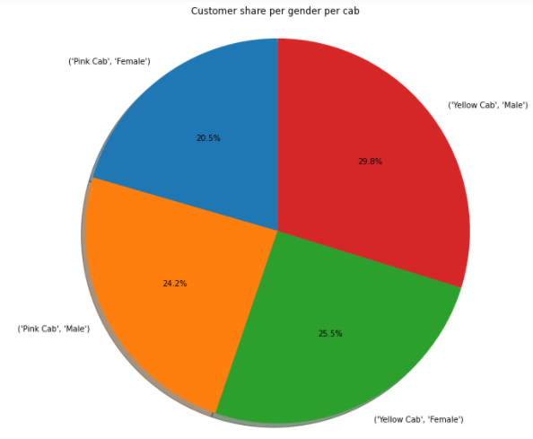
Customer Share per Gender

Slide 16
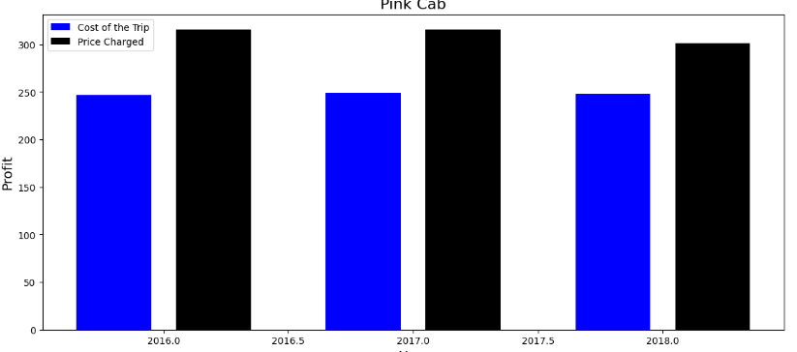
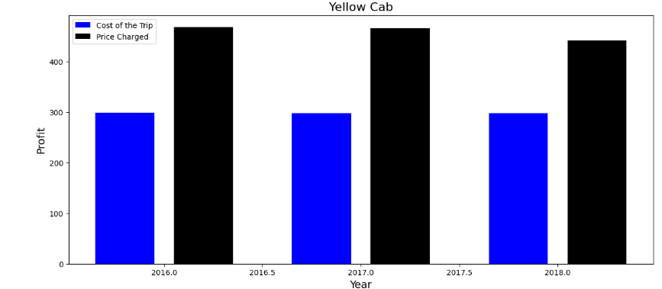
Profit Margin per year for both Cabs:
Yellow cab has a higher Profit Margin (Price Charged - Cost of Trip).

Slide 17
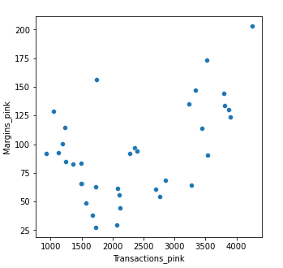
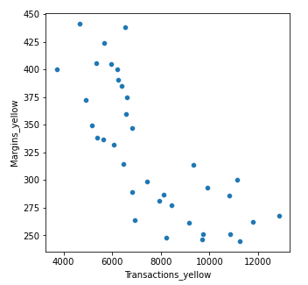
Margins per Transaction
Margin: Price Paid - Trip Cost
Pink Cabs' margins improve as the number of transactions increases.
Yellow Cab reduces margins as transaction volume increases.

Slide 18
EDA SUMMARY

Slide 19


Rides are in the range of approximately 2 to 48 KM.
Rides are in the range of approximately 2 to 48 KM.
Price range from 150 to 450.
Price Charge range from 250 to 600 d
In December which is the holiday season, no. of travels was around 11000.
In December which is the holiday season, no. of travels was around 35000.
Transaction per year:
2016: 20000 – 40000
2017: 20000 – 40000
2018: 20000 – 40000
Transaction per year:
2016: 80000 – 100000
2017: 80000 – 100000
2018: 80000 – 100000

Slide 20
Pink Cab charges same for both Male and Female Customers.
Yellow Cab charge less from Female Customers.
Female customers are around 20.5% out of the total Customers.
Female customers are around 25.5% out of the total Customers.
Profit Margin is low each year (2016-2018) compared to Yellow Cab.
Profit Margin is high each year (2016-2018) compared to Pink Cab.
Pink Cabs increase margins with increase in number of Transactions.
Yellow Cab decrease Margins with the increase in Transaction.

Slide 21
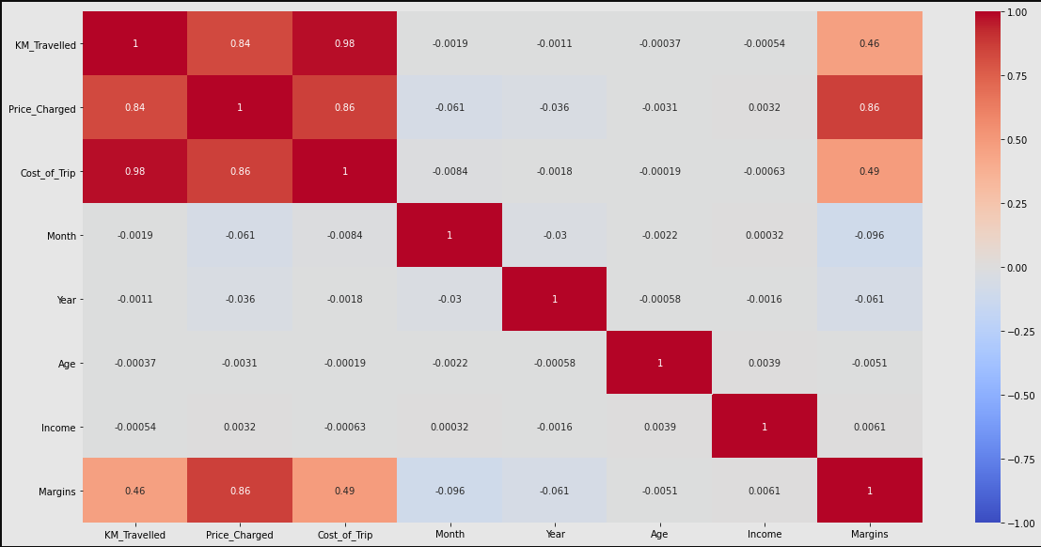
Correlation:
As per the graph, there is a positive correlation between Margin & Price Charged

Slide 22
Hypothesis Testing

Slide 23

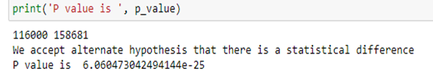



Slide 24

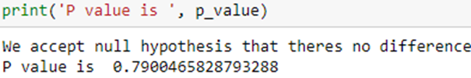



Slide 25
Building Predictive Models using Linear Regression, Decision Tree and Random Forest.

Slide 26
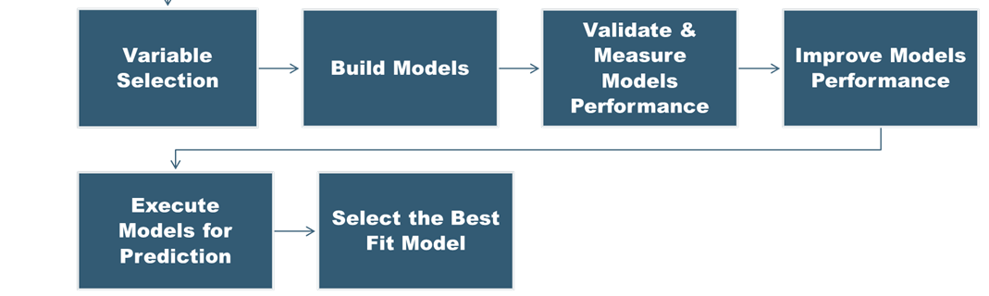
Model Building steps

Slide 27
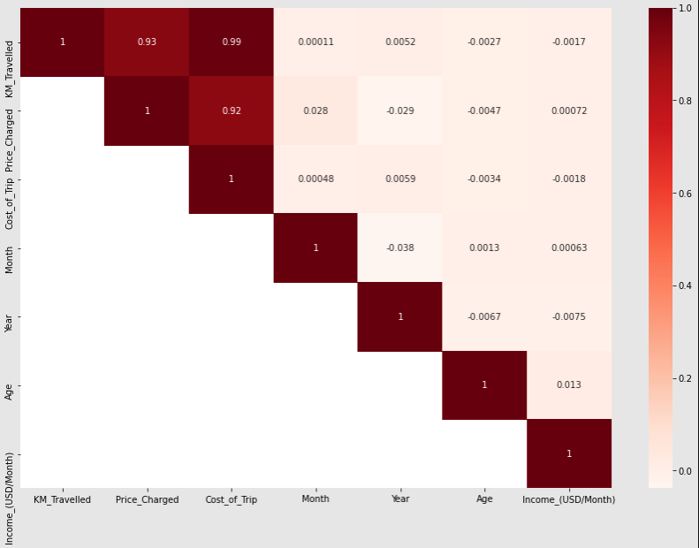
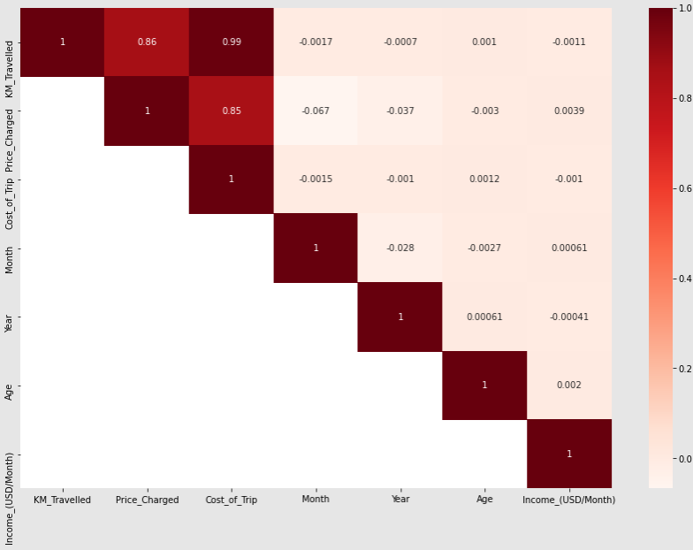
Correlation:
Pink Cab
Yellow Cab
From the correlation graph, we can see KM travelled is correlated with Price Charged followed by Cost of trip.
Year, Month, Age, Income are not correlated.

Slide 28
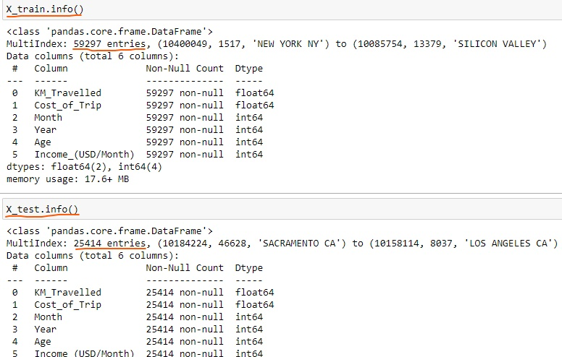
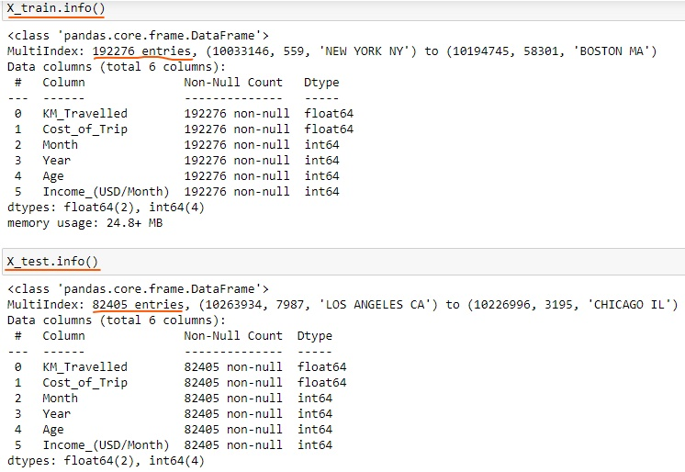
Model1: Linear Regression
Linear Regression is a method for predicting target value and attempts to model the linear relationship between target and one or more predictors.
In our dataset, Price Charge is the target value and all the other variables are predictors.
Splitting the data into a training set (75%), and test set (25%).
Yellow Cab
Pink Cab

Slide 29
Model2: Decision Tree
Regression models are constructed using decision trees, which resemble trees. It partitions a dataset into progressively smaller subsets and simultaneously builds a corresponding decision tree piecemeal.
A tree with decision nodes and leaf nodes is the end product.the highest decision node in a tree that represents the most accurate forecaster of the desired value (Price Charged).
Model3: Random Forest
To function, a Random Forest builds many Decision trees.
The average of the forecasts made by the forest's Decision trees is a prediction from the Random Forest.

Slide 30
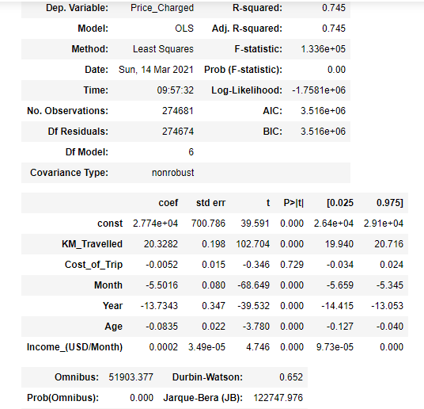
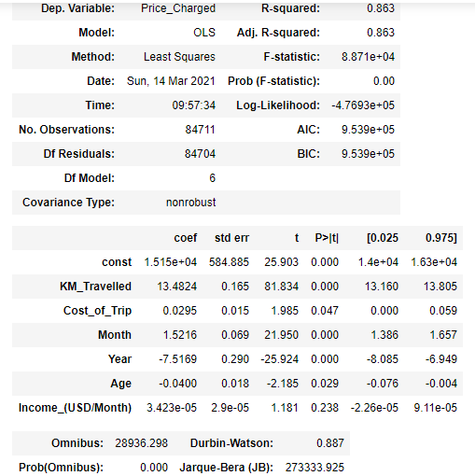
Base Model:
Yellow Cab
Pink Cab

Slide 31
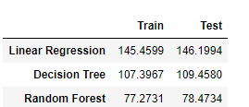
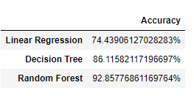
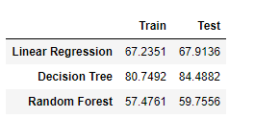
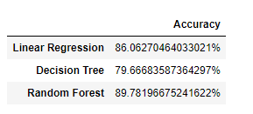
Best Fit Model: RMSE Value & Accuracy
RMSE or root mean square error measures the error which is Prediction values – Actual values.
Lower the RMSE value the better is the Model.
RMSE values & Accuracy for Yellow Cab
RMSE values & Accuracy for Pink Cab
The Random Forest Model is the most appropriate model for further deployment based on the RMSE data and accuracy shown above.
The top predictors of price charged include age, income, month, year, and cost of trip, according to the Random Forest Model.

Slide 32
Recommendation
Transaction per year: For Yellow Cab Transaction per year from 2016 to 2018 is almost double than Pink Cab.
Margin per Gender: Yellow Cab has a different margin for male and female customers, which accounts for the larger percentage of female customers in Yellow Cab compared to Pink Cab.
Profit Margin: From 2016 to 2018, Yellow Cab's profit margin was higher annually than Pink Cab's.
Margin by Age: In a Yellow Cab, the Margin varies for individuals over 50, whereas in a Pink Cab, the Margin remains the same for all age groups.
Due to Yellow Cab's fall in margins with an increase in transactions, it travels three times as frequently than Pink Cab during the month of December, which is the holiday season.
Yellow Cab's customer base is largest in New York City
On the basis of the above points, Yellow Cab is recommended for investment.

Slide 33
Thank You

