Slide 1
MOVIE CATALOG PROJECT
Aishwarya M Mathapati 231CS107 Annabathula Bhavya Sri 231CS112 Dhiya N 231CS121 Sugavasi Lalitha 231CS157

Slide 2
ABSTRACT
The Movie Database Project aims to create a user-friendly, interactive platform for movie enthusiasts to browse, explore, and manage their movie preferences. By integrating The Movie Database (TMDB) API, users can access real-time movie details, including descriptions, trailers, and ratings. The platform features secure user authentication using JWT, allowing users to sign in, save their favorite movies, and manage a personalized watchlist. The backend is powered by Node.js with Express.js and MySQL for efficient data management and storage. The project also focuses on providing a visually appealing UI using Angular, SCSS, and Bootstrap. Future enhancements include adding user reviews, a recommendation system, and mobile app support.

Slide 3
INTRODUCTION
The movie database project was developed to address the challenge of managing and discovering movies in an easy and personalized way. With thousands of films released every year, existing platforms like imdb can often overwhelm users with excessive information. This project aims to simplify the process by offering a user-friendly platform that allows movie enthusiasts to explore real-time data from the movie database (TMDB) API, view movie descriptions, trailers, and ratings, and securely save favorites and manage watchlists. The platform ensures a seamless user experience and efficient data management, all while providing secure user authentication for a personalized browsing experience.

Slide 4
EXISTING SYSTEM
Platforms like IMDb and Rotten Tomatoes provide a large amount of movie data.
Users are often overwhelmed by the volume of information.
Lack of personalized features such as saving favorites or creating watchlists.
Interfaces can be complex, making it difficult to find specific movies.

Slide 5
PROPOSED SYSTEM
Simplifies movie discovery with a user-friendly platform.
Integrates real-time data from the TMDB API for movie details, trailers, and ratings.
Offers secure user authentication for personalized experiences.
Allows users to save favorites, create and manage watchlists.
Provides an intuitive, easy-to-navigate interface for seamless movie exploration.

Slide 6
MODULES
Movie browsing module
Movie details module
User authentication module
Favorites and watchlist module
Search functionality module
Contact us module

Slide 7
1. Movie Browsing Module:
Description: This module allows users to browse a list of movies effortlessly. It fetches real-time data from the TMDB API, displaying movie posters, titles, and short descriptions on the homepage.
Key Features:
Movie titles and posters with brief descriptions.
Search functionality to find specific movies.
Real-time data fetching and display from TMDB.

Slide 8
2. Movie Details Module:
Description: Users can view detailed information about a selected movie, including full descriptions, trailers, ratings, and release dates.
Key Features:
Display of Full Movie Details
Embedded trailers for each movie
Movie ratings and release year

Slide 9
3. User Authentication Module:
Description: This module handles user registration, login, and secure authentication using JWT. It ensures that user data, such as favorites and watchlists, are stored securely.
Key Features:
Secure sign-up and login functionality
JWT-based session management
Password encryption using bycrpyt

Slide 10
4. Favourites and Watchlist Module:
Description: Allows users to add and manage their favorite movies and watchlist. This data is stored securely in the database for personalized access.
Key Features:
Option to add/remove movies from favorites and watchlist.
Users can view and manage their saved movies.
Data is stored and retrieved efficiently from the MySQL database.

Slide 11
5.Search Functionality Module:
Description: This module enables users to search for movies by title, genre, or other parameters, providing quick and relevant results.
Key Features:
Seach bar to input movie titles
Display filtered results based on search queries
Real time search suggestions

Slide 12
6.Contact Us Module
Description: A page for users to reach out for feedback, suggestions, or support.
Key Features:
Contact form for user inquiries
Option to provide feedback on the platform

Slide 13
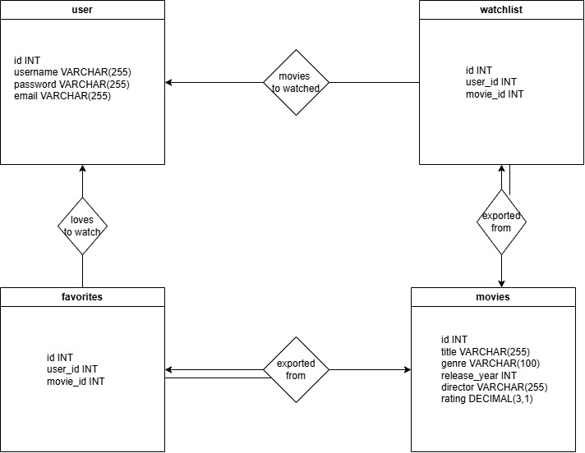
ER DIAGRAM

Slide 14
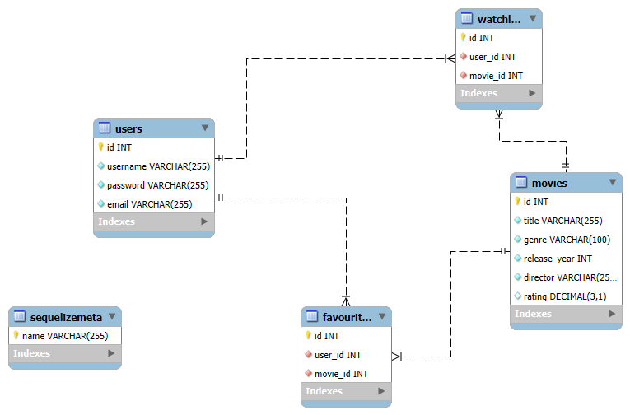
SCHEMA DIAGRAM

Slide 15
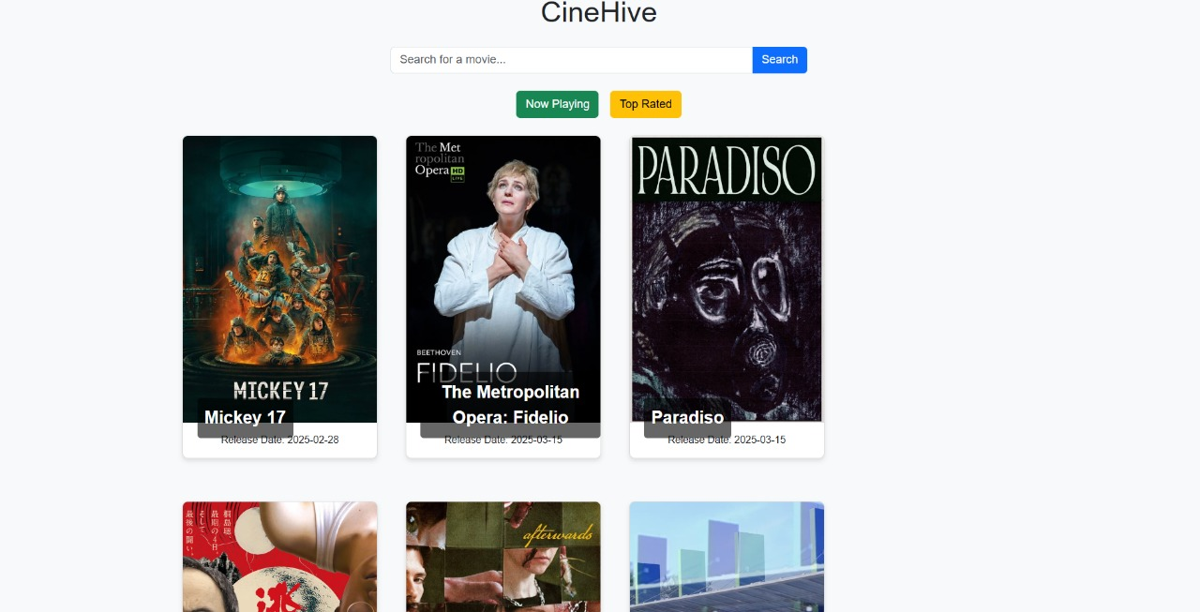
Work in Progress

Slide 16
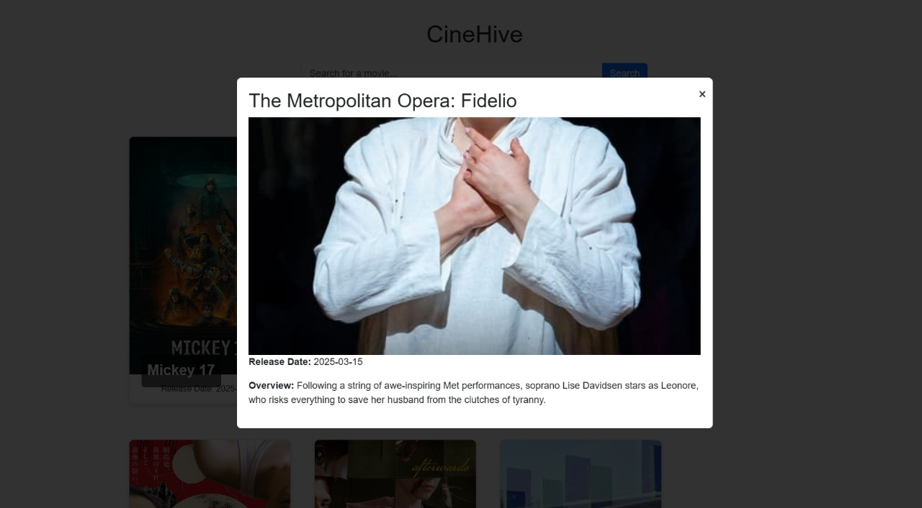
Work in Progress

Slide 17
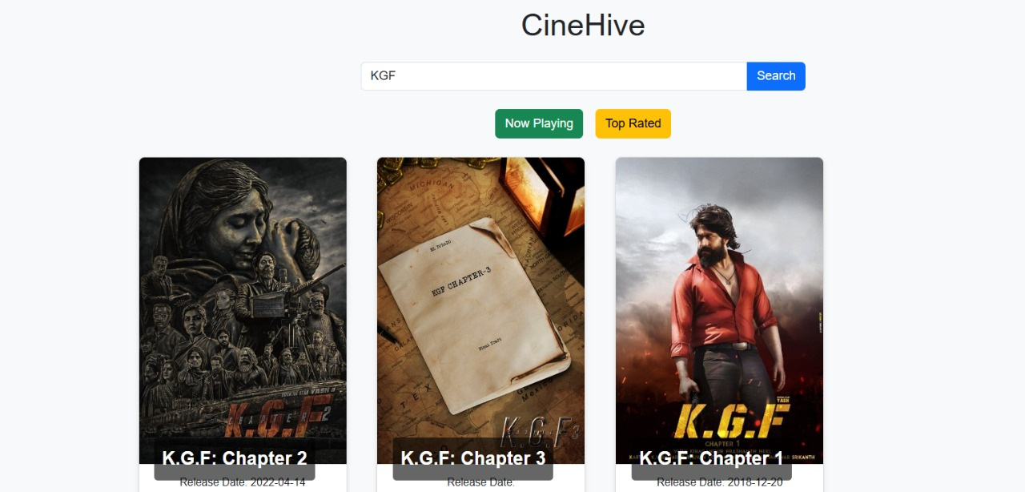
Work in Progress

Slide 18
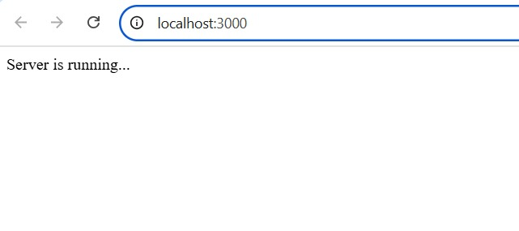
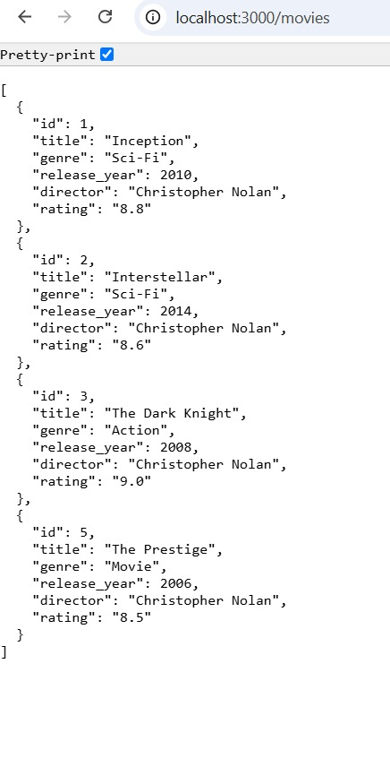
Work in Progress
This is the home page of the web server
This shows the movies in the Data Base

Slide 19
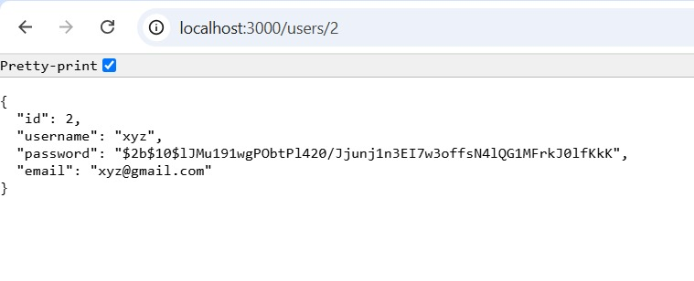
Work in Progress
This shows the details of user with id=2

Slide 20
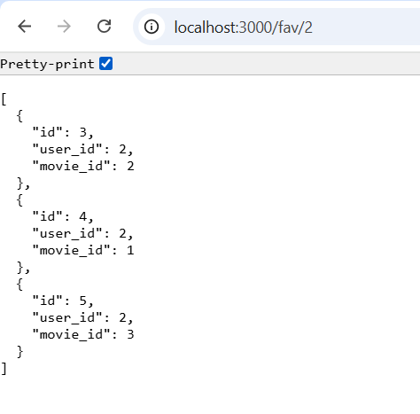
Work in Progress
This fetches the fav list of user with specific id

Slide 21
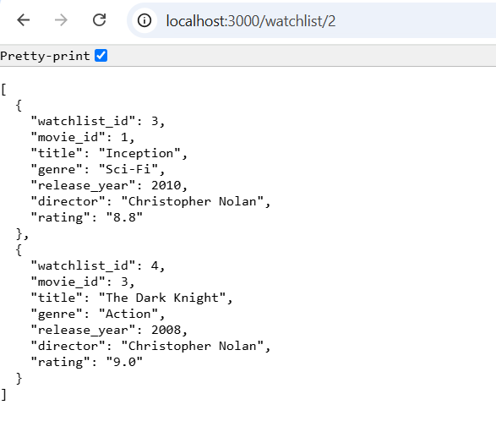
Work in Progress
This fetches the watchlist of a specific user

Slide 22
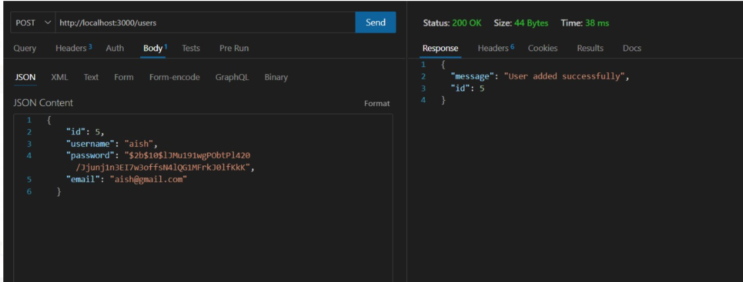
Work in Progress
This displays the output of successful creation of user with id=5

Slide 23
Future Enhancements
To further enhance this project, We plan to add:
1️⃣ User Reviews & Ratings: Letting users leave reviews and rate movies 2️⃣ Recommendation System: Suggesting movies based on user preferences and watch history 3️⃣ Dark Mode Support: Adding a toggle for light/dark themes for a better visual experience 4️⃣ Mobile App Version: Expanding the platform into a mobile-friendly application

Slide 24
Conclusion
This project is expected to be a valuable learning experience in Full-Stack Development, leveraging Angular, Node.js, and MySQL to build an engaging and user-friendly movie database. By integrating real-time movie data, secure authentication, and structured database management, it will offer a personalized and seamless movie exploration experience.

Slide 25
THANK YOU
Aishwarya M MATHAPATI
ANNABATHULA BHAVYA SRI
DHIYA N
SUGAVASI LALITHA

