Slide 1


INNOVASIA 2K24
Problem Statement Title-
Extraction and Verification of Information from semi- categorized data.
Theme-Smart Automation
Team Name- Hamming Code

Slide 2
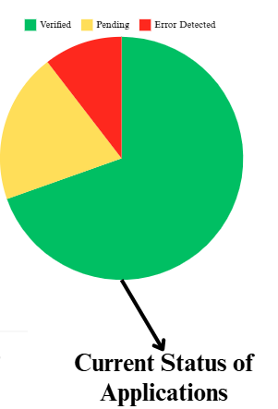
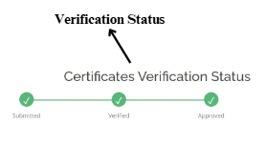
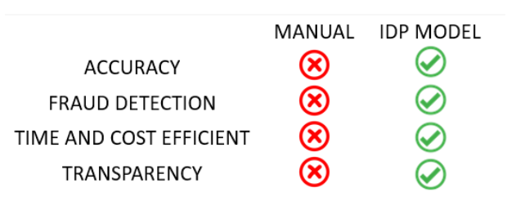
IDEA Approach details
The idea approach for the problem statement involves creating an AI-powered document verification system that can extract and verify information from uploaded documents.
This system would streamline the application process and reduce processing time by automating the manual verification process!
In this document processing, the appeal can be divided into extraction and verification.
In pilot extraction, during form submission, it alerts the user in case of any mismatch of the template.
In accurate extraction, before the verification, text is extracted and processed.
Verification and comparison of docs with the authorized data sets provided by the government and institutions.
Analysis and Visualization of the verified data is done to get an overview of the categorized information.

Slide 3
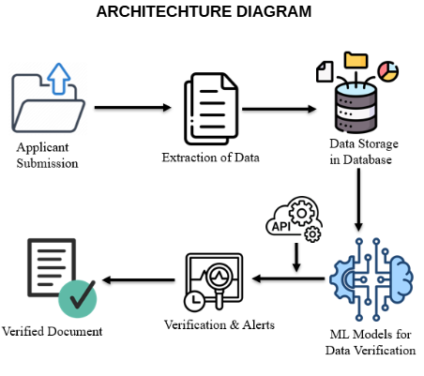
IDEA Approach details
HOW IT ACTUALLY WORKS
The user first uploads the certificates and a first level of filtration (check) is done.
Immediately the applicant is alerted with the error and helps in providing changes. After the changes, uploaded files can be submitted.
The user’s uploaded files are instantly converted via OCR (Optical Character Recognition) into a clear, readable format. If necessary, language translation is also performed.
APIs can be utilized to cross-check the extracted information and a trained Information Document Processing model using NLP is used to validate the data and identify any mistakes.
Information from these submitted files is extracted and verified w.r.t the original files stored in the database
After screening of applications, the extracted and verified data will be presented using modern Business Intelligent(BI) Tools.

Slide 4
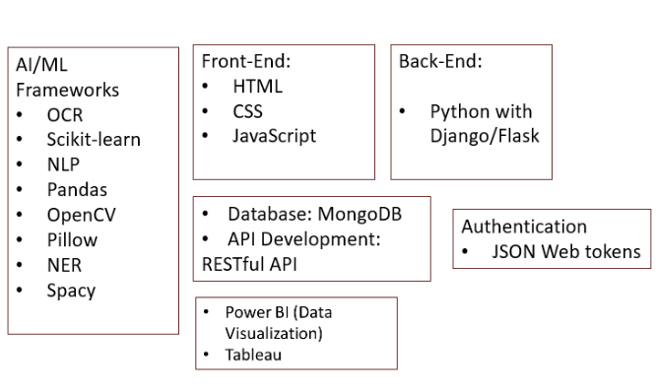
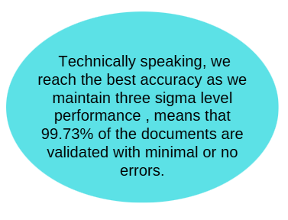
TECHNICAL APPROACH

Slide 5
FEASIBILITY AND VIABILITY
Technical Feasibility
Developing and deploying ML/DL models to recognize and extract information from a wide range of document types is technically feasible.
Achieving Three Sigma accuracy (99.73%) is challenging but achievable with high-quality training data, pre-processing techniques, and continual model retraining.
Legal and Compliance Feasibility
Personal data, such as certificates and identification documents, must be handled in compliance with data protection laws.
Time Feasibility
Training ML models to achieve high accuracy across diverse document types and languages will require time

Slide 6
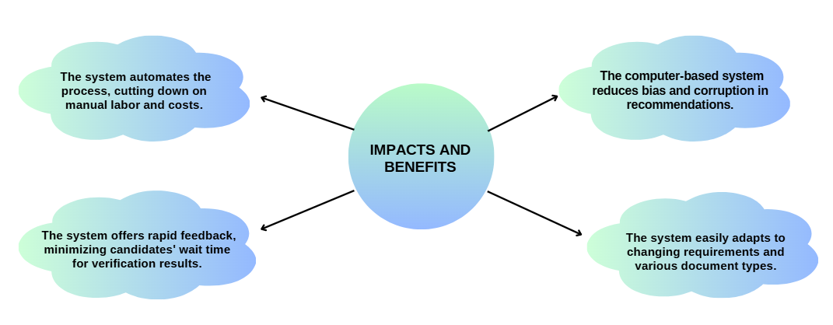
IMPACT AND BENEFITS

Slide 7
RESEARCH AND REFERENCES
“Document Verification System for Fraud Detection using Machine Learning Technique”
https://www.researchgate.net/publication/380527994_Document_Verification_System_for_Fraud_Detection_using_Machine_Learning_Technique
“Smart Data Processing: Unleashing the Power of AI and ML”
https://www.researchgate.net/publication/376877991_Towards_Personalised_Mood_Prediction_and_Explanation_for_Depression_from_Biophysical_Data

