Slide 1
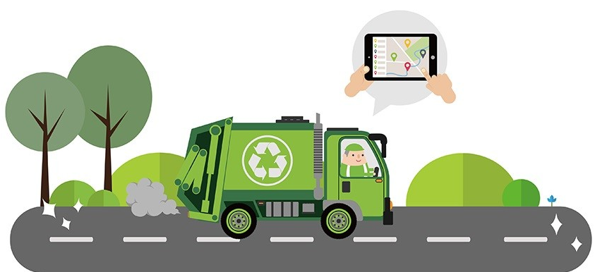
Smart Waste Management
Tracking, Reducing and Reusing of plastic waste!

Slide 2
Problem Statement
India is a developing country, but it still lacks proper waste management.
We will be creating a web-based application that will serve as a platform for consumers to get rid of accumulated plastic and other recyclable waste at home while also benefitting technologically.

Slide 3
Market size and Statistics
Market Size: The recycling industry in India is valued at approximately USD 5 billion and is growing rapidly due to the emphasis on circular economy practices.
Plastic Waste: India generates around 3.5 million tons of plastic waste annually. With rising awareness and regulatory measures, the market for plastic waste management is expanding.
Growth Opportunities: The plastic recycling market is projected to grow at a CAGR of 6-8% over the next few years, driven by increased recycling activities and government policies.
Government Initiatives: Initiatives like Swachh Bharat Abhiyan and the Plastic Waste Management Rules have provided a regulatory push, encouraging more investment and innovation in this sector.

Slide 4
Stake Holders
Consumers ( households, individuals, small businesses )
Recycling Centers and Waste Management Companies
Local Municipalities and Government Bodies
Media and Marketing Partners
Logistics and Transportation Partners

Slide 5
Present Scenario
India is facing significant challenges in managing its waste, particularly in urban areas where rapid population growth and urbanization are contributing to an increase in waste generation.
Current Waste Management Practices:
Limited Segregation: Waste segregation at the source (household or business level) is not widely practiced, leading to mixed waste that is difficult to process and recycle.
Inadequate Infrastructure: Many cities and towns lack the infrastructure needed for efficient waste segregation, collection, and processing. As a result, a large portion of waste is either dumped in open spaces or poorly managed landfills.
Informal Sector Involvement: The informal sector, including waste pickers and small-scale recyclers, plays a crucial role in waste management. However, they often work in unsafe conditions without proper recognition or support.

Slide 6
PROPOSED SOLUTION-Predictive/Preventive Maintenance
Simply take a proper snapshot of the amount of plastic waste generated at your home and send it in our platform.
The automation system tracks the user’s location and the nearest trader will be allocated to pick up the wastes and takes the snapshot of the waste received.
AI and ML models are used in assessing the quality and quantity of plastic and generate credit points based on that information.
After selling the plastic garbage to the trader, the app users get credit points which when reaches maturity they will receive cashbacks.
This Web application also provides scope to buy recycled plastic items from the same website.
USP
An android and web based platform which serves the term-”Waste Management”-a proper and efficient structure.
Providing secure employment to those vendors who get stable income.
Once the trader is allocated the AI-powered chatbot provides user interaction and real –time tracking of the user’s location
User’s are provided with a possibility to donate some amount towards the educating rural students.

Slide 7
1.Take a snapshot of the plastic waste generated at home and upload it in the platform
2.The automation system tracks the user’s location so the nearest traders allocated to pick up the waste
3.The trader then takes snapchot of the waste collected and post it in the app.
4. AI and ML models are used in assessing the quality and quantity of plastic and generate credit points based on that information.
5.After selling the plastic garbage to the trader, the app users get credit points which when reaches maturity they will receive cashbacks.
6.This Web application also provides scope to buy recycled plastic items from the same website.

Slide 8
Idea Details and Tech-Stack
Front-End:
Reach.js
Vue.js
HTML5/CSS3
JavaScript
Back-End:
Node.js
Python with Django
Cloud Hosting and DevOps
AWS
Docker
Kubernetes
GitLab
Payment gateway:
Stripe
Razor pay
Big Data Processing
Apache Spark
Amazon S3
Tableau or Google Data Studio
Apache Kafka
AI/ML Frameworks
TensorFlow
PyTorch
Scikit-learn
Keras
Database: MongoDB
API Development:
Graph QL
RESTful API
Google Cloud AutoML or H2O.ai

Slide 9
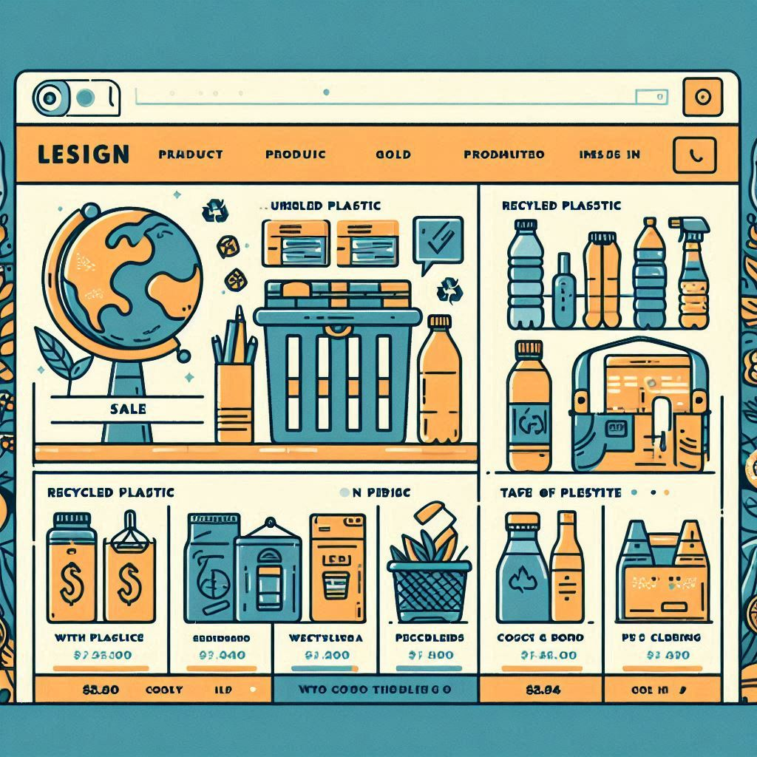
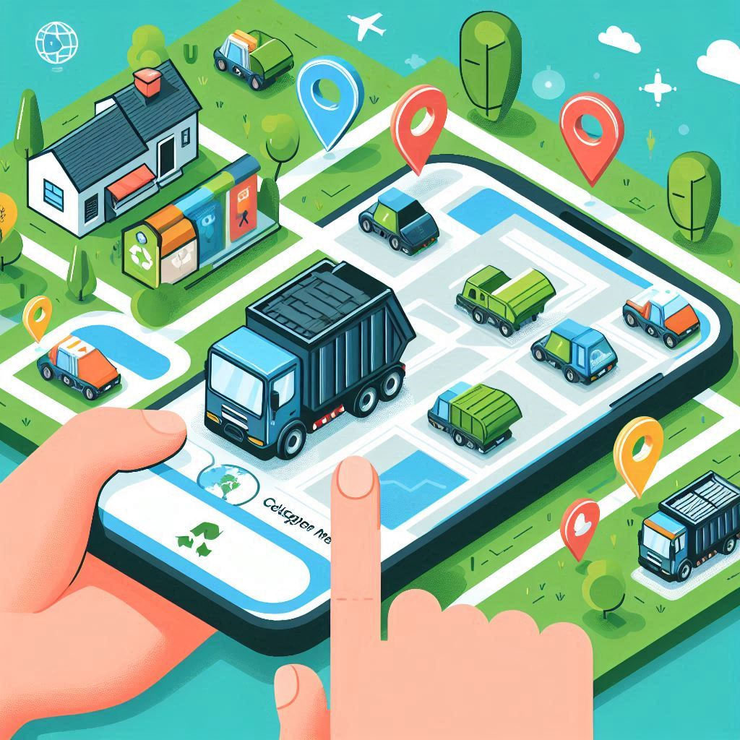
Trash to Treasure…
THANK YOU
Team – Idea BASKet

