Slide 1
FAKE NEWS ARTICLE DETECTION
USING MACHINE LEARNING
PRESENTED BY
P.AISHWARYA

Slide 2
TABLE OF CONTENTS
INTRODUCTION
APPROACH
TESTING AND RESULTS
CONCLUSION
REFERENCES

Slide 3
INTRODUCTION
The project uses NLP techniques and machine learning algorithms to classify fake news articles using Scikit libraries from Python .
LIAR dataset which is the benchmark dataset, is used in detecting fake news.
The project focuses on automatic identification of fake news and also gives its probability of truth.

Slide 4
The contribution is twofold : First, the model is trained using LIAR dataset.
Then followed by testing the model using Testing dataset.
The process starts with Data Preprocessing and then followed by Feature Selection.
These extracted features are fed into two classifiers : Naive-Bayes and Logistic Regression.

Slide 5
Once fitting the model as per the trained data is done, Confusion Matrix and F1 score for both models are computed.
Based on the results , best model is selected.
The class of the given article(true/false) and also the probability of truth is determined as the outcome.

Slide 6
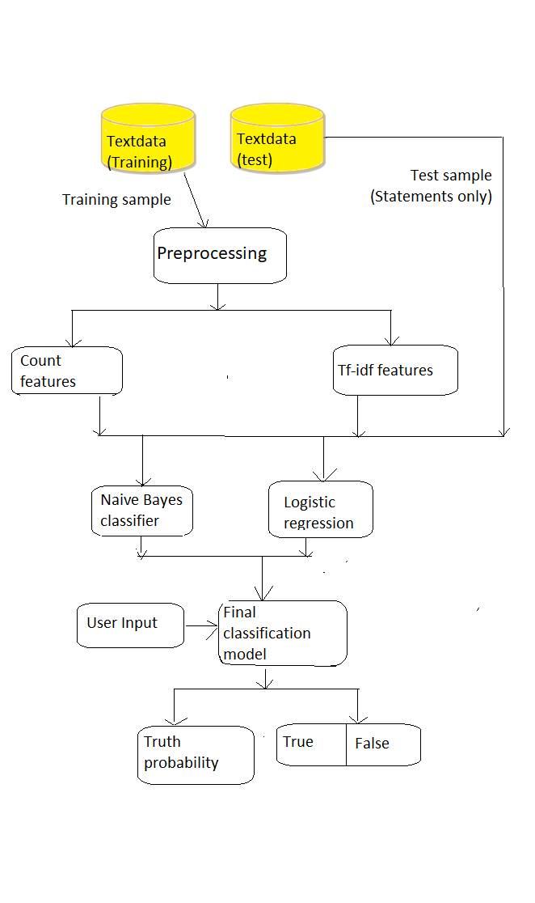
FLOW CHART

Slide 7
METHODOLOGY
The project is implemented in python 3.7.
The major packages used are Sklearn (scikit-learn) , Numpy and Scipy.
The dataset used is the LIAR dataset which contains 3 files for testing ,training and validation.
This contains 13 columns like the label,the statement, ID , the subject, the speaker etc.

Slide 8
In the project we use only 2 variables from the original data set ,the statement (news headline or text) and the label(class : true/false).
The entire process includes preprocessing , feature selection , classifiers and prediction.
Preprocessing : The data files are read and the preprocessing methods are applied.
These methods include tokenizing and stemming.
Data analysis is performed like response variable distribution and data quality checks (null or missing values).

Slide 9
Feature Selection : feature extraction and selection methods are performed with the help of scikit learn python libraries.
These methods include : bag of words, n-grams and term frequency weighting.
Word2vec and POS tagging are also used to extract features.
Classifier Selection: The extracted features are fed into 2 different classifiers, Naive-bayes and logistic regression.

Slide 10
Naive- bayes classifier: It is a probabilistic classifier and is very efficient in supervised learning setting.
Logistic regression classifier :It is a statistical model.It is a go to model for binary classification problems.
Then confusion matrix and f1 score for each model is computed.

Slide 11
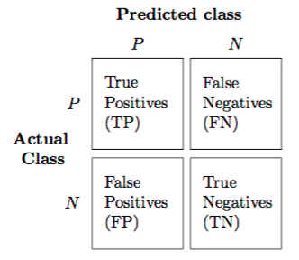
Confusion Matrix :It summarizes the performance of a classifier for binary classification tasks.
Precision : It is the fraction of relevant instances among the retrieved instances.
Precision = TP/(TP+FP)

Slide 12
Recall : It is the fraction of relevant instances that have been retrieved over the total amount of relevant instances .
Recall = TP/(TP+FN)
F1 score : It considers both precision and recall to compute the final score.
F1 score is considered perfect when it is near to 1 ,while the model is a total failure when it is 0.
(precision * recall)
F1 score = 2 * -------------------------
(Precision +recall)

Slide 13
Based on the F1 score nearest to 1 , a classifier model is chosen among the two model as the final model.
K fold cross validation method (in this case 5 folds ) is used for partitioning the data set into complementary subsets for training and testing.
Prediction : It takes a news article as input from user ,the selected model is used for final classification output (true/ false).
It also gives the probability of truth.

Slide 14
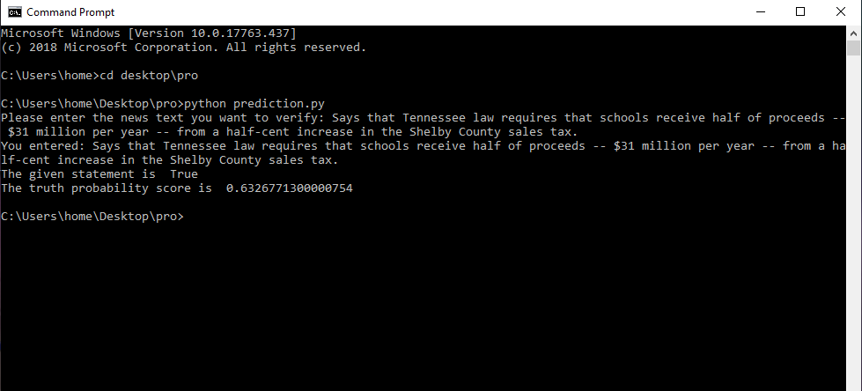
TESTING

Slide 15
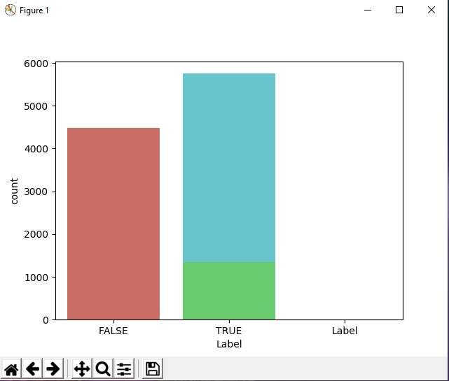

Slide 16
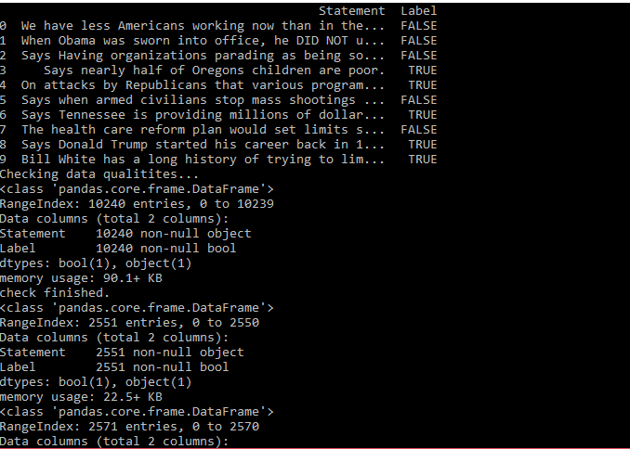
RESULTS

Slide 17
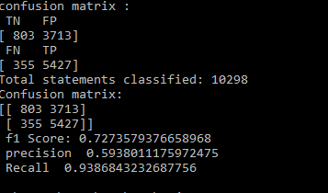
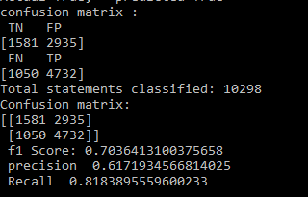
Logistic Regression Naïve Bayes

Slide 18
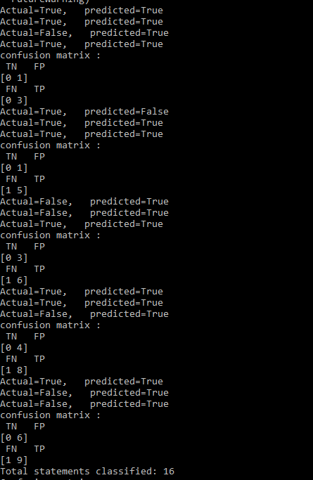
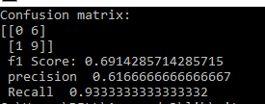
Naïve Bayes Classifier result on sample data

Slide 19
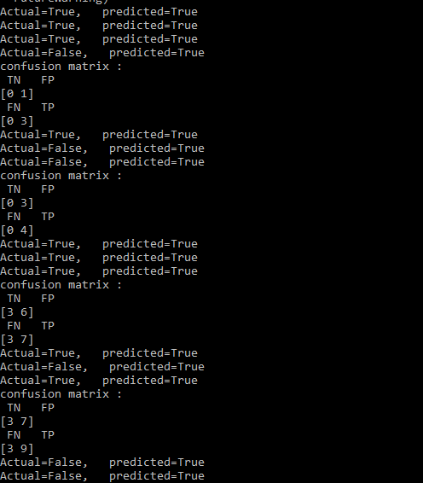
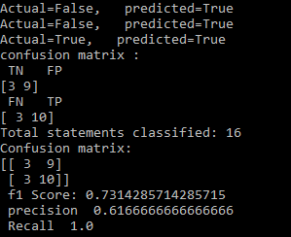
Logistic Regression Classifier Result on sample data

Slide 20
CONCLUSION
Automatic fake news detection is a challenging problem in deception detection.
It has tremendous real world political and social impacts.
However, statistical approaches to combating fake news has been dramatically limited by the lack of labeled benchmark datasets.

Slide 21
Also many leading organisations like Google and facebook are taking steps towards preventing the spread of fake news.
Our project takes input from a LIAR dataset and classifies it to be true or false.
It also gives the truth probability.
To implement this, various NLP and ML techniques have been used.

Slide 22
REFERENCES
· https://ieeexplore.ieee.org/document/8305411
· https://scikit-learn.org/stable/modules/feature_extraction.html
· https://www.geeksforgeeks.org/introduction-machine-learning-using-python/
· https://www.oreilly.com/library/view/feature-engineering-for/9781491953235/ch04.html

Slide 23
THANK YOU !

