Slide 1
NLP SENTIMENT ANALYSIS FOR
AMAZON’S FOOD REVIEW
SRIRAKSHA SRIRANGAPATNA ARUN - 862325113
AISHWARYA PAGADALA - 862324772

Slide 2
SENTIMENT ANALYSIS
Sentiment Analysis is one of the used branches of Natural language processing.
Humans can determine whether the text is showing positive or negative sentiment using both NLP and machine learning.
Sentiment Analysis is also called as Opinion mining.
From reducing churn to increase sales of the product, creating brand awareness and analyzing the reviews of customers and improving the products.
Implementing a machine learning model which will predict the sentiment of customer reviews.

Slide 3
THE PROBLEM STATEMENT
One of the popular application of sentiment analysis is predicting sentiment of customer reviews.
Helpful for banking, eCommerce & in all domains where you are selling some product to customers.
Implementing the machine learning model which will predict the Positive or Negative sentiment based on the reviews of the product.
Prediction based on the new incoming customer review is positive or negative.
Using amazon’s food review dataset from kaggle.

Slide 4
FEATURE EXTRACTION AND TEXT PRE-PROCESSING
The text data needs a special preparation before giving text data to the machine to predict something.
Special preparation includes several steps such as removing stops words, correcting spelling mistakes, removing meaningless words, removing rare words and many more.
The first step of preparing text data is applying feature extraction and basic text pre-processing.

Slide 5
In feature extraction and basic text pre-processing there several steps as follows.
1. Removing Punctuations
2. Removing HTML tags
3. Special Characters removal
4. Removing AlphaNumeric words
5. Tokenization
6. Removal of Stopwords
7. Lower casing
8. Lemmatization

Slide 6
CREATING DOCUMENT CORPUS AND ADVANCE TEXT PREPROCESSING
Perform Advance text preprocessing on the reviews which will convert the reviews into Numeric Vectors and using that create our Machine Learning model.
Using the document corpus, create Bag of Words model along with applying Tri-grams.
The document corpus is a collection of all reviews in the document, where the document is your dataset.
Bag of Words model creates a set of words or in other words, it creates a dictionary of words from the single document. Then it converts that dictionary of words into a vector, where each word is a separate dimension.
Grams(Tri-gram) are useful in creating the word dimensions from the document corpus.
The Uni-grams is the default method used in BoW model while creating Vectors from the text data.

Slide 7
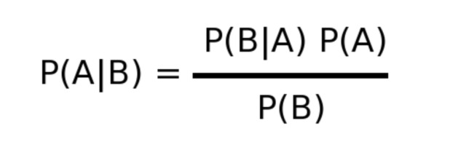
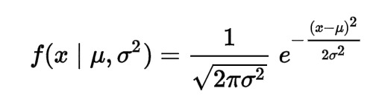
GAUSSIAN NAIVE BAYES CLASSIFICATION
NAIVE BAYES THEORY
The Gaussian or Normal Distribution depends on 2 parameters of a series — The mean and the standard Deviation. Knowing these 2 parameters of the series we can find it’s distribution function.
The mean value of the series and its standard deviation help find out the probability that the value x will occur.
This formula means that the probability of happening of the event A knowing that event B happened already.
Gaussian functions are often used to represent the probability density function of a normally distributed random variable with expected value and variance.
GAUSSIAN DISTRIBUTION FUNCTION

Slide 8
BUILDING NLP SENTIMENT ANALYSIS MACHINE LEARNING MODEL
Create a machine learning model by splitting the dataset into the Training set and Test set.
Creating a Naive Bayes classification model using the training set.
Test set can check the performance of a Naive Bayes classification model.
Importing the train_test_split API to split the vectors into test and training set.
Imported GaussianNB() class to create a Naive Bayes classification model.
After creating the Naive Bayes classification model, fit the training set into the Naive Bayes classifier.

Slide 9
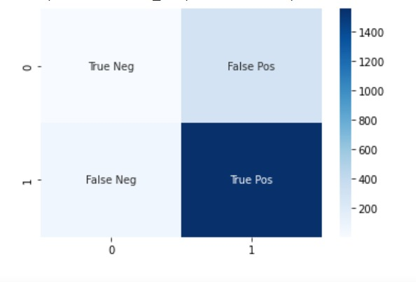
HEAT MAP
Accuracy is : 0.8176563321071991
Recall/Precision is : 0.8431053203040174

Slide 10
CONCLUSION
Applied the Text pre-processing on the Reviews after that performed the advance text pre-processing followed by Ngrams.
Able to convert text to numeric vectors and then we used the Machine learning model to predict the sentiment.
Used the Naive Bayes classification model to predict the sentiment of any given review.

